Slide 1

Request Analyzer
Overview

Slide 2
Scope and context
API Calls
Microsoft Policy
Tools
Power Platform licences include daily API calls limits. This limit is defined at each user level and is set at the sum of entitlements from each assigned license.
Any possible high usage enforcement won't happen until six months after Power Platform Request usage reporting has been generally available.
API consumption details can be downloaded from the admin portal as a CSV file.
This file details API consumption by user, day, product, and environment.
How to anticipate enforcements ?
Check who can be impacted in your organization ?
Identify use cases where the scale requires additional licenses ?

Slide 3
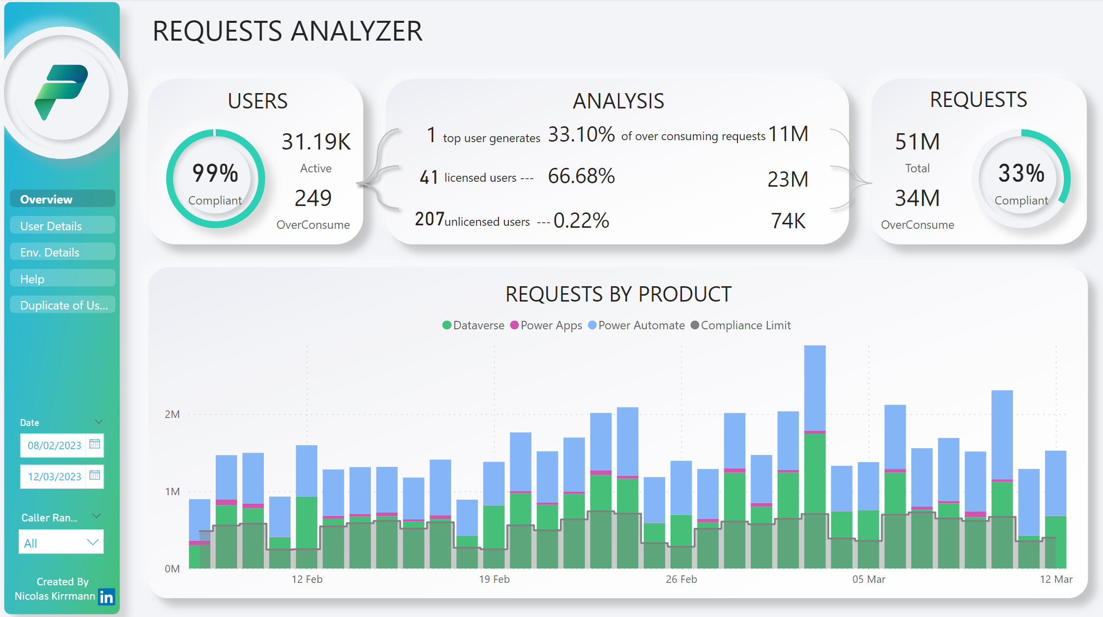
Tenant Analysis
How many user overconsumed ?
How overconsumption is split between the top1 users the licensed users, and users without licenses.
How many requests above the threshold ?
Get an overview of your tenant consumption.
Know if and when overconsumption occurs.
View consumption over time
Filter time period and most consuming users

Slide 4
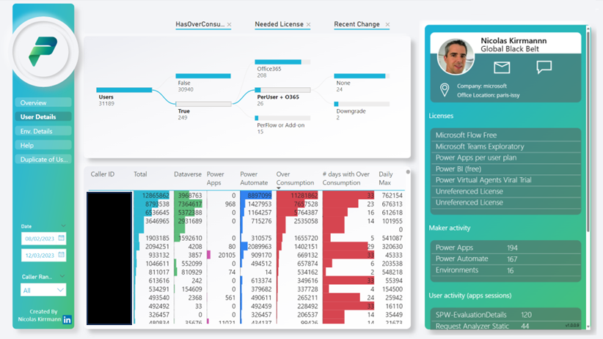
User Analysis
How many users overconsume ?
What licenses are needed to match consumption ?
How licences evolved over time for these users ?
Understand who overconsumed,
when, and why.
Understand Selected user context :
Location
Licenses assigned
Items created
Most used apps
View consumption by user over the period.
Total overconsumptions
# of days with over consumptions
Daily consumption peak
Notes:
Rendre plus Claire la cinématique qui permet de partir de plusieurs users à un seul (sinon on croit que totu concerne Nicolas ici)

Slide 5
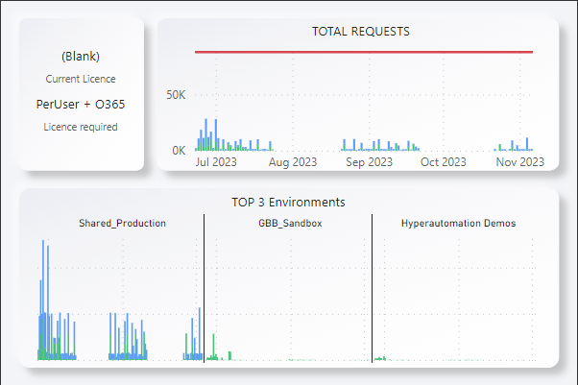
User Analysis
Hoover to get a detailed view of the user’s consumption pattern over time, compared to his daily entitlement. Split this consumption across the top 3 environments. Here “Shared_Production” is clearly where consumption happens, and mainly from Power Automate Flows
Understand who overconsumed,
when, and why.
Notes:
Rendre plus Claire la cinématique qui permet de partir de plusieurs users à un seul (sinon on croit que totu concerne Nicolas ici)

Slide 6






Architecture
Request Analyzer Solution
Report to analyse tenant requests.
Automated data collection
(every morning, ask for previous day data)
Manual data collection
(Ask for data based on provided timeframe parameters)
PowerBI extracts
& model data
Collect licenses assigned to selected user
Collect details on a specific user
Get user
picture
Get user
assigned
licenses
collect data for a given timeframe
Get user details from table “AAD User” (name, location, email, etc)
Get counts of created items from Maker table
Get App Sessions from Audit logs table
Power Platform admin portal
Sharepoint Site to host the CSV files
Dataverse – CoE Starter Kit Database
“Office 365 User”
connector
Arrows show the direction of business data from the provider to the consumer

Slide 7
Architecture
Request Analyzer Solution
Power BI Report to analyse tenant requests.
Power Automate cloud flow used to collect licenses assigned to the user
PowerBI extracts
& model data
Sharepoint Site to host the CSV files
Power App app used to collect details on a specific user
Get user
assigned
licenses
Get user
picture
Manual extract of cvs file and upload in Sharepoint
Get user details (name, location, email, etc) from table “AAD User”
Get counts of created items
from Maker table
Get App Sessions
from Audit logs table
Power Platform admin portal
Dataverse – CoE Starter Kit Database
“Office 365 User”
connector
Arrows show the direction of business data from the provider to the consumer

Slide 8
Pre-requisites
Licenses :
Power Apps Premium (required to play the premium app embedded into the report)
Power BI (to publish & share the report)
Sharepoint (required to host the csv files)
Privileges :
Access to admin portal to download the API call consumption data (files can eventually be provided by an admin, direct access is not needed)
Full read access to the following CoE tables (AAD Users, makers, Audit Logs)
Capability to create a new PBI workspace (done at solution import)
Data :
Access to the csv files containing consumption data
CoE Starter Kit Installed with Audit logs collection enabled
HTTP with AD Connector allowed in the environment where the Request Analyzer is installed

