Slide 1
MLxOSSA
Machine learning for open source code scan

Slide 2

Methodology Overview
Packages collection
Is it malicious? Y/N
Features Extraction
Deploy
Test data
Dataset split
Decision Rule/ Best set of parametrs
Bayes Inference
Posterior
Train data
labelled
Objective function
Prior Knowledge
stopwords
Generalization languages
Acquisition function
Parameters space
Logarithm base
Model hyperparameters

Slide 3
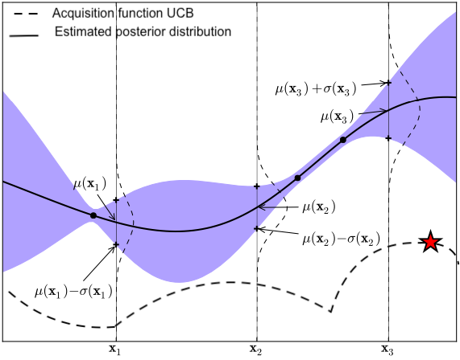

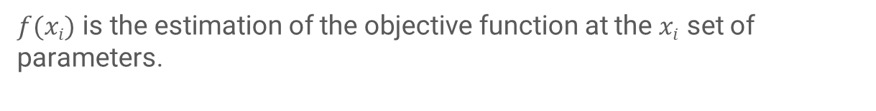
Bayes Inference: Toy Example of a 1D Gaussian process for parameter optimization .
$f(xi)$ is the estimation of the objective function at the $xi$ set of parameters.
Construct posterior distribution of functions (gaussian process) that best describes the objective function we want to maximize.
The Acquisition function determines which set of parameters evaluate at the next iteration.

Slide 4
Construction of a labelled datasets
Assumptions:
Packages with a number of stars greater than a certain threshold can be considered benign.
Npm repository: APIs from libraries.io (Pybraries). Filter by keywords, version, rank and number of stars. ✅ 90%.
Packages Collection
1080
Backstabber’s knife dataset. Filter by version and campaign of the attack.⛔️ 10%.

Slide 5
JavaScript package: surface inspected
identifiers
Aggregated
Lexer
(Slimit)
strings
All file.js in the package
regular expressions
Operators [ ;
package.json
json.loads
Python dictionary
primary key: script
presence/absence of markdown files (i.e. README.md)

Slide 6
Generalization languages:
Different levels of generalization can be reached by defining multiple alphabets.
Which one fit better a given contest is decided by the optimization.
Upper case
L if x is a letter
i.e. input string: http://123.10.22
output string: LLLLSSSDDDSDDSDD
Lower case
D if x is a digit
i.e. input identifier: _0xb7A
output identifier: SDLLDL
/
%
S if x is a symbol
-
~
:

Slide 7
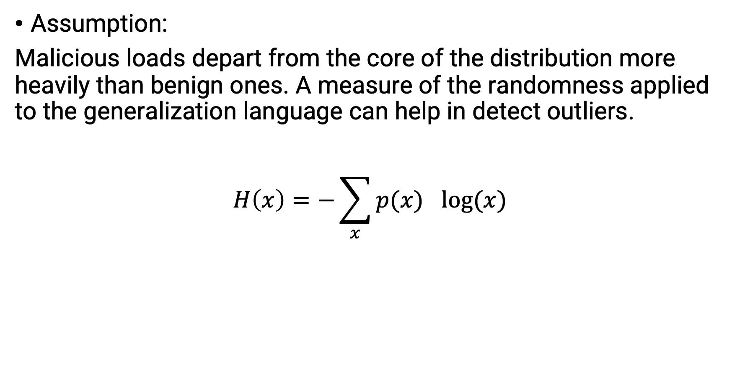
Shannon Entropy
Assumption:
Malicious loads depart from the core of the distribution more heavily than benign ones. A measure of the randomness applied to the generalization language can help in detect outliers.
$$H\left(x\right)=−\sum_{x}{p({x)}^{}log⁡(x)}$$

Slide 8
18 Features:
Number of words
package.json: script key
mean
Shannon entropy computed after applying a generalization language to each subkey and value treated as independent.
std
Q3
Number of files.
mean
max
Shannon entropy computed after applying a generalization language to each string.
std
Q3
aggregated file.js
max
mean
Shannon entropy computed after applying a generalization language to each identifiers.
std
Q3
Count number of: semicolumns, RegularExpression, square brackets
max
Markdown: presence/absence of at least one file

Slide 9
Parameters
Category | Type
DecisionTreeClassifiers hyperparameters | Max_depth
 | Max_features
 | Criteria for measure the quality of a split
Generalization language | Alphabet for identifiers
 | Alphabet for strings
 | Alphabet for package.json
Stopwords | Stopwords for strings
 | Stopwords for package.json
Shannon Entropy | Base of the logarithm

Slide 10
DecisionTreeClassifier
The addition of irrelevant features does not influence the result.
It is not sensitive to feature scaling.
It returns the importance of a feature in affecting the target variable. It is also known as the Gini importance.

Slide 11
Experiment Set Up
33% of the dataset is used as test-set, while the best combination of parameters is decided with a 3-fold cross validation in the train-set (66% of the dataset).
We implement a stratify sampling procedure, to maintain the ratio between malicious and benign packages.
The objective function to be maximized is the f1-score, to cope imbalance between benign and malicious packages.
The number of iterations in the Bayesian optimization is set to 25.

