Slide 1
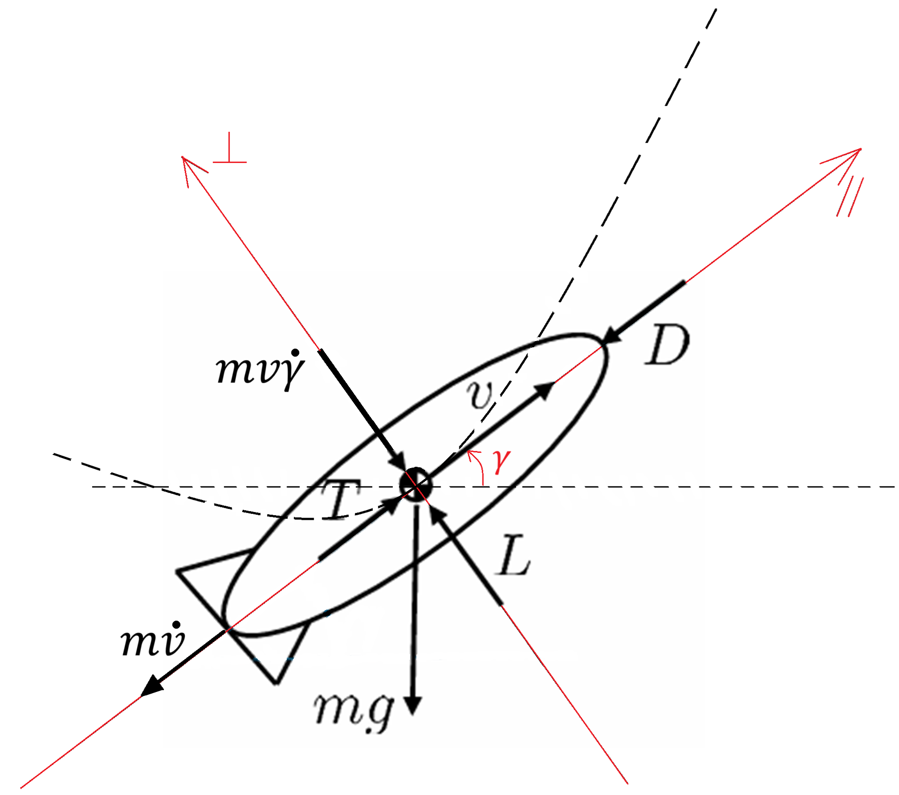
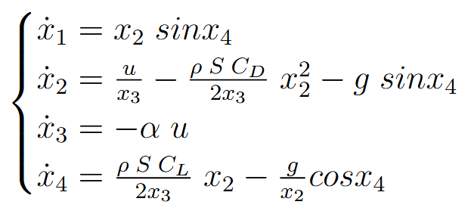
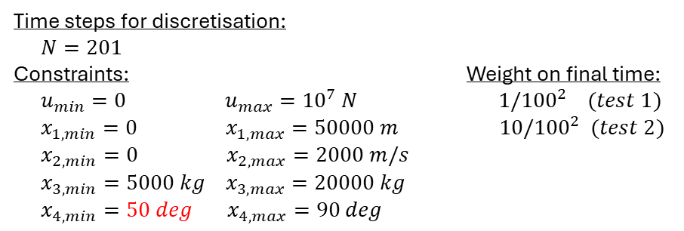
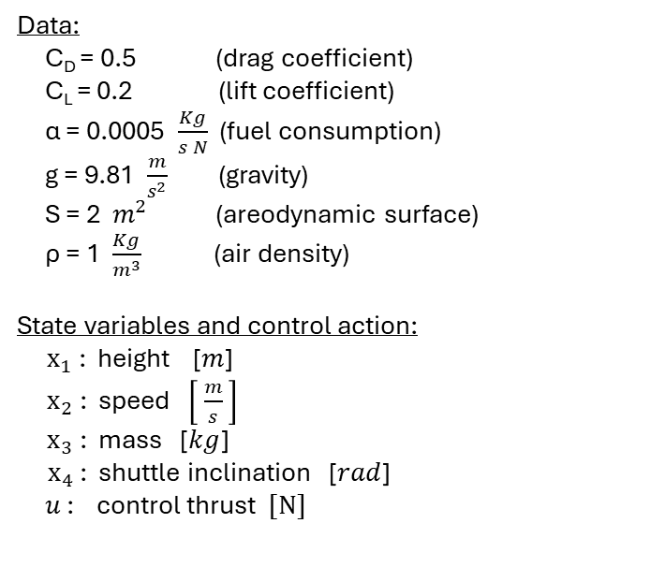
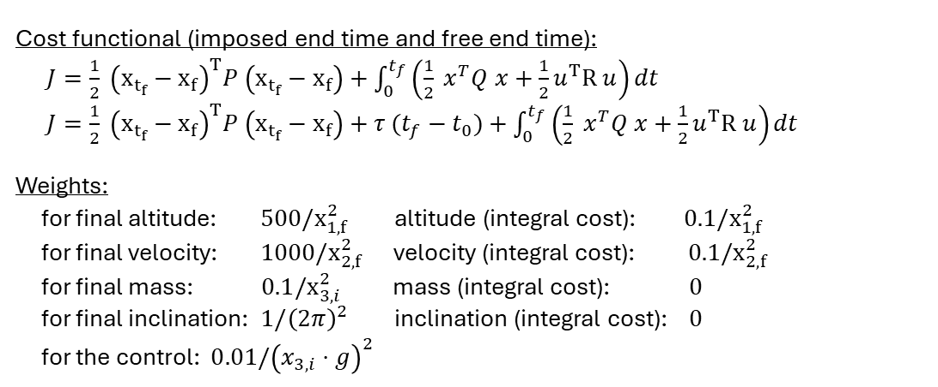
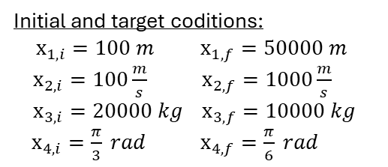
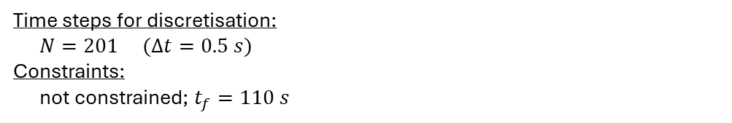
PROBLEM AND METHODOLOGY
Optimal control problem: shuttle during the climb
Cost functional (imposed end time and free end time):
$J=\frac{1}{2} {\left(x_{t_{f}}−x_{f}\right)}^{T}P \left(x_{t_{f}}−x_{f}\right)+\int_{0}^{t_{f}}{\left(\frac{1}{2} x^{T}Q x+\frac{1}{2}u^{T}R u\right)dt}$
$J=\frac{1}{2} {\left(x_{t_{f}}−x_{f}\right)}^{T}P \left(x_{t_{f}}−x_{f}\right)+τ (t_{f}−t_{0})+\int_{0}^{t_{f}}{\left(\frac{1}{2} x^{T}Q x+\frac{1}{2}u^{T}R u\right)dt}$
Weights:
for final altitude: ${500/x}_{1,f}^{2}$ altitude (integral cost): ${0.1/x}_{1,f}^{2}$
for final velocity: ${1000/x}_{2,f}^{2}$ velocity (integral cost): ${0.1/x}_{2,f}^{2}$
for final mass: ${0.1/x}_{3,i}^{2}$ mass (integral cost): $0$
for final inclination: $1/{\left(2π\right)}^{2}$ inclination (integral cost): $0$
for the control: $0.01/{\left(x_{3,i}⋅g\right)}^{2}$
Data:
C_{D} = 0.5 (drag coefficient)
C_{L} = 0.2 (lift coefficient)
α = 0.0005 $\frac{Kg}{s N}$ (fuel consumption)
g = 9.81 $\frac{m}{s^{2}}$ (gravity)
S = 2 $m^{2}$ (areodynamic surface)
ρ = 1 $\frac{Kg}{m^{3}}$ (air density)
State variables and control action:
$x_{1}$: height [$m$]
$x_{2}$: speed $\left[ \frac{m}{s} \right]$
$x_{3}$: mass [$kg$]
$x_{4}$: shuttle inclination [$rad$]
$u$ : control thrust $[N]$
Method: direct transcription (direct method) → free end time, constraints
Time steps for discretisation:
$N=201$
Constraints: Weight on final time:
$u_{min}=0 u_{max}={10}^{7} N$ $1/{100}^{2} (test 1)$
$x_{1,min}=0 x_{1,max}=50000 m$ $10/{100}^{2} (test 2)$
$x_{2,min}=0 x_{2,max}=2000 m/s$
$x_{3,min}=5000 kg x_{3,max}=20000 kg$
$x_{4,min}=50 deg x_{4,max}=90 deg$
*neglect rotational inertia
Equations of motion:
Initial and target coditions:
$x_{1,i}=100 m$ $x_{1,f}=50000 m$
$x_{2,i}=100\frac{m}{s}$ $x_{2,f}=1000\frac{m}{s}$
$x_{3,i}=20000 kg$ $x_{3,f}=10000 kg$
$x_{4,i}=\frac{π}{3} rad$ $x_{4,f}=\frac{π}{6} rad$
Method: direct single shooting (direct method) → imposed $t_{f}$, unconstr.
Time steps for discretisation:
$N=201 (Δt=0.5 s)$
Constraints:
not constrained; $t_{f}=110 s$

Slide 2
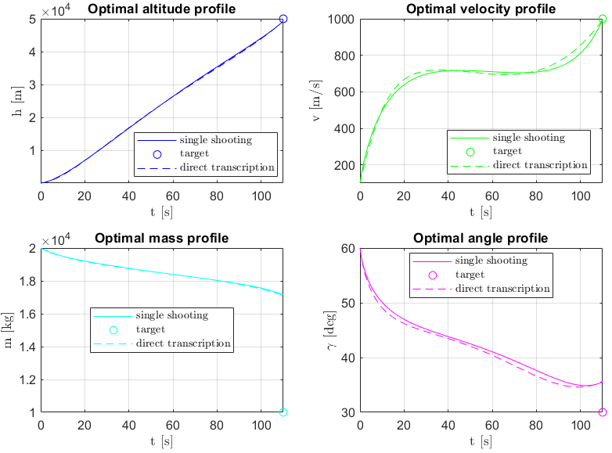
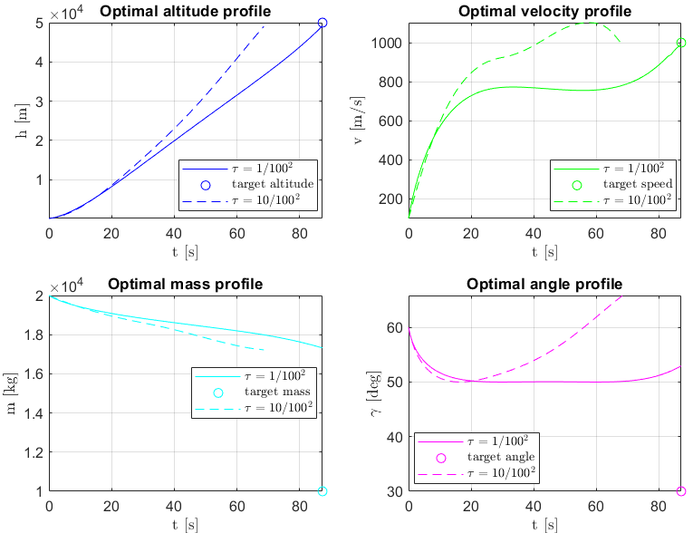
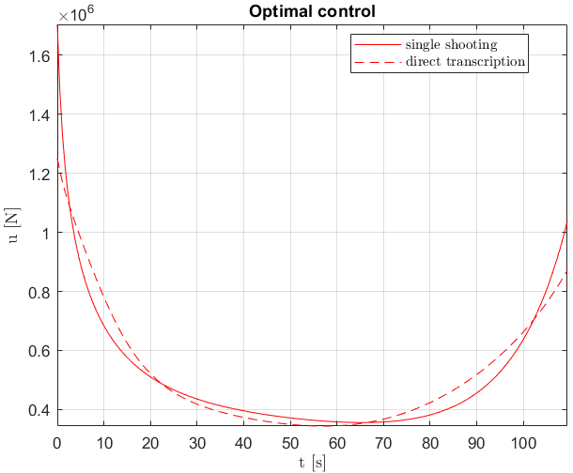
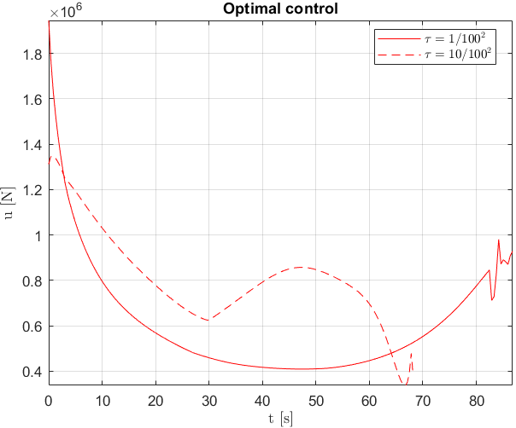
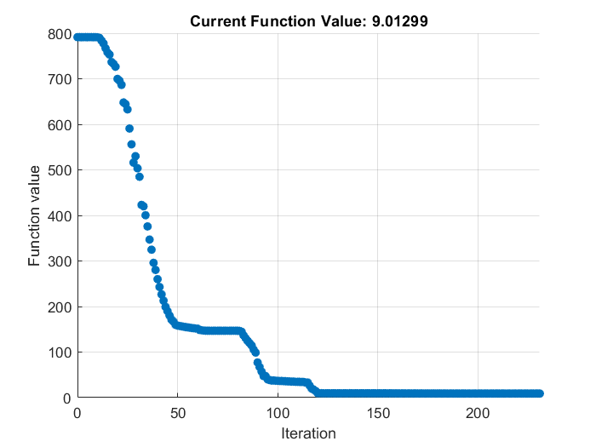
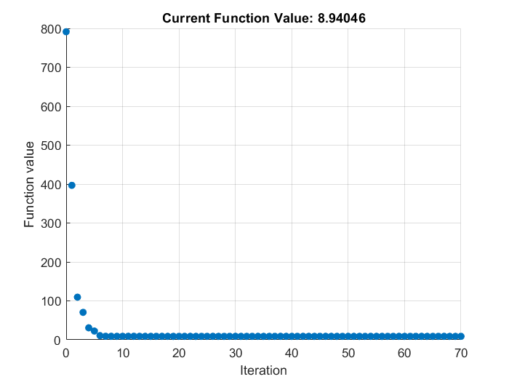
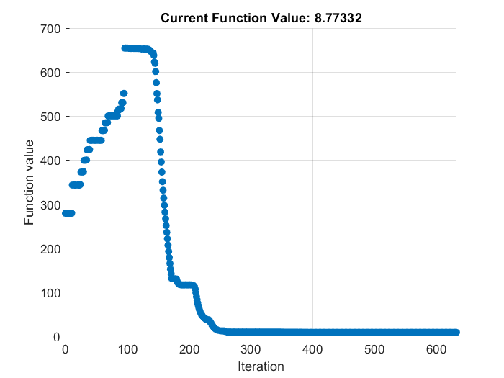
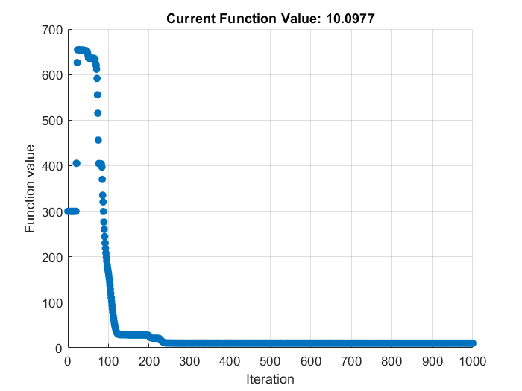
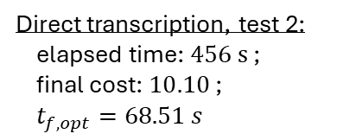
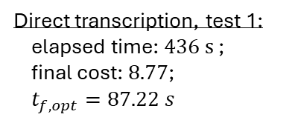
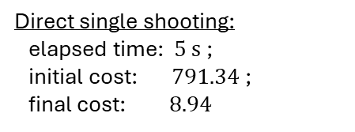
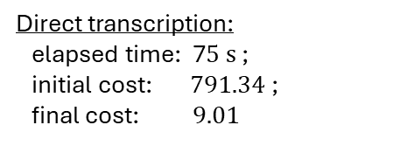
RESULTS
Unconstrained, imposed end time case
Constrained, free end time case
Direct transcription:
elapsed time: 7$5 s$ ;
initial cost: $791.34$ ;
final cost: $9.01$
Direct single shooting:
elapsed time: $5 s$ ;
initial cost: $791.34$ ;
final cost: $8.94$
Direct transcription, test 1:
elapsed time: $436 s$ ;
final cost: $8.77$;
$t_{f,opt}=87.22 s$
Direct transcription, test 2:
elapsed time: $456 s$ ;
final cost: $10.10$ ;
$t_{f,opt}=68.51 s$

