Slide 1
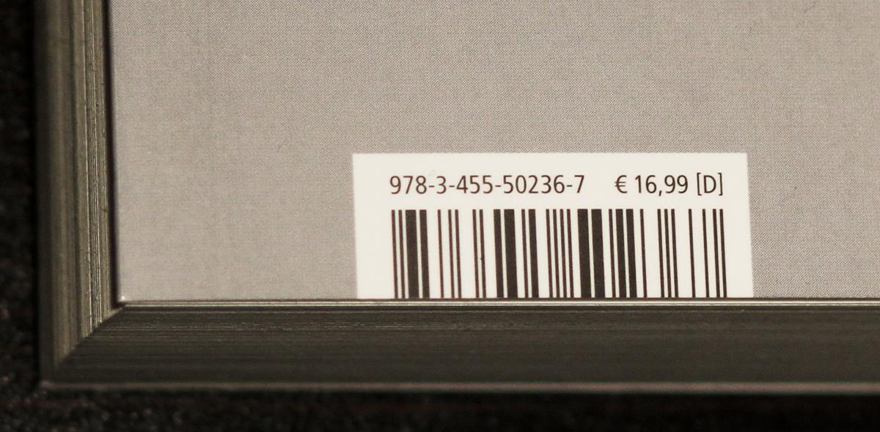
Barcode scan FOR mobile web apps
Nicola Zordan
Nicola.Zordan@outlook.com

Slide 2
Expanding the usability of existing web applications
Existing web application have probably been designed for the PC web browser
It would be nice however to take advantage of resources on the mobile devices
It is possible to enable using the device camera to scan barcodes, making it easier entering data
This is mostly useful for Inventory, Shipping, Delivery, Sales Analysis apps
I am showing you an example that allows integrating this ability on web application without hardware integration coding, special libraries, all handled in the client in JavaScript

Slide 3
Read barcodes using the camera in yoUr mobile phones
There are already many native apps on mobile devices that can scan barcodes, but web apps are not normally able to take advantage of the device camera in this way
I had a simple use case example about a Sales Analysis application to check sales and inventory info on specific items, to be used by the manager while walking in the warehouse
This makes a big difference in the effectiveness of an app used on a mobile device
Notes:
Consider talking about:
Collins at Sylvania
Computer Identics Corporation
Universal Product Code

Slide 4
QUAGGAJS
To do this I used a client JavaScript library that does all the processing in JavaScript
The library name is QuaggaJS
But it had multiple variables on configuration and settings
So I created a simple JavaScript app that will make it easy to simply attach code to a button and get the scanned code into an input field
You can get my code and implement it in your app from my github repository

Slide 5
My code and The javascript library QUAGGA
Nicola Zordan
BarcodeScannerJSnz: https://nicolazordan.github.io/NicolaZordan/
Github: https://github.com/NicolaZordan/BarcodeScannerJSnz
Quagga is the JavaScript library I am using
https://serratus.github.io/quaggaJS/
Available in github
Created by: Christoph Oberhofer
In 2017
https://github.com/serratus

Slide 6
EASY TO ADD a Barcode scan button
My code simplifies using a button and an input field to read the barcode into the field
HTML:
<input type=“button” value=“Scan Barcode” onClick=“barcodeScanner.start()” />
JavaScript:
barcodeScanner.inputField=document.inputForm.inputField;
Or even combine the 2 in the button onclick

Slide 7
DEMO
Demo web app https://nicolazordan.github.io/NicolaZordan/barcodeScanner/barcodeScannerTest.html
Scan a UPC bar code
Integrating in CM WebClient Abram Darnutzer

