Slide 1
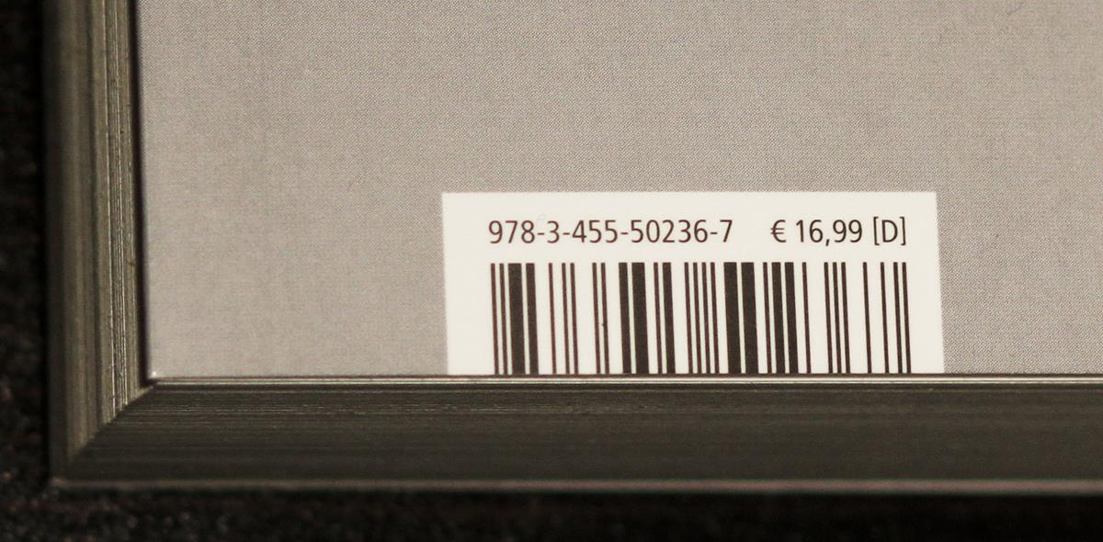
Barcode scan from mobile web apps
Nicola Zordan
Nicola.Zordan@outlook.com

Slide 2
How and why
We have web applications to read products codes
We wanted to use them on mobile
Looking at them I noticed that it would be great to be able to use a mobile phone camera to read barcodes, instead of having to type them
This was an easy way to do this on the client side without much programming

Slide 3
Read barcodes using the camera in yor mobile phones
Many business apps I have worked with could use the ability to scan a bar code to avoid typing parts numbers on a mobile device
There are many apps available to use the mobile phone camera to scan bar codes or QR codes
It is complex without a dedicated native mobile app integrating it with the existing web app
Notes:
Consider talking about:
Collins at Sylvania
Computer Identics Corporation
Universal Product Code

Slide 4
use the camera luke
There is a JavaScrip library that natively will allow reading bar codes using the client camera
I have created a simple adaptor that would allow clicking a button on a web site to load the scanned code into an input field

Slide 5
The javascript library QUAGGA
Quagga is the JavaScript library I am using
https://serratus.github.io/quaggaJS/
Available in github
Created by: Christoph Oberhofer
In 2017
https://github.com/serratus
Nicola Zordan
Script
Test page
Github

Slide 6
Simplifying
My code simplifies using a button and an input field to read the barcode into the field
barcodeScanner.inputField=document.form.inputField;
barcodeScanner.scannedFunction= function (barcode) {
console.log("Scanned barcode: ["+barcode+"]");
}

Slide 7
DEMO
Demo web app
Scan a UPC bar code
Integrating in WebClient

Slide 8
DEMO
Demo web app
Scan a UPC bar code

