Slide 1


EcheloNews
A SIMPLE WAY TO stay up to date

Slide 2
What is it?
EcheloNews is a news multiplexer. Basically, it fetches news from all over the world, classifying them by topic and giving them back to users according to their preferences.

Slide 3
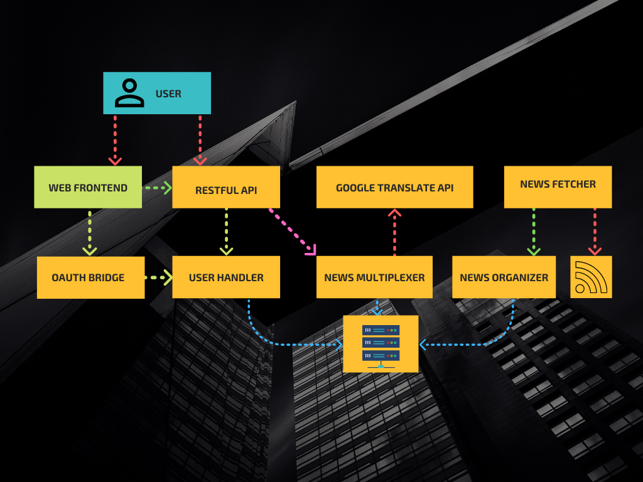
Architecture
Red edges: external interactions
Green edges: internal restful calls
Pink edges: internal ampq calls

Slide 4
Architecture benefits
Scalability
The architecture can be scale up adding new istances of modules
Modularity
The architecture is split into modules that interact with each,remaining independent.
Resilience
Most of functionality are guaranteed in case of problems

Slide 5
Tecnologies used
TECHNOLOGIES:
EXPRESS
AMQPLIB
PINO
PEERSEST
VALIDABLE
PASSPORT
BODY-PARSER
JSONWEBTOKEN
BCRYPT
External services:
GOOGLE OAUTH2 API
GOOGLE TRANSLATE API
NEWS FETCHER THAT RETRIEVE RSS FEEDS
Testing:
MOCHA
CHAI
CHAI-HTTP
DOTENV
NYC
NOCK
SINON

Slide 6
MODULES
RESTful API
It interfaces with a plethora of separated independent microservices to provide echelonews functionalities
Web frontend
It uses the api as it were an external service, being completely separated from the infrastructure
News fetcher
Fetch news via the rss protocol ffrom various websites and pass them to the news organizer as a json object.
News organizer
Organize news and save them in a permanent data structure offering a simple restful service

Slide 7
MODULES
News Multiplexer
According to topic or category and return them to a user interface microservice.
User Handler
Management of user is handled by the user handler
Oauth Bridge
Act as a bridge between the Web Frontend and the User Handler

