Slide 1


Slide 2
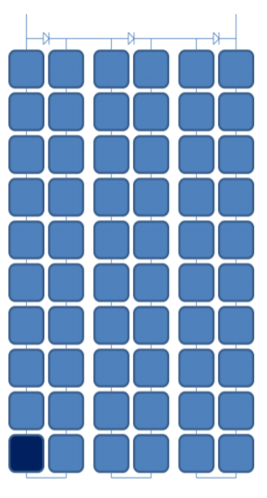
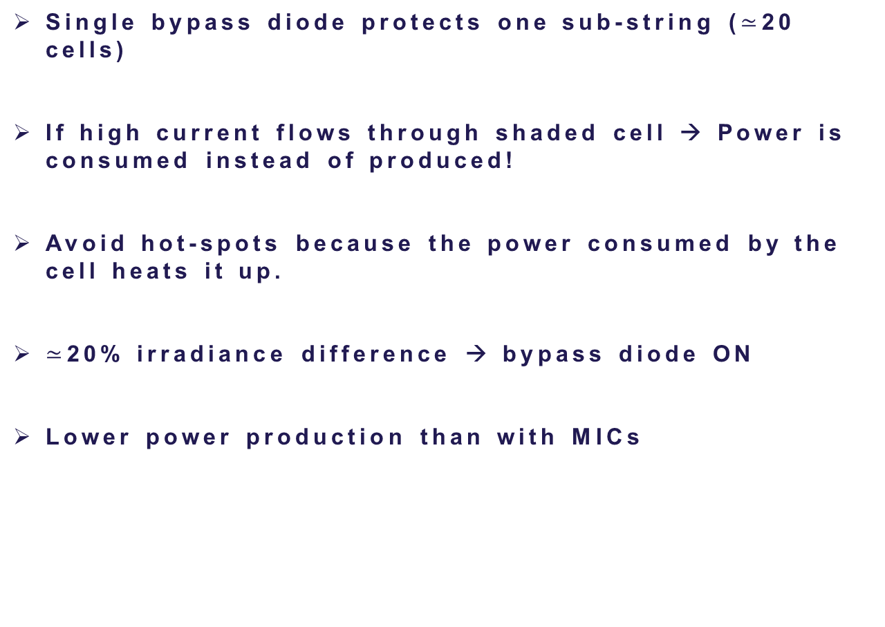
Bypass diodes vs MICs
Single bypass diode protects one sub-string ($≃$20 cells)
If high current flows through shaded cell → Power is consumed instead of produced!
Avoid hot-spots because the power consumed by the cell heats it up.
$≃$20% irradiance difference → bypass diode ON
Lower power production than with MICs
Sub-string
Notes:
file:///C:/Users/estef/Downloads/se_technical_bypass_diode_effect_in_shading.pdf

Slide 3
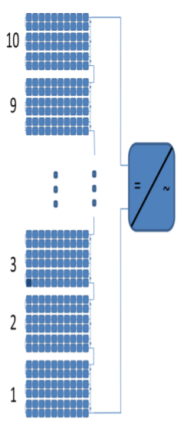
Bypass diodes vs MICs
Why using MICs improves power extraction?
Demonstration example: shaded cell at 80% irradiance
1st option: Bypass diode ON → 9*10% + 1*6.6% = 96.6%
2nd option: Reduce current to 80%→ 80% of full power
3rd option: MIC (MPPT) → 9*10% + 1*8% = 98%
Using MICs in each PV module → Increases power by 1.4%

Slide 4
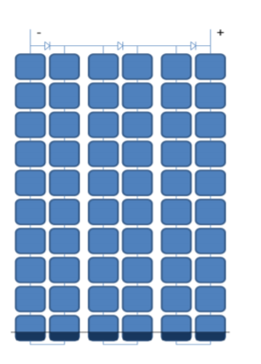
Bypass diodes vs MICs
Why using MICs improves power extraction?
Demonstration example: 30% shaded región (same example)
1st option: Bypass diodes ON → 9*10% + 1*0% = 90%
2nd option: Reduce current to 70%→ 70% of full power
3rd option: MIC (MPPT) → 9*10% + 1*7% = 97%
Using MICs in each PV module → Increases power by 7%

Slide 5
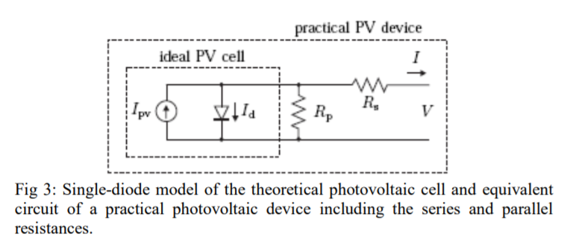

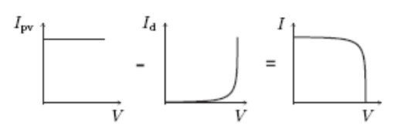
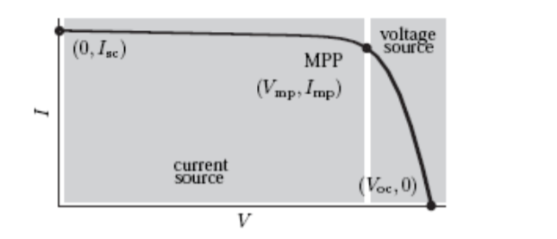
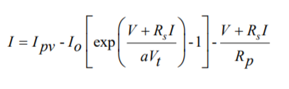
Limitations of single diode PV model
ideal
practical
Not enough with the ideal cell model to define the I-V characteristics of a solar panel because it is an array of series connected cells so it’s necessary to include Rs and Rp!
Notes:
http://www.iitk.ac.in/npsc/Papers/NPSC2012/papers/12118.pdf

Slide 6
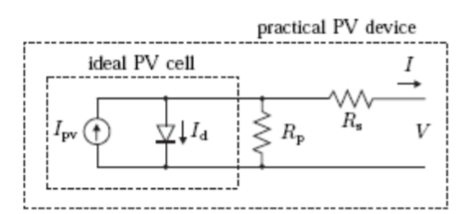
Limitations of single diode PV model
Rs → sum of several structural resistances of the PV panel.
Rp → due to the leakage current of the p-n junction and depends on the fabrication method of the cell.
Rp has very high value and Rs very low value (in some cases can be neglected)
Notes:
http://www.iitk.ac.in/npsc/Papers/NPSC2012/papers/12118.pdf

Slide 7
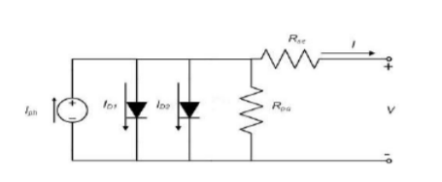

Limitations of single diode PV model
Double diode model:
Extra diode in parallel included to provide an EVEN more accurate I-V characteristic curve
This model considers the difference in flow current when the current is low.
Higher accuracy with this model BUT increase difficulty to solve the equation → Single diode model is preferred!

