Slide 1
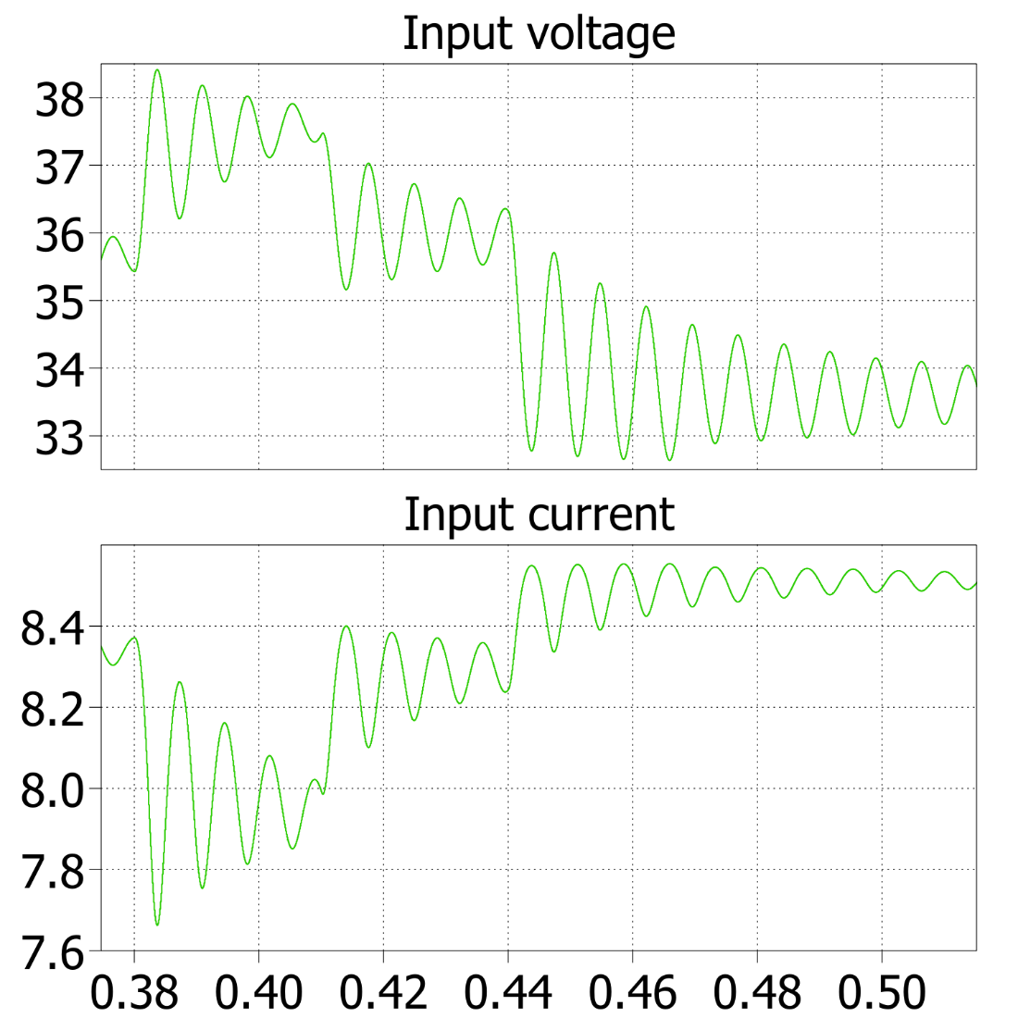
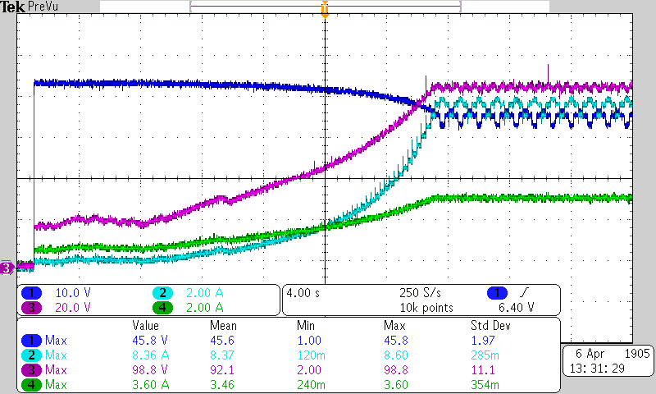

MPPT – Running frequency
Low frequency will lead to low reaction speed and oscillations
High frequency increases computational requirements
The system has a specific time constant (Tau) and having an MPPT faster than Tau is an overkill which can lead to instabilities as the variables are read during transients.
$Τ$ = $\frac{\sqrt{LC}}{D^{′}}=3 ms{\left.​\right|}_{D=0,5}$
10 Hz MPPT
oscillations
Oscillations of the system start-up working at 100 Hz. Working at a higher frequency would lead to too early measurements.

Slide 2
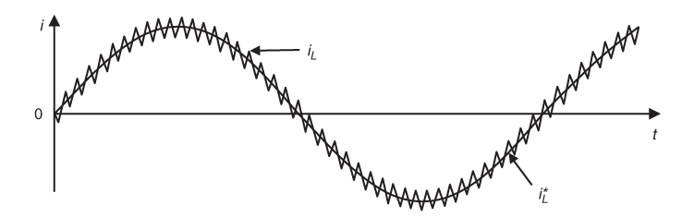
Hardware current sensor filtering
Different frequencies for different goals
50 Hz → Low frequency allows reliable MPPT information
80 kHz → In case a current controller is desired to be implemented, full sensor’s bandwidth is also available.
Further filtering can be achieved
through software
Hysteresis current control,
example of current control
that requires full bandwidth
Predictive Control of Power Converters and Electrical Drives. P. Cortes. 2012

