Slide 1
DC-DC CONVERTER FOR PV MODULE INTEGRATION
Group MsC1 – 760
Estefanía Ruiz Thassilo Lang Aitor Terán Nicolás Murguizur Jesper Kloster Nicolai H. Fransen

Slide 2
AGENDA
INTRODUCTION
MODULE INTEGRATED CONVERTER (MIC)
PROBLEM STATEMENT
OBJECTIVES
GROUP PROCESS
Notes:
Intro
Module Integrated Converter (MIC)
Problem Statement
Objectives
Group Process

Slide 3
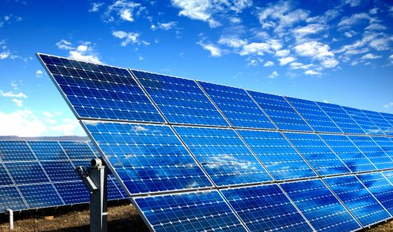
INTRODUCTION
Why PV solar energy?
What is the problem?
How can it be solved?
Notes:
Problem with environment and energy.

Slide 4
AGENDA
INTRODUCTION
MODULE INTEGRATED CONVERTER (MIC)
PROBLEM STATEMENT
OBJECTIVES
GROUP PROCESS

Slide 5
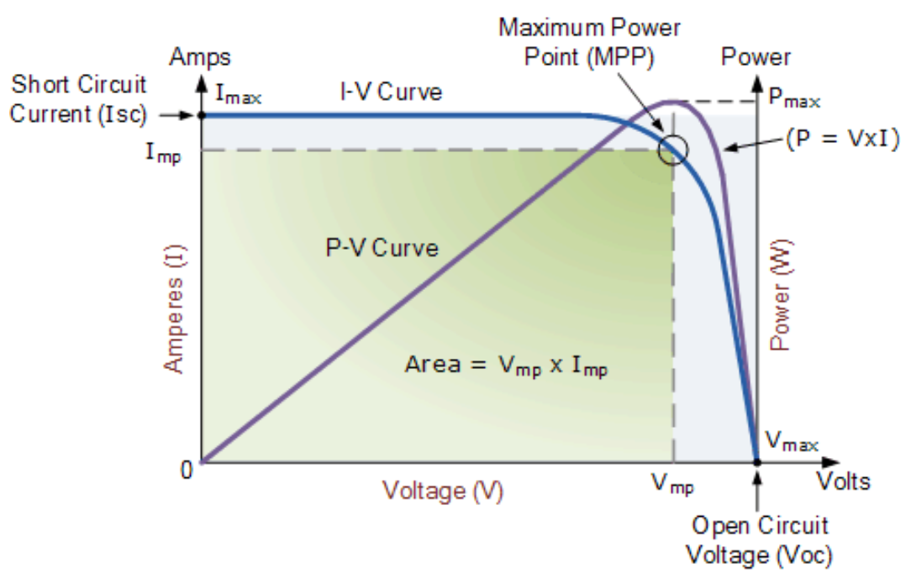
MODULE INTEGRATED CONVERTER - MIC
MPPT Maximum Power Point Tracking

Slide 6
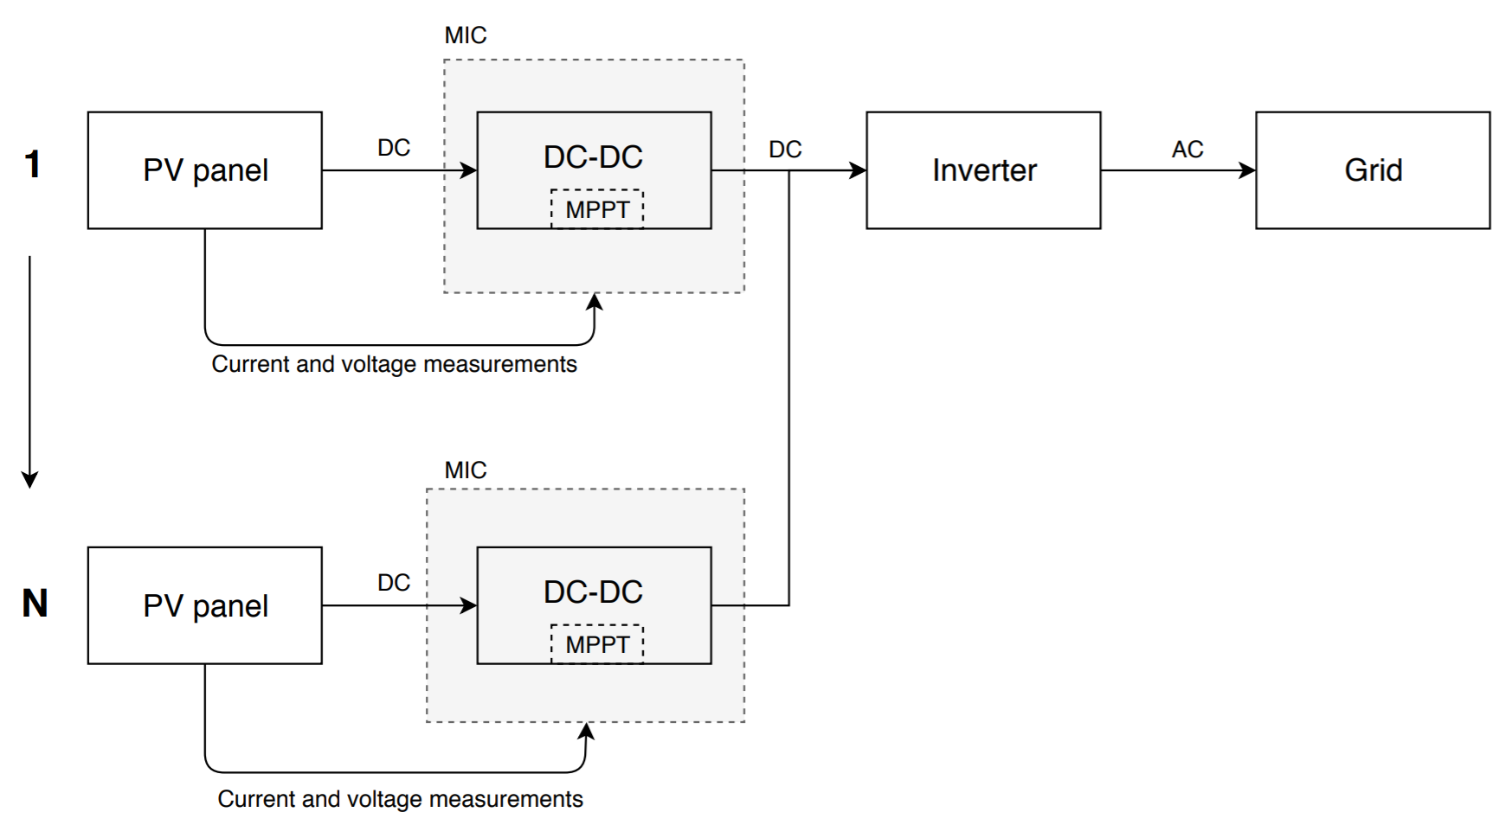
MODULE INTEGRATED CONVERTER - MIC

Slide 7
AGENDA
INTRODUCTION
MODULE INTEGRATED CONVERTER (MIC)
PROBLEM STATEMENT
OBJECTIVES
GROUP PROCESS

Slide 8
PROBLEM STATEMENT
How can a module integrated converter be designed to maximize the PV power generation under real conditions?

Slide 9
AGENDA
INTRODUCTION
MODULE INTEGRATED CONVERTER (MIC)
PROBLEM STATEMENT
OBJECTIVES
GROUP PROCESS

Slide 10
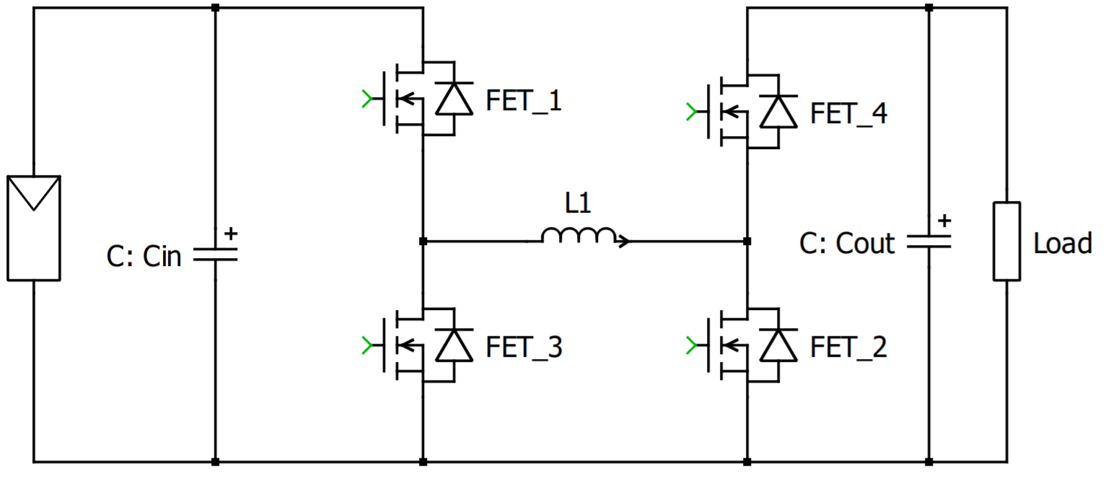
OBJECTIVES
Design of DC-DC converter.
Design of MPPT control system.
Hardware implementation.
Test & Validation using PV simulator.
Non-inverting Buck-Boost converter

Slide 11
AGENDA
INTRODUCTION
MODULE INTEGRATED CONVERTER (MIC)
PROBLEM STATEMENT
OBJECTIVES
GROUP PROCESS

Slide 12
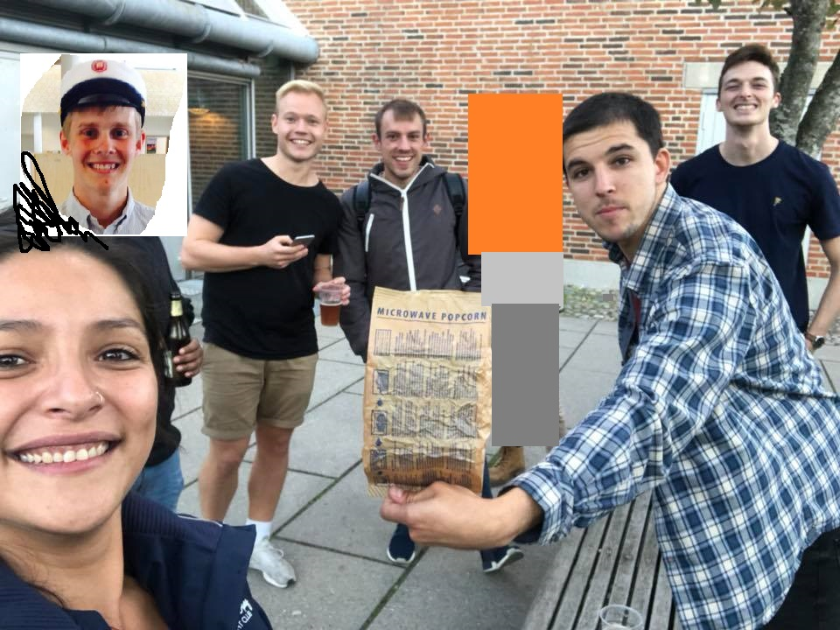
Group process

Slide 13
Thank you
Questions? ☺

