Slide 1
DC-DC CONVERTER FOR PV MODULE INTEGRATION
Group MsC1 – 760
Estefanía Ruiz Thassilo Lang Aitor Terán Nicolás Murguizur Jesper Kloster Nicolai H. Fransen

Slide 2
AGENDA
INTRODUCTION
PV generation
Module Integrated Converter (MIC)
CONVERTER TOPOLOGIES
Selection of the MIC topology
PROBLEM ANALYSIS
Problem statement
FUTURE WORK

Slide 3
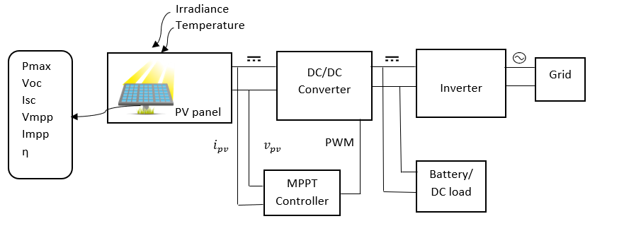
INTRODUCTION – PV generation
Photovoltaic effect
Irradiance Power Temperature Power
Basic diagram of a PV grid-tie with battery backup system

Slide 4
AGENDA
INTRODUCTION
PV generation
Module Integrated Converter (MIC)
CONVERTER TOPOLOGIES
Selection of the MIC topology
PROBLEM ANALYSIS
Problem statement
FUTURE WORK

Slide 5
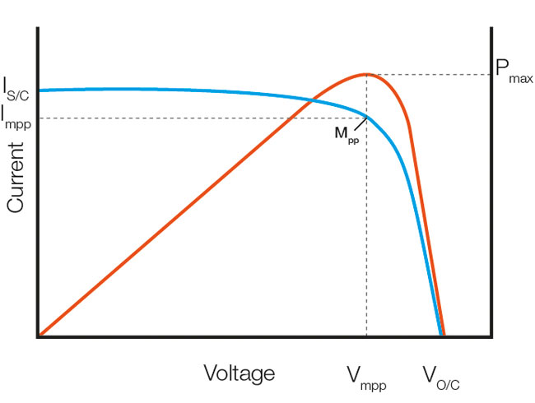
INTRODUCTION – Module Integrated Converter
MICs DC-DC converters / Microinverters
MPPT Maximum Power Point Tracking
Maximum Power Point of generic solar panel [????].

Slide 6
AGENDA
INTRODUCTION
PV generation
Module Integrated Converter (MIC)
CONVERTER TOPOLOGIES
Selection of the MIC topology
PROBLEM ANALYSIS
Problem statement
FUTURE WORK

Slide 7
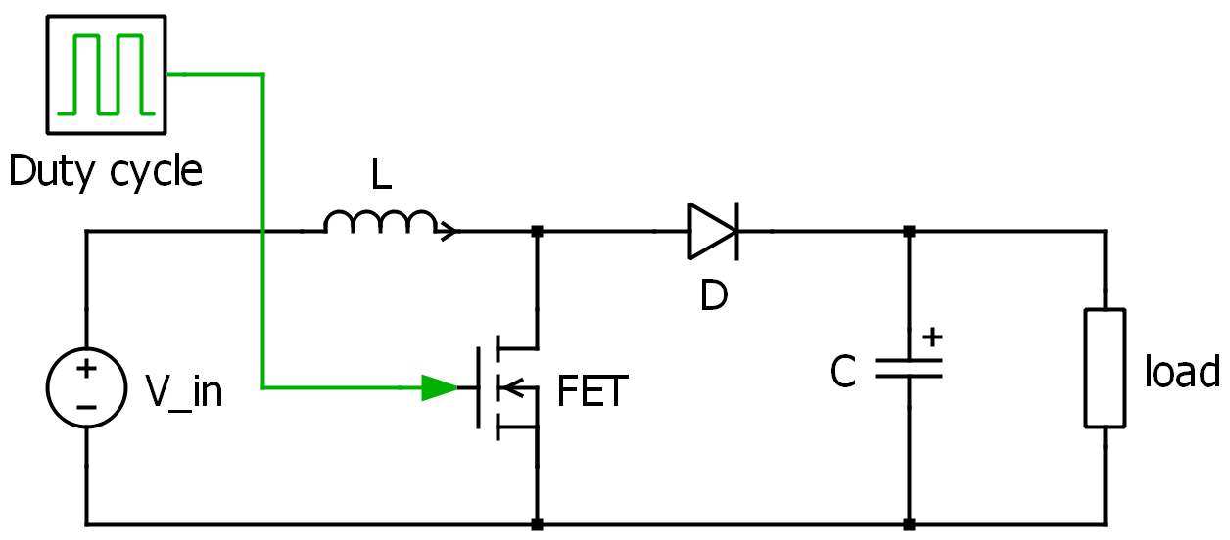
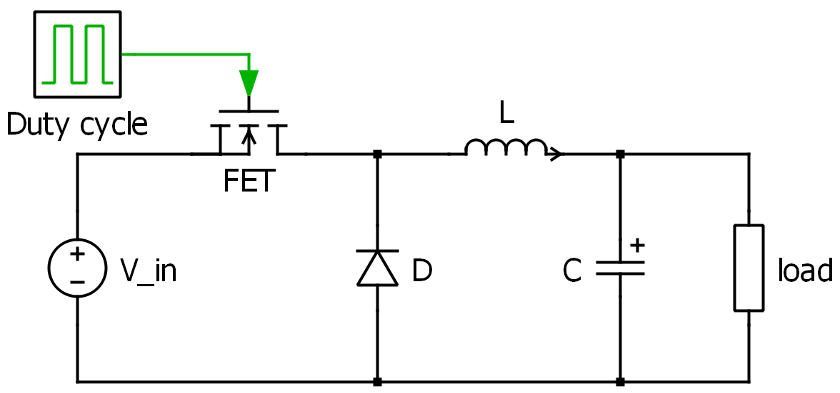


CONVERTER TOPOLOGIES
Schematic Buck converter
Schematic Boost converter
$$V_{input }> V_{load}$$
$$V_{input }< V_{load}$$

Slide 8
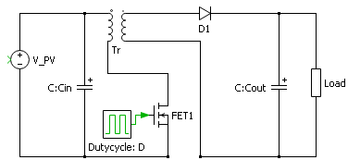
CONVERTER TOPOLOGIES
Galvanic isolation
Buck-boost (inductor split to form a transformer)
Schematic Flyback converter

Slide 9
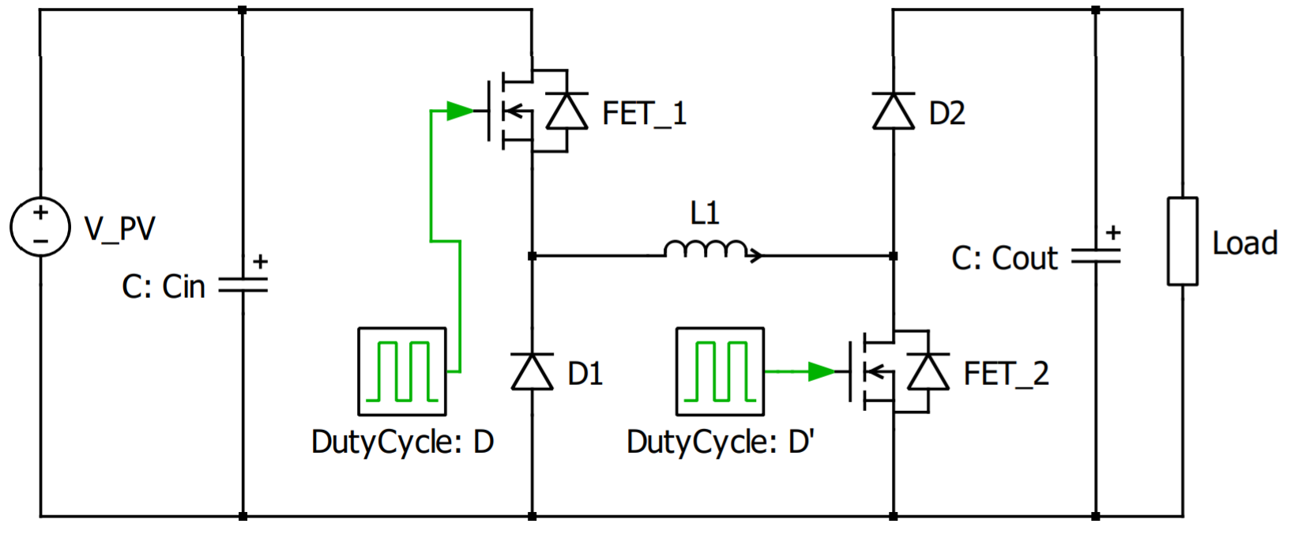
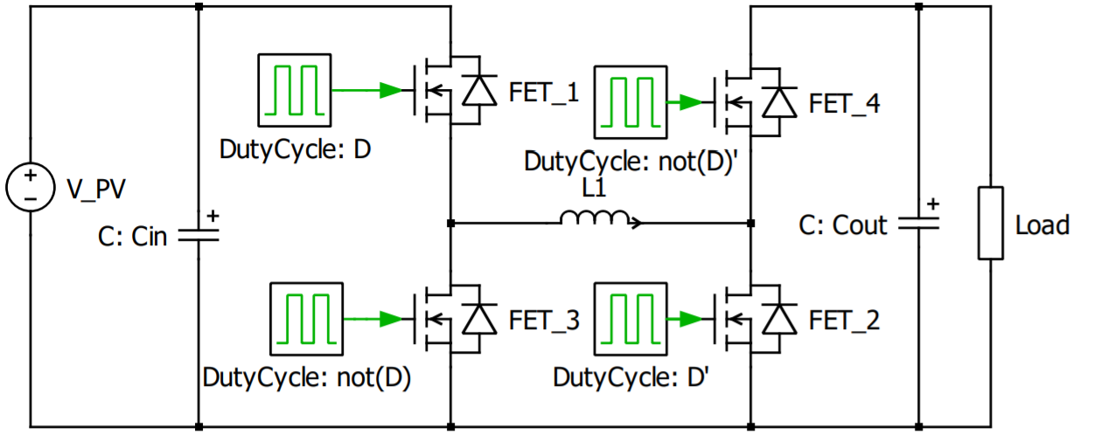

CONVERTER TOPOLOGIES
Non-inverting Buck-boost converter – 2 SW
Non-inverting Buck-boost converter – 4 SW
$$V_{input }{}_{<}^{>} V_{load}$$
Full bridge Bidirectional

Slide 10
CONVERTER TOPOLOGIES
Non-inverting Buck-boost converter – 2 SW
Non-inverting Buck-boost converter – 4 SW
$$V_{input }{}_{<}^{>} V_{load}$$
Full bridge Bidirectional

Slide 11
AGENDA
INTRODUCTION
PV generation
Module Integrated Converter (MIC)
CONVERTER TOPOLOGIES
Selection of the MIC topology
PROBLEM ANALYSIS
Problem statement
FUTURE WORK

Slide 12
CONVERTER TOPOLOGIES – Selection of MIC topology
Buck and Boost converters limited to either or the voltage.
Flyback has η because of the transformer.
2-SW buck-boost has power loss.
4-SW Non-inverting buck-boost converter!!
Why? Bidirectional and Efficiency than the other topologies

Slide 13
AGENDA
INTRODUCTION
PV generation
Module Integrated Converter (MIC)
CONVERTER TOPOLOGIES
Selection of the MIC topology
PROBLEM ANALYSIS
Problem statement
FUTURE WORK

Slide 14
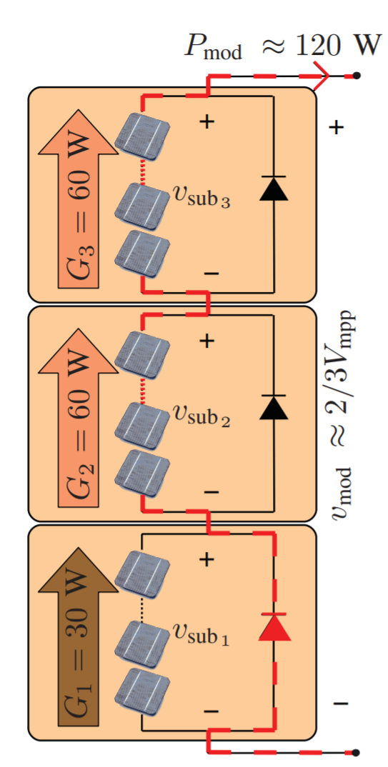
PROBLEM ANALYSIS
Mismatches → Lower power generation
Solution → Bypass diodes to keep the current flow
Problem → PV bypassed module power generation = 0 !
Advanced solution → Implementation of MICs
Non- inverting buck-boost converter for MPPT
PV module being bypassed by a diode.

Slide 15
AGENDA
INTRODUCTION
PV generation
Module Integrated Converter (MIC)
CONVERTER TOPOLOGIES
Selection of the MIC topology
PROBLEM ANALYSIS
Problem statement
FUTURE WORK

Slide 16
PROBLEM ANALYSIS - Problem statement
How can a module integrated converter be designed to maximize the PV power generation under real conditions?
Objectives:
Design of DC-DC converter.
MPPT techniques.
Design of control system.
Hardware implementation.
Test & Validation using PV simulator.

Slide 17
Thank you
Questions? ☺

