Slide 1
Passive components Sizing
Calculated using the ripples under worst case conditions
Depends on the switching frequency
Notes:
Should i mention the conditions and why they are worst case?
Should i add the equations?

Slide 2
Passive components Selection
20% margin was included
Electrolytic capacitors for low ESR
Reused inductor
Component | Theoretical value | Implemented value | Voltage rating
Input capacitor | 1540µF | 1880µF | 100V
Output capacitor | 130µF | 820µF | 250V?
Inductor | 1.3mH | 1.93mH | -
Notes:
Input cap is 4*470uF

Slide 3
Power supplies
External supplies
Linear 5V voltage regulator
Isolated 12V TRACO supplies
LED at every supply line

Slide 4
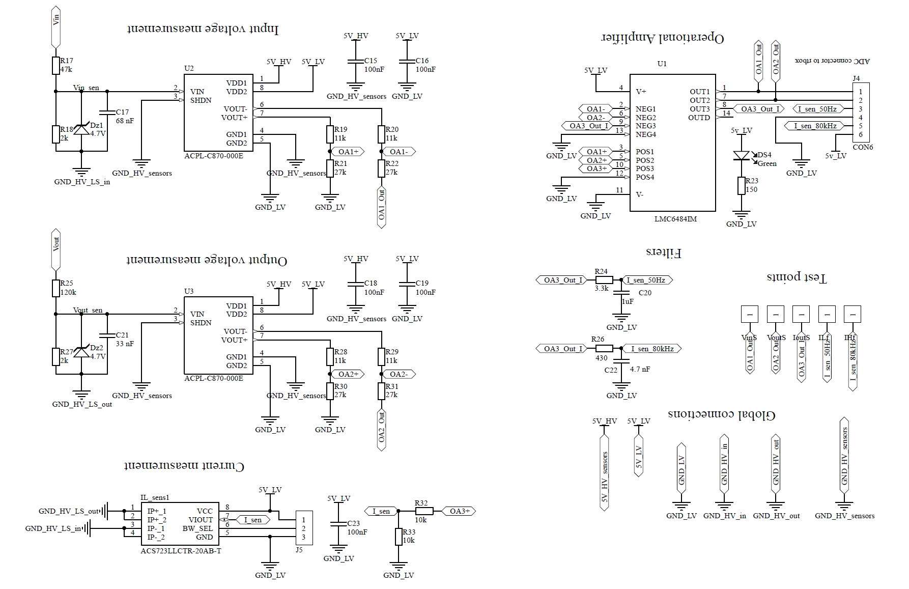
Sensors

Slide 5
Future work
Hardware improvements
Inductor design
PCB improvements
Converter’s efficiency
V/I controller

Slide 6
Conclusion
Add something about the general intro?
What went good
What went bad
What did we learn

