Slide 1
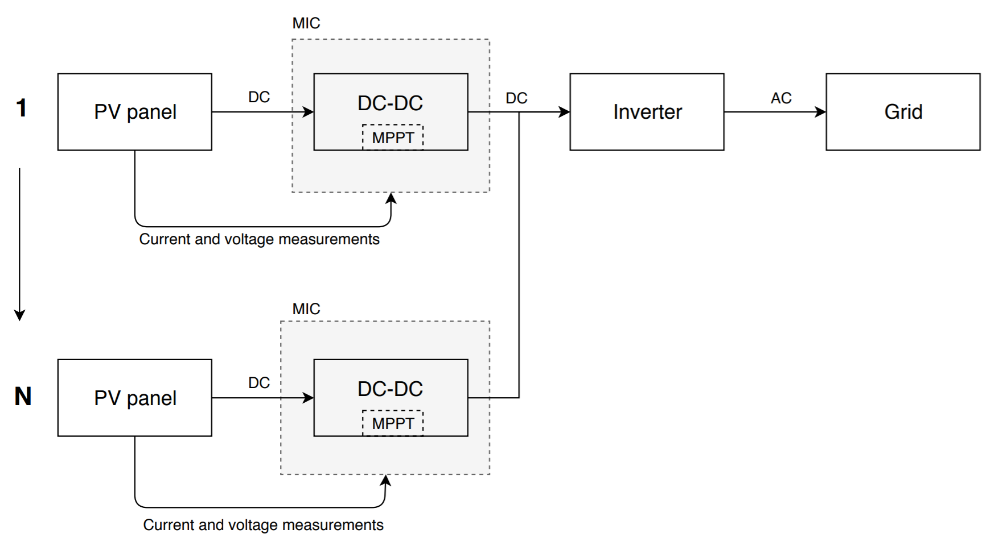
What is a MIC?
Module integrated converter.
Is located next to each PV module.
Prevents mismatch losses.

Slide 2
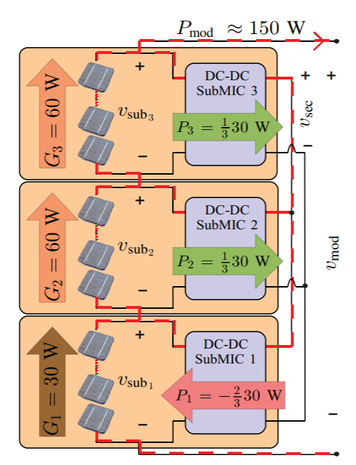
MIC advantages
Allows individual maximum power point tracking.
Replaces bypass diode.
Higher efficiencies achieved.
Certain topologies allow bidirectionality.

Slide 3

Converter design, change random picture

Slide 4
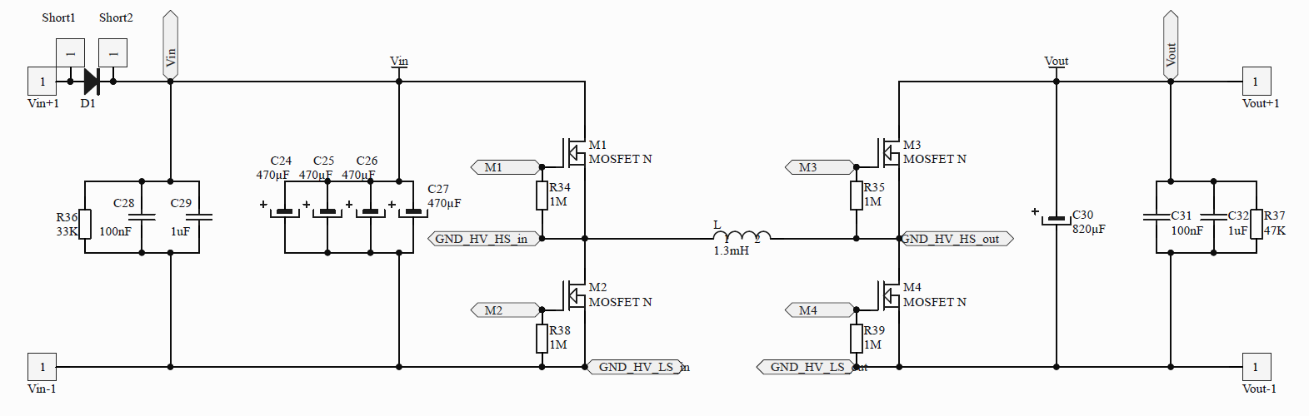
Power circuitry
Discharging resistors.
Protection diodes.
High frequency capacitors.

Slide 5
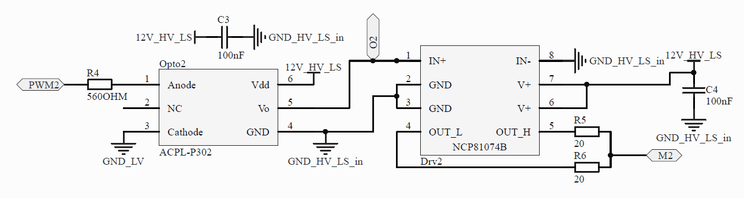
Driving circuitry
Optocouplers for isolation.
Decoupling capacitors.
Current limiting resistors.

Slide 6
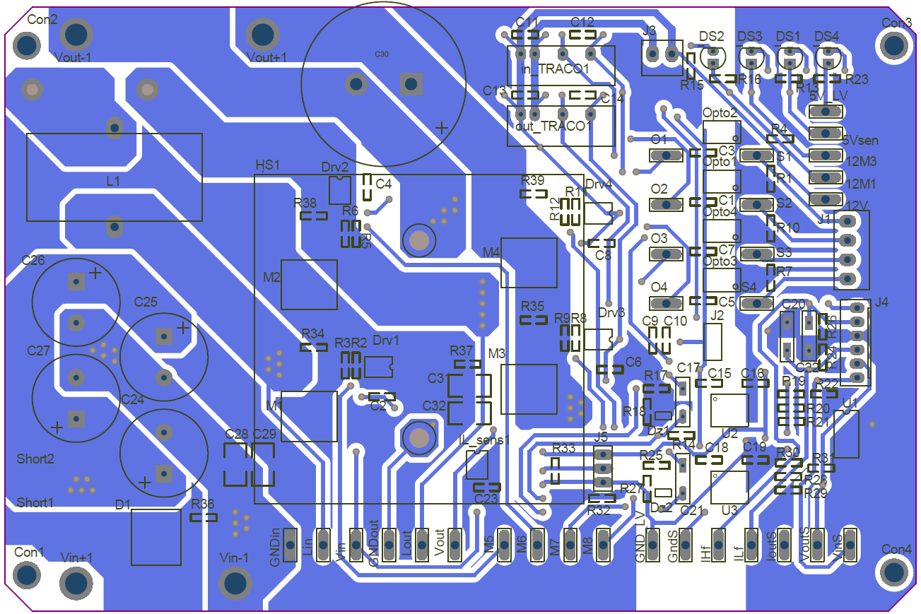
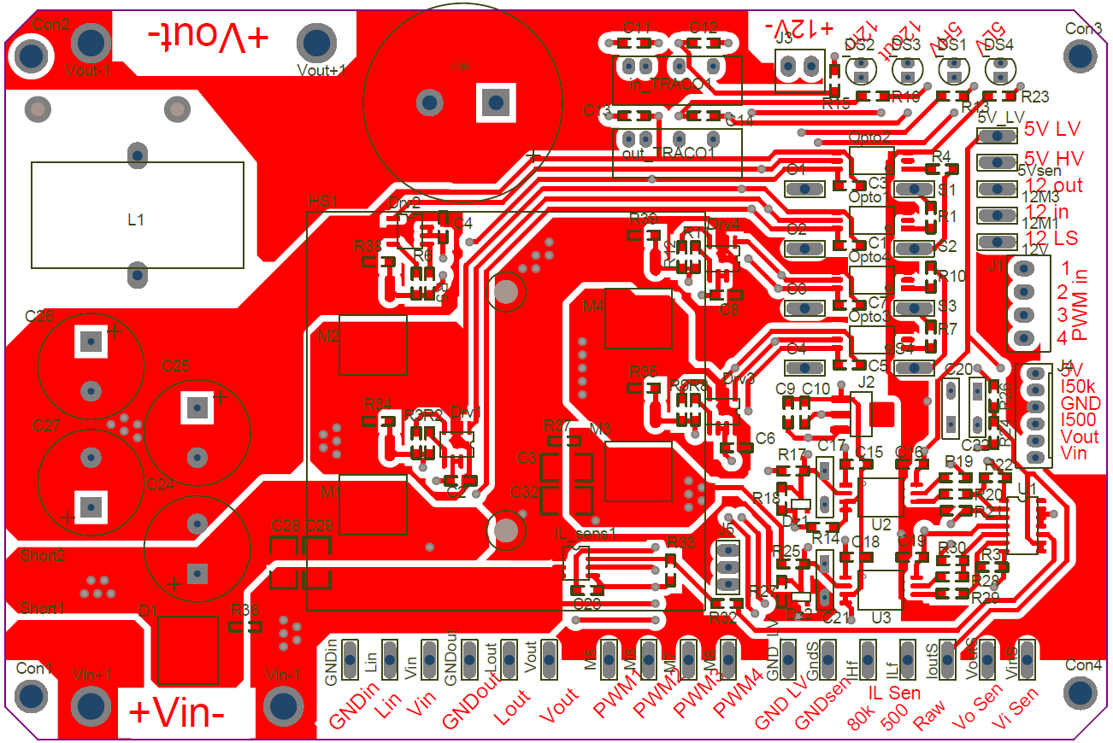
PCB layout
Considerations:
Hot and cold spots.
Isolations.
Interferences.
Others.

Slide 7
Hot and cold spots
Clear separation of hot and cold sides.
High power.
Low power,
Main side.
Low power,
Isolated side.

Slide 8
Interferences
Minimal current loops.
Hall sensor location.
Ground planes.
Removed ground plane under inductor.

Slide 9
Isolations
Isolation bridge under high and low voltage..

Slide 10
Others
Test points.
Other measuring points and user communication.
Heat sink location.
10mm power traces.

