Slide 1
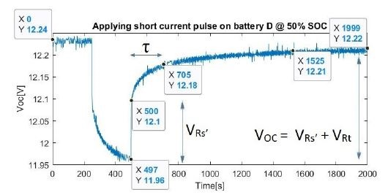

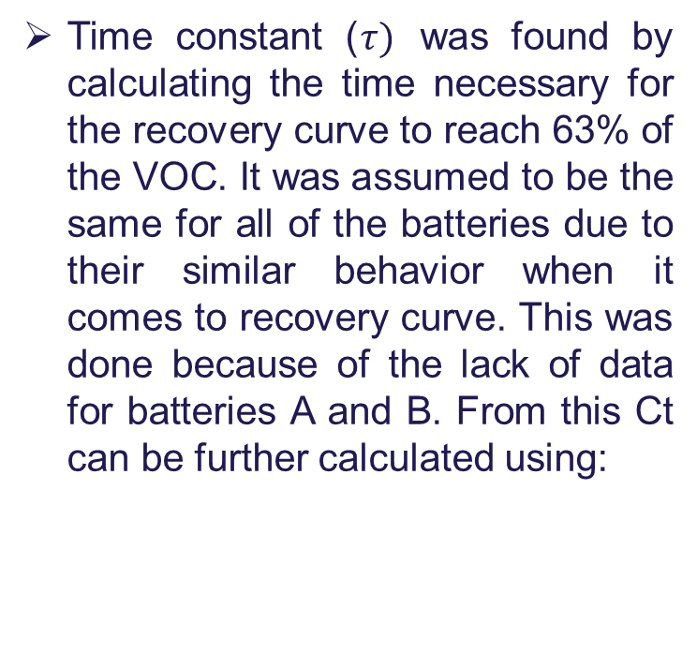
Obtaining the battery parameters
Time constant ($τ)$ was found by calculating the time necessary for the recovery curve to reach 63% of the VOC. It was assumed to be the same for all of the batteries due to their similar behavior when it comes to recovery curve. This was done because of the lack of data for batteries A and B. From this Ct can be further calculated using:

Slide 2
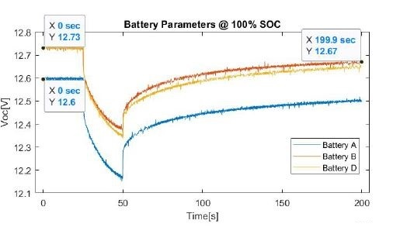

Obtaining the battery parameters
Rs’ an Rt were obtained by substituting the values from the experimental test in the equations:
Where VRs’ and VRt are read from the picture nearby and I is 10A
Where VRs’ and VRt are read from the picture nearby and I is 10A.

Slide 3
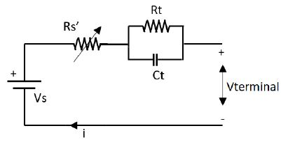
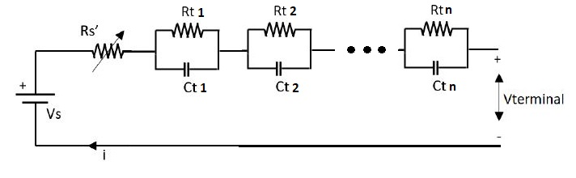
Model the batteries more precise
A bigger number of RC parallel blocks in the model of the batteries will increase the accuracy of the model. This is because approximating the model with only one block it is a correct approach but as it can be seen in the simulation result there is a mismatch in the portion representing charging a capacitor which suggests that the battery has actually more time constants of different values.

