Slide 1
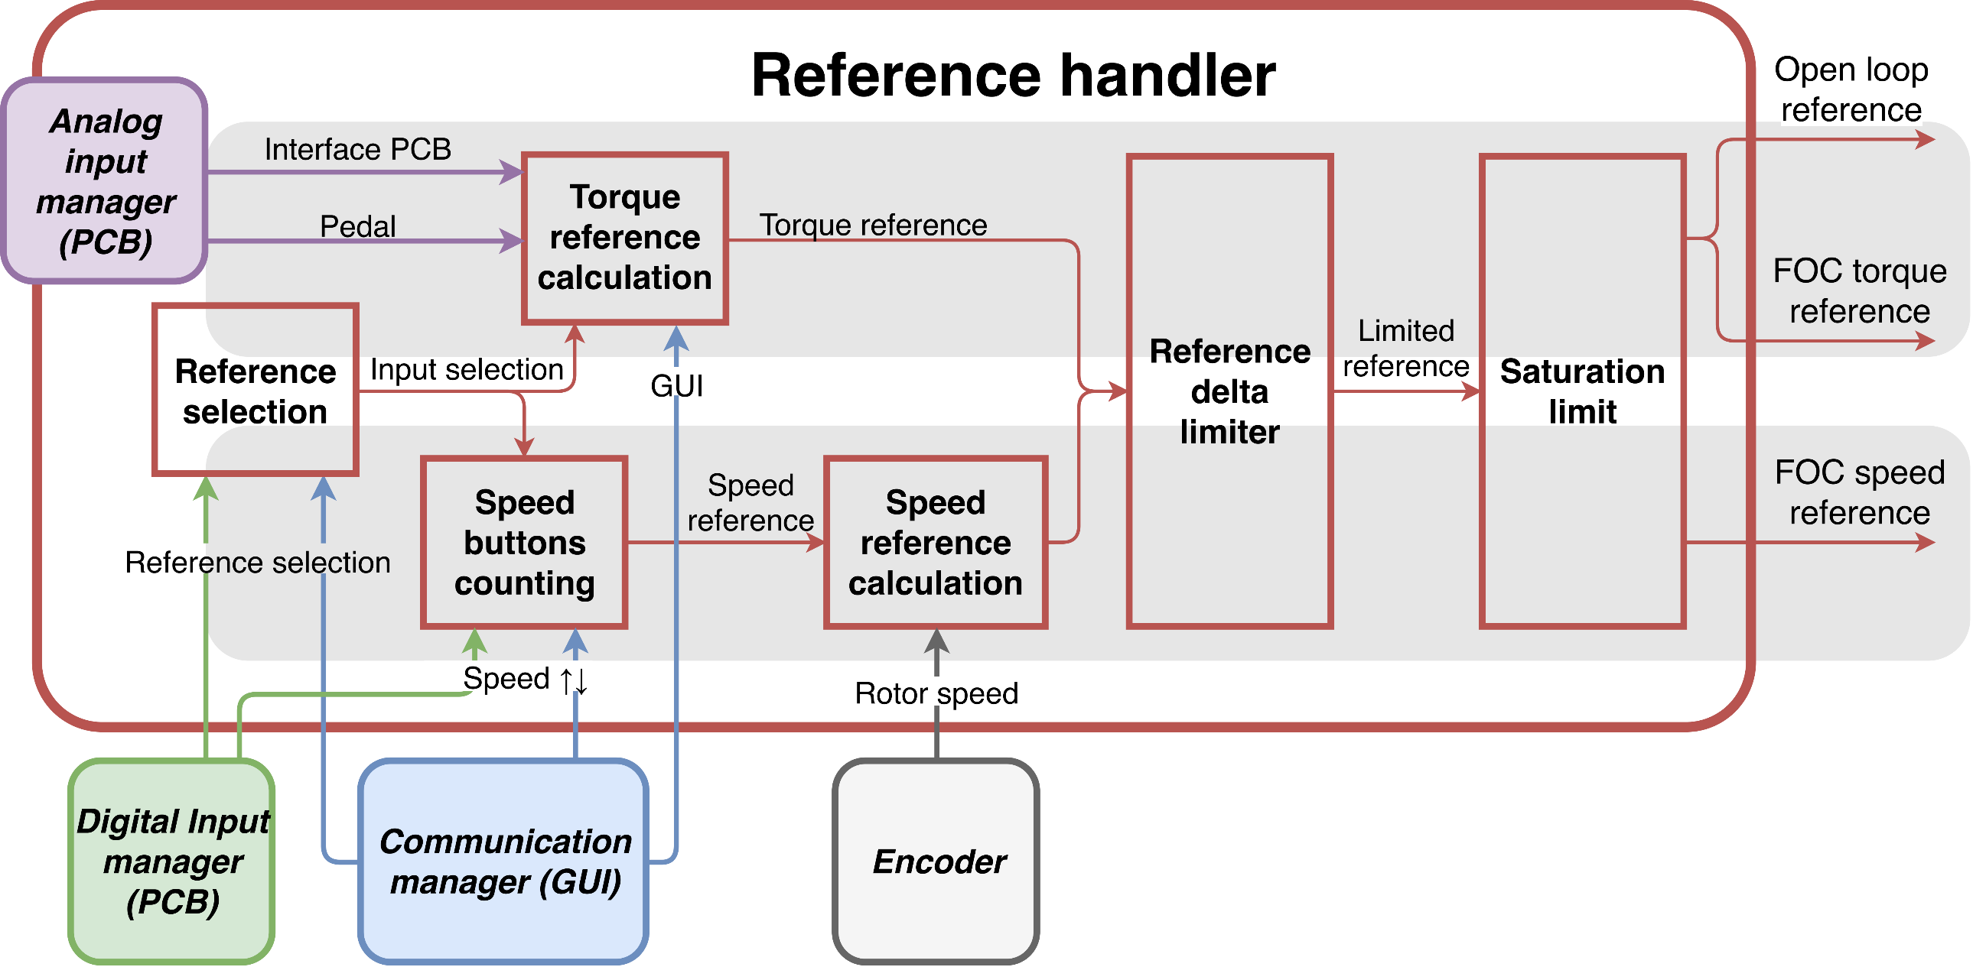
Reference Handler
Slide
Features
Reference source selection
Pedal
GUI
Interface PCB
Reference type selection
Torque control
Cruise control
Reference ramp limitation
Reference saturation
Used by motor controller
Complex module which collects information from many other modules

Slide 2
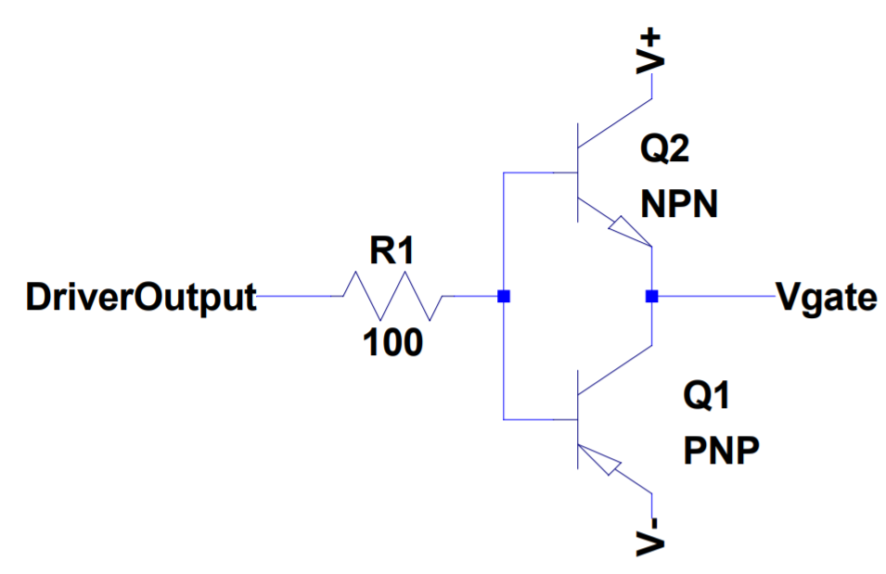
Driver IC damage
Slide
Problem
The driver IC was damaged during V/f control when the DC link voltage was increased
Approach
Simulate the circuit with LTSpice
Voltage spikes beyond absolut maximum ratings were found in the driver output
The solution consisted on an increase of the base of the push-pull stage resistor (1 Ohm to 100 Ohm)
Voltage spikes disappeared
Consequences
The rise time (10% to 90%) of Vds increased from 22 ns to 23 ns in simulation, which is acceptable

Slide 3
Regenerative braking implementation
Slide
First approach
Software
System requirements definition: Define user experience. Is an electronic braking control necessary(talking about frictional braking)?
Develop a regenerative braking software module. This module will monitor whether the resulting current from the regenerative braking torque command is feasible or it will be beyond battery capabilities. If that is the case, frictional braking must be used.
The rest of the modules already consider negative references and directions.
Hardware
If necessary, mount a brake pedal sensor and actuator to electronically control the frictional brake.

Slide 4
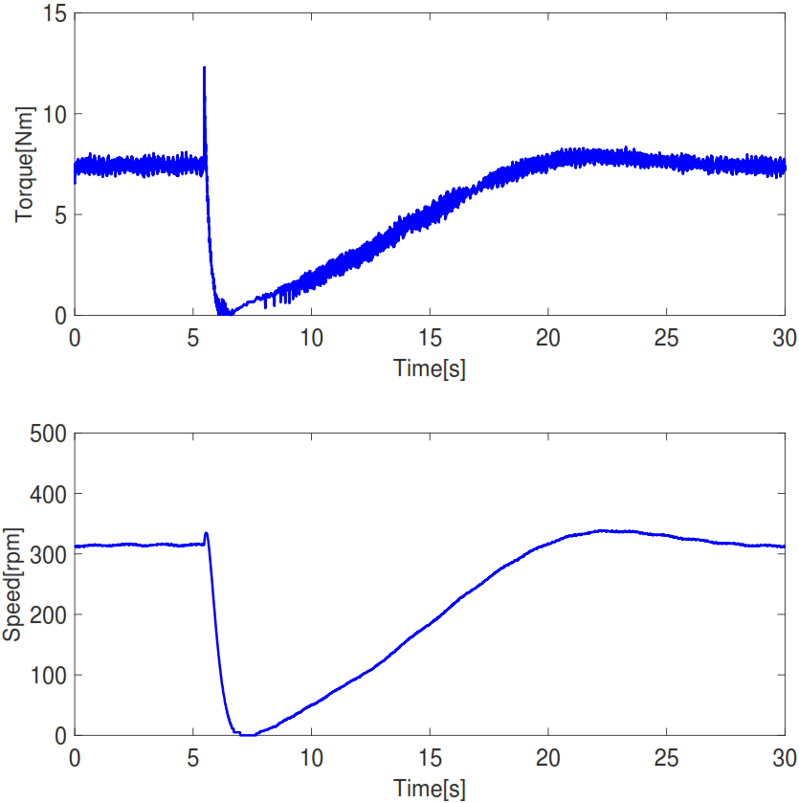
Torque control to Cruise control
Slide
Initially, the error is 0 rpm, which is translated into a 0 Nm torque reference
This leads to a decrease in rotor speed (see picture)
In the simulations this behaviour did not appear because the inertia of the system is larger and the PI is more agressive
A solution could be to initialize the speed PI output to the torque reference at the switch instant

Slide 5
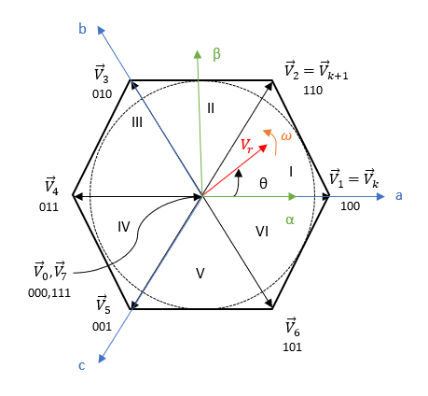
SVM Implementation
Slide
Translated from MATLAB script
Procedure
Limit voltage references (So they are within the ranges which Vdc can provide)
Find sector. Graphical explanation with picture
Calculate dwell times, using logic explained in report
Set duty cycle

Slide 6
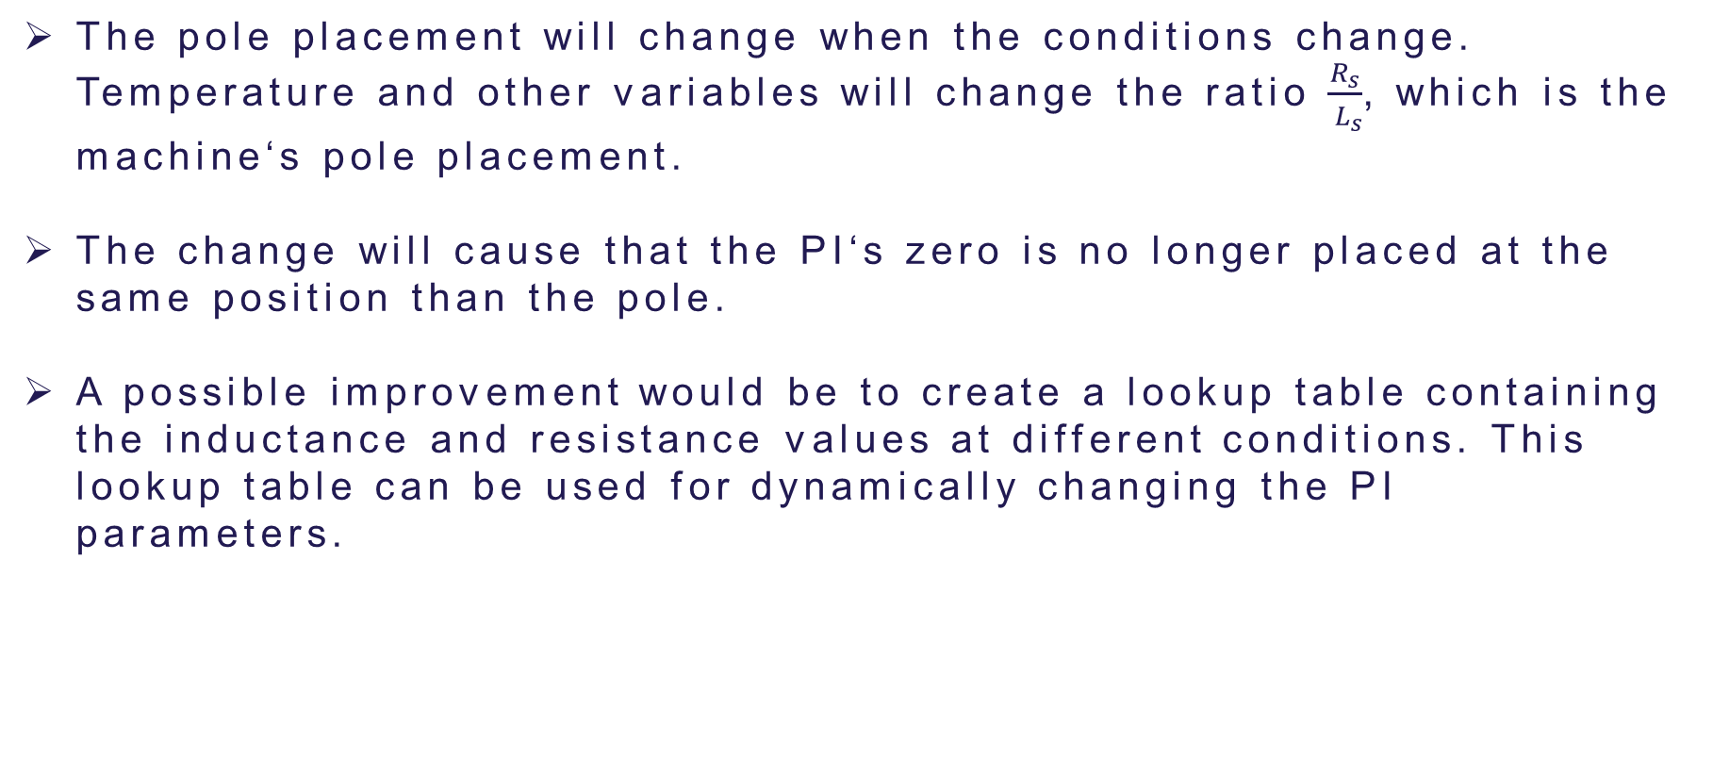
Pole cancellation technique Limitations
Slide
The pole placement will change when the conditions change. Temperature and other variables will change the ratio $\frac{R_{s}}{{ L}_{s}}$, which is the machine‘s pole placement.
The change will cause that the PI‘s zero is no longer placed at the same position than the pole.
A possible improvement would be to create a lookup table containing the inductance and resistance values at different conditions. This lookup table can be used for dynamically changing the PI parameters.

