Slide 1
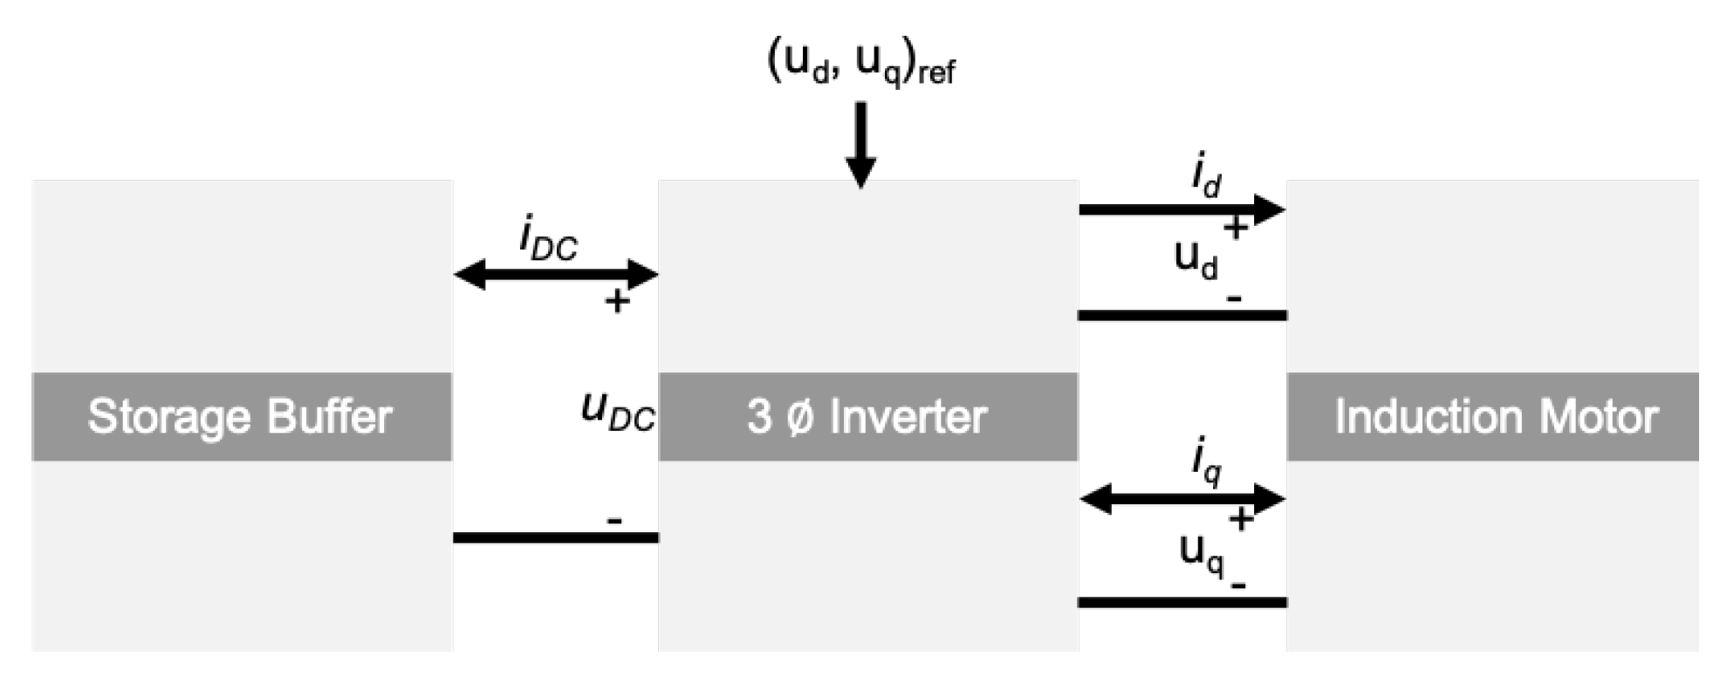
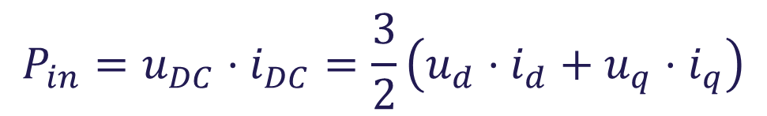
Power flow in regenerative braking
$$P_{in}=u_{DC}⋅i_{DC}=\frac{3}{2}\left(u_{d}⋅i_{d}+u_{q}⋅i_{q}\right)$$

Slide 2
Power flow in regenerative braking
For the power to flow back to the DC-link the power has to become negative
For this to happen the q-part has to make the expression negative
When a negative torque reference is given, then the q-current will turn negative as well
As the d-current is positive, then the d-voltage has to drop, for that part to become smaller

Slide 3
Integral anti-windup
Limit the output of the PI controllers with saturation blocks
A saturated output would lead to a big error term, as the PI is not allowed to follow the reference
Causes oscillations on the system response
This is solved by using anti-windup

Slide 4
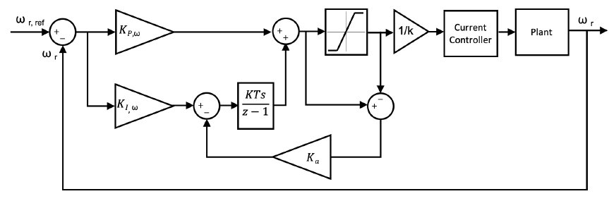
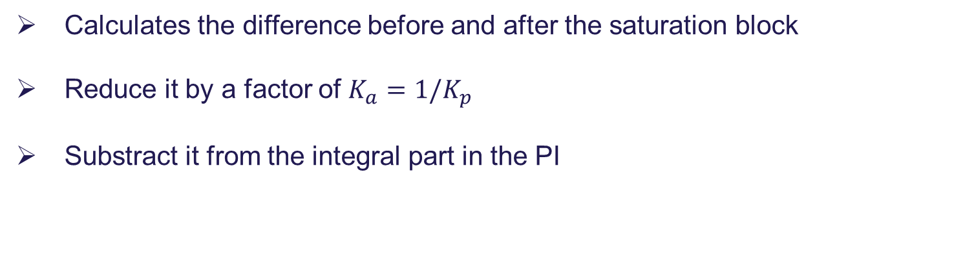
Integral anti-windup
Calculates the difference before and after the saturation block
Reduce it by a factor of $K_{a}=1/K_{p}$
Substract it from the integral part in the PI

Slide 5
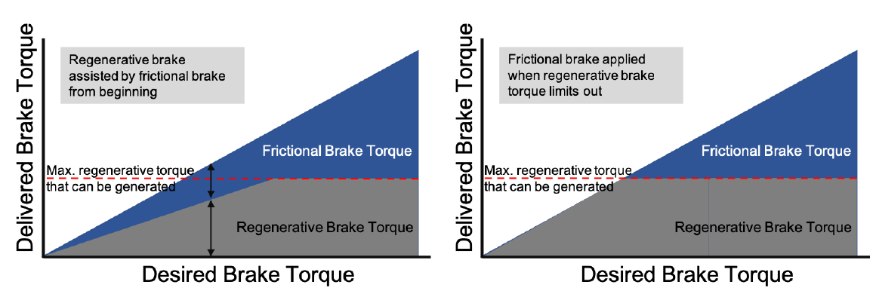
Serial and parallel regenerative braking
In parallel regenerative braking, the braking torque is divided between frictional and regeneration, in the entire braking scope
In series regenerative braking, first the full regenerative torque is applied, before frictional braking is used

