Slide 1
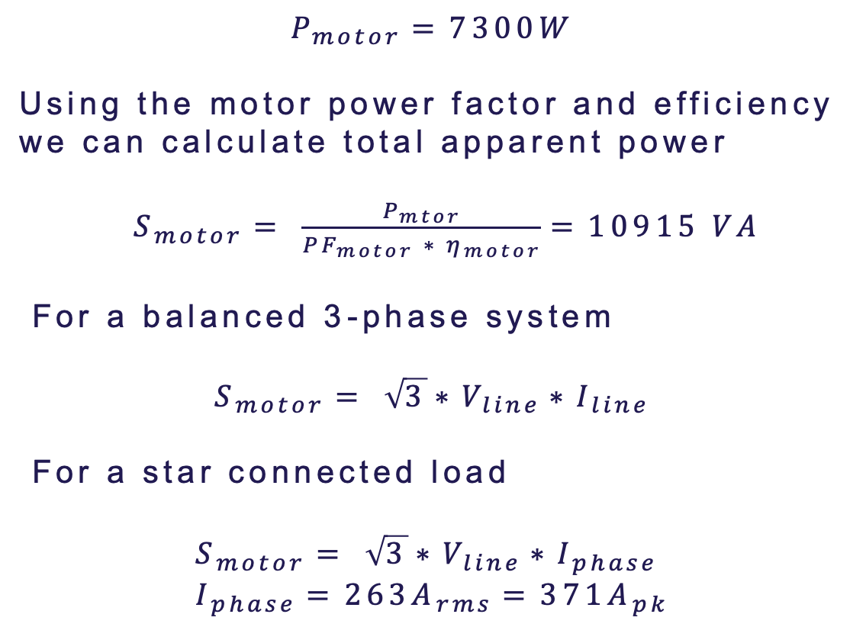
Parallel MOSFET
Slide
of 59
$$P_{motor}=7300W$$
Using the motor power factor and efficiency we can calculate total apparent power
$S_{motor}= \frac{P_{mtor}}{{PF}_{motor} ∗ η_{motor}}=10915 VA$
For a balanced 3-phase system
$$S_{motor}= \sqrt{3}∗V_{line}∗I_{line}$$
For a star connected load
$$S_{motor}= \sqrt{3}∗V_{line}∗I_{phase} \\ I_{phase}=263A_{rms}=371A_{pk}$$
1
3
5
V_{A}
DC Link
V_{B}
V_{C}
4
6
2
Drain
R_{gate}
R_{gate}
Driver
Source
Faheem

Slide 2
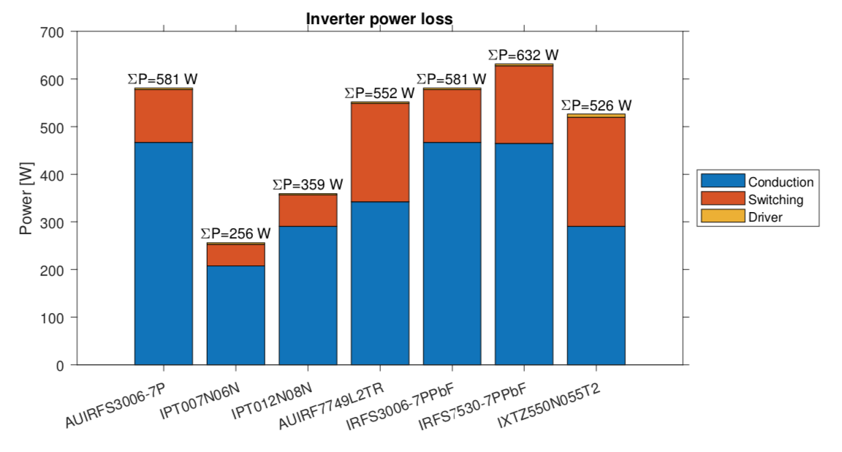
Parallel MOSFET
Slide
of 59
By comparing multiple available MOSFETs from different manufactures of rating 60V and 80V for 300A.
Based on the obtained SPICE model simulation IPT007N06N and IPT012N08N5 are the most suitable MOSFETS. But, due to IPT012N08N5 higher drain-source voltage of 80V, it can ensure a better safety margin that occurs in turn off transition of the MOSFETs.
Faheem

Slide 3
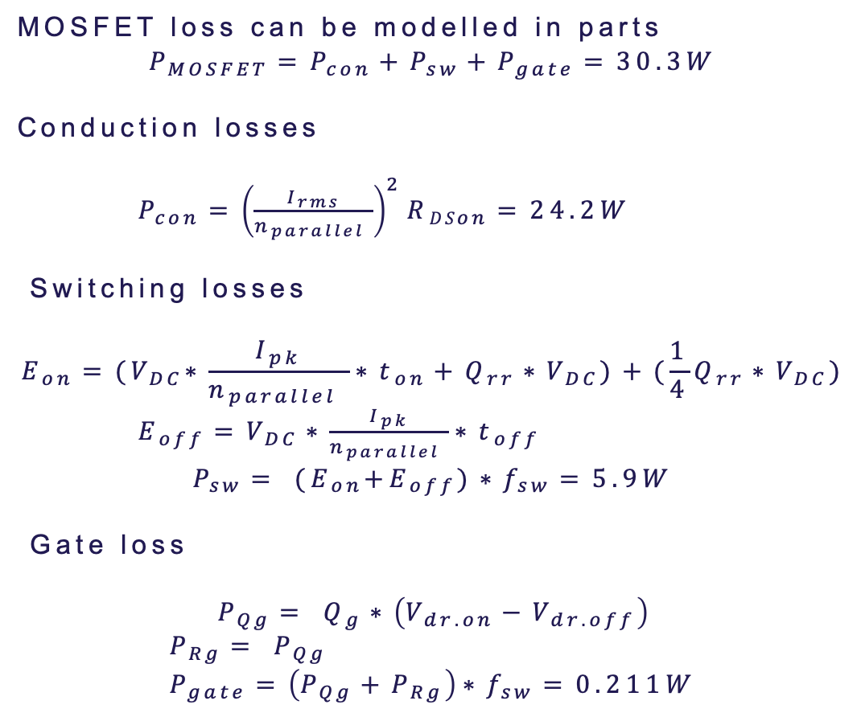
MOSFET loss calculation
Slide
of 59
MOSFET loss can be modelled in parts
$$P_{MOSFET}=P_{con}+P_{sw}+P_{gate}=30.3W$$
Conduction losses
$P_{con}={\left(\frac{I_{rms}}{n_{parallel} }\right)}^{2}{RDS}_{on}=24.2W$
Switching losses
$$E_{on}={(V}_{DC}∗\frac{I_{pk}}{n_{parallel} }∗t_{on}+Q_{rr}∗V_{DC})+(\frac{1}{4}Q_{rr}∗V_{DC})$$ $E_{off}=V_{DC}∗\frac{I_{pk}}{n_{parallel} }∗t_{off}$
$$P_{sw}= {(E}_{on}+E_{off})∗f_{sw}=5.9W$$
Gate loss
$$P_{Qg}= Q_{g}∗\left(V_{dr.on}−V_{dr.off}\right)$$
$$P_{Rg}= P_{Qg} \\ P_{gate}=\left(P_{Qg}+P_{Rg}\right)∗f_{sw}=0.211W$$
Operating Condition
 | Values | Unit
DC link voltage (V_{DC}) | 36 | V
Power Rating | 7.3 | kW
RMS current (I_{RMS}) | 263 | A
Peak current (I_{pk}) | 371 | A
Switching Frequency (f_{sw}) | 20 | kHz
MOSFET Parameter (IPT012N08N5)
 | Values | Unit
DS voltage (V_{DS}) | 80 | V
R_{DS(on),max} | 1.2 | mΩ
Drain current (I_{D}) | 300 | A
Output Capacitance (Q_{oss}) | 208 | nC
Gate Capacitance (Q_{G}) | 178 | nC
Faheem

