Slide 1
Multi-Class Sentiment Analysis on Amazon Fine Food Reviews
HY577 Project / Nikolaos Gounakis – csdp1254

Slide 2
What is sentiment analysis?
Sentiment analysis, studies the expression a piece of text can provide.
The most common pattern is to determine if a piece of text has a positive, negative or neutral meaning.
Where it can be useful?
Large companies such as Facebook and Twitter
Better analytics (reviews, feedback)
Spotting users that post unwanted content

Slide 3
Amazon Fine Food Reviews
This dataset [3] consists of reviews of fine foods from amazon. The data span a period of more than 10 years, including all ~500,000 reviews up to October 2012. Reviews include product and user information, ratings, and a plain text review. It also includes reviews from all other Amazon categories.

Slide 4
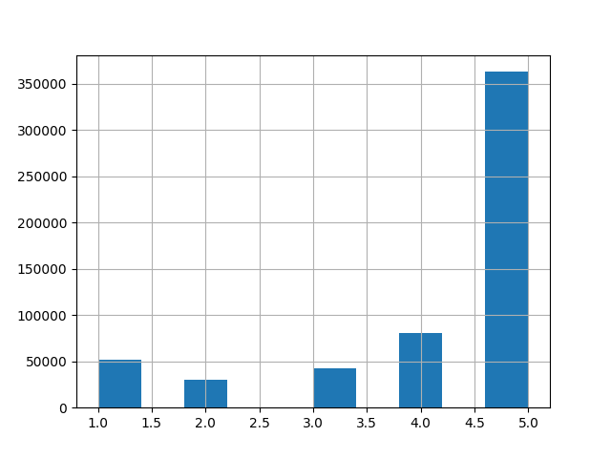
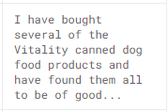
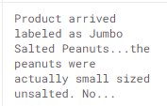
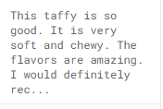
Feature selection
Score Count Distribution (1-5)
We found use of the columns: Score & Text
Score: The Score of the review ranges from 1 to 5 indicating how positive or negative it is. We use this as our label feature (Y).
Text: The actual text of the review (X)

Slide 5
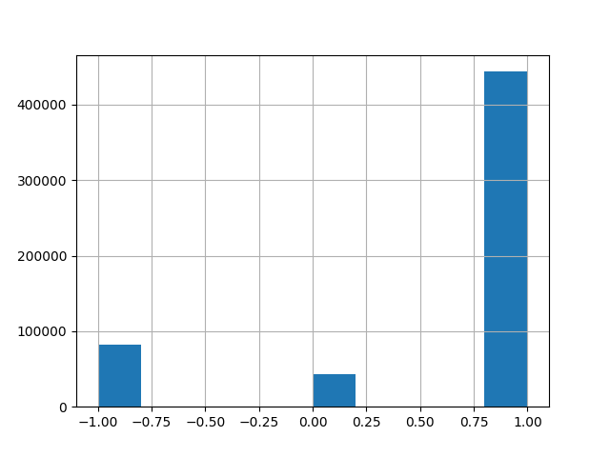
Feature selection
Score Count Distribution (1-3) after dimensionality reduction
The main idea is to use the Text of the review in order to predict its Score.
To simplify the problem for multi-class classification we consider:
Positive review with Score of 4 or 5
Neutral review with Score of 3
Negative review with Score of 1 or 2

Slide 6
Feature extraction
Challenge: how to extract features from text, or more specific how to turn a sentence into a vector?
There are several techniques out there such as Bag of Words.
We considered a study of Avinash M and Sivasankar E [2] of feature extraction for sentiment analysis, in which they compared 2 methods, TF-IDF and Doc2Vec.

Slide 7
Feature extraction
TF-IDF [6]
Is short form for term frequency-inverse document frequency.
Is a weight metric which determines the importance of word for that document.
Doc2Vec
Was put forward by Quoc Le and Tomas Mikolov [1] to improve the learning of embeddings from word to word sequences.
can be applied for word n-gram sentence, paragraph or document.
Is a set of approaches to represent documents as fixed length low dimensional vectors.

Slide 8
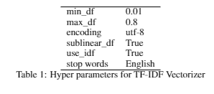
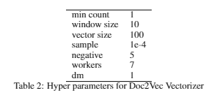
Feature extraction
We use the hyperparameters displayed in the tables for each method in order to export a dataset (X) for each method.
For the extraction we used all the samples for the neutral class and then
sampled the same size for the other 2 classes, resulting in a total of 127.920 rows
The resulting datasets shapes are:
TF-IDF: 638*127.920
Doc2Vec: 100*127.920

Slide 9
Evaluation
In order to compare the 2 methods we used 5 classifiers: (KNN n=5, SVM-rbf, Naive Bayes, Random Forests, Logistic Regression)
Used the sklearn [4] implementation of the classifiers and no hyperparameters were set.
Randomly selected 10.000 samples with equal class distribution
Performed stratified 10-fold cross validation
Measured Accuracy, F1 , AUC

Slide 10
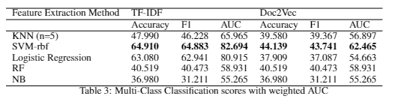
Multi-class results
TF-IDF performs 45% better than Doc2Vec in multi-class classification with the SVM-rbf

Slide 11
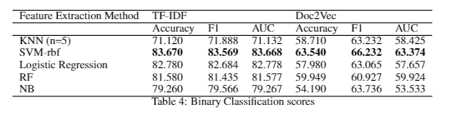
Binary classification
Again, TF-IDF performs better by 31% with SMV-rbf
Binary Classification performance was better than multi-class by 29%.

Slide 12
COncslusions
We can say that TF-IDF more preferable for extracting features for review-like text
SMV with rbf kernel is a very good choice in combination with these feature extraction methods
The neutral class resulted in confusing the classification, maybe should focus in separating the classes
Any Questions?

Slide 13
References
[1] Quoc Le and Tomas Mikolov. Distributed representations of sentences and documents. In Proceedings of the 31st International Conference on International Conference on Machine Learning - Volume 32, ICML’14, pages II–1188–II–1196. JMLR.org, 2014.
[2] Avinash Madasu and Sivasankar E. A study of feature extraction techniques for sentiment analysis, 2019.
[3] Julian John McAuley and Jure Leskovec. From amateurs to connoisseurs: Modeling the evolution of user expertise through online reviews. In Proceedings of the 22nd International Conference on World Wide Web, WWW ’13, pages 897–908, New York, NY, USA, 2013. Association for Computing Machinery.
[4] F. Pedregosa, G. Varoquaux, A. Gramfort, V. Michel, B. Thirion, O. Grisel, M. Blondel, P. Pret- tenhofer, R. Weiss, V. Dubourg, J. Vanderplas, A. Passos, D. Cournapeau, M. Brucher, M. Perrot, and E. Duchesnay. Scikit-learn: Machine learning in Python. Journal of Machine Learning Research, 12:2825–2830, 2011.
[5] Radim ˇReh ̊uˇrek and Petr Sojka. Software Framework for Topic Modelling with Large Corpora. In Proceedings of the LREC 2010 Workshop on New Challenges for NLP Frameworks, pages 45–50, Valletta, Malta, May 2010. ELRA.
[6] Claude Sammut and Geoffrey I. Webb, editors. TF–IDF, pages 986–987. Springer US, Boston, MA, 2010. 4

