Slide 1
3D Epigenomic Characterization of the Transition from Naïve to Formative Pluripotency
Nicolas Eng
PhD Candidate
Biomedical Sciences
Shen Lab

Slide 2
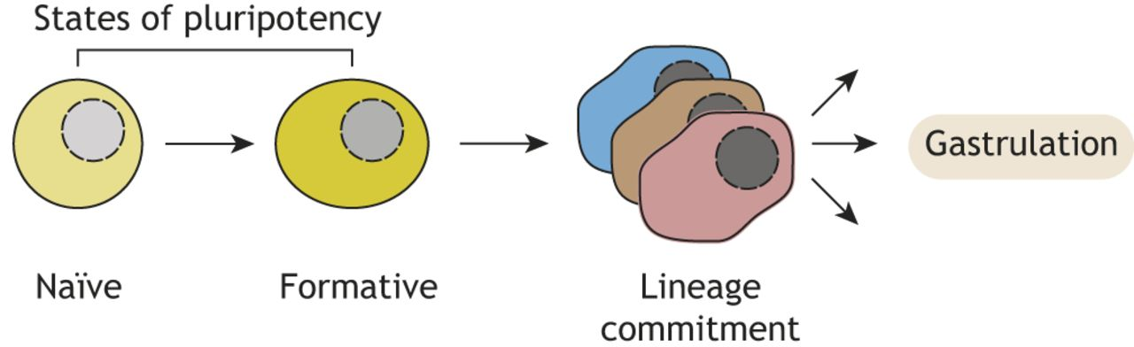
In Early Embryogenesis, There are Two
Distinct States of Pluripotency
(Gökbuget, D. et. al 2019 Development)

Slide 3
Naïve to Formative Transition in Mouse
ESCs recapitulates early Development

Slide 4
Schematic of Promoter Categorization with Histone Marks
promoter
promoter
promoter
H3K27me3
H3K4me3
“Active”
“Bivalent”
“Repressed”
Check Gene Expression?

Slide 5
Categorized Promoters Show Expected Gene Expression Signatures
Naïve
Unpaired Two-Sample Wilcox Test

Slide 6
Categorized Promoters Show Expected Gene Expression Signatures
Formative
~2 fold more
Naïve N=2171
Unpaired Two-Sample Wilcox Test

Slide 7
Bivalent Promoters are Interactive, but less than Active
Formative
1) Absolute # Of Interactions
Unpaired Two-Sample Wilcox Test

Slide 8
Bivalent Promoters are Interactive, but less than Active
Formative
Absolute # Of Interactions
Interaction Score
Unpaired Two-Sample Wilcox Test

Slide 9
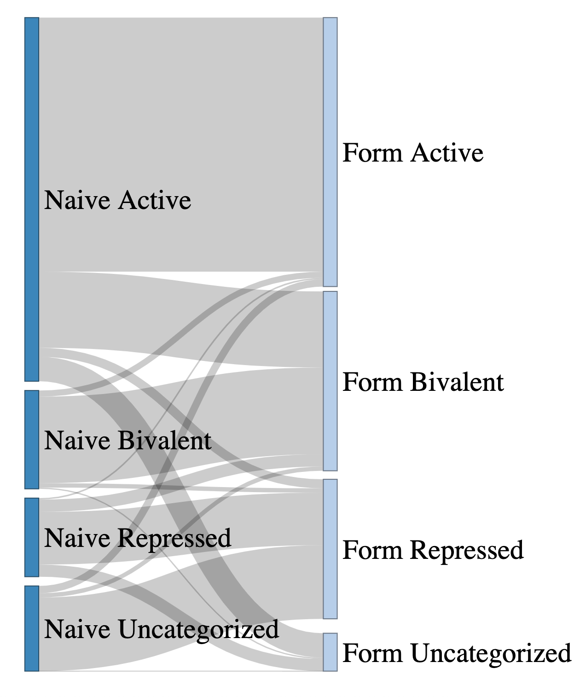
Formative Bivalent Promoters were Previously “Active” or Unchanged
N=3960
Form Bivalent Promoters
N=3960

Slide 10
“Active” to Bivalent Promoters
promoter
Naive
H3K4m3
Formative
H3K27m3
Naive
Formative

Slide 11
“Active” to Bivalent Promoter Genes Exhibit Significant Decrease in Expression
Paired Two-Sample Wilcox Test
One Sided (Top) (alt: less)
Two-Sided (Bottom)

Slide 12
“Maintained” Bivalent Promoters
promoter
Naive
H3K4m3
Formative
Naive
H3K27m3
Formative

Slide 13
“Maintained” Bivalent Promoters Exhibit Significant Increase in Gene Expression
Paired Two Sample Wilcox Test
One Sided (Top) (alt: greater)
Two-Sided (Bottom)

Slide 14
Formative Bivalent Promoters Exhibit “Local” Changes in Interactivity
Paired Two-Sample Wilcox Test

Slide 15
Formative Bivalent Promoters Exhibit “Local” Changes in Interactivity
Paired Two-Sample Wilcox Test

Slide 16
Formative Bivalent Promoters Preserve “Global” Interactivity
Unpaired Two-Sample Wilcox Test - Holms P-Adjustment

Slide 17
Formative Bivalent Promoters Preserve “Global” Interactivity
Unpaired Two-Sample Wilcox Test - Holms P-Adjustment
Cell Type Specific vs. Shared?

Slide 18
Formative Bivalent Promoters Interactions are Highly Cell-Type Specific
What about Gene level?
Cell Type Specific vs. Shared?
>60% Interactions are cell-type specific!

Slide 19
Gene Level Interaction Types
“Maintained”
promoter
Naive
Interactions
Formative
Naive
H3K4m3
Formative
Naive
H3K27m3
Formative

Slide 20
Gene Level Interaction Types
“N + F Specific”
promoter
Naive
Interactions
Formative
Naive
H3K4m3
Formative
Naive
H3K27m3
Formative

Slide 21
Gene Level Interaction Types
“N + F Specific & Maintained”
promoter
Naive
Interactions
Formative
Naive
H3K4m3
Formative
Naive
H3K27m3
Formative

Slide 22
Gene Level Interaction Types
“N Specific + Maintained”
promoter
Naive
Interactions
Formative
Naive
H3K4m3
Formative
Naive
H3K27m3
Formative

Slide 23
Formative Bivalent Promoters exhibit Substantial Interaction Rewiring
> 60% of Genes Exhibit Rewiring!

Slide 24
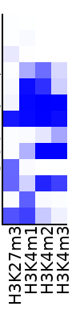
ChromHMM Modeling To Annotate Sequence Elements
Formative States
Repressed Gene Body
Repressed Gene Body
Active Gene Body
Active Enhancer 1
Active Enhancer 2
Bivalent TSS
Active Promoter
Poised Enhancer 1
Bivalent TSS/Flanking
Primed Enhancer
Poised Enhancer 2

Slide 25
Formative SIPs are Genes Important for Development
Formative

Slide 26
ERVL-MaLR TE Family Broadly Enriched in Formative SIPs

Slide 27
ERVL-MaLR sites are Enriched in individual SIPGs
Formative

Slide 28
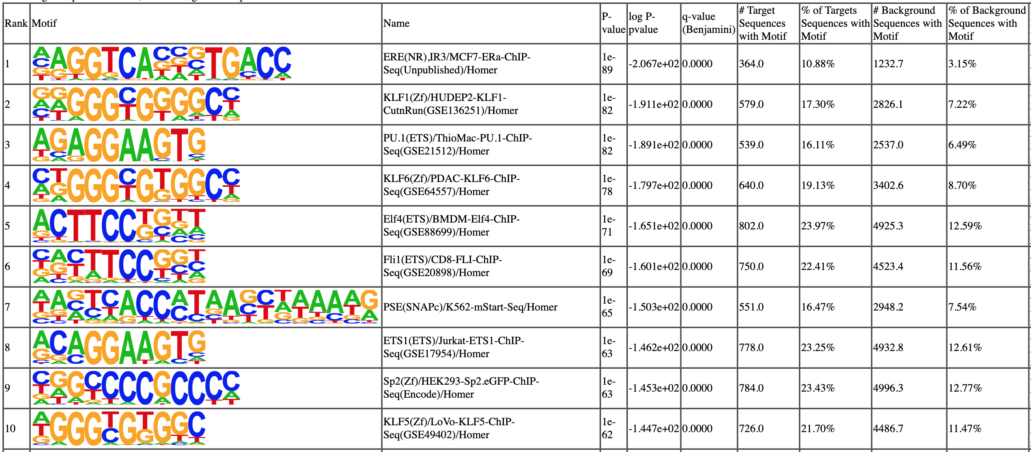
ERVL-MaLR Enriched SIPGs are Enriched for Well-Studied and Novel TFs

