Slide 1
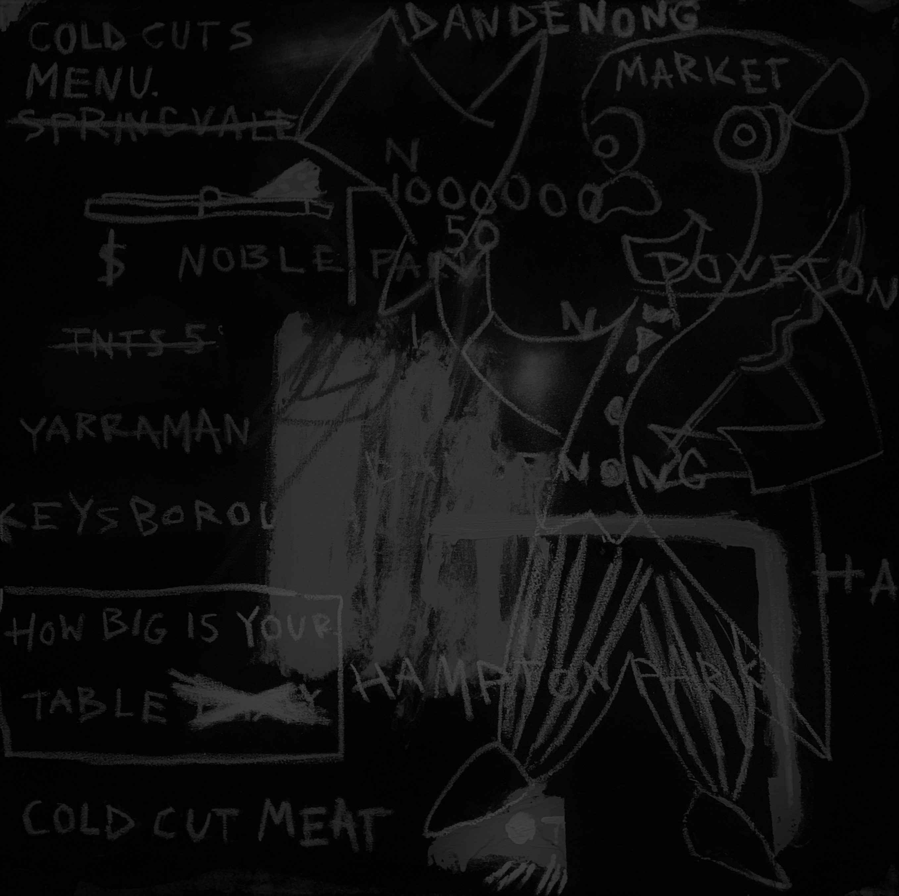

DELIVERING A COMPLEX CLOUD NATIVE APPLICATION
By NICOLAS A TOMAS(221351413)

Slide 2
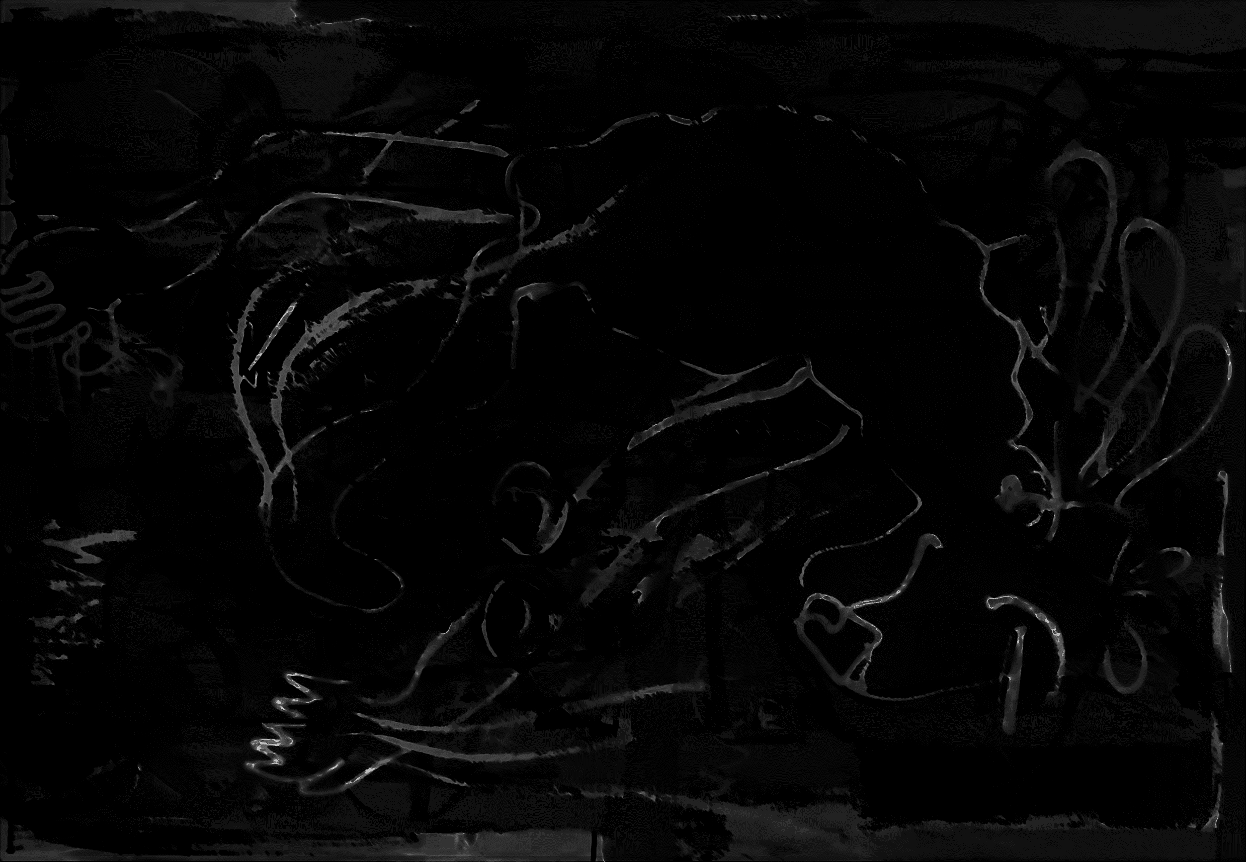
PROJECT
Artist (DIADOS)
Represented in the fashion scene involving street art.
Intends to utilize media platforms such as Instagram to attract audience.
Requesting a mailing list form that obtains user emails.
CONSIDERATIONS
MongoDB
Mongo will be used to store the user’s data such as their email in a secure database.
Google Cloud Platform (GCP)
GCP will be suitable for this project as it relies on API engines such as Kubernetes, Cloud Monitoring, etc.

Slide 3
DEMONSTRATION
Commands
gcloud auth login (Visual Studio Code)
docker tag 221351413/nodejs-app gcr.io/diados/nodejs-app:latest (Visual Studio Code)
docker push gcr.io/diados/nodejs-app:latest(Visual Studio Code)
gcloud container clusters get-credentials cluster-1 --zone australia-southeast1-b --project diados (GCP)
kubectl apply -f createConfigMap.yaml (GCP)
kubectl apply -f createHeadlessService.yaml (GCP)
kubectl apply -f createMongoDbSecret.yaml (GCP)
kubectl apply -f createPersistentVolumeClaim.yaml (GCP)
kubectl apply -f createStatefulSet.yaml (GCP)
kubectl apply -f createStorageClass.yaml (GCP)
kubectl get pvc (GCP)
kubectl get pods (GCP)
kubectl create deployment nodejs-app --image=gcr.io/diados/nodejs-app:latest (GCP)
kubectl expose deployment nodejs-app --type=LoadBalancer --port 80 --target-port 8081(GCP)
kubectl get deployments (GCP)
kubectl get services (GCP)

Slide 4
DEMONSTRATION
Commands
kubectl exec -it mongo-0 -- mongo (GCP)
rs.initiate({
_id: "rs0",
members: [
{ _id: 0, host: "mongo-0.mongo.default.svc.cluster.local:27017" },
{ _id: 1, host: "mongo-1.mongo.default.svc.cluster.local:27017" },
{ _id: 2, host: "mongo-2.mongo.default.svc.cluster.local:27017" }
]
}) (GCP)
use admin (GCP)
db.subscribers.find() (GCP)

