Slide 1
Using movie plots for unsupervised Movies/TV Series summarization
Nicolas BOINAY
https://github.com/NicolasBOINAY/ScriptSummarization

Slide 2
Table of contents
Introduction
Related work
Data description
Method used
Experiment and Results
Conclusion

Slide 3
Introduction

Slide 4
Project origins
Solve a challenging NLP problem : text summarization
Focus on less narrative texts : movie scripts
Align scenes from movie script with sentences from the plot summaries
Work on dialogue summarization to optimize alignment

Slide 5
Related work

Slide 6
AligNarr: Aligning Narratives on Movies
Paramita Mirza, Mostafa Abouhamra and Gerhard Weikum (2021)
Objective :
Automatically align scenes from movie scripts with sentences from plot summaries
Challenges :
Movie scripts are much longer than plot summaries
Language register in a script is different than in a summary
Scripts go much more into details whereas summaries focus on salient points

Slide 7
AligNarr: Aligning Narratives on Movies
Paramita Mirza, Mostafa Abouhamra and Gerhard Weikum (2021)
Dataset
Preprocessing
Scripts
Plot
Summaries
Computing the similarities
Similarity matrix
Integer Linear Programming (ILP)
Alignement mapping

Slide 8
AligNarr: Aligning Narratives on Movies
Paramita Mirza, Mostafa Abouhamra and Gerhard Weikum (2021)
Preprocessing :
Given a movie script S and a plot summary U, divide them into units, respectively scenes s_{j} and sentences u_{i}
Link the story entities
Similarity Matrix :
Document Relevance Score :
using BM25
Word Overlap Score:
using the cosine similarity of word2vec embeddings
Sentence Similarity Score :
using the cosine similarity RoBERTa
Alignement Mapping :
Using an Integer Linear Programming (ILP) model
Find the alignment that maximizes the sum of the similarities

Slide 9
Multi-View Sequence-to-Sequence Models with Conversational Structure for Abstractive Dialogue Summarization
Jiaao Chen, Diyi Yang (2020)
Objective : Summarize a conversation by combining the multiple and diverse views of it.
Challenge : Conversations are often informal, verbiose, repetitive.
Method :
Interpret conversations from each different views
Encode them and use a Seq2Seq model to decode them and generate a summary

Slide 10
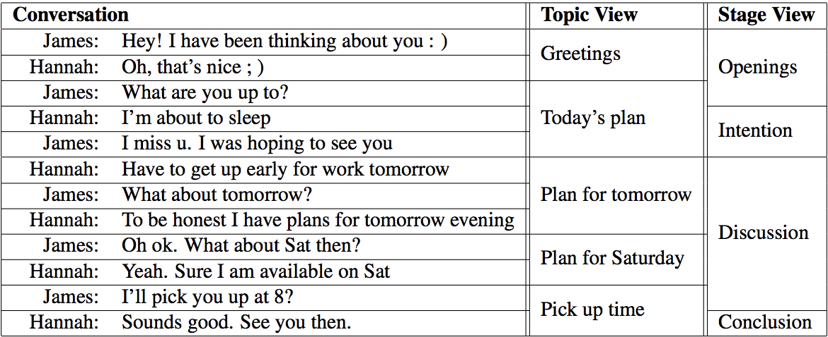
Multi-View Sequence-to-Sequence Models with Conversational Structure for Abstractive Dialogue Summarization
Jiaao Chen, Diyi Yang (2020)
Conversation views :
Topic, Stage, Global and Discrete
Extraction of different views using transformers (C99 and Sentence-Bert)

Slide 11
Multi-View Sequence-to-Sequence Models with Conversational Structure for Abstractive Dialogue Summarization
Jiaao Chen, Diyi Yang (2020)
MultiView Seq2Seq model :
Extend a sequence to sequence model to combine different conversation views
The base encoders and decoders are implemented with a transformer based pre-trained model: BART
Conversation encoder : Take conversation under each specific view and for each view encode the utterances into tokens
Multi-View decoder : Combine all different views in order to decode

Slide 12
Data description

Slide 13
Data description
Scriptbase corpus :
Philip John Gorinski and Mirella Lapata (2015). Movie Script Summarization as Graph-based Scene Extraction. In Proceedings of NAACL-HLT 2015, Denver, Colorado, USA.
Contains data for 1,276 movies including script, keywords, summary or synopsis
We use the screenplays provided, the summaries and the wiki plots.
Turning Point dataset :
Contains the screenplays and plot synopsis with turning point (TP) annotations for 99 movies
Also provides a python script for segmenting movie script into scenes

Slide 14
Method

Slide 15
Transformers
Bert :
Bidirectional Encoder Representations from Transformers
Transformer language model
Pretrained for two tasks : language modelling and next sentence prediction
Sentence-Bert :
Modification of BERT to use it for new tasks
Allows to use BERT with common similarity measures like cosine-similarity
Fine-tunes BERT in a siamese / triplet network architecture
Used to segment and encode conversations

Slide 16
Transformers
C99 :
Used to segment conversations
Takes a list of tokenized sentences as input then it measures the similarity between sentences using the cosine measure
Does a ranking of the sentences inside their local region (this is the number of neighboring elements with a lower similarity value)
Clusters to determine the location of the topic boundaries and allows to segment the conversation.
BART :
Transformer that allows us to decode and then summarize conversations
Combines a bidirectional encoder and an auto-regressive decoder
Corrupts input text and learns to reconstruct the original.

Slide 17
Conversation View extraction
Topic View :
Conversations always organized around topics
Telephone chat example “greetings → invitation → party details → rejection”
Idea is to segment conversation into topics for model to interpret it more precisely
C99 : to segment conversations based on inter-sentence similarities
Sentence-BERT : to encode the conversation
Each utterance u_{i} in a conversation C = {u₁, u₂, ..., u_{m}} is first encoded into hidden vectors via Sentence-BERT.
Then conversation C is divided into blocks C_{topic} = {b₁, ..., b_{n}} through C99

Slide 18
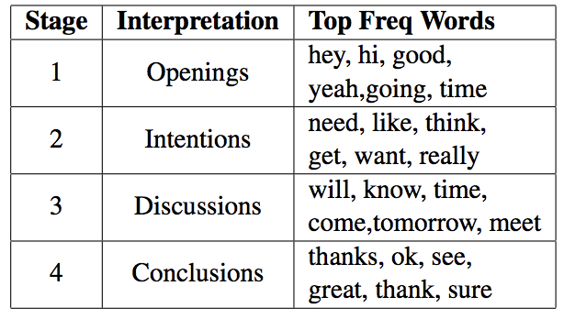
Conversation View extraction
Stage View :
conversations are found to follow another common pattern “introductions → problem exploration → problem solving → wrap up”
Use of a Hidden Markov Model (HMM)
The observations in HMM are the encoded representation h_{i} from Sentence-BERT
Number of hidden stages = 4
Same as for topic view, conversation segmented into blocks containing several utterances.
We interpret the inferred stages qualitatively and further visualize the top 6 frequent words appearing in each stage

Slide 19
MultiView Sequence-to-Sequence model
Conversation Encoder :
Given a conversation under a specific view k with n blocks:
C_{k} = {b₁^{k} , ...,b_{n}^{k} }
b_{j}^{k} = {x_{0,j}^{k} , x_{1,j}^{k} , ..., x_{m,j}^{k}}
each token x_{i,j}^{k} is first encoded through BART encoder
Add special tokens x_{0,j}^{k} at the beginning of each block to describe them.
To depict different views using hidden vectors, we aggregate the information from all blocks in one conversation through LSTM layers.

Slide 20
MultiView Sequence-to-Sequence model
MultiView decoder:
Key is to strategically combine different views
Inputs in the decoder are the previously generated tokens
Multi view attention layer is introduced in each transformer block and this layer decides the importance of each view
Then the multi-head attention is performed over conversation tokens h_{i,j}^{k} from different views k and form A_{k} separately. The attended results are further combined and this is how summaries are generated.

Slide 21
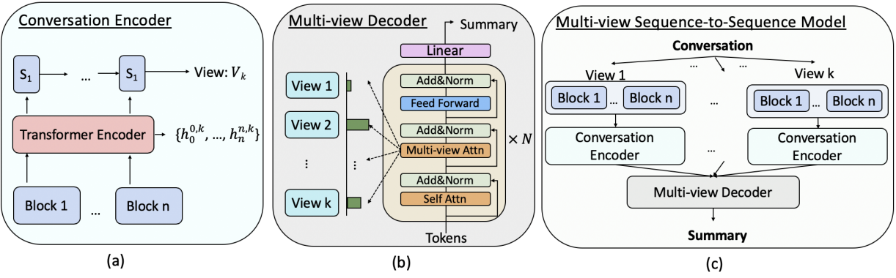
Conversation Encoder, Multi-view decoder and Multi-view Sequence-to-Sequence architectures
multi-view decoder to generate summaries (b).

Slide 22
Experiment and Results

Slide 23
Experiment
Segment the screenplay in scenes and retrieve only spoken parts :
From raw screenplay
To segmented in scene screenplay
To a list of lists containing the dialogues from each scene
Embed my dialogues with sentence-transformer
Segment into different views
Decode conversation using BART

Slide 24
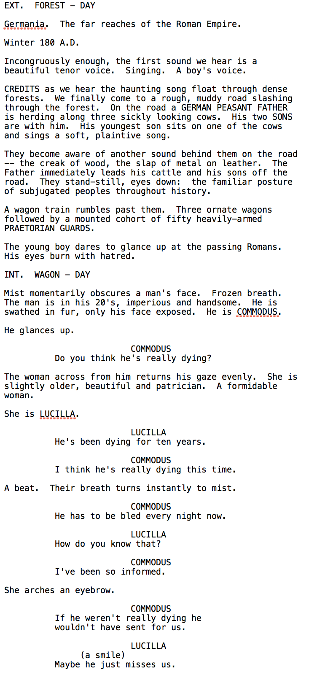
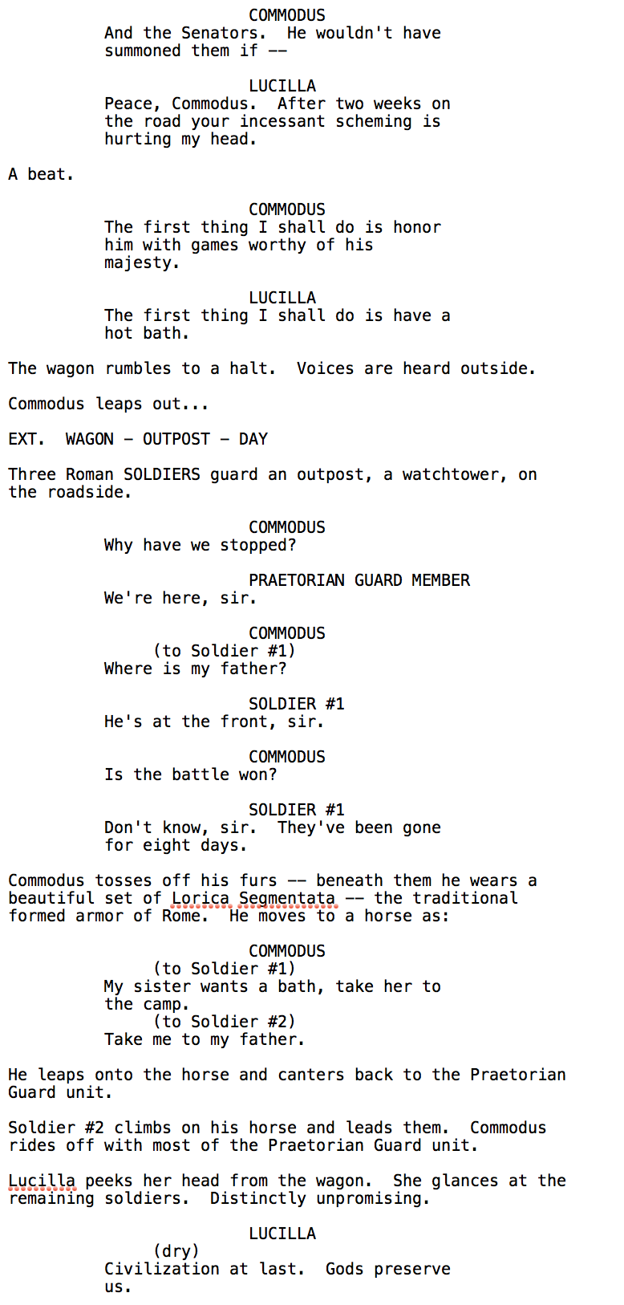
Raw screenplay

Slide 25
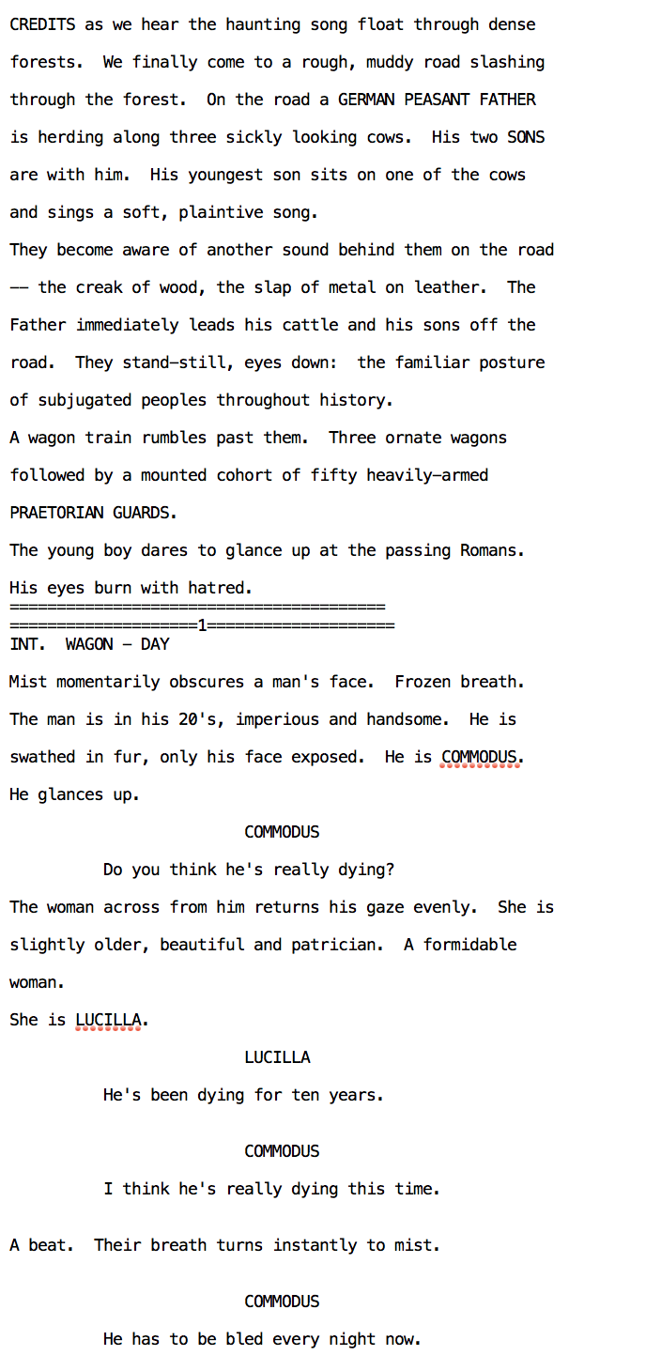
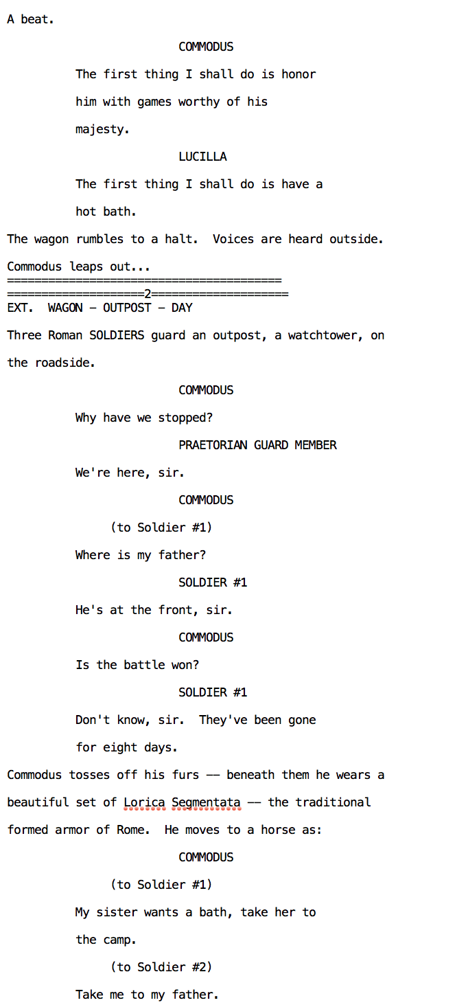
Scene segmented screenplay

Slide 26
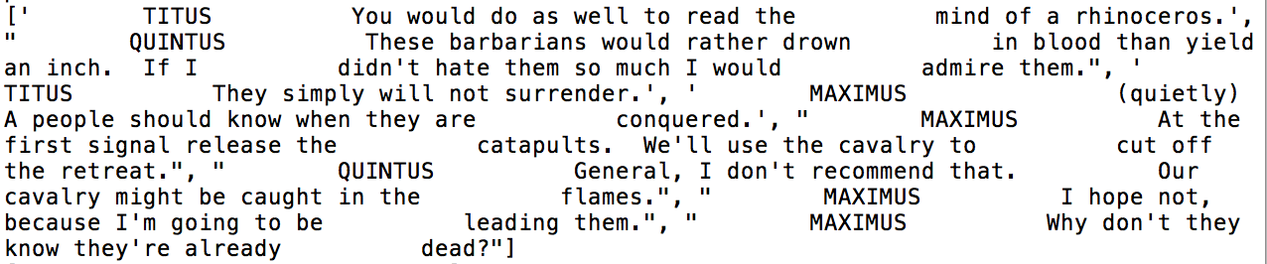
Only dialogues
One element of my list containing the dialogue of one scene

Slide 27
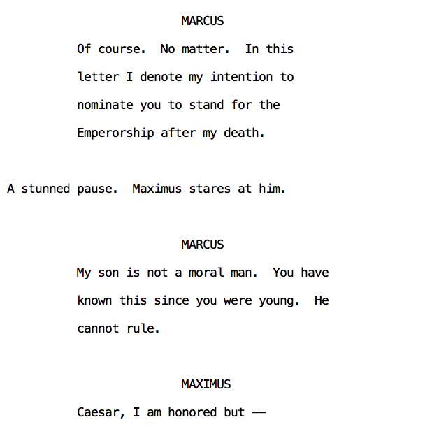
Results
Issue for understanding who is the speaker and who is the listener
Contains all informations from plot summary

Slide 28
Conclusion

Slide 29
Conclusion
Work done :
Turn raw screenplays into processed text for Dialogue to Summary model
Test on 3 movies and obtain summaries scene by scene
Future work :
Extract interesting scenes with Alignarr method and compare with the results obtained with dialogues
Run the experiment for the entire set of movies used by Alignarr to evaluate the alignment

Slide 30
Thank you for listening
Nicolas BOINAY
https://github.com/NicolasBOINAY/ScriptSummarization

