Slide 1

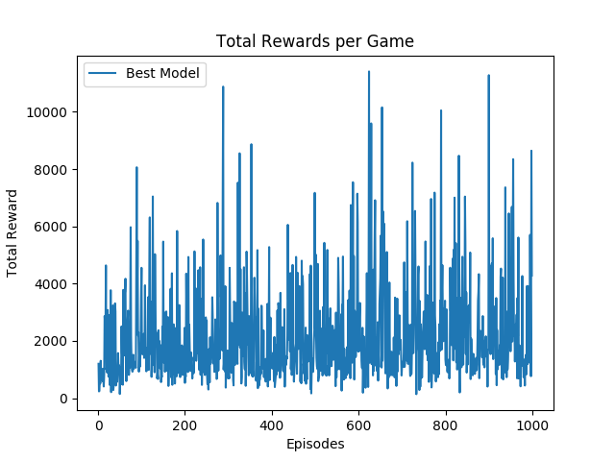
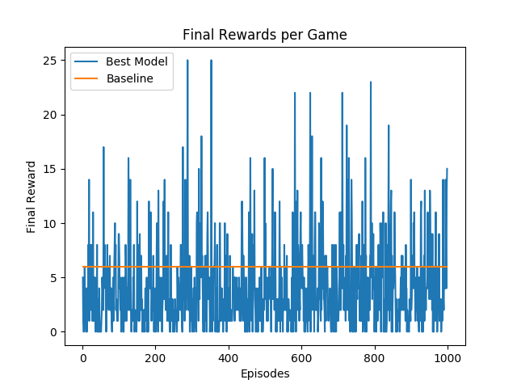
Network Intrusion Detection
Amir Ziai (amirziai@stanford.edu)
Motivation
Approach
Results and Analysis
Network operators are generally aware of common attack vectors that they defend against. For most networks the vast majority of traffic is legitimate. However new attack vectors are continually designed and attempted by bad actors which bypass detection and go unnoticed due to low volume. One strategy for finding such activity is to look for anomalous behavior.
Ensemble of unsupervised, active learning, and semi-supervised learning. Analyst-in-the-loop ML.
[insert figure]
Evaluation metric gain per
Baseline: completely unsupervised or majority classification
Oracle: fully-supervised ML, very expensive
Featurization pipeline / infra process automated, one-hot encode, hashing trick, imputation strategy,
[insert figure]
Hyper-parameter tuning
Sample efficiency
Train and prediction time
Complexity
Storage
Extreme imbalance
 | Baseline | Value Iteration | Q-learning | Q-learning (Function Approx.) | Q-learning (Feature Extraction)
Result | 194/200 | 199/200 | 187/200 | 187/200 | 175/200
We were able to show why Value Iteration would not do well for the given environment due to randomness in the number of frames per steps (unknown probabilities which this method relies on).
We implemented Q learning (function approximation) which gave an improvement in our performance as compared to our baseline. With the feature extraction we see a significant jump in our performance as compared to previous models.
Problem
Challenge labeled data points are expensive, extremely rare events, class imbalance.
Objective reach a required level of generalization performance while minimizing the number of queries to the analyst.
Pipeline / input-output / infra
Future Work
References
Datasets
Features
Output is label assignment
Intrusion prevalence 0.1%-10%
M. A. Farhan Khan, Oguz H. Elibol. Car Racing using Reinforcement Learning
Volodymyr Mnih, Koray Kavukcuoglu, David Silver, Alex Graves, Ioannis Antonoglou, Daan Wierstra, Martin Riedmiller. Playing Atari with Deep Reinforcement Learning
David Hershey, Rush Moody, Blake Wulfe. Learning to Play Atari Games.
Log level RNN,

