Slide 1


DIGISCRIPT
TOUCH TO SEE
ARPIN Thomas
CORNIER Thomas
DEMEULEMEESTER Steve
DZIURDA Nicolas
JOBIN Guillaume
M1 - ISCE

Slide 2

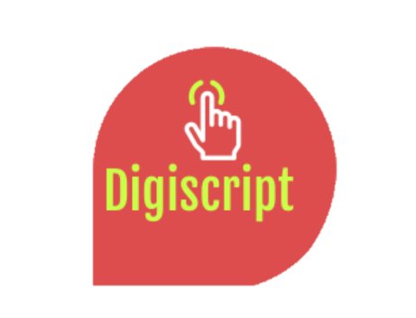
Resume
The context and the product
Montage
Arduino and algorithmics
AWS Cloud (Rekognition)
JAVA/Data cleaning
Conclusion

Slide 3
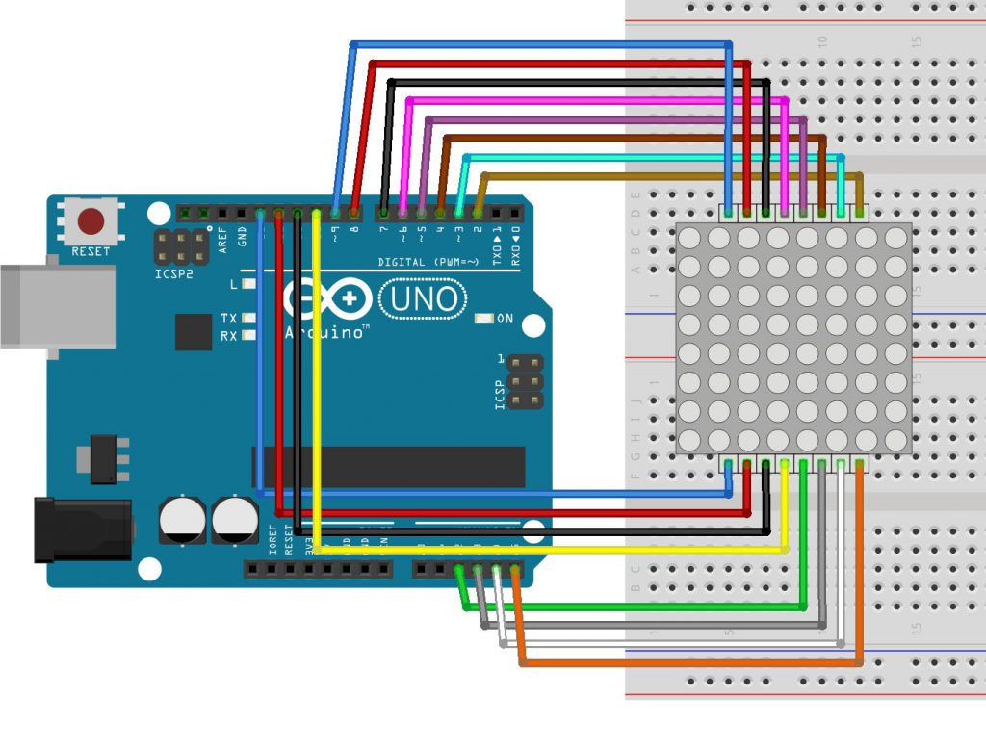
Montage
One 400 Hole Breadboard .
One mini breadboarD
16 wires
Arduino UNO

Slide 4
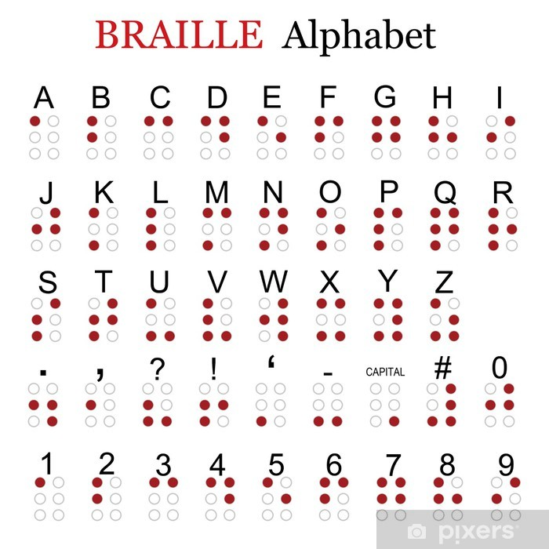
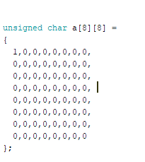
ENcoding letters into the arduino
First method of encoding

Slide 5

Encoding letters into the arduino
Second method

Slide 6
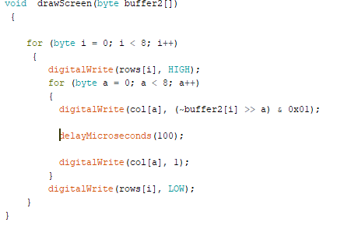
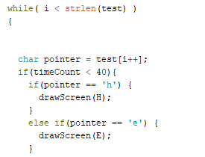
Various functions on arduino
Function DrawScreen :
Function Verification of words

Slide 7
Potentials problems
Memory of the arduino, we cant translate long sentences or articles (even with our second type of encoding)
No return aptic on the arduino
Our actual montage is not really convenient for moving (maybe we should have put it in a nice package)

Slide 8




AWS CLOUD

Slide 9
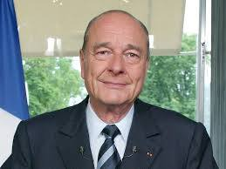
Celebrity detection and object detection

Slide 10
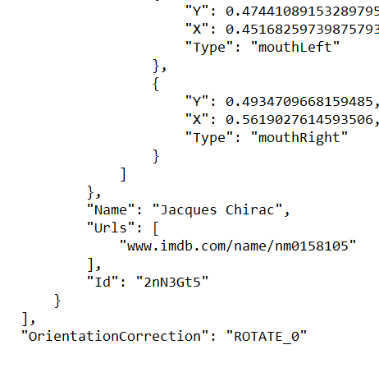


DATA Cleaning

Slide 11
DEMONSTRATION

Slide 12
Have you some questions ?

