Slide 1
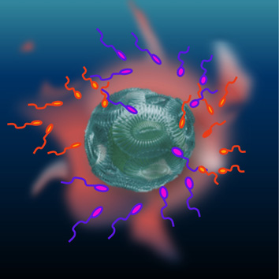
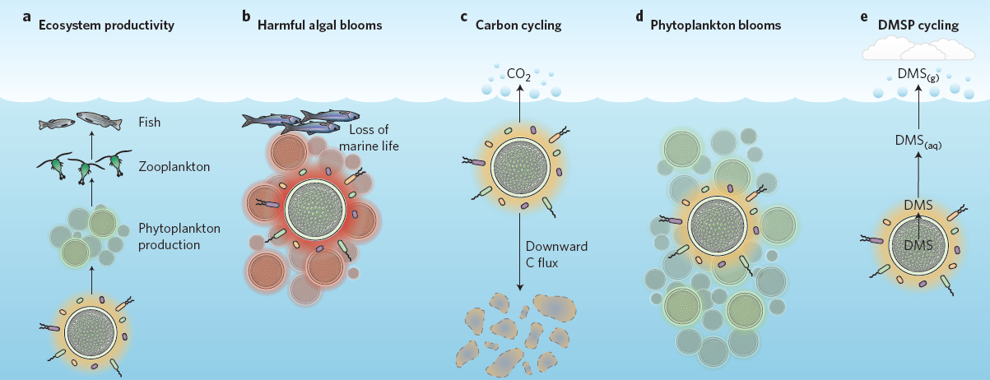
The Phycosphere : an ecological interface for phytoplankton – bacteria relationships.
What interactions ?
How does it happen ?
Competition / antagonism : competition for inorganic nutrients or algicidal activities of bacteria
Mutualism : bacterial vitamins synthesis, nitrogen fixing cyanobacteria, release of vibrioferrin, …
Random encounters : very low encounter rates
Chemotaxis : highly increase encounter rates but majority of marine bacteria do not exhibit chemotaxis.
Vertical transmission : for fixed bacteria, allows the prolonged preservation of close spatial associations.
Metabolites and infochemicals
What consequences ?
Interactions between these two groups :
strongly influence carbon and nutrient cycling,
regulate the productivity and stability of aquatic food webs,
affect ocean–atmosphere fluxes of climatically relevant chemicals
GLOBAL SCALE CONSEQUENCES
Seymour et. al, 2017

Slide 2
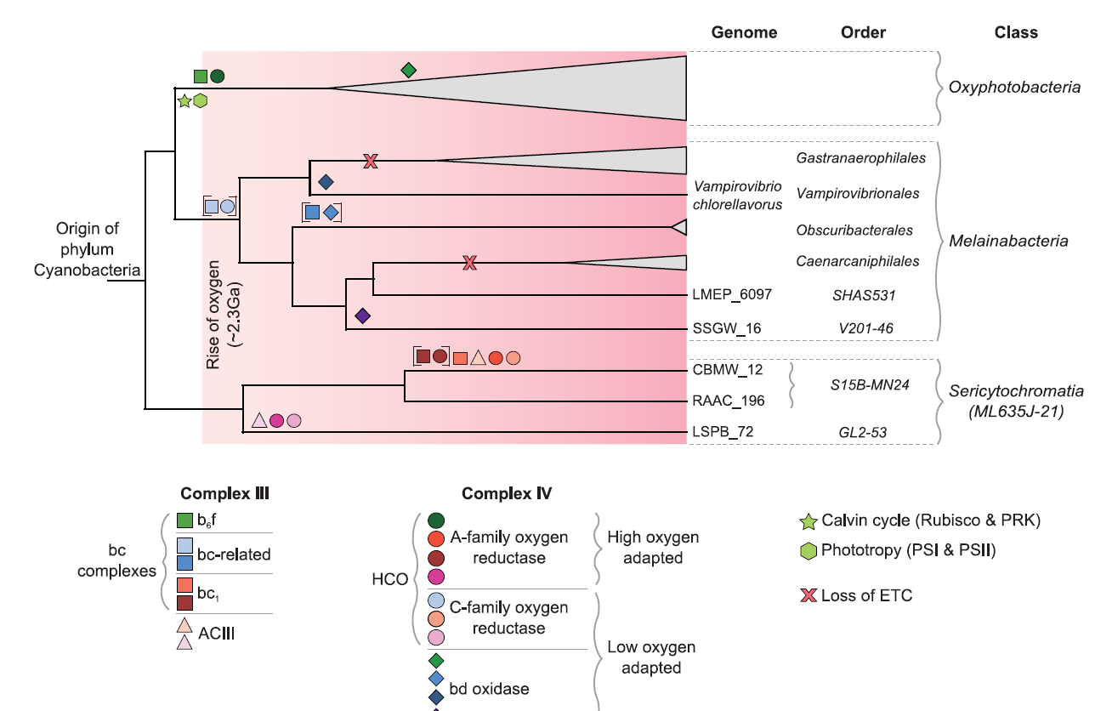
Origins of oxygenic photosynthesis and aerobic respiration in Cyanobacteria.
Only Oxyphotobacteria are phototrophic.
The 3 classes can perform aerobic respiration.
If photosynthesis / aerobic respiration were present in the ancestor, genes for Complex III would be homogenous between the 3 classes.
However, it is observed that sets of proteins are neither closely related between the classes nor phylogenetically congruent with cyanobacterial evolution.
-> it seems right to assume that the last common ancestor did not use oxygen and that the 3 classes acquired aerobic respiration independently.
Oxygenic photosynthesis apparition is close in time to the rise of O2 which might be directly caused by the evolution of oxygenic photosynthesis.
Soo et. al, 2017

Slide 3
Universal Primers amplify a 23S rDNA plastid marker in eukaryotic algae and cyanobacteria.
Development of universal primers to study variations of a 23S rDNA marker.
This ~410 nt region distinguishes most species included in the analysis. This suggests potential for their use in assays of environmental samples to detect different algal lineages.
The universality of this primer has a disadvantage :
- > It is sensitive to contaminant algal sequences that might get recovered with the primer pair. Even more when multispecies collections are used. -> this can be solved by developing an adequate protocol.
Sherwoood et. al, 2007

Slide 4
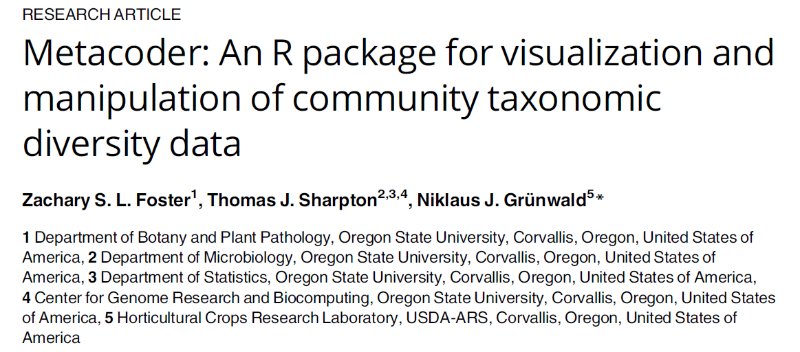
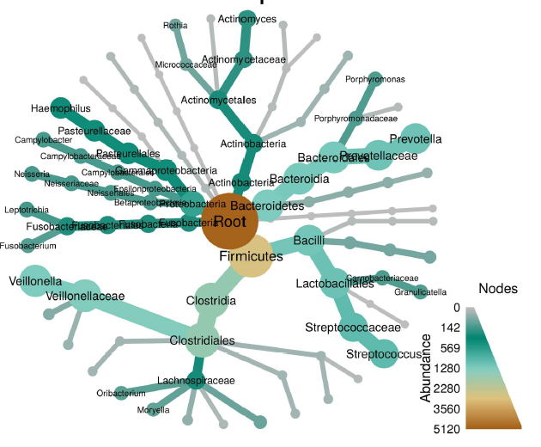
Takes into account the hierarchical component of taxonomic data.
Can perform digital PCR = quick and inexpensive way of estimating biases caused by primers
Visualisation of both genomic and observational data with heat trees.
-> how specific subsets of samples vary in their taxonomic composition.
Allows manipulation of data (filtering, subsetting, …) through intuitive functions inspired from the dplyr package.
Not exclusive to genetic data : can be used with any type of data that can be organized hierarchically
(e.g. : 2016 Democratic Primary election)

Slide 5
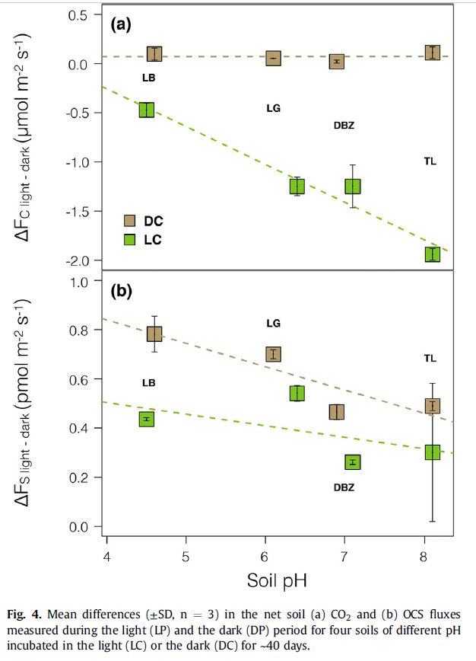
Interactions of soil phototrophs and fungi and their impact on CO2, CO18O and COS gas exchange.
The enzyme carbonic anhydrase (CA) is an enzyme that allows homeostatic regulation of intra-cellular pH.
It catalyses both the reversible hydration of CO2 and the irreversible hydrolysis of OCS.
Different families of CA (alpha, beta, gamma) = different affinities to CO2 and COS + different expression rates.
Soil phototrophs like high pH soil, (but RUBISCO can be inhibited at high PHs??) OCS uptakes were attributed to fungi whose abundance was positively correlated with alkaline soils but only in the presence of increased phototrophs.
-> findings demonstrate that soil-atmosphere CO2, OCS and CO18O fluxes are strongly regulated by the microbial community structure in response to changes in soil pH and light availability and supports the idea that different members of the microbial community express different classes of CA, with different affinities to CO2 and OCS.
Beta class CA is dominant in bacteria and fungi.
Algae and cyanobacteria both express alpha CA on their membrane and intra-cytoplasmic beta CA.
Soil pH is an important factor = variations in CA activities could be linked to variations in microorganism abundance as well as CA activity.
Sauze et.al, 2017

Slide 6
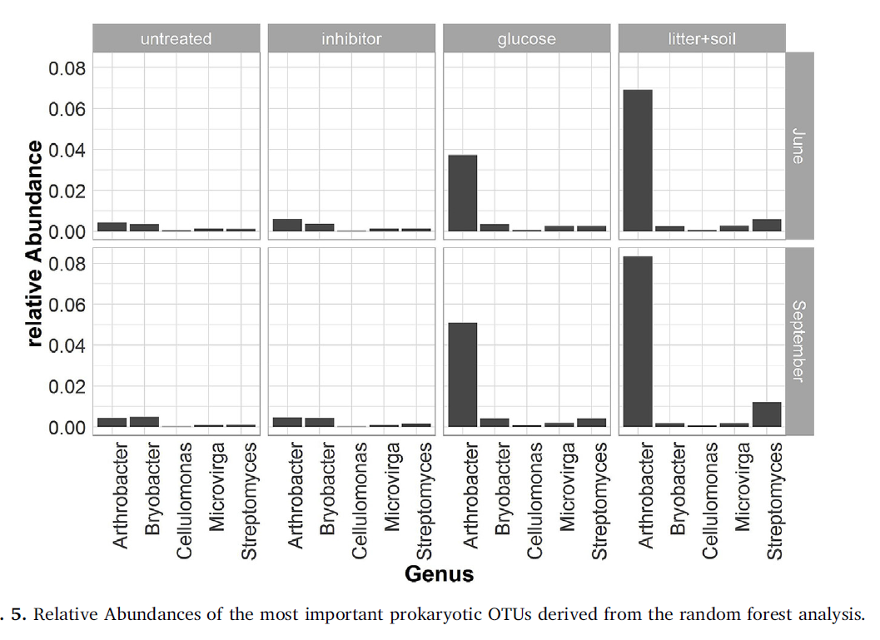
COS fluxes and community structure
-> Goal = to relate abundance of microbial taxa in differently treated soil samples to the measured COS fluxes.
Untreated soils are on average source of CO2 and sink for COS.
Inhibiting CAs increase CO2 emissions and reduce COS uptake.
Glucose addition increase both gases emissions.
Gamma irradiation (=sterilization with minimal soil disturbance) reduces CO2 emissions and increases COS emissions.
Co-occurring abiotic production and biotic consumption of COS in soil.
Biotic consumption = CAs activity
Decisive role of the quality and quantity of the substrate.
Arthrobacter spp. could be involved in COS production since the genus is known to mobilize sulfur and produce volatile sulfur compounds (COS precursors) = COS production.
Pseudomonas is also mentioned in the literature.
Streptomyces ambofaciens can degrade COS under ambient COS concentrations. = COS consumption.
FUNGI : Mortierellaceae might be potential COS emitters.
Kitz et.al, 2019

Slide 7
Microbial community responses determine how soil-atmosphere exchange of COS, CO and NO responds to soil moisture
Thiocyanate and thiosulfate are important precursors for COS.
[thiocyanate] up in soil = OCS production up according to Lehmann and Conrad 1996.
Katayama study demonstrated that it can also inhibit COS production.
S-containing amino acids might be important percursors too.
COS production rates were higher for soils at water-filled pore space >60 %.
Negatively related to thiosulfate concentrations.
When WFPS goes down (15-37%), soils switch from net source to net sink BUT not linearly dependant.
High nitrate concentrations correlates with maximum COS release rates at high soil moisture.
COS consumption is linked to microbial pathways that utilize either CO2 or bicarbonate HCO3- by various microbial carboxylases.
CO2 HCO3-
reversible hydration
COS H2S + CO2
irreversible hydrolysis
RUBISCO is also a candidate for COS consumption since COS acts as a competitive inhibitor for CO2 uptake by rubisco.
CA is also known to act like an “upstream amplifier” for RUBISCO and PEPCO.
Thus, their role for COS consumption might have been underestimated.
In desertic soils, COS consumption is at its lowest since low amounts of organic matter might limit the abundance and activity of heterotrophs such as Actinobacteria.
Pathways catalyzed by CA
Wetlands are known for being sources of COS.
Oxic soils are considered to be a sink for COS.
BUT current studies report that soils can switch between net COS uptake and emission related to soil moisture and/or soil T°C.
Both inorganic and organic S availability control COS production rates in general but rates of COS consumption is controlled by different parameters.
Behrendt et.al, 2019

Slide 8
Exchange of reduced sulfur gases between lichens and the atmosphere
14 lichens, 10 green algal lichens and four cyanolichens emitted significant quantities of H2S and DMS but were sinks for COS.
It appears that, in contrast with DMS and H2S emissions, COS uptake is strongly influenced by degree of thallus hydration.
Both photosynthesis and COS uptake are strongly influenced by the hydration status of the lichens.
Lichens might play a significant role in the COS cycle for some ecosystems, such as coastal deserts and polar systems.
Indeed, they lack of stomates and cuticles that prevents a biological control of uptake and emissions of gases.
In constrast to higher plants, all lichens species showed a nearly permanent uptake of COS in the dark as well as in the light, depending only on moisture content.
This may be explained by the fact that gas assimilation is not under stomatal control in lichens.
This shows a pattern strongly dependant on RUBISCO activity for CO2 uptake, and provides evidence that the process is under metabolic control within the lichen.
In contrast, the lack of dependency of H2S or DMS emission on thallus water content implies either a lack of physiological control or processes centered within the surficial fungal tissue.
CA enzyme system might be also responsible for the consumption of COS by a lichen through fungal or algal carbonic anhydrase.
THEN, an enhancement under light conditions should only be observed if the lichen species is more dominated by the algal partner, leading to a more intensive consumption of CO2 by the photosynthetic pathways.
Gries et.al, 1994

Slide 9
Soil exchange rates of COS and CO18O differ with the diversity of microbial communities and their CA enzymes.
CO18O is the oxygen-18 isotopologue of CO2.
CA activity in leaves is responsible for the largest biosphere-atmosphere trace gas fluxes of COS and CO18O that both reflect gross photosynthetic rates (ecosystem GPP).
During CO2 hydration, oxygen isotopes are exchanged between CO2 and water molecules in leaves and soils, thereby influencing CO18O concentrations in the atmosphere.
It means that CO18O can be used to trace land photosynthesis and soil respiration at large scales.
Also, as COS uptake by the terrestrial biosphere is dominated by photosynthesis during growing season, fluctuations of atmospheric COS concentrations can serve as a tracer of land photosynthesis.
However, CA activity also occurs in soils and will be a source of uncertainty in the use of these gases as carbon cycle tracers.
Indeed, soil exchange of COS and CO18O and soil CA activity are spatially and temporally variable, which introduce uncertainty to estimate primary productivity.
In this experiment, they measured COS and CO18O exchange rates and estimated the corresponding CA activity in different soils.
It appears that soil CA activity was not uniform for COS and CO2, and patterns of divergence were related to microbial community composition and CA gene expression patterns.
CA activity for COS was related to fungal activity and B-D-CA expression, whereas CA activity for CO2 was related to algal and bacteria taxa and a-CA expression. This is consistent with observed reductions in COS consumption in soils exposed to fungicides.
CAs are diverse : they include 6 known classes (α, β, γ, δ, ζ, η) and organisms often contain CA genes for more than one class or multiple genes encoding CA from the same class.
They’re found in autotrophic and heterotrophic microorganisms, and participate in C fixation, pH regulation and sulfur metabolism.
COS consumption appears to be higher in forests and lower in mediterranean ecosystems and deserts. Agricultural soils also have high COS production and low consumption compared to other ecosystems.
Microbial diversity varied most strongly with soil C/N, while it increased with soil pH in other studies.
Dominant predictors of CA activity were structural (bulk-density and texture) and chemical (C, N, P, …) soil properties (more infos in the article).
Meredith et.al, 2018

Slide 10
Soil exchange rates of COS and CO18O differ with the diversity of microbial communities and their CA enzymes PART 2
COS catalyzed reaction rate was positively correlated with 19 OTUs from the fungal lineages :
Ascomycota
Basidiomycota
Zygomycota
But only 2 OTUs from bacterial lineages Proteobacteria.
Also, kcos/kco2 was positively correlated with 41 fungal OTUs but only with 3 bacterial OTUs.
In contrast, it was negatively correlated with 18 bacterial OTUs, 2 green algae OTUs and only 4 fungal OTUs.
This supports a role for fungi in OCS consumption and for algae and bacteria in CO2 exchange.
Soil CA diversity was dominated by B-CA, with low relative abundance of y-CA and a-CA.
There are different clades of CA for each group. Soil CA expression was dominated by B-CA from clade D, and particularly B-CA HMM that contain CA from Ascomycota and Basidiomycota CA, and also from Actinobacteria and Proteobacteria reference genome.
Then, it seems that Actinobacteria were the dominant source of y-CA expression in soils.
A-CA expression was associated to Proteobacteria.
Trends in COS catalyzed reaction rate were correlated with CA expression levels of B-CA from clade D.
Trends with y and a-CA were difficult to discern because of their lower recovery rates compared to B-CA.
BUT, even if significantly greater rates of COS catalysis are described for B-CA than a-CA, differences in CA activities for CO2 are relatively small.
CA activity for CO2 was instead more related to a-CA than B-CA expression with
clusters associated with Proteobacteria that showed a-CA expression. There is also a contribution of Actinobacteria B-CA.
Algae such as Chlamydomonas reinhardtii are known to express a-CA at high levels under ambient CO2 concentrations.
Enhanced CA activity for CO2 by phototrophs has been shown in soils incubated under light conditions.
Ascomycota, Basidiomycota, Actinobacteria and Proteobacteria are ubiquitous and abundant members of the soil microbiome and may be important global drivers of CA activities in soils.
Meredith et.al, 2018

Slide 11
Disentangling the rates of COS production and consumption and their dependency with soil properties across biomes and land use types
One approach for estimating COS emission rates from soils is to measure the net COS flux rate of air-dried soil samples. This assumes that the COS consumption by dry soils is negligeable since hydrolysis by CA require the presence of water to proceed.
Thus with a further assumption that COS emissions do not vary while soils are drying. However, it is still not clear whether the COS production by soils is related to biological activity and potentially varying with soil moisture.
An alternative approach, presented by Conrad (1994), facilitates the estimation of COS production and consumption on fresh soils, thereby providing a test of whether COS production changes with soil water content or not. It requires the measurement of net COS fluxes at different atmospheric COS concentrations, and so can hardly be implemented in the field without large artefacts.
However, it is well adapted to measurements on soil microcosms.
This study focuses on this last approach, by trying to estimate COS production and consumption rates simultaneously from moist soils near ambient COS concentrations (which is pretty innovative).
Along with the potentiel role of soil properties such as pH, texture, soil C and N, microbial biomass, … as drivers of COS gross fluxes.
All moist soils were net COS sinks at 18°C. BUT, the COS production rates measured on moist soils were not significantly different than those measured on dry soils.
COS production correlates with total soil N content, soil redox potential and negatively correlated with pH.
The 8 europeans soils with the highest COS production showed high C and N contents. Also, C and N contents are positively correlated with high microbial C and N biomass, whilst negatively correlated with bulk density.
The exact mechanisms underlying COS production are still under debate but a number of hypothesis have been proposed. This includes the thermal degradation of soil organic matter or desorption of COS from soil surfaces. These propositions are partially supported by the persistence of COS emissions after autoclaving.
Another abiotic process that could lead to COS production is the chemical reaction that occurs in flue gas from molecules present during combustion such as
CH4 + SO2 COS + H2O + H2.
Both CH4 and SO2 can be produced in soils, however CH4 is generally produced in anaerobic zones of submerged soils and tends not to accumulate at the soil surface.
It is not clear yet whether this reaction would be possible in aerobic, dry soils.
There is also growing evidence that biotic processes could lead to COS emissions. A number of studies provide direct evidence for the production of COS during the hydrolysis of thiocyanates when catalysed by thiocyanate hydrolase, an enzyme found in a range of bacteria. If COS production rates were even partially driven by such biotic processes, this contribution might be sensitive to soil water content and expected to decrease at very low soil water content as microbial activity tends to slow down and microbes enter either a stationary growth phase and / or a dormant state.
However no significant reduction in COS production was observed after air drying of the soils. MAYBE this is because some microorganisms can persist for prolonged period of time in drought conditions, utilising reserves at a very slow rate, but remain nonetheless metabolically active.
Kaisermann et.al, 2018

Slide 12
Disentangling the rates of COS production and consumption and their dependency with soil properties across biomes and land use types _ PART 2
For example, Zoppini and Marxsen (2010) demonstrated that some extracellular activities in river sediments were not reduced after one year of drying. This could be an explanation since air-dried soils can still contain some residual water in soil micropore that maintain enzymatic activity. This could result in a detectable amount of COS emitted.
In addition, Maire (2013) showed that endoenzymes released from dead organisms were stabilized in soils and could still lead to extracellular oxidative metabolism, meaning that even sterilised soils might still produce COS.
Mechanisms for observed link between sulphur and nitrogen cycling in soils is still not understood. However, it is known that S-containing amino-acids such as methionine, cystine and cysteine are all potentiel precursors of COS and CS2.
Soils exposed to higher nutrient inputs may thus contain soil organic matter with relatively more N-countaining precursors available for either biotic or abiotic degradation.
Link with T°C too
COS uptake : uptake is driven by CA activity.
Soil water content influence.
The main CA hydrolysis rate was mostly related to microbial C biomass.
Differences in pH and microbial community structure may complicate that.
Kaisermann et.al, 2018

Slide 13
Ugreen-db : a reference database of the plastidial 23S rRNA gene of photosynthetic eukaryotic algae and cyanobacteria
The goal is to study photosynthetic eukaryotic microalgae and prokaryotic cyanobacteria communities.
The 23S rRNA gene presents several advantages over the other markers. Its length and higher sequence variability provide a better phylogenetic resolution compared to small rRNA subunits.
Domain V of the 23S rRNA gene = the Universal Plastic Amplicon (UPA).
UPA allows the targeting of organisms containing plasmids with a remarkable universality, covering most photosynthetic microbial groups.
For cyanobacteria, this marker is promising as it provides better coverage of community diversity than either 16S/18S rDNA or tufA.
Moreover, the UPA has a length (~410bp) suitable for HTS technologies.
18S gene allows targeting of eukaryotic photosynthetic organisms but not cyanobactera group.
Metabarcoding still remains the fastest and cheapest method to study microbial diversity and community structures. However, it requires reference databases, updated with a good coverage of organisms, high level of sequence quality and curated taxonomy to achieve taxonomic assignment of obtained sequences.
See article for most popular databases.
This article proposes a new reference database of plastid sequences in eukaryotes and cyanobacteria = ugreen-db.
It was constructed from various sources to be the most representative.
Since there is often studies of algae communities in soil environments where mosses and liverworths can be abundant, bryophytes sequences can also be co-amplified with algal sequences because of the similarity of the plastidial 23S rRNA gene between algae and mosses. This is why providing identification of sequences related to bryophyte taxa will help avoid orphaned sequences and improve the recovery of taxonomic information from datasets.
This is an open-source database.
Taxonomy determination includes 3 different sources : PR2/SILVA, NCBI and AlgaeBase.
Under long-term dark incubation, the dominant eukaryotic microalgae can be related to species having a mixotrophic strategy (=mixotrophs) to remain active in the dark, and/or to species better able to overcome unfavorable lighting conditions through the switch to dormant forms and/or the production of resistant forms.
Number of algae taxa detected in the dark soils across the dominant phyla (Chlorophyta, Bacillariophyta, Ochrophyta) are able to modulate their metabolism from phototrophic to heterotrophic with assimilation of dissolved organic carbon depending on prevalent environmental conditions.
Such trophic and flexible metabolism strategies are important competitive advantage in soils, where light can rapidly become a limiting factor for obligate autotrophs during photosynthetic growth, as reported in lakes.
Djemiel et.al, 2018

Slide 14
Ugreen-db : a reference database of the plastidial 23S rRNA gene of photosynthetic eukaryotic algae and cyanobacteria _ PART 2
Moreover, the relatively strong occurrence of certain species, currently not considered as mixotrophs, may result from an ability of these organisms to switch to a dormant stage during unfavorable conditions and produce resistant forms (zygospore, akinetes, zoospores). Such forms of resistance or dispersal stages have been reported for a wide range of Cyanobacteria and eukaryotic algae.
During the photoperiod treatment, the strong development of numerous cyanobacterial taxa over-competing eukaryotic algae might also be explained partially by the high alkalinity of the studied soil (pH = 8,2). Alkaline soils are known to promote cyanobacteria over eukaryotic green algae.
Under the experimental conditions (optimum water content, T°C and light), cyanobacteria that have relatively faster growing strategies with shorter generation times than eukaryotic algae may have been favoured other them.
This could potentially explain why the soil surface became overrun by cyanobacteria and contributed to the lower diversity indices observed under light condition.
Djemiel et.al, 2018

Slide 15
Host parasite interactions between freshwater phytoplankton and chytrid fungi
Chytrids are characterized by having zoospores in their life cycle = motility.
Ibelings et.al, 2004

Slide 16
Photoautotrophic organisms control microbial abundance, diversity and physiology in different types of biological soil crusts.
Alpha-diversity increases along succession:
Bare soils → cyanobacteria-dominated → chlorolichen-dominated → moss-dominated
Bacterial and fungal gene copies were highest in moss-dominated biocrusts.
Post-hoc comparison identified bare soil to have significantly lower bacterial diversity compared to biocrusts.
Both total C and N contents increased with biocrust succession.
PH values of biocrusts and bare soils were in a neutral to weakly alkaline range (7.4 – 8) with moss-dominated reaching significantly higher values than chlorolichen dominated biocrusts, whereas cyanobacteria-dominated and bare soil did not differ significantly from them.
Photosynthetically active biomass measured as chla and chlab contents showed similar patterns of increasing contents with progressing biocrust succession.
Respiration of all biocrust types increased with ascending temperatures.
Cyanobacteria were present with the highest relative abundance in bare soils. This is consistent with the view that cyanobacteria act as pioneers in the stabilization process of soils.
Mechanisms of facilitation probably also occurs in biocrusts, via substrate stabilization and nutrient input by early colonizers, thus driving microbial succession.
The pre-dominance of bacteria taxa, which are known to be highly tolerant to environmental stresses, in early biocrust stages could be linked to the successional development of biocrusts.
Data suggests that the dominating photoautotrophic organism may facilitate the persistence of a specific microbial community, potentially induced by locally modified environmental conditions (light, T°C, nutrient conditions).
In drylands regions, where vascular vegetation is usually quite sparse, the uppermost millimeters of the soil develop biological soil crusts = biocrusts.
Multicellular organisms in these communities are poikilohydric.
By photosynthetic uptake of atm CO2 and fixation of atm N2, biocrusts serve as elemental sinks in the environments. These nutrients serve as food source for plants, animals and other organisms in often strongly depleted dryland ecosystems.
Biocrusts are known to affect soil carbon cycling, as Castillon-Monroy et.al found that 42% of the annual soil respiration of a dryland ecosystem was attributed to biocrust-dominated areas.
The objective of this study is to investigate the relevance of the dominating photoautotrophic organisms for the overall biocrust microbial composition. The hypothesis is that photoautrophic organisms affect the composition of the heterotrophic microbial community, thus also the physiological properties of different biocrust types.
→ analysis of microbial composition depending on surface cover type by means of qPCR and high-throughput 16S rRNA gene and fungal ITS region sequencing.
→ assession of the physiological response of different biocrust types to varying T°C conditions by conducting CO2 gas exchange measurements and investigation of the effects of N cycling on their gaseous reactive N emissions during wetting and drying cycles.
Maier et.al, 2018

Slide 17
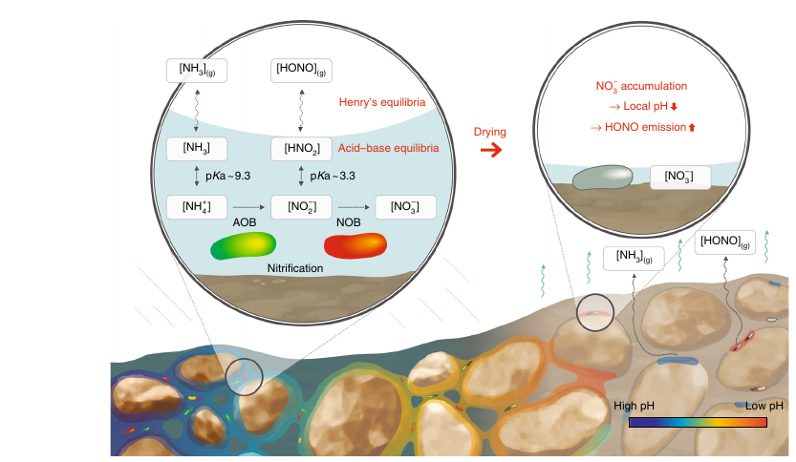
Microscale pH variations during drying of soils and desert biocrusts affect HONO and NH3 emissions.
The model links localised microbial activity with pH variations within thin aqueous films that jointly enhance emissions of nitrous acid (HONO) and ammonia (NH3) during soil drying well above what would be predicted from mean hydration conditions and bulk soil pH.
→ microscale interactions causes highly localised conditions that disproportionally affect soil nitrogen transformations.
Laboratory measurements confirm the onset of microscale pH localisation and highlight the critical role of micro-environments in the resulting biogeochemical fluxes from terrestrial ecosystems.
Biocrusts that mainly provide fixed N to desert soils also emit large amounts of HONO, known to form under acidic conditions. Evidence suggests that significant amount of HONO can be emitted from neutral or alkaline soils.
Local variations in the concentration of dissolved substances during desiccation induce changes in local pH at microscale that, in turn, give rise to hotspots for emissions of pH-dependant gases such as HONO and NH3.
Simulated microbial activities show that NO3- accumulated in thinning water films that act as a driver for pH zonation. NO3- seems to control the changes for local pH drastically because of its high solubility and because it can be protonated to nitric acide HNO3.
The most dominant sink and source for NO3- in soil is nitrification and denitrification resulting from microbial activity.
This accumulation could be responsible for the large HONO emissions observed in desert biocrusts.
However, unlike with cyanobacterial crusts, measurements in lichen- and bryophyte-dominated biocrusts did not show a strong correlation with NO3- accumulation. These biocrusts emit smaller amounts of HONO over a wider range of water contents.
Kim and Or, 2019

Slide 18
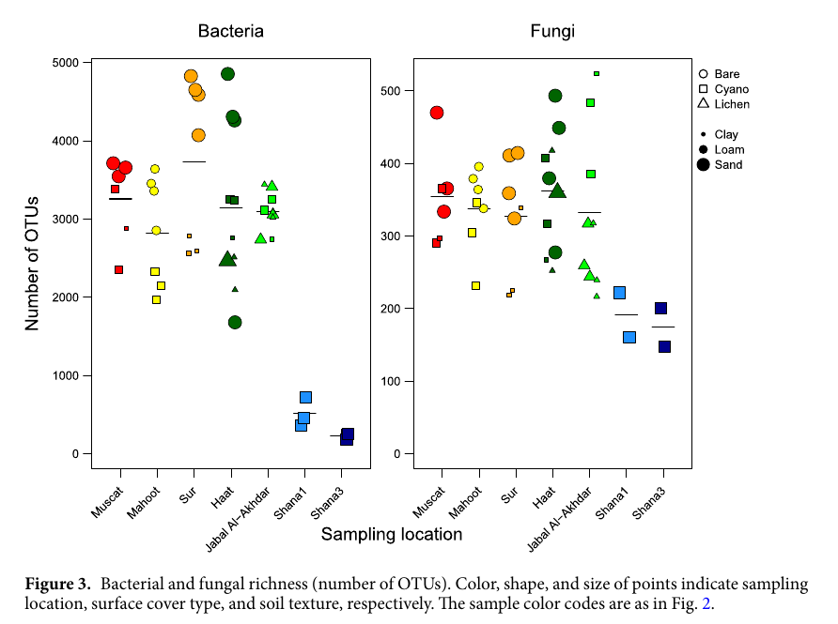
Habitat dependent composition of bacterial and fungal communities in biological soil crusts from Oman.
.
Soil properties including texture class, pH, salinity, nutrients and porosity strongly correlated with the distribution patterns of biocrust species.
Usage of Rpackage “PCAmixdata”.
Lichen-dominated biocrusts become more prevalent as aridity decrease and precipitation rates increase.
Growth of cyanobacteria results in higher levels of organic matter and nutrients in crustel soils, relative to bare soils, thus promoting the growth of different microbial communities.
The improvement of soil physiochemical properties under crusts also promotes hyphal proliferation and fungal growth. However, the competition for organics and nutrients in crusts could result in the growth of highly specific and competitive microbial populations and this could explain the lower OTU richness of bacteria and fungi in crusted than in bare soils.
Chytridiomycota seems to be tolerant to stress environments.
Microbial communities in the crusts were strongly affected by soil texture and C, N contents. Soil texture affects crust development by influencing soil stability, aeration and water retention ability, as coarser soils are unstable and lose more water relative to fine soils.
It seems that cyanobacteria develop on sandy soils whereas lichens preferably grow on fine texture soils.
Abed et.al, 2018

Slide 19
Reshaping of sandstone surfaces by cryptoendolithic cyanobacteria.
Novel weathering mechanism in South African sandstone formations.
→ cryptoendolithic cyanobacteria induce weathering by substrate alkalization during photosynthesis. As a result, the upper rock part is loosened and then eroded away by physical forces such as wind, water, trampling.
Culture of cyanobacteria strains found on the field shows a strong pH elevation to 11 in an eight month old mass culture.
There is a strong correlation between alkalization and photosynthesis in the liquid pure cultures (O2 évolution simultaneous to pH changes).
The accumulation of OH- was probably caused by the activation of a CO2 concentrating mechanism (CCM), in which HCO3- is actively taken up by several options.
A CCM has been demonstrated in cyanobacteria, where it serves to alleviate CO2 limitation imposed by low solubility and slow diffusional supply of CO2 in water.
→ Internally accumulated HCO3- serves as a source of CO2 because it is rapidly dehydrated by a carboxysomal carbonic anhydrase. The resulting HO- is then excreted back to the surrounding environment.
Budel et.al, 2005

Slide 20
Effects of light and dark on the ultrastructure of lichen algae.
Novel weathering mechanism in South African sandstone formations.
→ cryptoendolithic cyanobacteria induce weathering by substrate alkalization during photosynthesis. As a result, the upper rock part is loosened and then eroded away by physical forces such as wind, water, trampling.
Culture of cyanobacteria strains found on the field shows a strong pH elevation to 11 in an eight month old mass culture.
There is a strong correlation between alkalization and photosynthesis in the liquid pure cultures (O2 évolution simultaneous to pH changes).
The accumulation of OH- was probably caused by the activation of a CO2 concentrating mechanism (CCM), in which HCO3- is actively taken up by several options.
A CCM has been demonstrated in cyanobacteria, where it serves to alleviate CO2 limitation imposed by low solubility and slow diffusional supply of CO2 in water.
→ Internally accumulated HCO3- serves as a source of CO2 because it is rapidly dehydrated by a carboxysomal carbonic anhydrase. The resulting HO- is then excreted back to the surrounding environment.
Brown et.al, 1988

