Slide 1
Robust optimization :
formulation, kriging and evolutionary approaches
Rodolphe Le Riche
CNRS and Ecole des Mines de Saint-Etienne
class given as part of the “Modeling and Numerical Methods for Uncertainty Quantification” French-German summer school, Porquerolles, Sept. 2014

Slide 2
Outline of the talk
1. Motivations for robust optimization
2. Formulations of optimization problems with uncertainties
3. Kriging-based approaches (costly functions)
4. Evolutionary approaches (non costly functions)

Slide 3
Why do we optimize ?
Optimization as a mathematical formulation for decision
followed by a numerical, approximate, resolution,
x
Optimization
algorithm
software
[seconds]
Simulation
software, s(x)
(FE, … )
[min, hours]
Post-process
of simulation
[0 , seconds]
f(s(x)) , g(s(x))
s(x)
Communication between programs by file, pipe, messages, ...

Slide 4
Motivations for robust optimization
What is the point – in practice – for deterministically solving an optimization problem when there are
unstable optima
aleatory model ( s ) parameters
model uncertainties
dynamically changing model conditions (complex systems)
???
x* ?
f
x

Slide 5
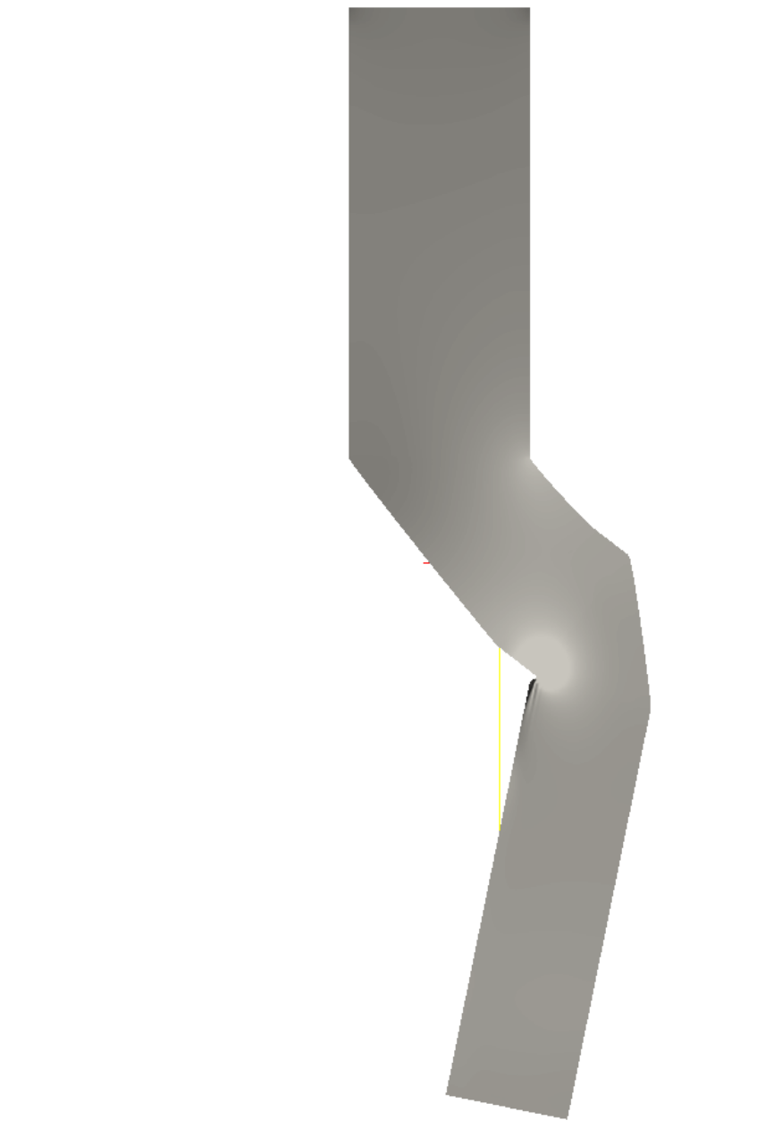
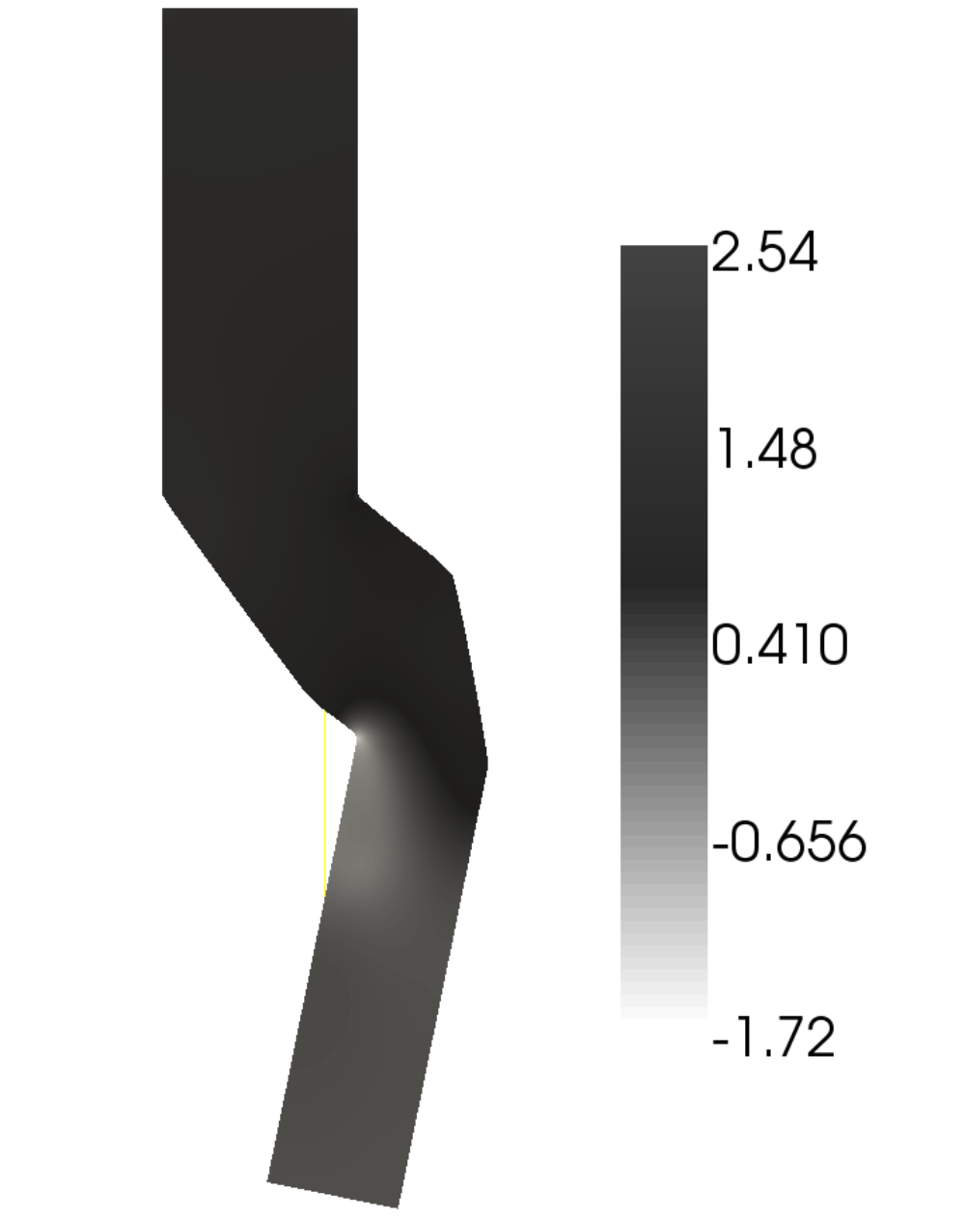
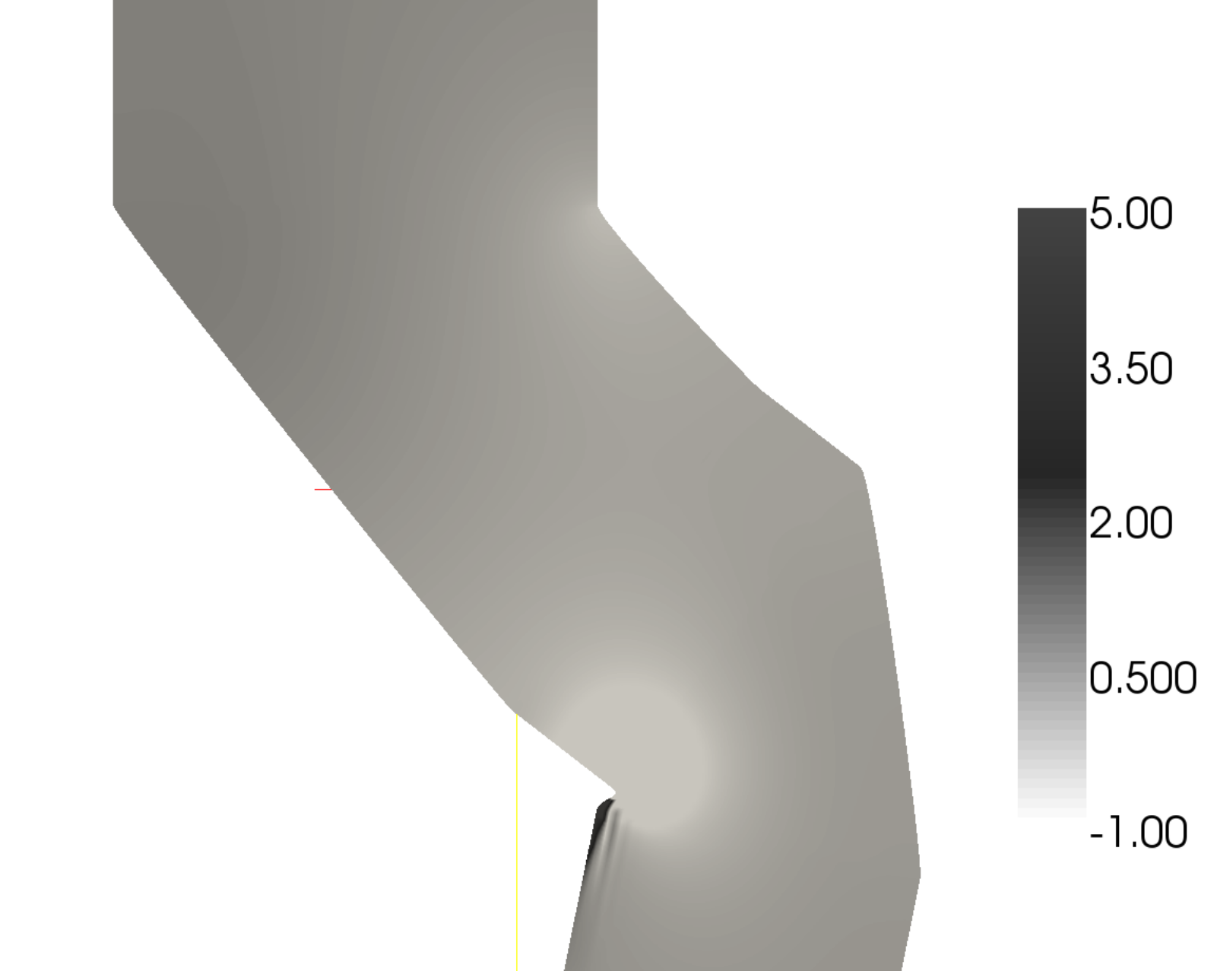
Unstable deterministic optimum. Expl of an air duct.
Minimize pressure loss by changing the (parameterized) shape.
deterministic design
robust design
(zoom)
The optimization exploits meshing flaws.
The result is not stable w.r.t. mesh or boundary conditions changes.
Cf. J. Janusevskis and R. Le Riche, Robust optimization of a 2D air conditioning duct using kriging, technical report hal-00566285, feb. 2011.

Slide 6
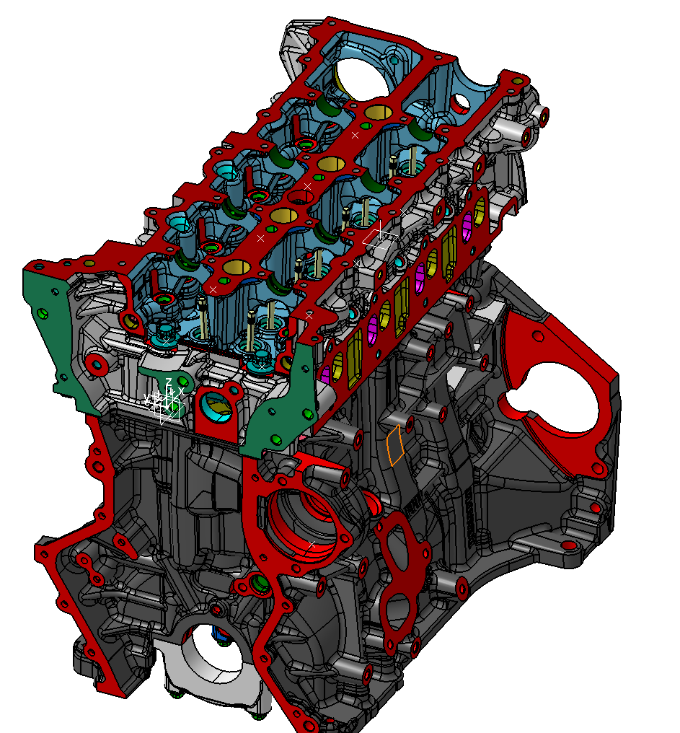
Unstable deterministic optimum.
Expl of a combustion engine.
a +/- 1mm dispersion in the manufacturing of a car cylinder head can degrade its performance (g CO2/km) by -20% (worst case)

Slide 7
Motivations for robust optimization
What is the point – in practice – for deterministically solving an optimization problem when there are
unstable optima
aleatory model ( s ) parameters
model uncertainties
dynamically changing model conditions (complex systems)
???
→ modify the problem statement, therefore also the optimization algorithms → robust optimization

Slide 8
Outline of the talk
1. Motivations for robust optimization
2. Formulations of optimization problems with uncertainties
3. Kriging-based approaches (costly functions)
4. Evolutionary approaches (non costly functions)

Slide 9
Formulations of optimization problems under uncertainties
H.G. Beyer, B. Sendhoff, Robust Optimization – A comprehensive survey, Comput. Methods Appl. Mech. Engrg, 196, pp. 3190-3218, 2007.
G. Pujol, R. Le Riche, O. Roustant and X. Bay, L'incertitude en conception: formalisation, estimation, Chapter 3 of the book Optimisation Multidisciplinaire en Mécaniques : réduction de modèles, robustesse, fiabilité, réalisations logicielles, Hermes, 2009 (in French ;-( )

Slide 10
Formulation of optimization under uncertainty
The double (x,U) parameterization
We introduce U, a vector of uncertain (random) parameters that affect the simulator s.
x is a vector of deterministic optimization (controlled) variables. x in S, the search space.
(cf. Taguchi, 80's)
s(x) → s(x,U) , therefore f(x) → f(s(x,U)) = f(x,U)
and g(x) → g(s(x,U)) = g(x)
U used to describe
noise (as in identification with measurement noise)
model error (epistemic uncertainty)
uncertainties on the values of some parameters of s.
Notes:
U may depend on x as with heterogeous noise in kriging. But this would be confusing that early, so not mentioning it.

Slide 11
Formulation of optimization under uncertainty
The (x,U) parameterization is general
L
Three cases (which can be combined)
σ
1. Noisy controlled variables
Expl : manufacturing tolerance,
R
x
L+U
σ
2. Noise exogenous to the optimization variables
Expl : random load L+U, x is a dimension.
x
L
σ + U
3. Noise as an error model for the simulation
x

Slide 12
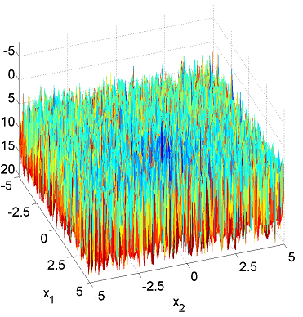
Formulation of optimization under uncertainties
(1) the noisy case
Let's not do anything about the uncertainties, i.e., try to solve
It does not look good : gradients are not defined, what is the result of the optimization ?
But sometimes there is no other choice. Ex : y expensive with uncontrolled random numbers inside (like a Monte Carlo statistical estimation, numerical errors, measured input).

Slide 13
Formulation of optimization under uncertainties
(2) an ideal series formulation
Replace the noisy optimization criteria by statistical measures

Slide 14
Formulation of optimization under uncertainties
(3) simplified formulations often seen in practice
For bad reasons (joint probabilities ignored) or good ones (simpler numerical methods – Gaussian pdf – , lack of data, organization issues), quantiles are often replaced by averages and variances, conditioning is neglected, constraints are handled independently :

Slide 15
Formulation of optimization under uncertainties
Direct approaches (1/4)
In practice, statistical performance measures are estimated

Slide 16
Formulation of optimization under uncertainties
Direct approaches (2/4)
Direct (naive) approaches to optimization with uncertainties have a double loop : propagate uncertainties on U, optimize on x.
Optimization : loop on x
Estimation of the performance (average, std dev, percentile of f(x,U) , prob. of g(x,U) ) : loop on u , Monte Carlo
Such a double loop is very costly :
( calls to s )

Slide 17
Formulation of optimization under uncertainties
Direct approaches (3/4)
Most local (e.g., gradient based) optimizers will show poor convergence with noisy statistical estimators (e.g., crude Monte Carlo).
Ex : quasi-Newton method with finite differences
little noise
more noise

Slide 18
Formulation of optimization under uncertainties
Direct approaches (4/4)
Avoid noisy statistical estimators with common random numbers
once for all before the loops
see Bruno Tuffin's class on sampling (quasi Monte Carlo)
But,
does not solve the cost issue

Slide 19
Outline of the talk
1. Motivations for robust optimization
2. Formulations of optimization problems with uncertainties
3. Kriging-based approaches (costly functions)
4. Evolutionary approaches (non costly functions)

Slide 20
kriging-based approaches
Context
Unconstrained continuous optimization
general,
no control on U
specific to E(f),
control on U
[ Constraints, g(x) ≤ 0 , are not explicitely discussed in this talk. As a patch, you may assume that
Constraints satisfaction problem : A. Chaudhuri, R. Le Riche and M. Meunier, Estimating feasibility using multiple surrogates and ROC curves, 54th AIAA SDM Conference, Boston, USA, 8-11 April 2013. ]
Unconstrained continuous optimization of costly functions
~ 20 to 1000 calls possible, d = 1 to 20

Slide 21
kriging-based approaches
Kriging with noisy observations (1/5)
Y
space x

Slide 22
kriging-based approaches
Kriging with noisy observations (2/5)
Apply the conditioning result to the vector
The only change w.r.t. the usual kriging formula is the addition of the observation variances on the covariance diagonal

Slide 23
kriging-based approaches
Kriging with noisy observations (3/5)
Y
space x
kriging no longer interpolating
the kriging mean filters the noise
additive covariance diagonal terms called « nugget effect »
often used as a regularization technique in non noisy situations
kriging = our approach to link x and U spaces in optimization

Slide 24
kriging-based approaches
Kriging with noisy observations (4/5)
In the context of robust optimization with MC estimators, the observation noise can be set as
( Expl. with quantile estimate, cf. Le Riche et al., Gears design with shape uncertainties using Monte Carlo simulations and kriging, SDM, AIAA-2009-2257 )

Slide 25
kriging-based approaches
Kriging with noisy observations (5/5)
The hyperparameters can be tuned through max likelihood, 2 cases
Known (from context) heterogeneous noise
Unknown homogeneous noise

Slide 26
kriging-based approaches
We have seen
  how to formulate a robust optimization problem
  how to model noisy observations with kriging
  but how to optimize when a kriging metamodel is built ?

Slide 27
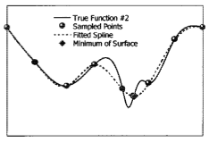
Kriging-based approaches
Kriging prediction minimization
The simplest (naive) approach.
For t=1,t^{max} do,
Learn Y^{t}(x) (m_{K} and s_{K}² ) from f(x¹), … , f(x^{t})
x^{t+1} = min_{x} m_{K}(x)
Calculate f(x^{t+1})
t = t+1
End For
e.g., using CMA-ES*
if multimodal
* Hansen et al., 2003
But it may fail if m_{K}(x^{t+1}) = f(x^{t+1}) :
the minimizer of m_{K} is at a data point which may not even be a local optimum.
D. Jones, A taxonomy of global optimization methods based on response surfaces, JOGO, 2001.

Slide 28
kriging-based approaches
Kriging and optimization
Search the volume
in an efficient manner.
Balance
EXPLORATION
with
INTENSIFICATION
We will deterministically fill the design space in an efficient order.
Other global search principles
  Stochastic searches : (pseudo)-randomly sample the design space S, use probabilities to intensify search in known high performance regions and sometimes explore unknown regions.
  (pseudo-)Randomly restart local searches.
  (and mix the above principles)

Slide 29
kriging-based approaches
A state-of-the-art global optimization algorithm
using metamodels : EGO
(D.R. Jones et al., JOGO, 1998)
EGO = Efficient Global Optimization = use a « kriging » metamodel to define the Expected Improvement (EI) criterion. Maximize EI to creates new x's to simulate.
EGO deterministically creates a series of design points that ultimately would fill S.
Some opensource implementations :
  DiceOptim in R (EMSE & Bern Univ.)
  Krisp in Scilab (Riga Techn. Univ & EMSE)
  STK: a Small (Matlab/GNU Octave) Toolbox for Kriging, (Supelec)

Slide 30
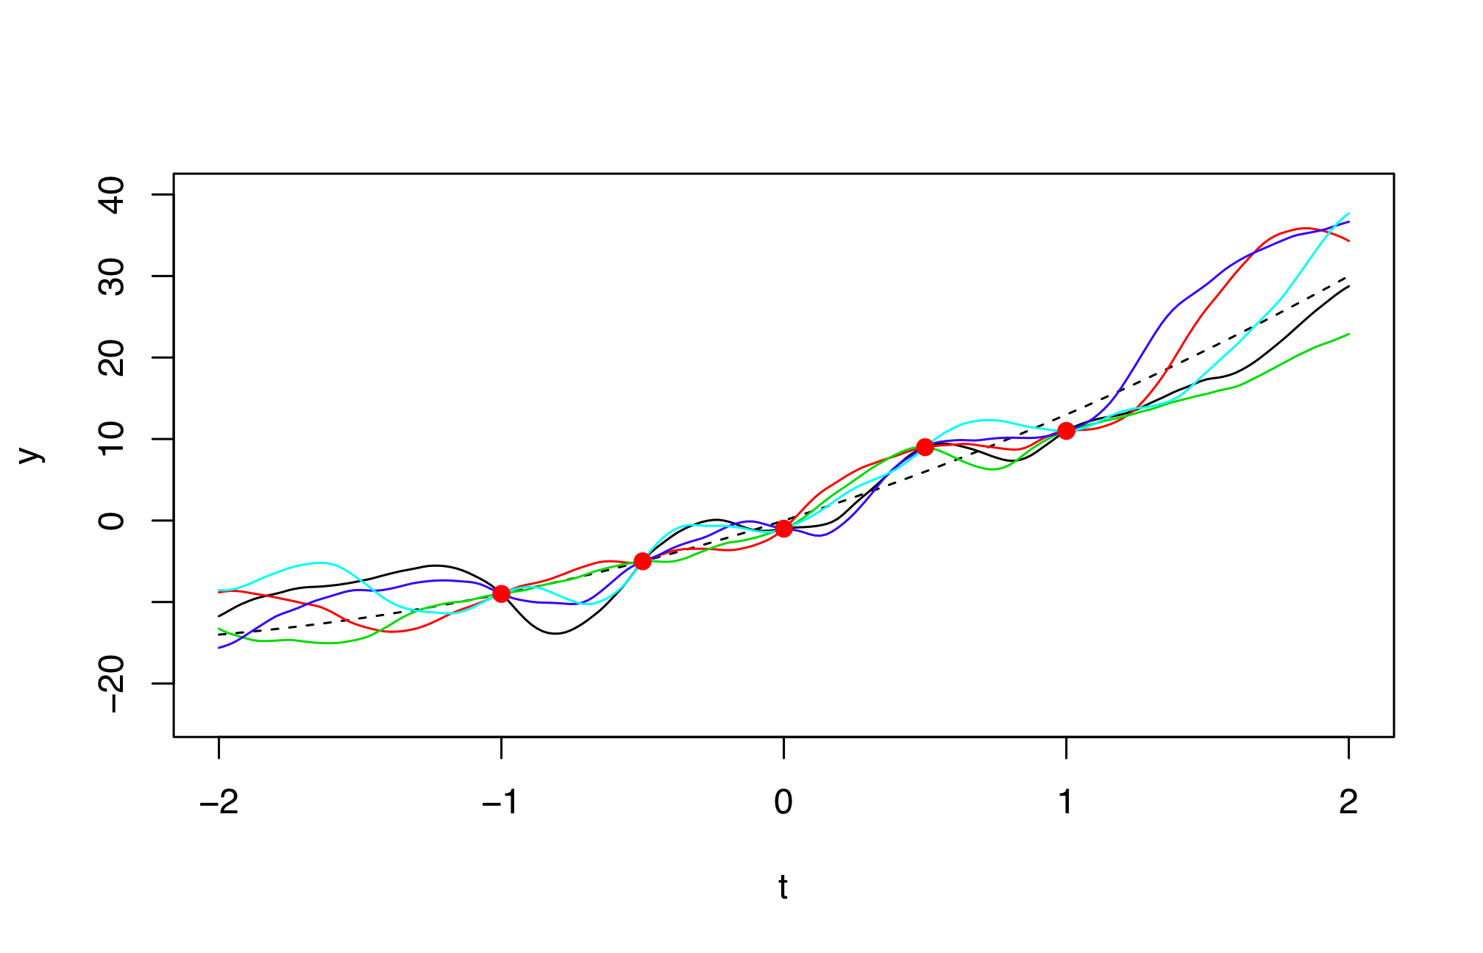
kriging-based approaches
(one point-) Expected improvement
A natural measure of progress : the improvement,
The expected improvement is known analytically.
It is a parameter free measure of the exploration-intensification compromise.
Its maximization defines the EGO deterministic global optimization algorithm.

Slide 31
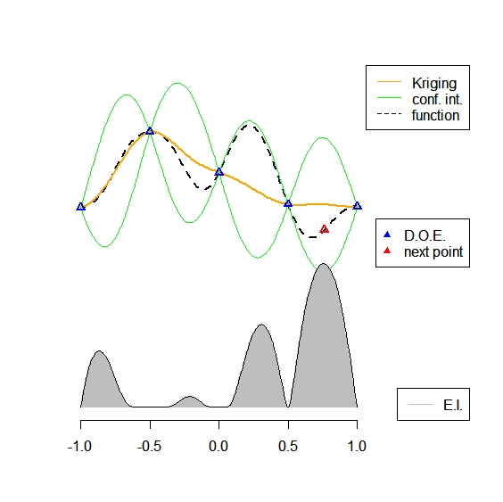
kriging-based approaches
One EGO iteration
At each iteration, EGO adds to the t known points the one that maximizes EI,
then, the kriging model is updated ...

Slide 32
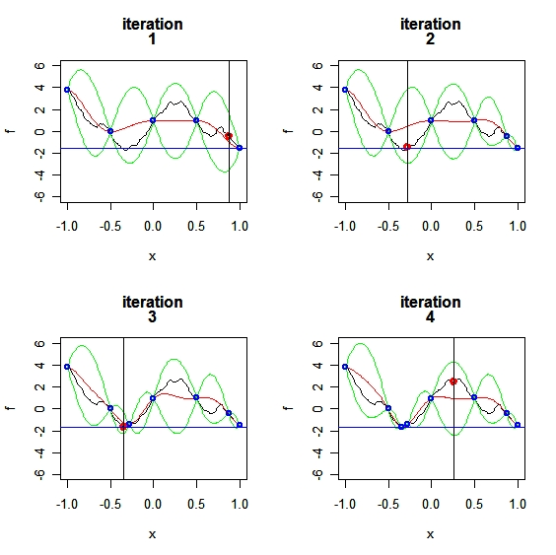
kriging-based approaches
EGO : example

Slide 33
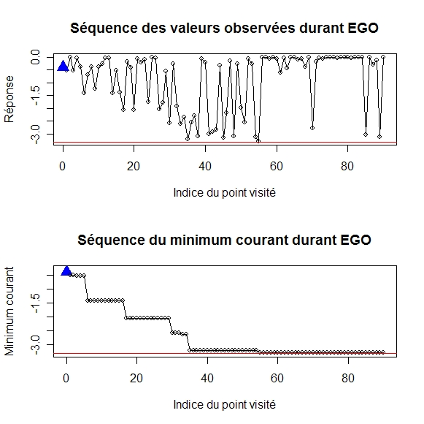
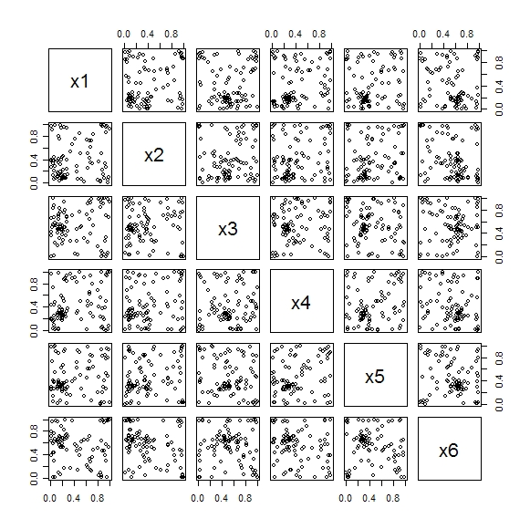
kriging-based approaches
EGO : 6D example
Hartman function, f(x*)=-3.32 , 10 points in initial DoE
(DiceOptim, D. Ginsbourger, 2009)

Slide 34
Outline of the talk
1. Motivations for robust optimization
2. Formulations of optimization problems with uncertainties
3. Kriging-based approaches to robust optimization (costly functions)
Kriging noisy observations
Optimization and kriging
Robust optimization, no control on U
Robust optimization, control on U
4. Evolutionary approaches (non costly functions)

Slide 35
Kriging-based robust optimization, no control on U
EI for noisy functions
Solution 1 : Add nugget effect and replace y_{min} by the best observed mean (filters out noise in already sampled regions) :
x

Slide 36
Kriging-based robust optimization, no control on U
Expected Quantile Improvement
V. Picheny, D. Ginsbourger, Y. Richet, Optimization of noisy computer experiments with tunable precision, Technometrics, 2011.
Solution 2 : Add nugget effect and use the expected quantile improvement.
A conservative criterion (noise and spatial uncertainties are seen as risk rather than opportunities).
Better for assigning ressources to reduce noise on a given DoE X^{t} obtained by Solution 1.

Slide 37
Kriging based optimization with uncertainties, no control on U
Related work
E. Vazquez, J. Villemonteix, M. Sidorkiewicz and E. Walter, Global optimization based on noisy evaluations: an empirical study of two statistical approaches, 6th Int. Conf. on Inverse Problems in Engineering, 2010.
J. Bect, IAGO for global optimization with noisy evaluations, workshop on noisy kriging-based optimization (NKO), Bern, 2010.

Slide 38
Outline of the talk
1. Motivations for robust optimization
2. Formulations of optimization problems with uncertainties
3. Kriging-based approaches to robust optimization (costly functions)
Kriging noisy observations
Optimization and kriging
Robust optimization, no control on U
Robust optimization, control on U
4. Evolutionary approaches (non costly functions)

Slide 39
Kriging based optimization with uncertainties, U controlled
(x,u) surrogate based approach
Assumptions : x and U controlled
(x,u) surrogate based approach
Direct approach
Optimizer of noisy functions
Optimizer
Monte Carlo
simulations
Simulator
Simulator
Multiplicative cost of two loops involving f
Only one loop of f

Slide 40
Kriging based optimization with uncertainties, U controlled
A general Monte Carlo - kriging algorithm
Hereafter is an example of a typical surrogate-based (here kriging) algorithm for optimizing any statistical measure of f(x,u) (here the average).
Create initial DOE (X^{t},U^{t}) and evaluate f there ;
While stopping criterion is not met:
    Create kriging approximation Y^{t} in the joint (x,u) space from f(X^{t},U^{t})
    Estimate the value of the statistical objective function from Monte Carlo simulations on the kriging average m_{Y}^{t}.
    Expl :
    Create kriging approximation Z^{t} in x space from
    Maximize EI_{Z}^{noisy}(x) to obtain the next simulation point → x^{t+1}
    u^{t+1} sampled from pdf of U
    Calculate simulator response at the next point, f(x^{t+1},u^{t+1}).
    Update DOE and t
MC – kriging algorithm
only call to f !

Slide 41
Kriging based optimization with uncertainties, U controlled
Simultaneous optimization and sampling (1)
J. Janusevskis and R. Le Riche, Simultaneous kriging-based estimation and optimization of mean response, Journal of Global Optimization, Springer, 2012
Assumptions : x and U controlled, U normal.
Optimizer
1. Building internal representation of the objective (mean performance) by «integrated» kriging.
Simulator

Slide 42
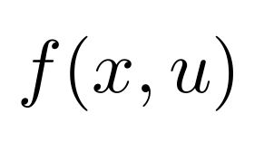
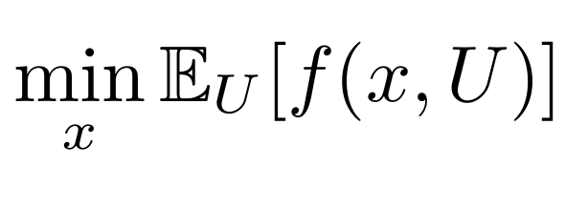
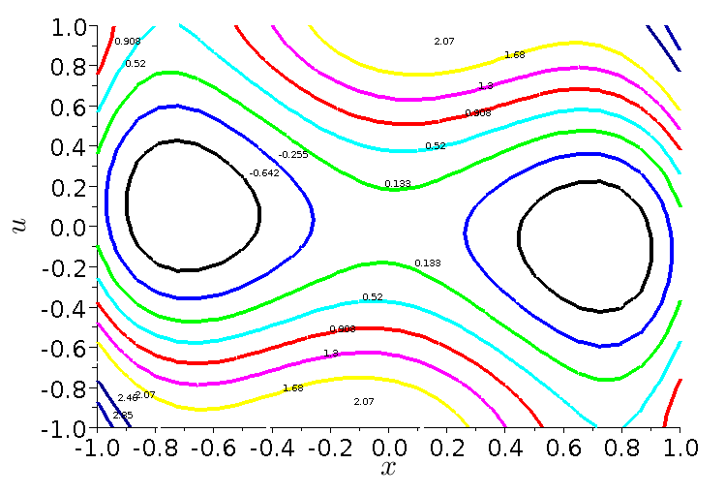
Kriging based optimization with uncertainties, U controlled
Simultaneous optimization and sampling
Objective :
u
Principle : work in the joint (x,u) space.
x
Cf. J. Janusevskis and R. Le Riche, Simultaneous kriging-based estimation and optimization of mean response, Journal of Global Optimization, Springer, 2012

Slide 43
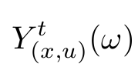
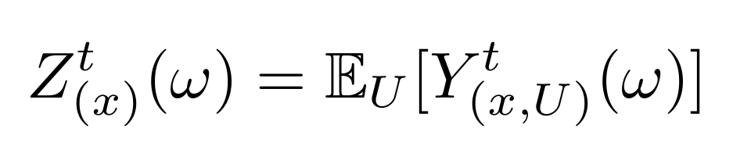
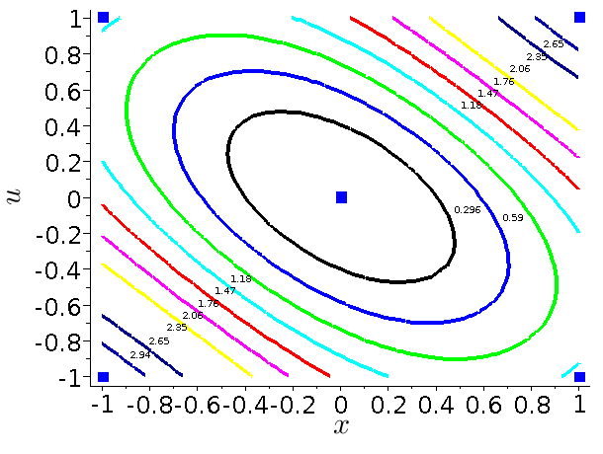
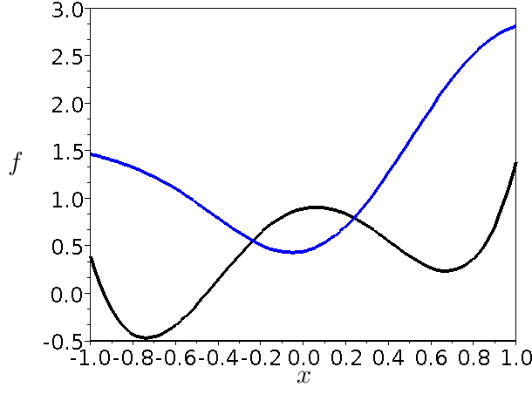
Kriging based optimization with uncertainties, U controlled
Integrated kriging (1)
: objective
: kriging approximation to deterministic
: integrated process
approximation to
integrate
u
approximation
u
objective
x

Slide 44
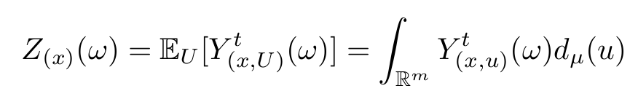
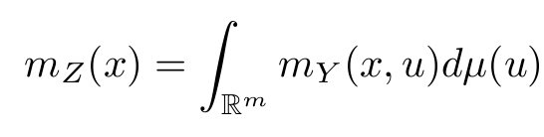
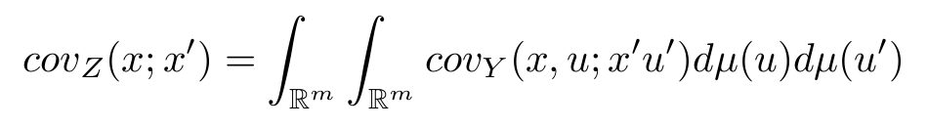
Kriging based optimization with uncertainties, U controlled
Integrated kriging (2)
The integrated process over U is defined as
-probability measure on U
Because it is a linear transformation of a Gaussian process, it is Gaussian, and fully described by its mean and covariance
Analytical expressions of m_{Z} and cov_{Z} for Gaussian U's are given in
J. Janusevskis and R. Le Riche, Simultaneous kriging-based estimation and optimization of mean response, Journal of Global Optimization, Springer, 2012

Slide 45
Kriging based optimization with uncertainties, U controlled
Simultaneous optimization and sampling (2)
Optimizer
1. Building internal representation of the objective (mean performance) by «projected» kriging.
2. Simultaneous sampling and optimization criterion for x and u
(both needed by the simulator to calculate f)
Simulator

Slide 46
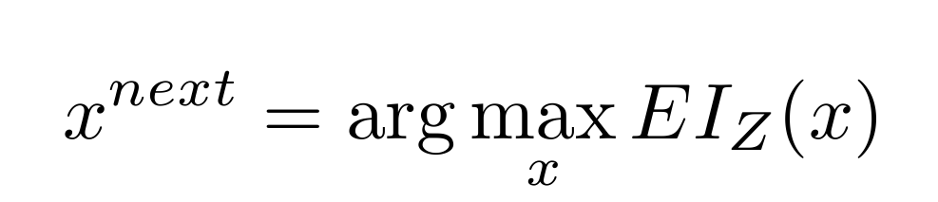
Kriging based optimization with uncertainties, U controlled
EI on the integrated process (1)
Z is a process approximating the objective function
Optimize with an Expected Improvement criterion,
Optimize with an Expected Improvement criterion,

Slide 47
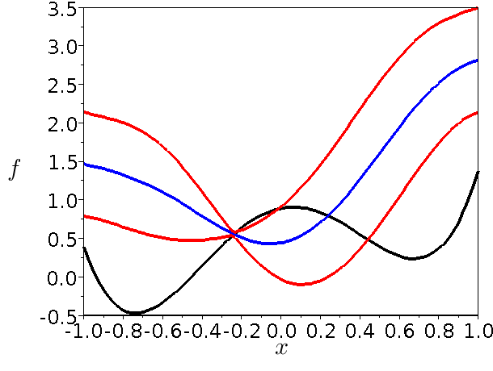
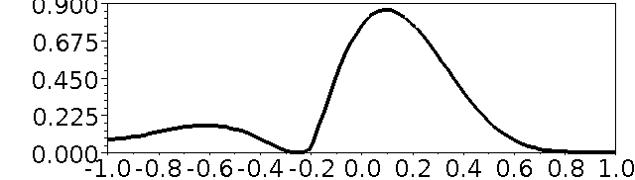
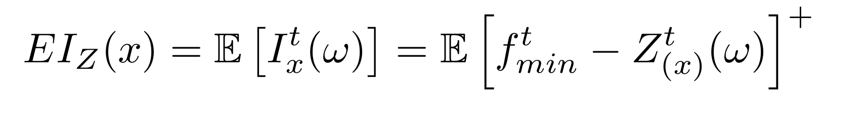
Kriging based optimization with uncertainties, U controlled
EI on the integrated process (2)

Slide 48
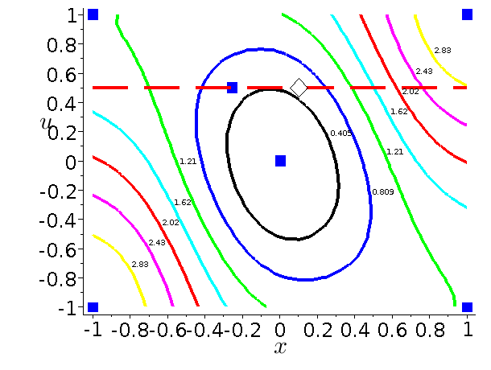
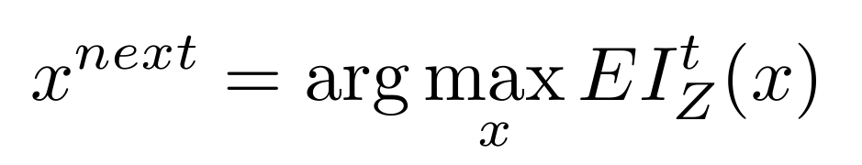
Kriging based optimization with uncertainties, U controlled
EI on the integrated process (3)
EU
x ok. What about u ? (which we need to call the simulator)

Slide 49
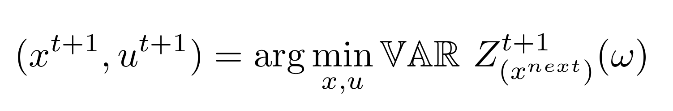
Kriging based optimization with uncertainties, U controlled
Simultaneous optimization and sampling : method
x^{next} gives a region of interest from an optimization of the expected f point of view.
One simulation will be run to improve our knowledge of this region of interest → one choice of (x,u).
Choose (x^{t+1},u^{t+1}) that provides the most information, i.e., which minimizes the variance of the integrated process at x^{next}

Slide 50
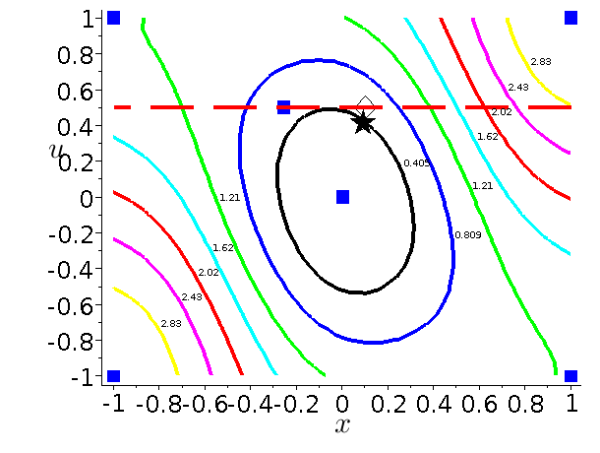
Kriging based optimization with uncertainties, U controlled
Simultaneous optimization and sampling : expl.
EU

Slide 51
Kriging based optimization with uncertainties, U controlled
Simultaneous optimization and sampling : algo
Create initial DOE in (x,u) space;
While stopping criterion is not met:
    Create kriging approximation Y in the joint space
    Using covariance information of Y to obtain approximation Z of the objective in the deterministic space
    Use EI of Z to choose
    Minimize to obtain the next point for simulation
    Calculate simulator response at the next point
( 4 sub-optimizations, solved with CMA-ES )

Slide 52
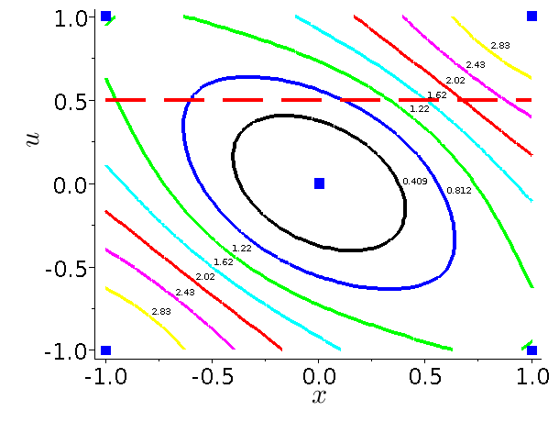
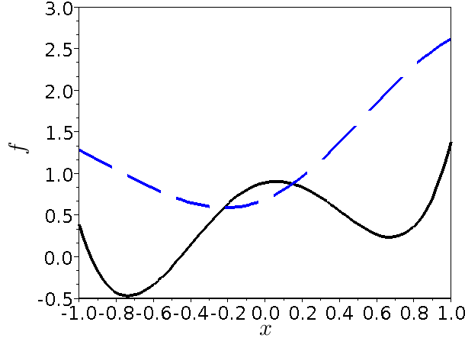
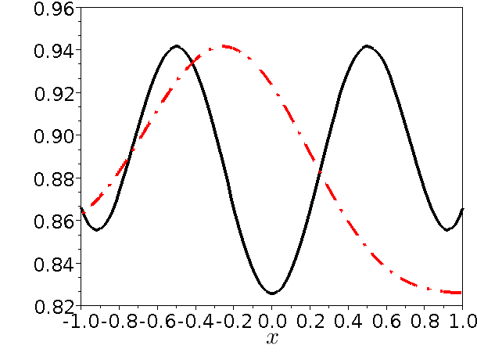
Kriging based optimization with uncertainties, U controlled
2D Expl, simultaneous optimization and sampling
test function

Slide 53
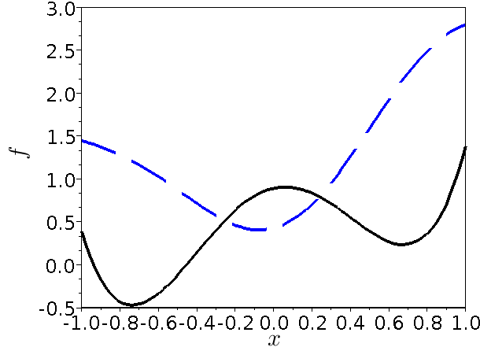
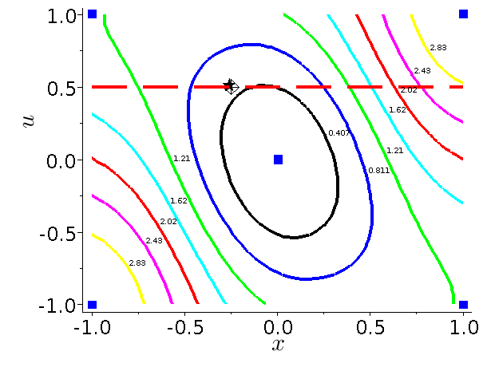
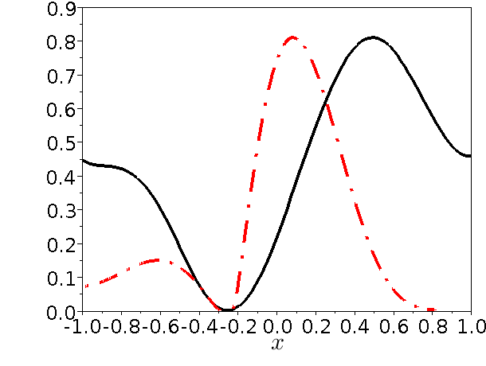
Kriging based optimization with uncertainties, U controlled
1st iteration

Slide 54
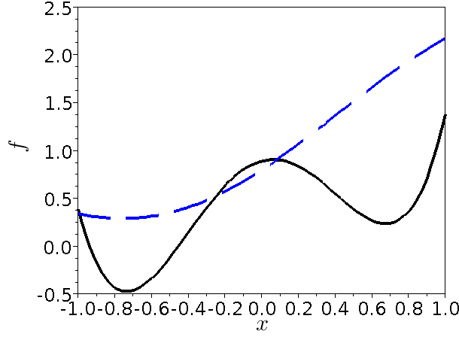
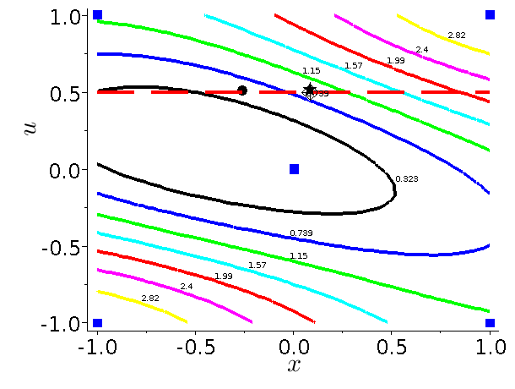
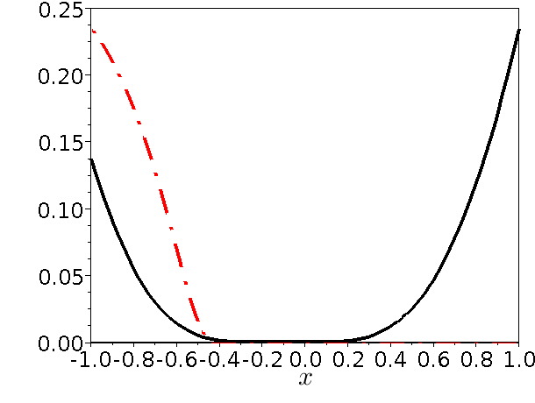
Kriging based optimization with uncertainties, U controlled
2nd iteration

Slide 55
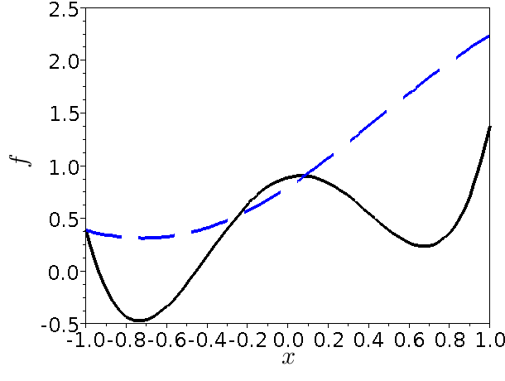
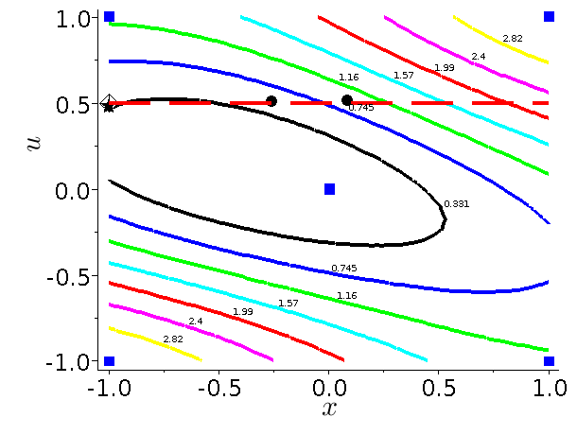
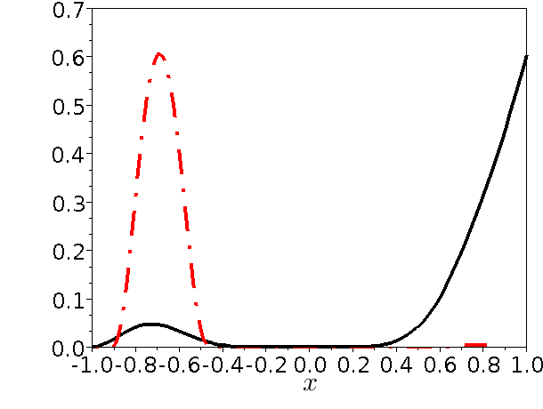
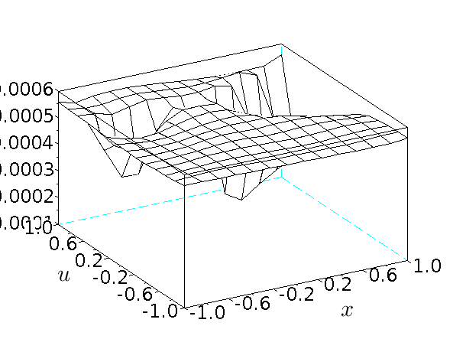
Kriging based optimization with uncertainties, U controlled
3rd iteration

Slide 56
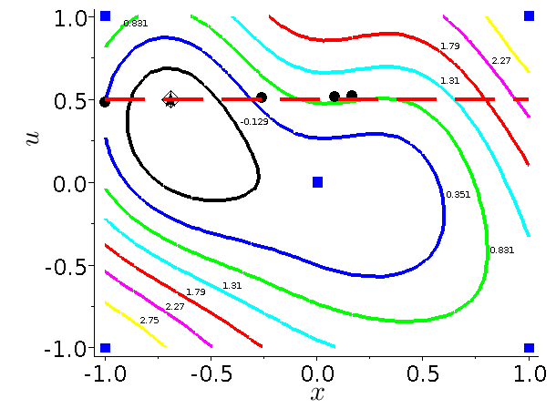
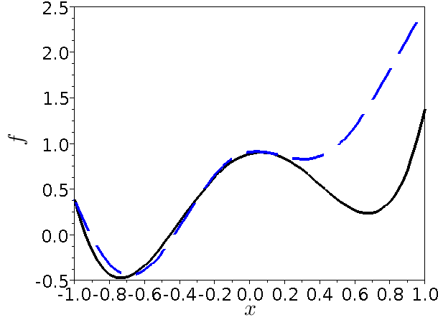
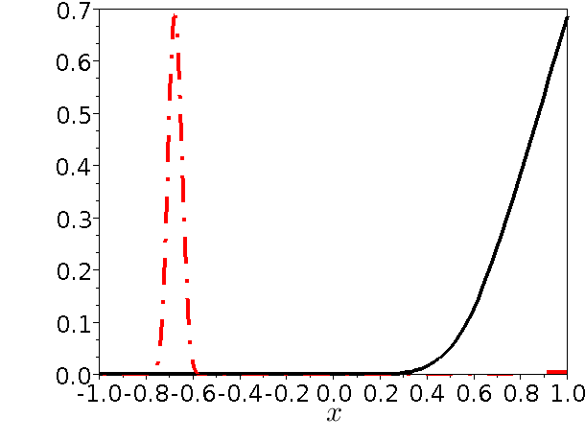
Kriging based optimization with uncertainties, U controlled
5th iteration

Slide 57
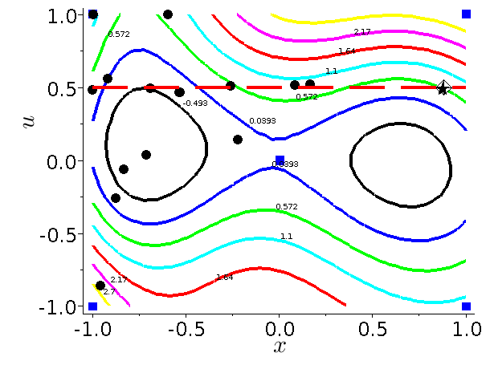
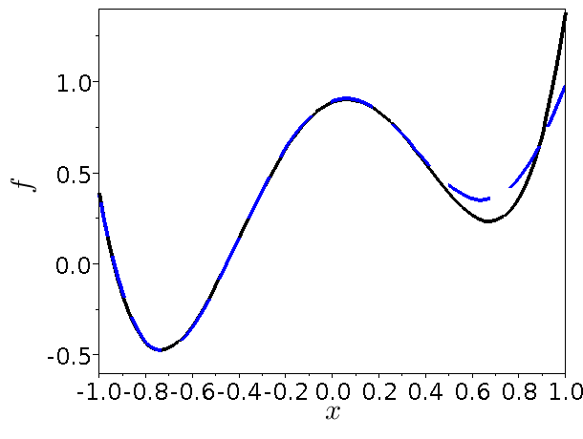
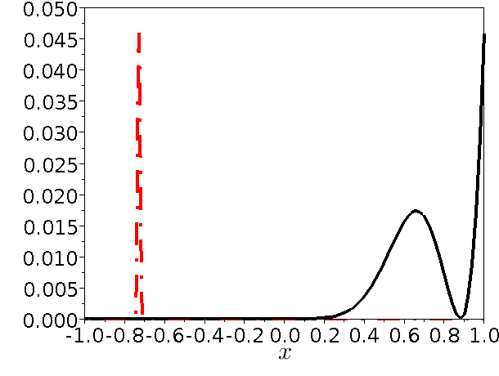
Kriging based optimization with uncertainties, U controlled
17th iteration

Slide 58
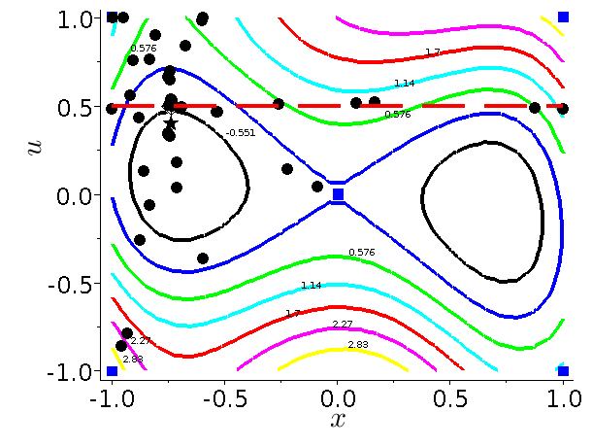
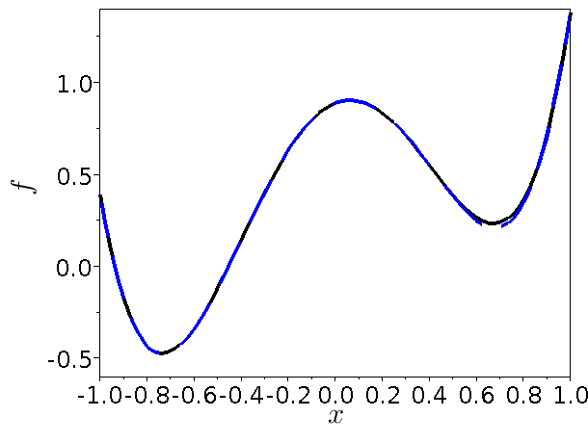

Kriging based optimization with uncertainties, U controlled
50th iteration

Slide 59
Kriging based optimization with uncertainties, U controlled
Comparison tests
Compare « simultaneous opt and sampling » method to
1. A direct MC based approach :
EGO based on MC simulations in f with fixed number of runs, s. Kriging with homogenous nugget to filter noise.
2. An MC-surrogate based approach :
the MC-kriging algorithm.

Slide 60




Kriging based optimization with uncertainties, U controlled
Test functions
Test cases based on Michalewicz function
2D:
4D:
6D:

Slide 61

Kriging based optimization with uncertainties, U controlled
Test results
6D Michalewicz test case, n_{x=3} =3 , n_{U} =3 .
Initial DOE: RLHS , m=(n_{x}+n_{U})*5 = (3+3)*5 = 30;
10 runs for every method.
EGO + MC on f , s=3 , 5 , 10
MC-kriging
Simult. opt & sampl.

Slide 62

Partial conclusion
min_{x} f(x,U)
We have discussed spatial statistics to filter the noise → kriging based approaches.
Limitation : number of dimensions , dim(x) + dim(U) < 20
Beyond this, if the function f is not too costly, use stochastic evolutionary optimizers, which can be relatively robust to noise if properly tuned.
Useful for optimizing statistical estimators which are noisy.
No control over the U's
No spatial statistics (i.e. in S or S × U spaces), pointwise approaches only.

Slide 63
Outline of the talk
1. Motivations for robust optimization
2. Formulations of optimization problems with uncertainties
3. Kriging-based approaches (costly functions)
No control on U
With control on U
4. Evolutionary approaches (non costly functions)
The general CMA-ES
Improvements for noisy functions :
Mirrored sampling and sequential selection
Adding confidence to an ES

Slide 64

Noisy optimization
Evolutionary algorithms
Taking search decisions in probability is a way to handle the noise corrupting observed f values
→ use a stochastic optimizer, an evolution strategy (ES).
« elitism »
A simple (1+1)-ES
Initializations : x, f(x), m, C, tmax.
While t < tmax do,
Sample N(m,C) --> x'
Calculate f(x') , t = t+1
If f(x')<f(x), x = x' , f(x) = f(x') Endif
Update m (e.g., m=x) and C
End while
%(Scilab code)
x = m + grand(1,'mn',0,C)

Slide 65

Noisy optimization
Adapting the step size (C²) is important
(A. Auger et N. Hansen, 2008)
Above isotropic ES(1+1) : C = σ² I , σ is the step size.
With an optimal step size ( ≈ ║x║/ d ) on the sphere function, log linear speed that degrades only in O(d).

Slide 66
Noisy optimization
The population based CMA-ES
(N. Hansen et al., since 1996, now with A. Auger)
CMA-ES = Covariance Matrix Adaptation Evolution Strategy = optimization through sampling and updating of a multi-normal distribution.
A fully populated covariance matrix is build : pairwise variables interactions learned. Can adapt the step in any direction.
The state-of-the-art evolutionary / genetic optimizer for continuous variables.

Slide 67
Noisy optimization
flow-chart of CMA-ES
CMA-ES is an evolution strategy ES-(μ,λ) :
Initializations : m, C, tmax, μ , λ
While t < tmax do,
Sample N(m,C) --> x¹,...,x^{λ}
Calculate f(x¹),...,f(x^{λ}) , t = t+λ
Rank : f(x^{1:λ}),...,f(x^{λ:λ})
Update m and C with the μ bests, x^{1:λ} ,...,x^{μ:λ}
End while
m et C are updated with
    the best steps (as opposed to points),
    a time cumulation of these best steps.

Slide 68



Noisy optimization
CMA-ES : adapting C² with good steps
(A. Auger et N. Hansen, 2008)
Initialization :
calculate f
sampling
selection
update m
rank 1 C update

Slide 69
Noisy optimization
The state-of-the-art CMA-ES
(A. Auger and N. Hansen, A restart CMA evolution strategy with increasing population size, 2005)
Additional features :
  Steps weighting,
  Time cumulation of the steps.
  Simultaneous rank 1 and μ covariance adaptations.
  Use of a global scale factor, C → σ² C .
  Restarts with increasing population sizes (unless it is the 2010 version with mirrored sampling and sequential selection, see later)
Has been used up to d ~ 1000 continuous variables.

Slide 70
Noisy optimization
The general CMA-ES
Improvements for noisy functions :
Mirrored sampling and sequential selection

Slide 71

Noisy optimization, improved optimizers
Resampling, noise and evolutionary algorithms
CMA-ES(μ,λ) can optimize many noisy functions because
it is not elitist
the choice of the next iteration average
averages out errors (spatial sampling as a proxy for U sampling)
To improve convergence on noisy function, is it preferable
1. to resample
2. or to increase the population size ?
(for an equivalent increase in computation)
→ it is better to increase the population size. [Beyer and Sendhoff 2007, Arnold and Beyer 2006 ]
But one can still do better ...

Slide 72
Noisy optimization, improved optimizers
Mirrored sampling and sequential selection (1)
D. Brockhoff, A. Auger, N. Hansen, D. V. Arnold, and T. Hohm. Mirrored Sampling and Sequential Selection for Evolution Strategies, PPSN XI, 2010
A. Auger, D. Brockhoff, N. Hansen, Analysing the impact of mirrored sampling and sequential selection in elitist Evolution Strategies, FOGA 2011
(1+1)-CMA-ES with restarts surprisingly good on some functions (including multimodal functions with local optima) ← small population advantage.
But « elitism » of (1+1)-ES bad for noisy functions : a lucky sample attracts the optimizer in a non-optimal region of the search space.
Question : how to design a fast local non-elistist ES ?

Slide 73


Noisy optimization, improved optimizers
Mirrored sampling and sequential selection (2)
Derandomization via mirrored sampling : one random vector generates two offsprings.
Often good and bad in opposite directions.
Sequential selection : stop evaluation of new offsprings as soon as a solution better than the parent is found.
Combine the two ideas : when an offspring is better than its parent, its symmetrical is worse (on convex level sets), and vice versa → evaluate in order m+y¹ , m-y¹ , m+y² , m-y² , … .

Slide 74
Noisy optimization, improved optimizers
Mirrored sampling and sequential selection (3)
Results :
(1,4)-ES with mirroring and sequential selection faster than (1+1)-ES on sphere function.
Theoretical result: Convergence Rate* ES (1+1)=0.202 ,
Convergence Rate (1,4ms)=0.223 .
Implementation within CMA-ES, tested in BBOB'2010** (Black Box Optimization Benchmarking)
Best performance among all algorithms tested so far on some functions of noisy testbed
** http://coco.gforge.inria.fr/bbob2010-downloads
small population, no elitism
[ Brockhoff et al., Mirrored sampling and sequential selection for evolution strategies, 2010. ]

Slide 75
Noisy optimization
The general CMA-ES
Improvements for noisy functions :
Mirrored sampling and sequential selection
Adding confidence to an ES

Slide 76
Noisy optimization, ES with confidence
Adding confidence to an ES
D. Salazar, R. Le Riche, G. Pujol and X. Bay, An empirical study of the use of confidence levels in RBDO with Monte Carlo simulations, in Multidisciplinary Design Optimization in Computational Mechanics, Wiley/ISTE Pub., 2010.
When evaluations of f(x,u) can be repeated (even without control of u) : f(x,u¹), … , f(x,u^{s})
Evolutionary optimizers are comparison based.
We compare empirical averages of f, therefore solve
The decision to be made during the optimization, in the presence of noise, is
(same number of samples s to keep formula simple)

Slide 77

Noisy optimization, ES with confidence
Hypothesis testing
Empirical averages and variances at current point 1 and new point 2 :
Test : H0 the new point is better than the current one
1-α
α
Statistic :
t_{1-α}
Note : this can also be done with functions of f . For example, replace f(x,U) by its estimated e-th quantile (batching),

Slide 78
Noisy optimization, ES with confidence
ES and hypothesis testing
The simplest ES-(1+1) evolutionary optimizer improved by hypothesis testing.
while cost < cost_max do
x' = x(t) + σ N(0,I)
calculate i.i.d. samples f(x',u^{i}) , i = 1,s
cost = cost + s
Hypothesis testing :
H0 , Ef(x',U) ≤ Ef(x(t),U) against H1 , Ef(x',U) > Ef(x(t),U)
Reject H0 with error α ?
Yes : x(t+1) = x(t)
No : x(t+1) = x'
t = t+1
end
α allows to change continuously the behavior of the optimizer from exploratory (low α) to conservative (high α).
Three parameters, whose optimal values are coupled : σ , s , α

Slide 79


Noisy optimization, ES with confidence
Test functions
On unimodal noisy functions : test convergence speed in noise, not globality of the search
decreasing signal / noise ratio as x → x* (=0)
increasing signal / noise ratio as x → x* (=0)

Slide 80
Noisy optimization, ES with confidence
Parameters of the tests
σ : the optimizer step size (=0.05 to 4)
nb : number of batches (=s). High noise when nb=2, little noise when nb=50.
α : first type error rate where H0 is « the new point is better than the current one ».
α=0.1 : exploratory optimizer
α=0.5 : traditional optimizer (no hypothesis testing)
α=0.9 : conservative optimizer
( but also,
n : number of variables, n=2 or 10. n=2 here, results generalize.
Crude Monte Carlo (shown here) versus Latin Hypercube Sampling. Prefer LHS. )
Each optimization is started from {2}^{n}, 500,000 calls to f long , and repeated 30 times.
b = 20 (fixed, smallest number for a Gaussian percentile)

Slide 81


Noisy optimization, ES with confidence
Number of MC simulations and step size
Expl. on F_{H}, traditional optimizer, the smallest step size (σ = 0.25) overlined in red.
nb = 50 : costly MC simulations, little noise
nb = 2 : cheap MC simulations, very noisy
Lower bound on step sizes needs to increase with the noise (decreasing nb) to prevent comparison errors

Slide 82

Noisy optimization, ES with confidence
Number of MC simulations
Expl. on F_{Q}, traditional optimizer, step size σ = 0.5 .
Low MC number at the beginning (nb = 2), increase nb later to converge accurately (observed on F_{Q} and F_{H}).

Slide 83


Noisy optimization, ES with confidence
Exploratory vs. traditional optimizer
The exploratory optimizer (with HT, α=0.1) tends to diverge and never converges faster on FQ and FH
→ not useful on non-deceptive functions.

Slide 84

Noisy optimization, ES with confidence
Conservative vs. traditional optimizer
Flat initial region (F_{H}) with high probability of being mislead (nb = 2)
→ the conservative optimizer is initially the best.
In all other tests made, traditional optimizer is better.

Slide 85
Concluding remarks (1)
Today's story was :
Optimization → difficult in the presence of noise → formulation of optimization in the presence of uncertainties → noisy functions
→ do spatial stats (kriging) [optimizer without U control → optimizer with U control]
→stochastic optimizers directly applied to noisy functions.
Each method has its application domain :
Stochastic optimizers robust to noise cannot be directly applied to an expensive (simulation based) objective function. An intermediate surrogate is needed.
Vice versa, kriging based method involve large side calculations : they are interesting only for expensive f's.

Slide 86
Concluding remarks (2)
Many (most) methods were not discussed :
Method of moments (Taylor expansions of the opt. criteria),
FORM/SORM (local constraints approximations about probable points) ,
Chance constraints and convex programming (worst U cases) … .
A lot still to be done :
effect of the a priori uncertainty model (law of random parameters),
optimize quantiles,
statistically joined criteria,
kriging like approaches (spatial stats) in high dimension,
…

Slide 87
Bibliography
Related books :
A. Ben-Tal, L. El Ghaoui, A. Nemirowski, Robust Optimization, Princeton Univ. Press, 2009.
R. E. Melchers, Structural Reliability Analysis and Prediction, Wiley, 1999.
M. Lemaire, A. Chateauneuf, J.-C. Mitteau, Structural Reliability, Wiley, 2009.
J. C. Spall, Introduction to Stochastic Search and Optimization, Wiley, 2003.
Multidisciplinary Design Optimization in Computational Mechanics, P. Breitkopf and R. Filomeno Coehlo Eds., Wiley/ISTE, 2010.
Articles :
H.G. Beyer, B. Sendhoff, Robust Optimization – A comprehensive survey, Comput. Methods Appl. Mech. Engrg, 196, pp. 3190-3218, 2007.
J. Janusevskis and R. Le Riche, Simultaneous kriging-based estimation and optimization of mean response, Journal of Global Optimization, Springer, 2012
G. Pujol, R. Le Riche, O. Roustant and X. Bay, L'incertitude en conception: formalisation, estimation, Chapter 3 of the book Optimisation Multidisciplinaire en Mécaniques : réduction de modèles, robustesse, fiabilité, réalisations logicielles, Hermes, 2009 (in French)
D. Salazar, R. Le Riche, G. Pujol and X. Bay, An empirical study of the use of confidence levels in RBDO with Monte Carlo simulations, in Multidisciplinary Design Optimization in Computational Mechanics, Wiley/ISTE Pub., 2010.

