Slide 1
AI NFL Football Manager
Building the best Football team.
Predicting the outcome
of a Football game.
Exploring the space
Of possible teams.

Slide 2
Prediction – Data
Years: 2010 → 2013
  Players statistics
    (~100 dimensional space, per game granularity)
    Includes injury records
  Games history
  Transfers records

Slide 3
Prediction – Feature
Player feature vector
  K-means
Team feature vector
  Aggregating, bucketizing?
Game feature
  Concatenation, difference?

Slide 4
Prediction – Machine Learning
Logistic regression L2
  Motivation: a strong why: helps us iterating on the feature extractor.
  The weight vector becomes an analysis tool for the feature engineering
  Fast

Slide 5
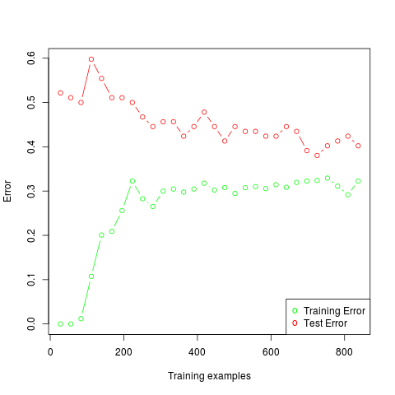
Prediction – ML

Slide 6
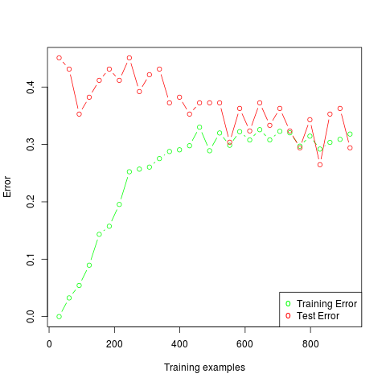
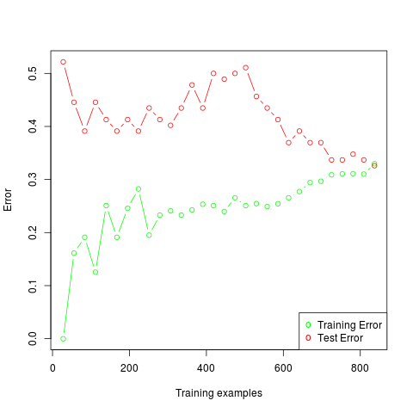
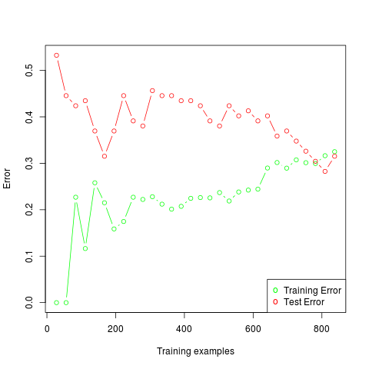
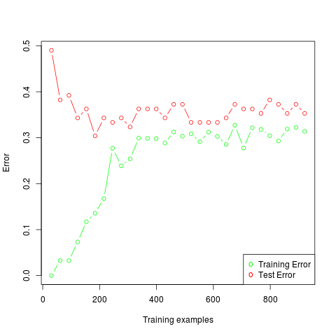
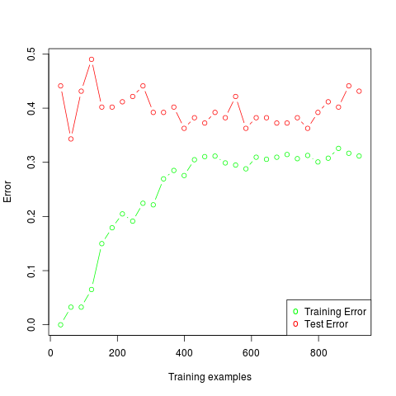
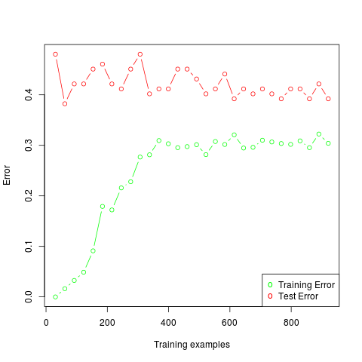
Prediction – ML
Learning curve: cross-validation error
  K = 3,4,5 // 6,8,10 → ~70% accuracy for k = 4

