Slide 1
World Hapiness Ranking
Winter Term 2023/24

Slide 2
Agenda
Potential topics for the presentation
Intro & Team
Idea and Project Outline
Problems & Solutions
Plots

Slide 3
Intro & Team
Some ideas for this section
Data from the Gallup World Poll, we aim to understand the factors driving global happiness.
By analyzing six key factors, we uncover what influences happiness levels across nations.

Slide 4
Idea & Project Outline
Some ideas for this section
Our objective is to understand factors influencing happiness worldwide.
This dataset includes various socio-economic indicators and happiness scores for different countries.
Building different correlations between the different factors.

Slide 5
Problems & Solutions
Challenges Experienced during the Project:
Coordination: Scheduling meetings and aligning on tasks was challenging due to differing schedules.
Collaboration: Balancing individual tasks with team progress was particularly challenging.
Overcoming the challenges
Overcame challenges through effective communication and flexibility.

Slide 6
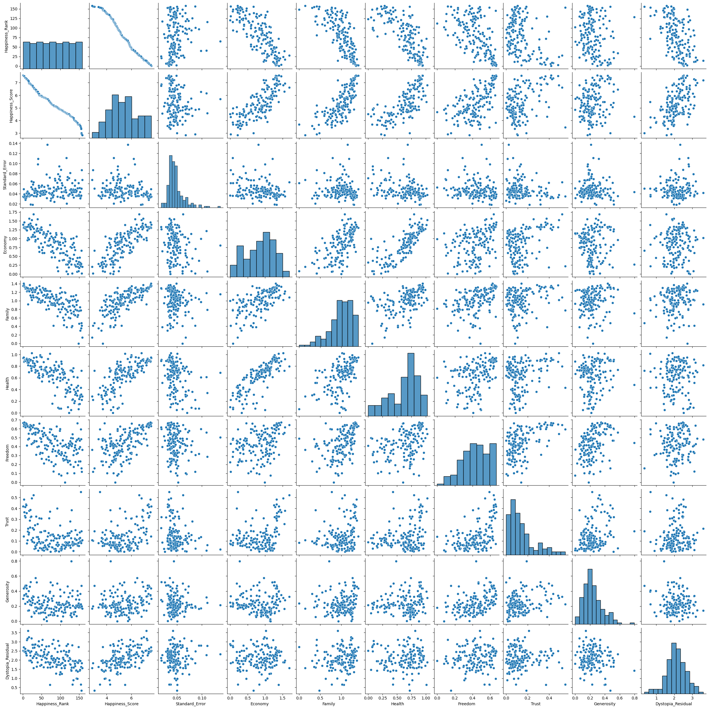
Plots

Slide 7
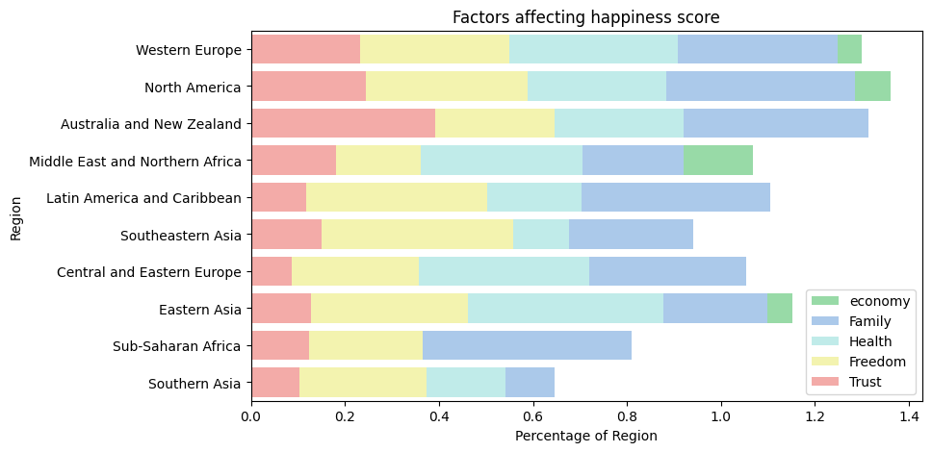
Plots

Slide 8
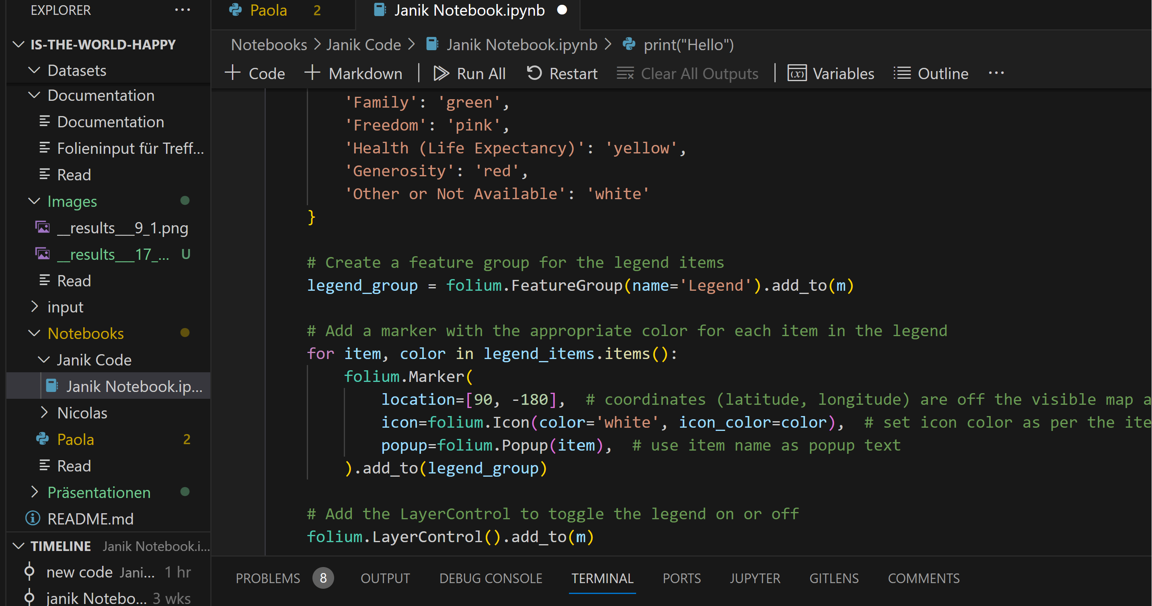
Progress Update
Codes and plots are nearing completion.
Plan to finalize all components and begin presentation preparation next week

Slide 9
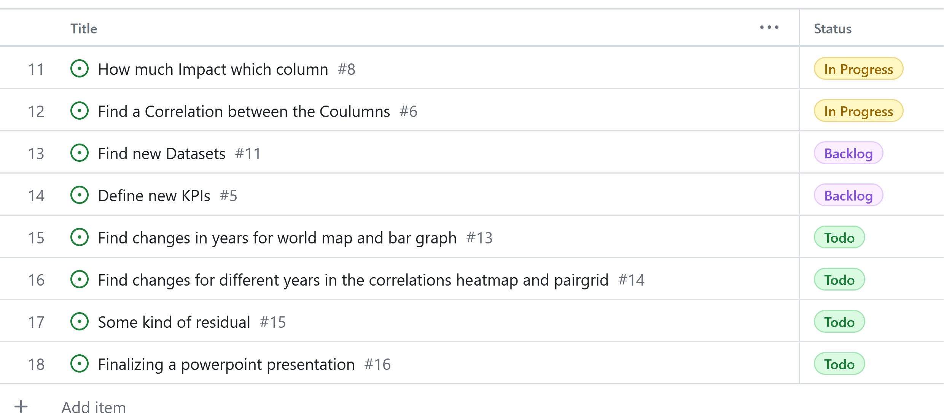
Ziele bis nächste Woche
Finalize remaining codes and plots.
Rehearse presentation and prepare slides.
Aim to complete presentation by 21.03.2024 for smooth delivery.

