Slide 1


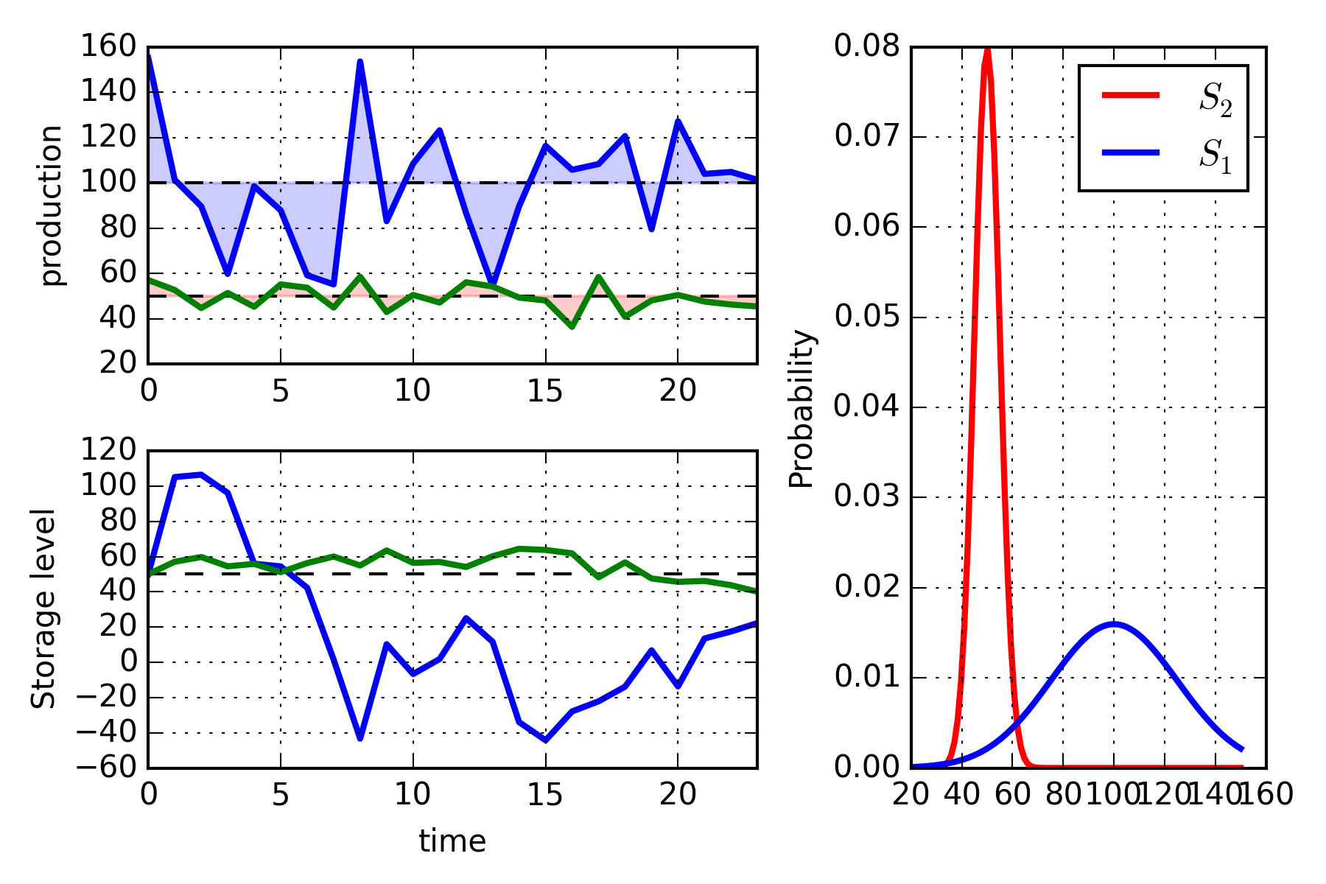
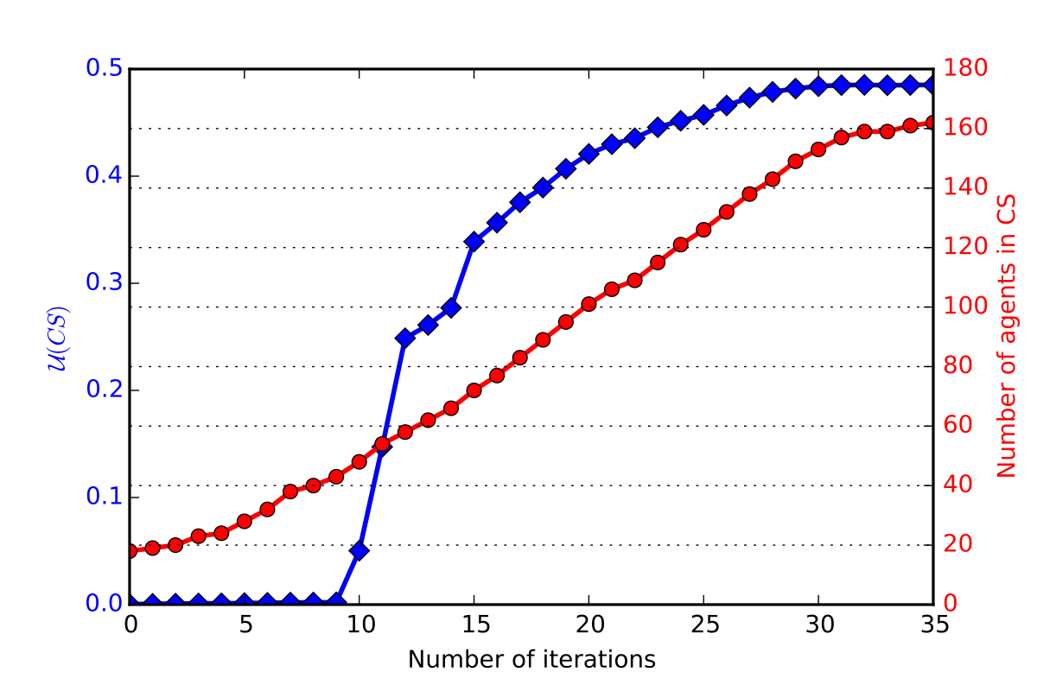
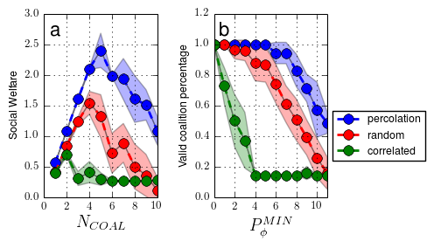
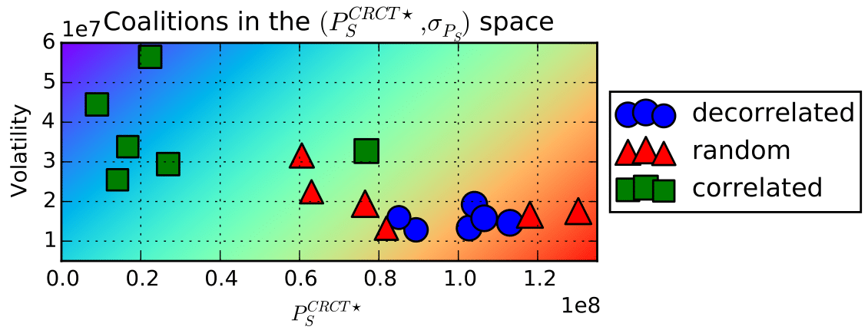
Coalition Formation Algorithm of Prosumers in a Smart Grid Environment
Auteurs
Objectives
Nicolas Gensollen
Vincent Gauthier
Monique Becker
Michel Marot
Prosumer = PROducer + conSUMER
Building a realistic prosumer model
Allowing virtual aggregations to sell energy
Restraining market to stable and productive coalitions
Maximizing the production on the market by optimizing the formation of the coalitions
Simulations
Prosumers are positionned geographically and configured (DER, Loads, preferences…)
Real weather data are used (wind speed, solar irradiance, temperature…)
The net productions are recorded for each agent :
Differences between agents :
profiles (DER owned)
Weather (location)
Behaviors (consumption habits)
Contract selection
Coalitions estimate contracts for next periods
Gains are proportionals to the contracts
Penalities when not respected
Deviations are inavitable due to volatilities
Stable coalitions = less deviations = less risky payoffs
Correlations between agents impact stability of coalitions
Grid operator specifies :
Maximum amount of risk acceptable
Minimum production acceptable
Optimization
Maximizing mean production and minimizing volatility
Graph representation of the correlation structure
Uncorrelated cliques are selected as coalition seeds
Local greedy utility improvements of the seeds
Results
Comparison with :
Random search (baseline)
Correlated coalitions (worst case)
Nicolas.gensollen@﻿telecom-sudparis.eu
﻿http://complex.luxbulb.org/.

