Slide 1
Puissance produite
δ
prevision
Δ
δ
reel
temps
t+1
t+2
Δ : « Macro control »
δ : « Micro control »

Slide 2
χN(x)
1
1
N
Pas de pénalité
pénalités

Slide 3
Précision (σi)
Classe III :
Faible production
Grande précision
Classe I :
Forte production
Grande précision
Classe IV :
Faible production
Faible précision
Classe II :
Forte production
Faible précision
Production (Pi)

Slide 4
Outcomes
CONTROL LEVEL
Electricity Markets
Δt = months, years
Scale = national, international
Market prices
Large scale trades
…
Forecasting advances techniques
Grid electricity pricing
Macro operations
Coalition formation process
Δt = Day,
Scale = Medium and low voltage network
VPP formation
Pricing/
Retribution
Coalitions
<CS, Pcontract, payoff>
Coalition Maintenance
Δt = min or sec
Scale = inside coalitions
∑ i Pi(t) = Pcontract forall t and C
Less expensive redistribution of deviations
Consensus algorithms…
Demand Response programs
Load Shedding
Storage / generation
Start / stop backup generators
…
Scale = inside coalitions, inside microgrids, inside homes…
Single units operations

Slide 5
Parameters
Wind speed (in m/s)
Wind Turbine model
Output Power (in W)

Slide 6
parameters
Solar irradiance (in W/m²)
PV model
Output Power (in W)

Slide 7
e
Inside
Tconf
Outside
Tout
Flux Thermique Φ
S

Slide 8
List_CS_to_test = { CS1, CS2,…CSM}
i from 1 to n
CSx = { VPP1, VPP2, … , VPPn }
VPP1 = { MG3, MG6, MG11, MG16, MG25, MG38}
j from 1 to |VPP1|
k from j+1 to |VPP1|

Slide 9
GRID
C
A
B

Slide 10
Agent i
Best situation ever ?
i+=1
YES with 1-p(t)
i+=1
NO or YES with p(t)
Action ?
Select a random coalition in the structure
p = 0.5
p = 0.5
Select a random size for the coalition to split
Calculate the payoffs of every agent concerned by the action
Does the action increase non strictly everyone payoff ?
NO with 1-p(t)
NO with 1-p(t)
MERGE
YES or NO with p(t)
SPLIT
Update structure

Slide 11
1:Reality
Chose a territory
Sample weather stations
2:Data
Get weather data for each stations
Format the data
3:Model
Fill the map instance with the traces
Set the microgrids in order to best represent reality
Gather information about big cities (inhabitants, coordinates…)
Position the microgrids on the map

Slide 12
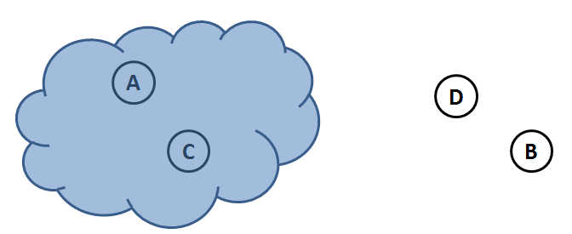

Slide 13
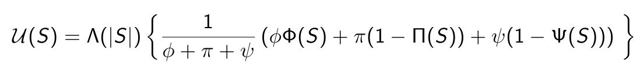


Coalitions | values
{A} | 0.6
{B} | 0.6
{A,B} | 1
Coalitions | P contract | Values
{A} | 5 | 5/6
{B} | 0 | 0
{A,B} | 6 | 1

Slide 14
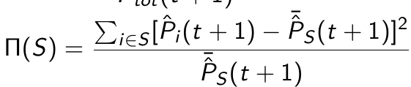
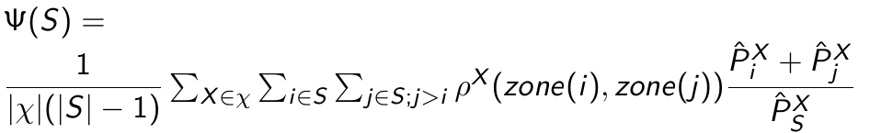
Coalitions | values
{A} | 1
{B} | 1
{A,B} | 8/6
Coalitions | values
{A} | 1
{B} | 1
{A,B} | 0.5
Coalitions | values
{A} | 0.16
{B} | 0
{A,B} | 0.388

