Slide 1
DSM
Microgrid
Optimization
VPP
Islanding
Load Schedding
Real Time Pricing
DATA

Slide 2
Main Grid
Microgrid A
Agents
1, 2, 3, 4, 5
2
4
Contract P
[Pinf,A, Pmax,B] ; τgrid
1
3
5
[Pinf,1, Pmax,1] ; τmicro
[Pinf,5, Pmax,5] ; τmicro

Slide 3
MG1 and MG2 in super Islanding mode
HV
GRID
Load
Load
HV/MV Transformer
Load
DER
MG1
PCC
MV
MG3 in islanding mode
(autonomous)
PCC
DER
DER
Load
DER
Load
PCC
Load
DER
DER
DER
Load
DER
MG2

Slide 4
TVPP 1
HV grid
TVPP 2
DER of CVPP 1
DER of CVPP 2
DER without CVPP

Slide 5
TVPP
CVPP1
CVPP2
CVPP3

Slide 6
Production
Production
Pmean
3h
Time
Time

Slide 7
A
D
C
B

Slide 8
SHERIDAN zone0 | Rapid city zone1 | Aberdeen zone2 | Huron zone3 | Sioux Falls zone4
Lander zone5 | Casper zone6 | Scottsbluff zone7 | Valentine zone8 | Norfolk zone9
Cheyenne zone10 | North Platte zone11 | Grand Island zone12 | Lincoln zone13 | Omaha zone14
Grand Junction zone15 | Colorado Springs zone16 | Buckley zone17 | Goodland zone18 | Concordia zone19
San Louis zone20 | Memorial zone21 | Dodge zone22 | Wichita zone23 | Topeka zone24

Slide 9
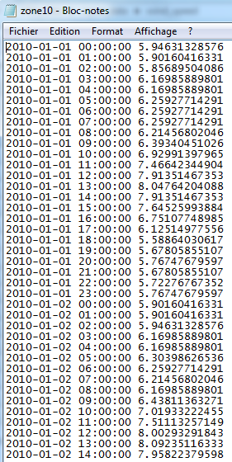

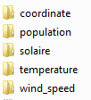
Final organization of clean input data

Slide 10
1
Get latitude, longitude, and elevation of the station
2
Convert “percentage of clear sky” data to cloudiness (in octats)
3
Apply cloudiness to Helios model as a degradation factor
Get “percentage of clear sky” data from a station
Use Helios model to generate perfect solar irradiance profile (clear blue sky) at this location on earth

