Slide 1
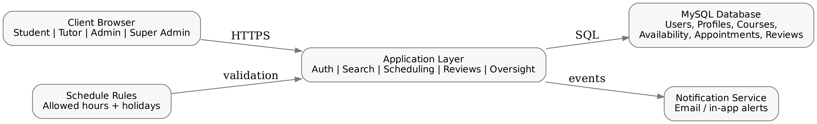
Milestone 2 — Design Presentation
Student-to-Tutor Scheduling & Availability Management System
Presenter
Nicolas Imhof (114606862)
Systems Design and Implementation
Instructor: Renu Balyan
Date: March 2026
Notes:
Milestone 2 design deck (planned for ~11 minutes). [Sources] - Milestone2_Design_Document.docx (uploaded) - Team6_GymPages.pdf (sample Milestone 2 presentation format) - Team2_ConoCancer.pdf (sample Milestone 2 presentation format) [/Sources]

Slide 2
What I did for Milestone 2
11-minute plan
Work completed
How this talk is organized
Translated the Milestone 1 concept into a full Milestone 2 design document
Defined assumptions, constraints, risks, and mitigations
Designed the database: logical ERD, physical schema, data dictionary, and MySQL schema
Created UI structure/navigation + wireframes for key screens and roles
Planned REST-style APIs (auth, search, scheduling, reviews, admin tools)
Defined non-functional requirements and a baseline test plan
1) Overview & scope
2) Assumptions / constraints / risks
3) Database design
4) UI design (navigation + screens)
5) APIs, NFRs, tests
Goal: show my design work
(not the final implementation).
Notes:
[Sources] - Milestone2_Design_Document.docx (uploaded) - Team6_GymPages.pdf (format reference) - Team2_ConoCancer.pdf (format reference) [/Sources]

Slide 3
Overview of the Design
system scope
System summary
High-level architecture
Roles: Student, Tutor, Admin, Super Admin
Flow: apply → approval → role dashboard
Student: search tutors → view basic profile → book appointment → leave review
Tutor: manage availability → manage appointment status → review summary (no author names)
Admin/Super Admin: approvals, moderation, schedule rules, holiday blocks, oversight
Client/server web app + relational DB + notifications
+ schedule-rule validation.
Notes:
[Sources] - Milestone2_Design_Document.docx (Sections 1–2) [/Sources]

Slide 4
Assumptions & Constraints
what the design depends on
Assumptions
Constraints
Desktop/laptop web browsers with stable Internet
School-managed environment with school IDs and role approval
Course and tutor capability data is maintained accurately
Ratings are derived from completed student reviews (not editable)
One primary relational database is sufficient for the scale
Internal tutoring workflow (not a public marketplace)
No booking outside availability, allowed hours, or holiday blocks
Tutor cannot manage reviews or see review author identity
Admin cannot edit another Admin profile
Filter-based matching (course/capability/rating/time)
Notes:
[Sources] - Milestone2_Design_Document.docx (Section 1.1.1–1.1.2) - Team6_GymPages.pdf (Assumptions/Constraints slide pattern) [/Sources]

Slide 5
Risks & Mitigation
design-level safeguards
Double booking
Outdated availability
Privacy exposure
Approval backlog
Validate slot availability during booking
+ transaction-safe reservation (unique slot).
Tutor + admin schedule controls
+ clear status history and notifications.
Role-based field visibility
+ review author masked in tutor view
+ admin moderation.
Admin approval queue
+ decision notifications
+ status tracking.
Notes:
[Sources] - Milestone2_Design_Document.docx (Section 1.1.3) [/Sources]

Slide 6
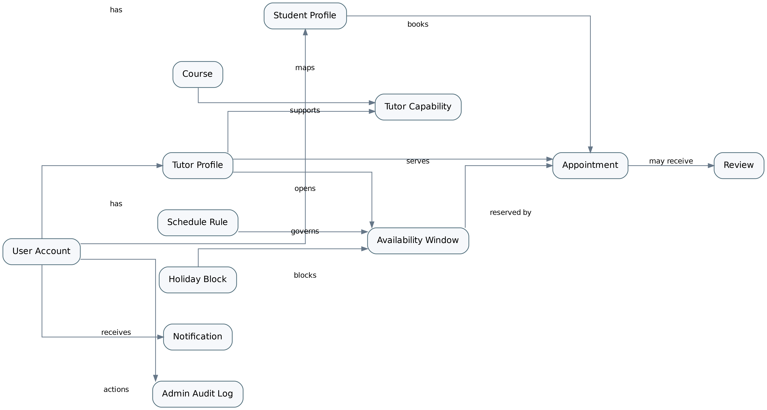
Database Design — Logical Model
entities & relationships
Key ideas
user_account anchors identity + role; profiles extend it. Search uses course + capability mappings. Scheduling uses availability → appointment, constrained by rules/holidays. Reviews attach to completed appointments.
Notes:
[Sources] - Milestone2_Design_Document.docx (Section 2.1.1) [/Sources]

Slide 7
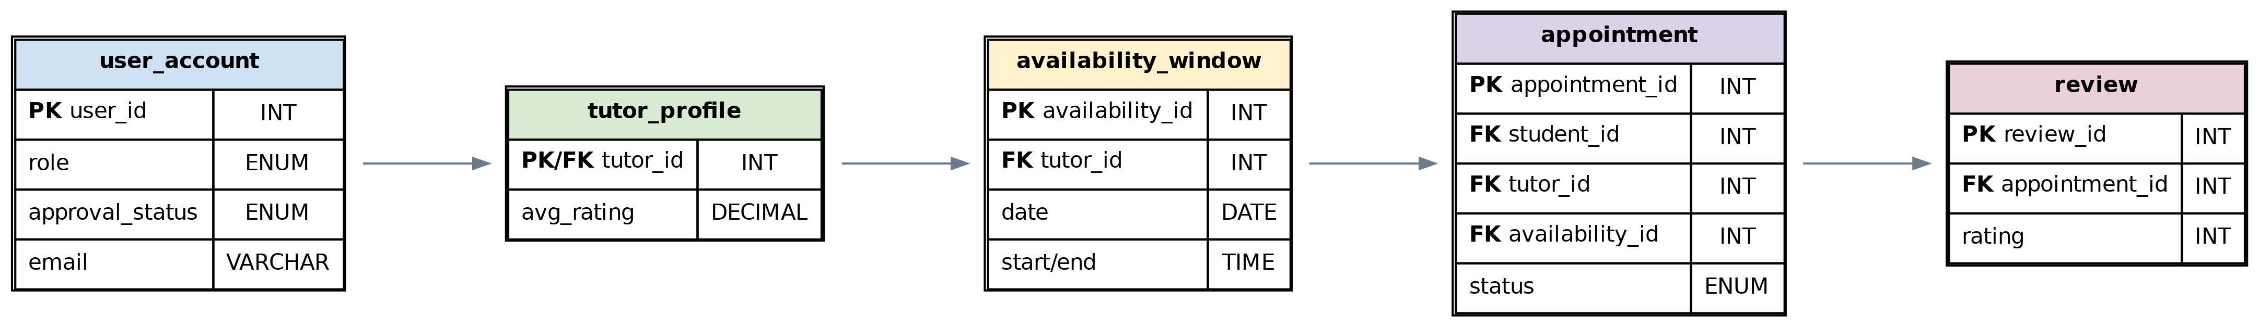
Database — Physical Schema & Data Dictionary
how the tables support the model
Physical schema (core)
Data dictionary highlights
Core tables
user_account + student_profile + tutor_profile
course + tutor_capability (search mapping)
availability_window + appointment (booking)
review (post-session feedback)
schedule_rule + holiday_block (validation)
notification + admin_audit_log (oversight)
Important constraints
• availability_id is unique in appointment
• review is 1:1 with appointment
• role-based visibility (privacy)
Notes:
[Sources] - Milestone2_Design_Document.docx (Sections 2.1.2–2.1.3) - Team6_GymPages.pdf (Data Dictionary slide pattern) [/Sources]

Slide 8
Database Schema (example)
appointment booking constraints
Why this table matters
SQL excerpt (simplified)
Connects a student + tutor to a specific availability slot
Enforces conflict prevention (unique reserved slot)
Tracks lifecycle status (Scheduled/Rescheduled/Canceled/Completed)
Tracks who created the record (student vs admin override)
CREATE TABLE appointment (
appointment_id INT PK,
student_id INT FK,
tutor_id INT FK,
availability_id INT UNIQUE FK,
appointment_date DATE,
start_time TIME, end_time TIME,
status ENUM(...),
created_by_user_id INT FK,
created_source VARCHAR(30)
);
Full schema is in the design document.
Notes:
[Sources] - Milestone2_Design_Document.docx (Section 2.1.3) [/Sources]

Slide 9
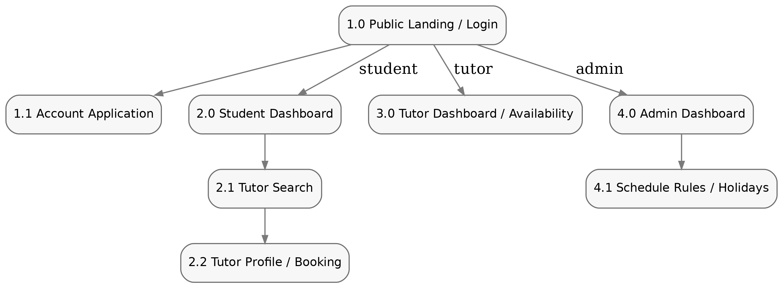
User Interface
structure & navigation
Navigation map
Role-based routing
Public: Landing → Apply → (wait for approval)
Student: Dashboard → Search → Profile/Booking
Tutor: Dashboard → Availability → Appointments
Admin: Dashboard → Approvals → Rules/Holidays
Design focus: clear task flow +
permission-based visibility.
Notes:
[Sources] - Milestone2_Design_Document.docx (Section 2.2.1) - Team2_ConoCancer.pdf (Structure & Navigation slide pattern) [/Sources]

Slide 10
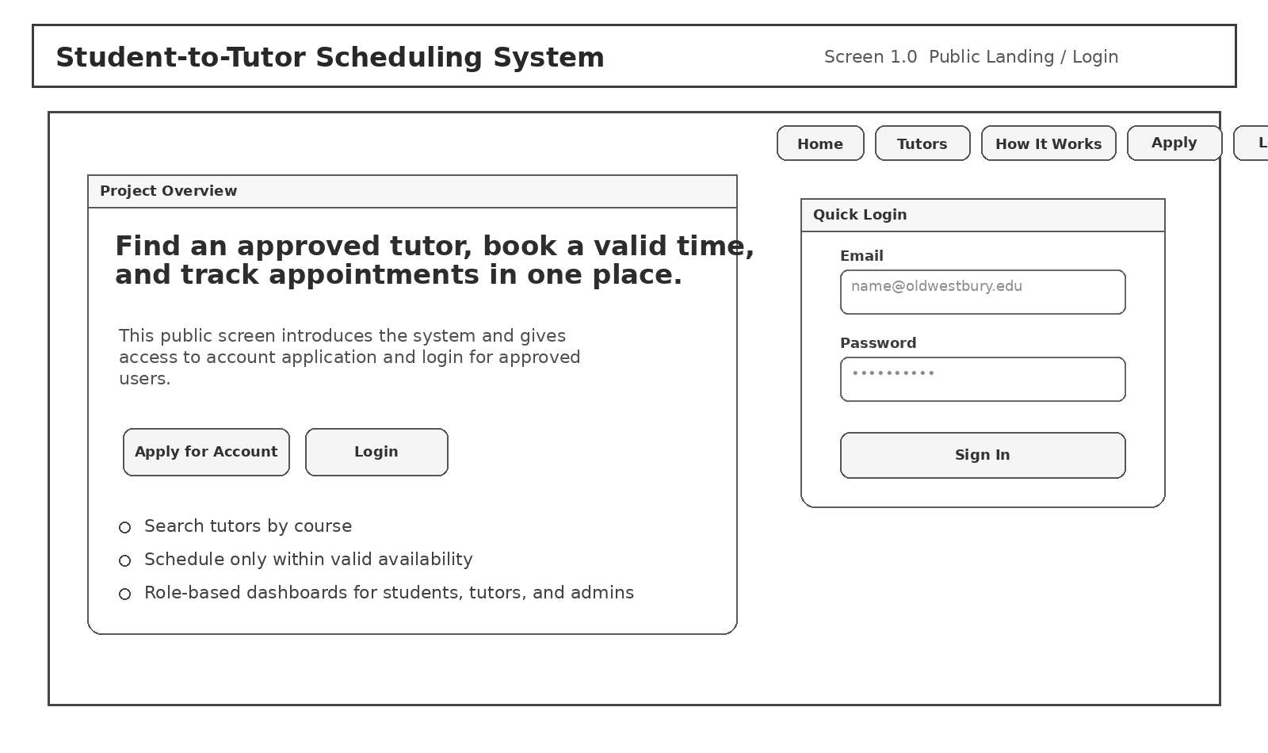
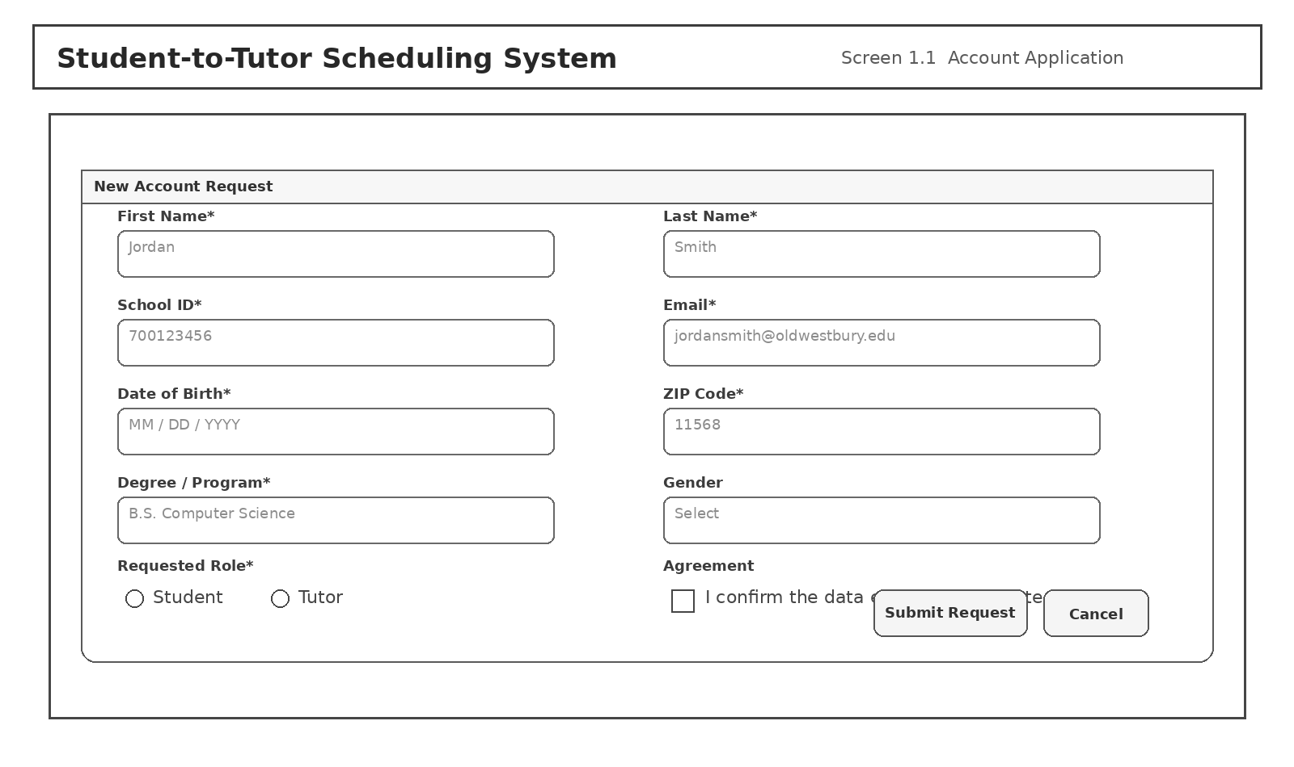
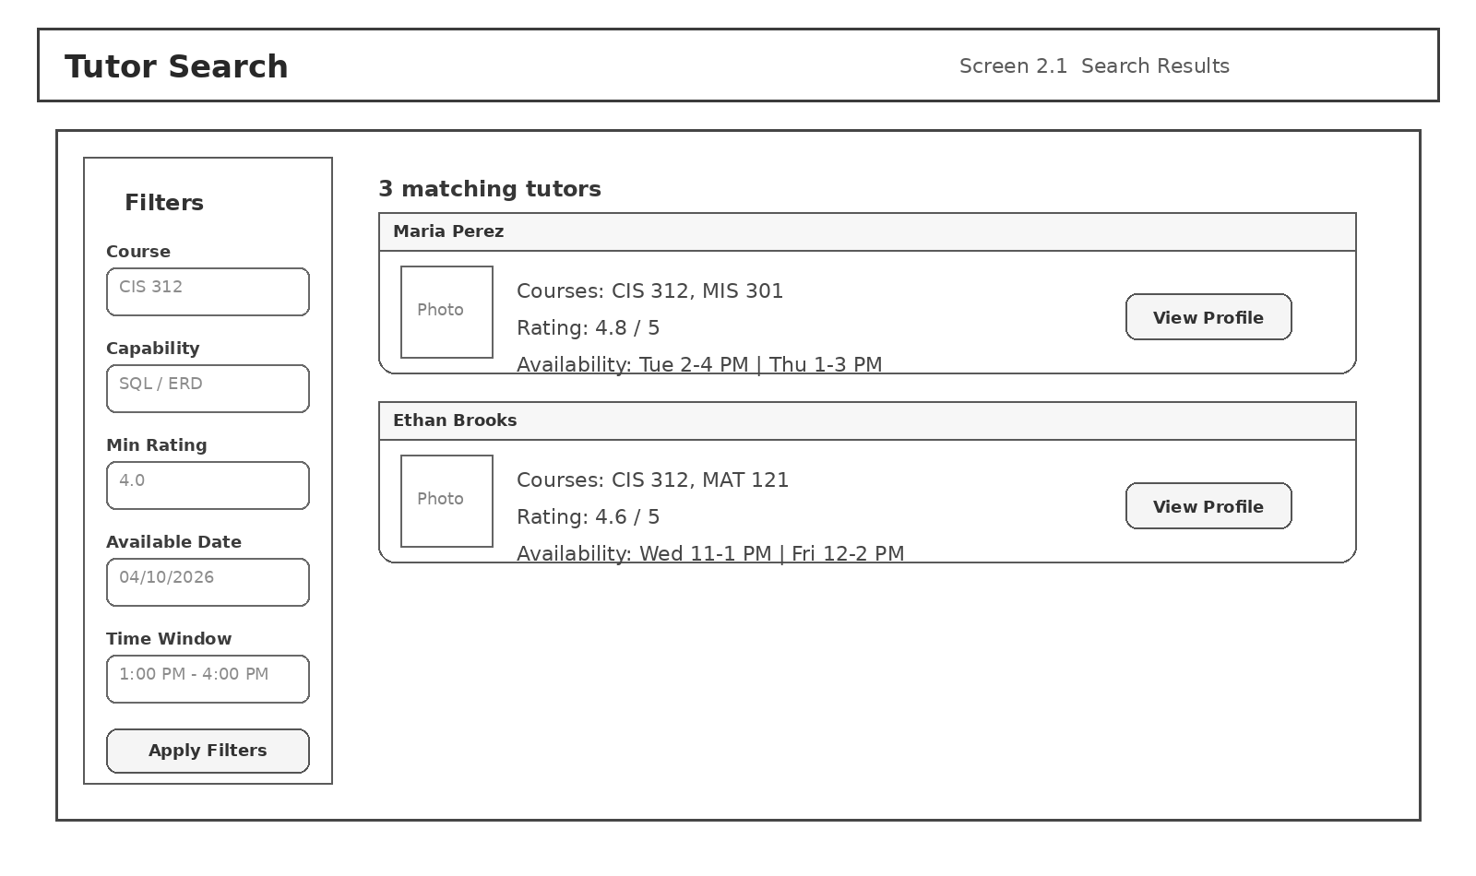
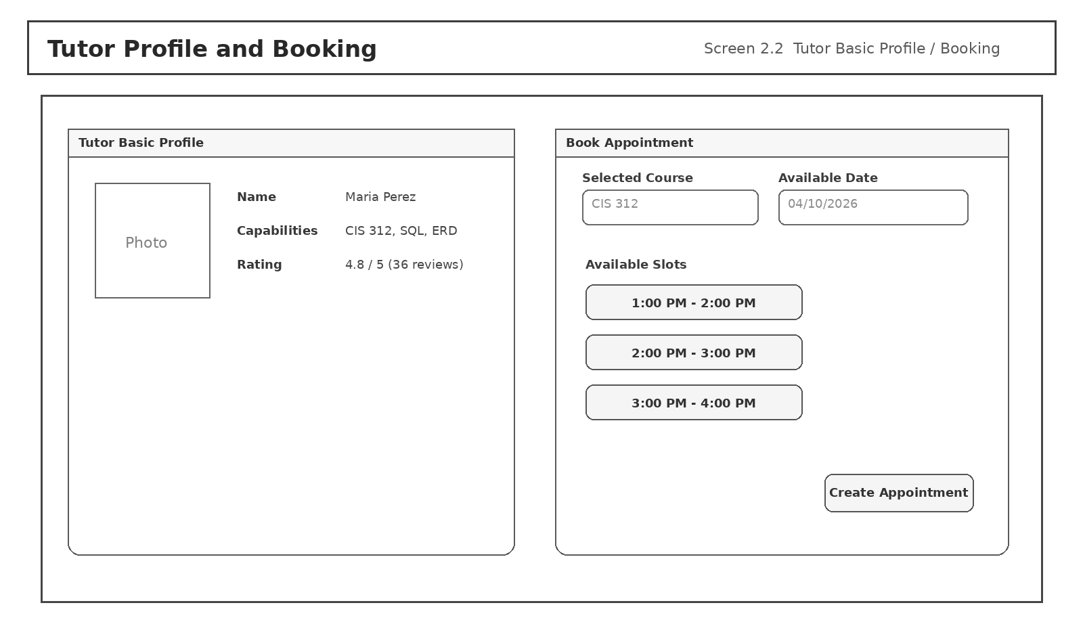
UI Wireframes — Student flow
from login to booking
Landing / Login
Account Application
Search Results
Profile + Booking
Notes:
[Sources] - Milestone2_Design_Document.docx (Section 2.2.2 Screens 1.0–2.2) - Team6_GymPages.pdf (Wireframe slide pattern) [/Sources]

Slide 11
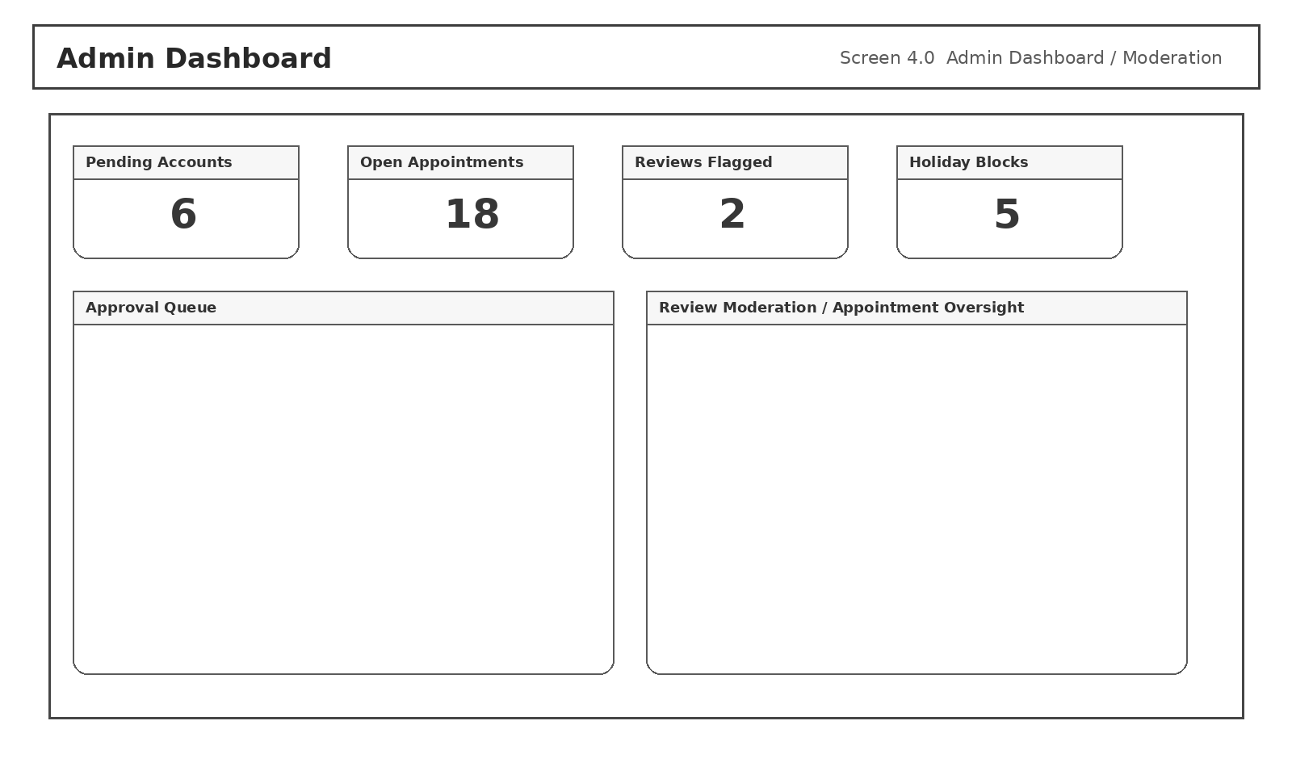
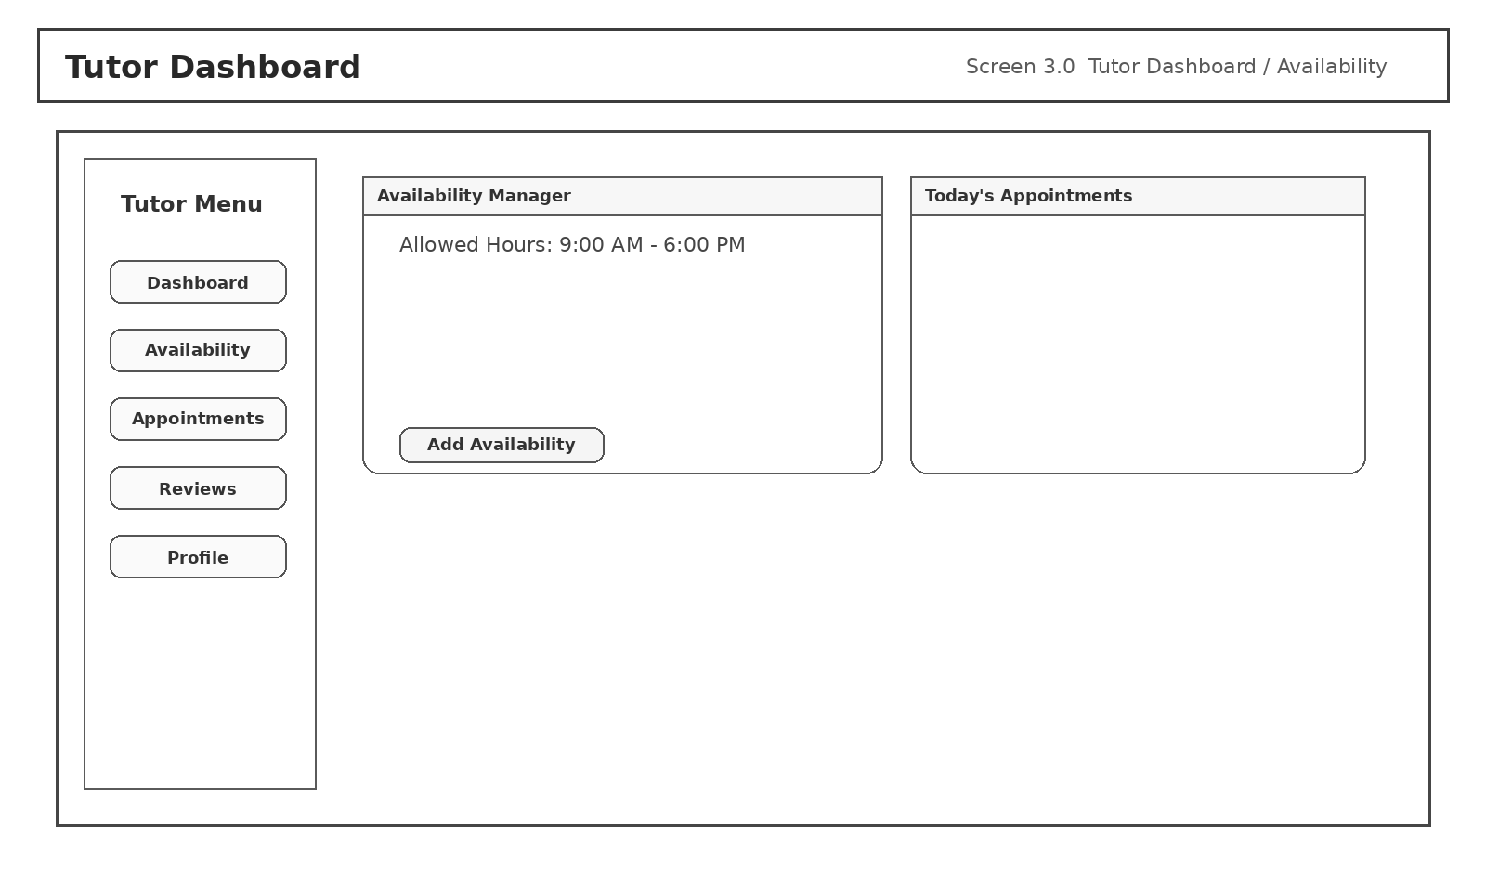
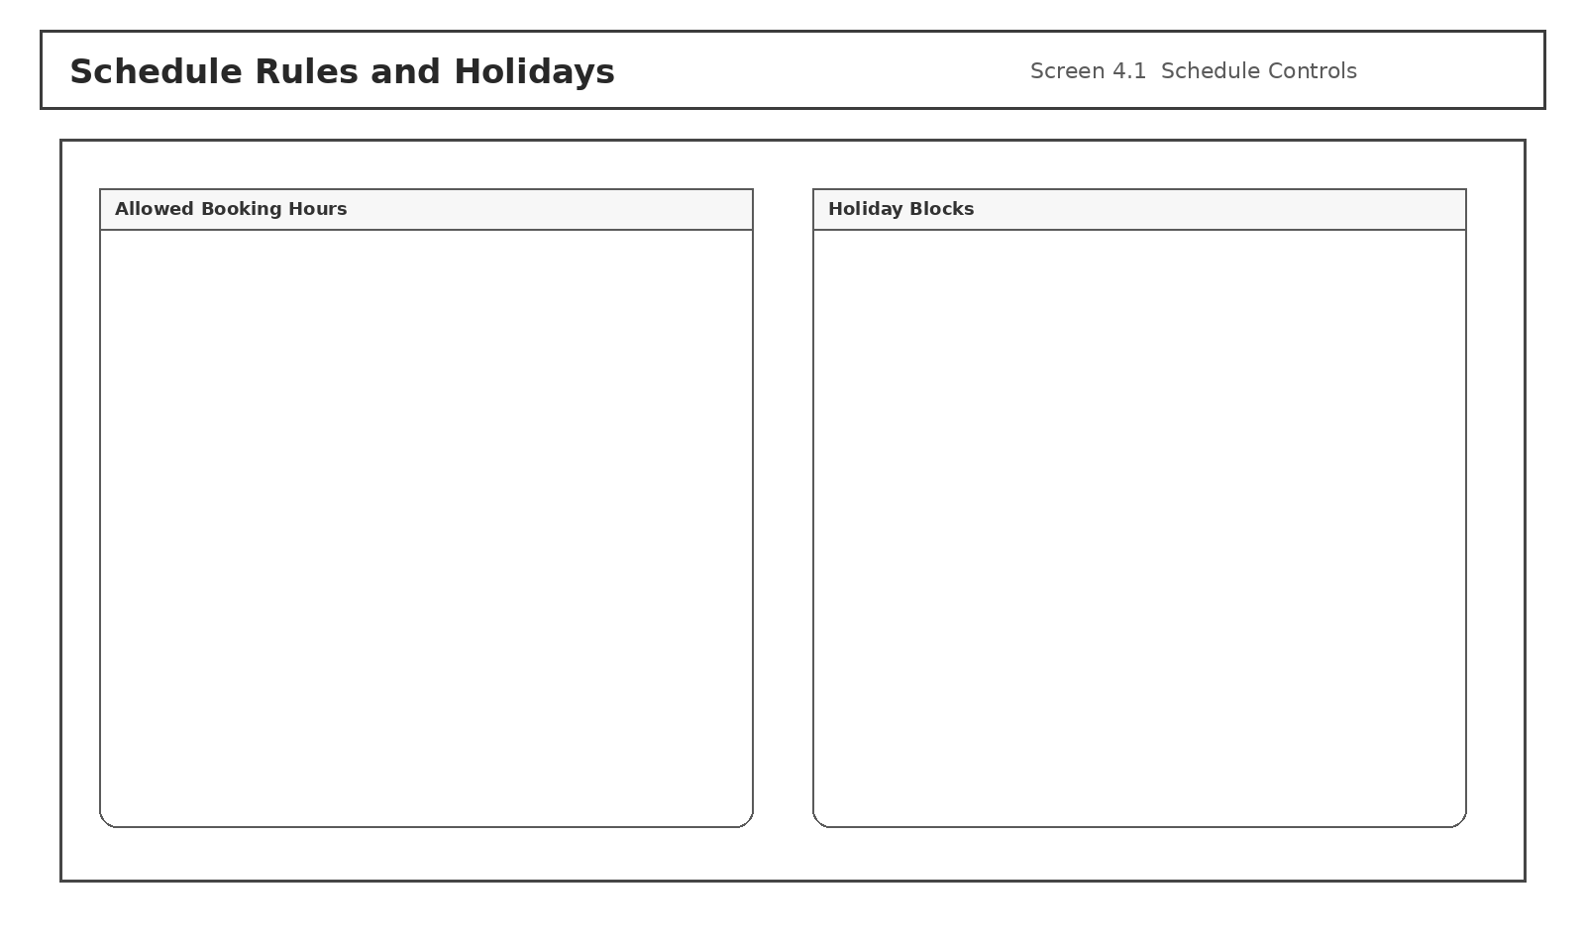
UI Wireframes — Tutor & Admin
availability + oversight
Admin Dashboard
Tutor Dashboard / Availability
Schedule Rules / Holidays
Notes:
[Sources] - Milestone2_Design_Document.docx (Section 2.2.2 Screens 3.0–4.1) [/Sources]

Slide 12
API Development
how the UI talks to the system
Endpoint groups
Example: booking flow
Group
Purpose
1) Student searches tutors
2) Selects an open availability slot
3) POST /appointments reserves slot
4) Notifications sent to both users
5) Tutor updates status (reschedule/cancel/complete)
6) Student creates review after completion
Auth
register, login, logout
Profiles
get/update own profile
Search
tutor list + basic profile
Availability
tutor creates/removes slots
Appointments
create + status updates
Reviews
create/edit/delete + visibility rules
Admin
approvals, rules/holidays, moderation, overrides
Security rule:
Role check first → validate inputs → then write to DB.
Sensitive fields are never returned to the wrong role.
Notes:
[Sources] - Milestone2_Design_Document.docx (Section 2.3) [/Sources]

Slide 13
Non-Functional Requirements & Tests
how quality is validated
Non-functional priorities
Test plan (examples)
Security: hashed passwords + role checks on every endpoint
Reliability: transaction-safe booking and consistent status states
Usability: role dashboards + disabled/hidden actions when invalid
Performance: indexed search + fast availability lookup
Privacy: mask review author identity in tutor view + audit admin actions
TC-01 Account request submits as Pending
TC-02 Admin approves/denies → access changes
TC-05 Booking creates Scheduled appointment
TC-06 Conflict prevention blocks double-booking
TC-09 Reviews: ownership + privacy enforcement
TC-11 Rules/holidays applied to availability + booking
Notes:
[Sources] - Milestone2_Design_Document.docx (Sections 3–4) [/Sources]

