Slide 1


Quantifying anomalies in patients with neuropathologies via diffusion Magnetic Resonance Imaging. (Application to Alzheimer diagnosis)
Nicolas Indriets

Slide 2
Questions of research
In a cohort of MCI patients characterized for amyloid status :
What best explains tau accumulation in the posterior cingulum cortex ?
  Is it the tau accumulation in the medial temporal lobe?
  Is it the mean diffusivity in the hippocampal cingulum bundle?
What best explains hypometabolism in the posterior cingulum cortex ? -
  Is it the tau accumulation in this part of the brain ?
  Is it the mean diffusivity in the hippocampal cingulum bundle ?
  Is it the tau accumulation in the medial temporal lobe ?
→ Use of multi-compartment model and comparison with the results of articles

Slide 3
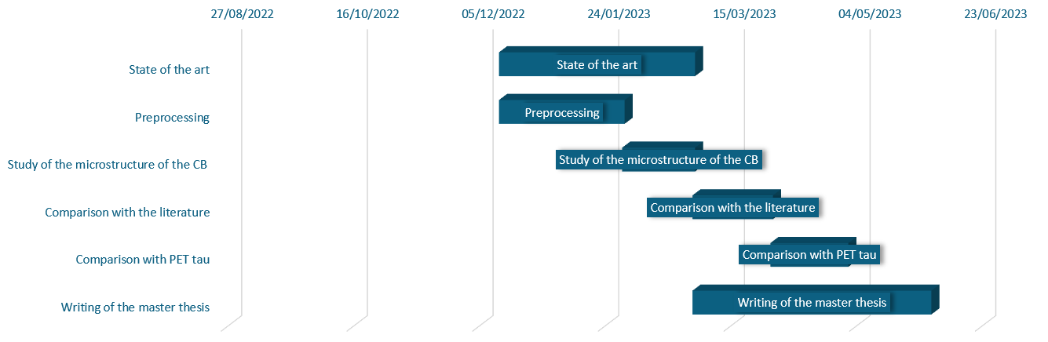
Gantt chart

Slide 4
Preprocessing
Reslice : Used if the raw data is not in its native resolution because it reduces performances of MPPCA.
-> Not used
MPPCA Denoising : Fast and does not blur the image or create artifact
-> Used
Gibbs ringing correction : If data suffers from Gibbs ringing artifacts. Might blur out small microstructural features
-> Not used
Topup : Estimate susceptibility induced distortions
-> Used
Eddy correction : Correct motion, susceptibility if estimated with Topup and Eddy current induced distortions.
-> Used
Bias field correction : Correct variability of the signal in tissues of the same type.
-> Not used

Slide 5
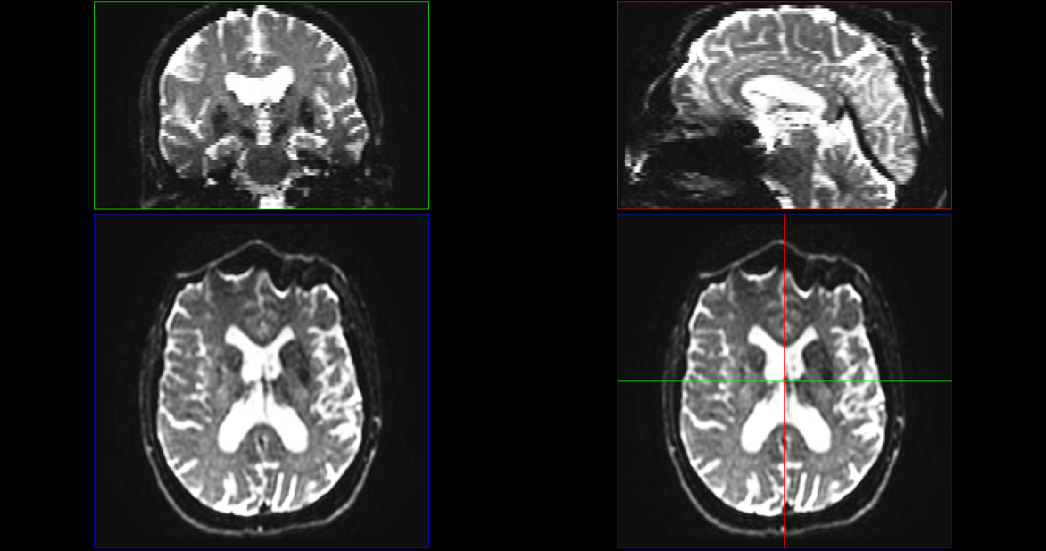
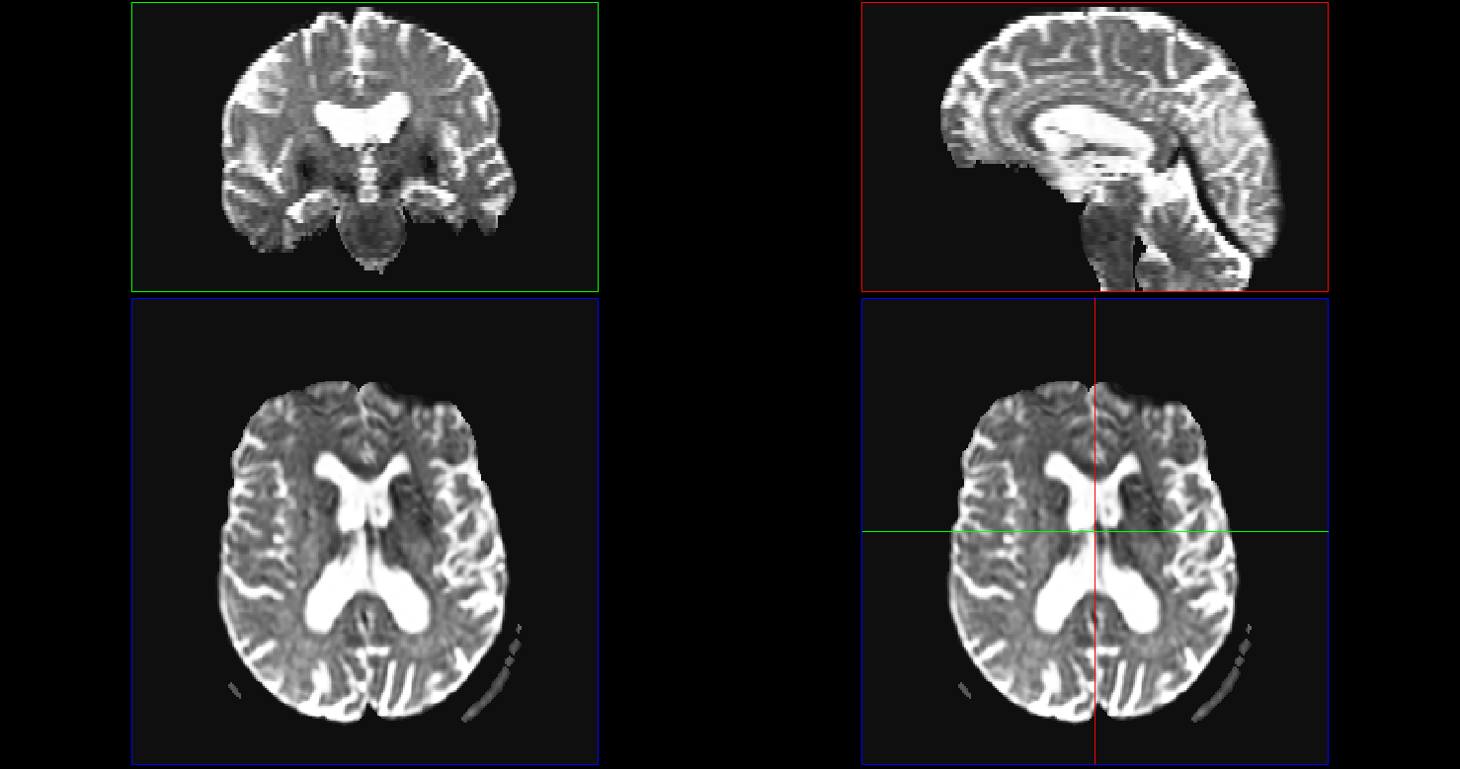
Preprocessing

Slide 6
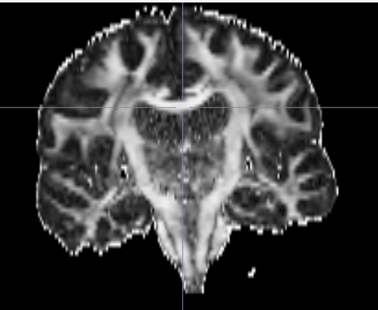
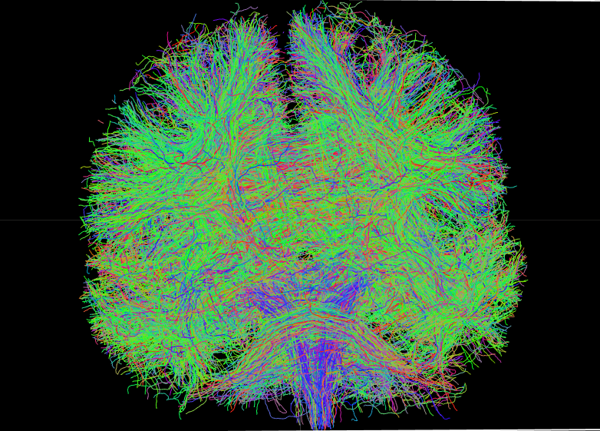
Preprocessing

Slide 7
Readings
Multi-compartment models :
Zhang, Hui, Torben Schneider, Claudia A. Wheeler-Kingshott, et Daniel C. Alexander. « NODDI: Practical in Vivo Neurite Orientation Dispersion and Density Imaging of the Human Brain ». NeuroImage 61, nº 4 (juillet 2012): 1000‑1016. https://doi.org/10.1016/j.neuroimage.2012.03.072.
Scherrer, Benoit, Armin Schwartzman, Maxime Taquet, Mustafa Sahin, Sanjay P. Prabhu, et Simon K. Warfield. « Characterizing Brain Tissue by Assessment of the Distribution of Anisotropic Microstructural Environments in Diffusion-Compartment Imaging (DIAMOND): Characterizing Brain Tissue with DIAMOND ». Magnetic Resonance in Medicine 76, nº 3 (septembre 2016): 963‑77. https://doi.org/10.1002/mrm.25912.
Rensonnet, Gaëtan, Benoît Scherrer, Gabriel Girard, Aleksandar Jankovski, Simon K. Warfield, Benoît Macq, Jean-Philippe Thiran, et Maxime Taquet. « Towards Microstructure Fingerprinting: Estimation of Tissue Properties from a Dictionary of Monte Carlo Diffusion MRI Simulations ». NeuroImage 184 (janvier 2019): 964‑80. https://doi.org/10.1016/j.neuroimage.2018.09.076.
Brain structure and tau deposition :
Pichet Binette, Alexa, Guillaume Theaud, François Rheault, Maggie Roy, D Louis Collins, Johannes Levin, Hiroshi Mori, et al. « Bundle-Specific Associations between White Matter Microstructure and Aβ and Tau Pathology in Preclinical Alzheimer’s Disease ». ELife 10 (13 mai 2021): e62929. https://doi.org/10.7554/eLife.62929.
Jacobs, Heidi I. L., Trey Hedden, Aaron P. Schultz, Jorge Sepulcre, Rodrigo D. Perea, Rebecca E. Amariglio, Kathryn V. Papp, Dorene M. Rentz, Reisa A. Sperling, et Keith A. Johnson. « Structural Tract Alterations Predict Downstream Tau Accumulation in Amyloid-Positive Older Individuals ». Nature Neuroscience 21, nº 3 (mars 2018): 424‑31. https://doi.org/10.1038/s41593-018-0070-z.

