Slide 1


Quantifying anomalies in patients with neuropathologies via diffusion Magnetic Resonance Imaging. (Application to Alzheimer diagnosis)
Nicolas Indriets

Slide 2
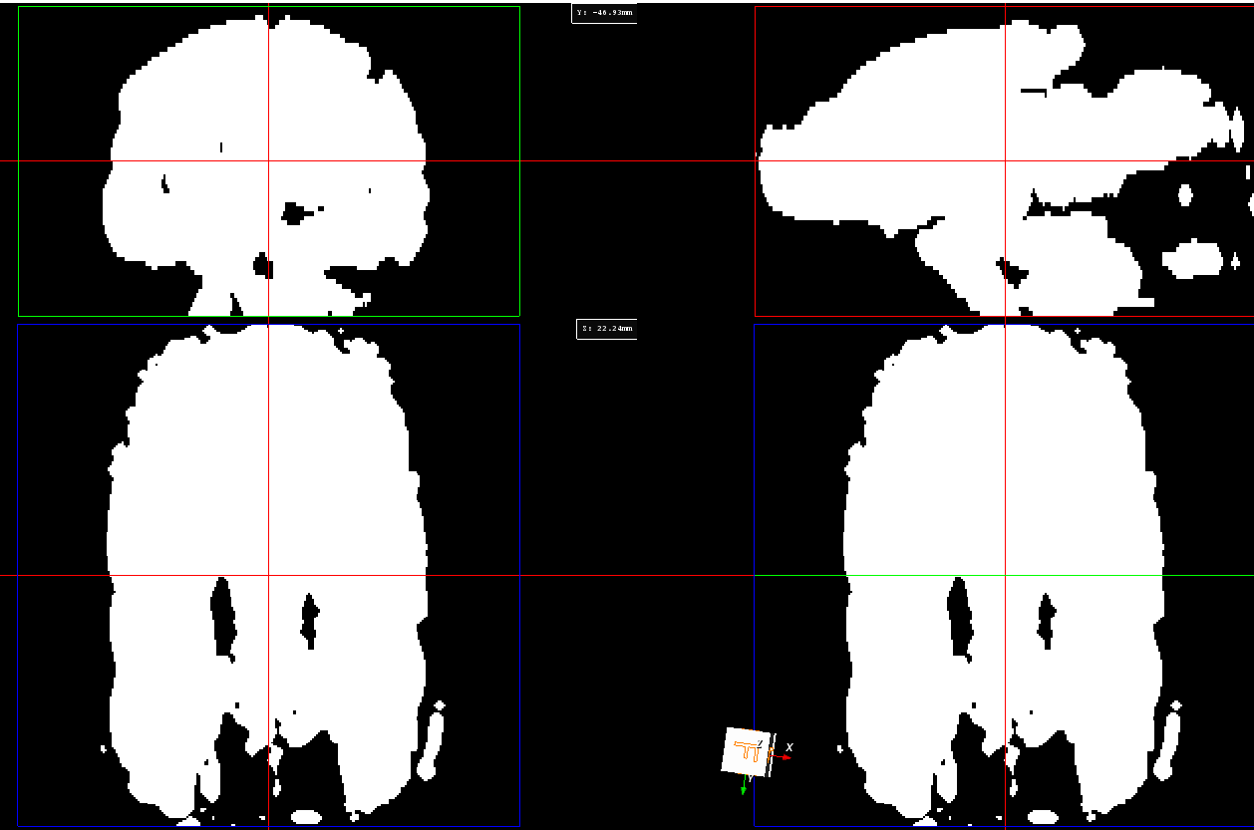
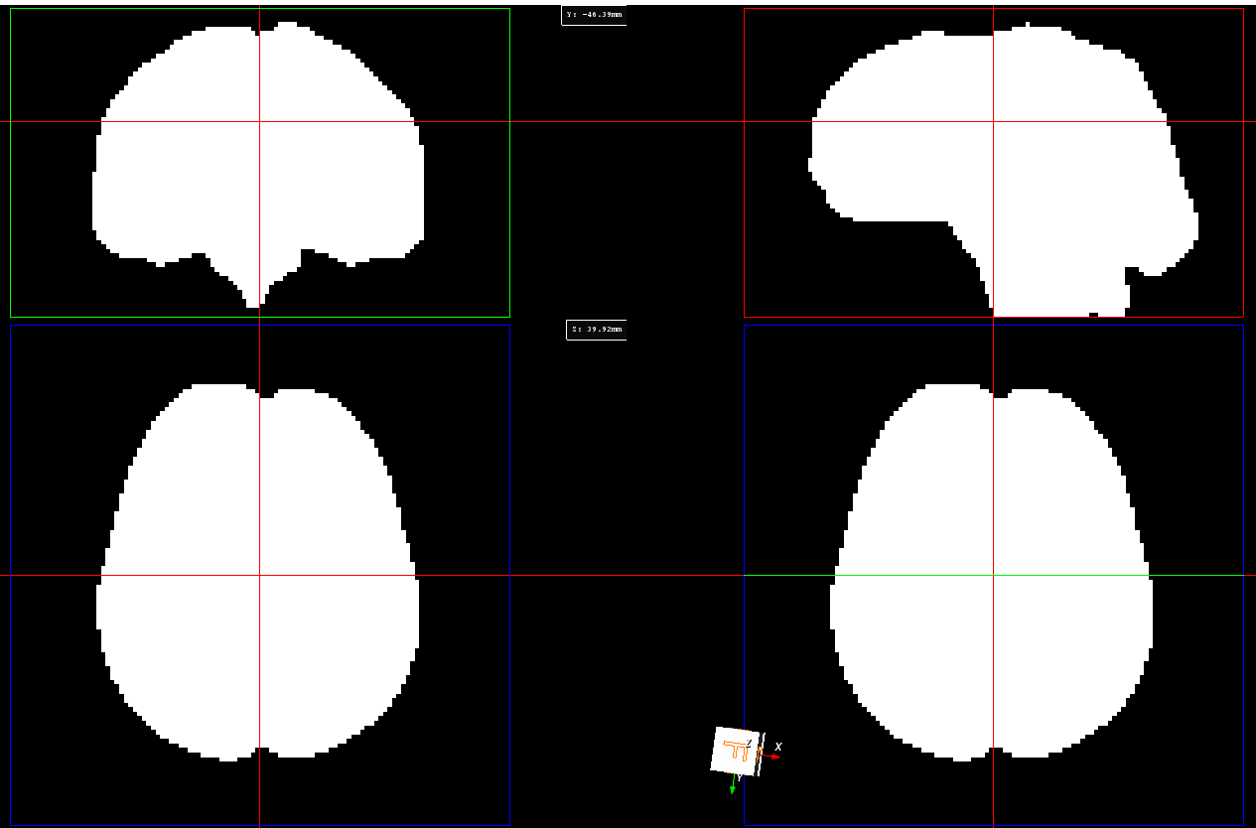
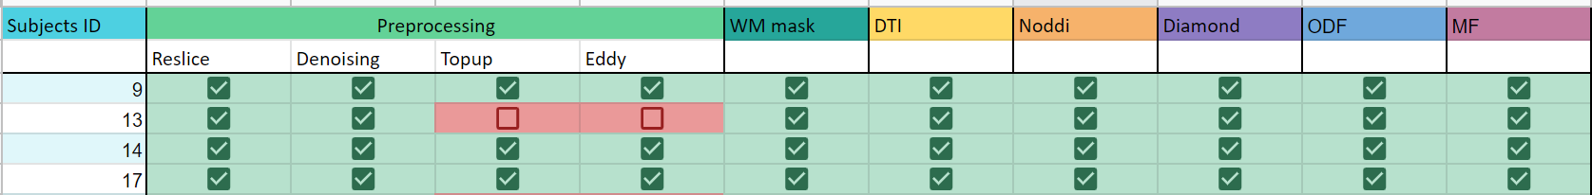
Preprocessing and model update
Brain mask dilated sub-106 without reslice
Brain mask dilated sub-106 with reslice
Problem solved, but still have some subjects where eddy does not work (It takes too much time to compute). Use of a variable in the study to take that into account

Slide 3
Atlas mapping
Area to analyse to answer my research questions :
Parahippocampal cortex
Enthorinal cortex
Posterior cingulate cortex
Isthmus cingulate cortex
Amygdala
Hippocampus
Baseline :
Uncinate fasciculus
First Method :
Register the Desikan-Killiany atlas on a T1 image in MNI152 space
Create the atlas with the labels file
Register patients with the T1 image and the first volume of white matter ODF
Apply the transform on the atlases.
Second method :
Register patients with a FA map of HCP1065 for XTRACT atlas and FA map obtained with DTI
Apply the transform on the atlases

Slide 4
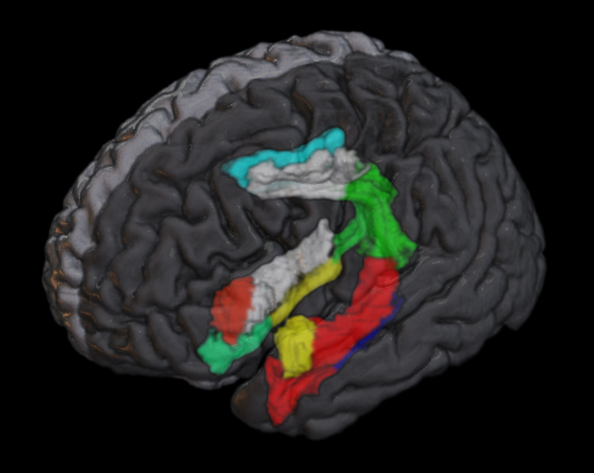
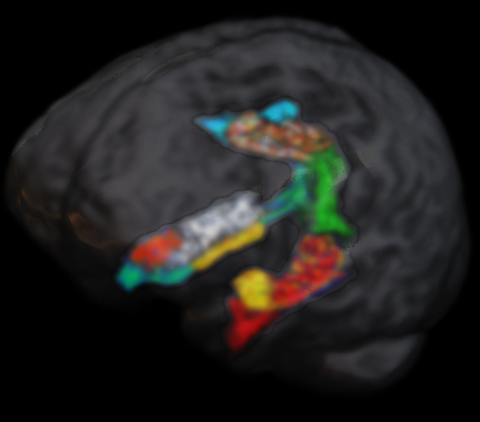
Atlas mapping
Desikan-Killiany Atlas
Registered and mapped atlas on sub-009

Slide 5
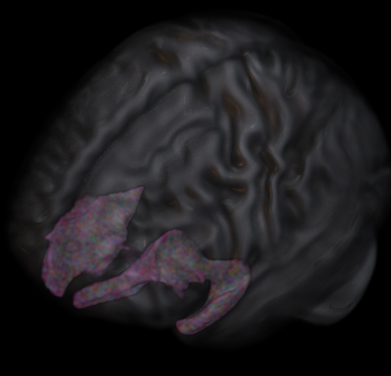
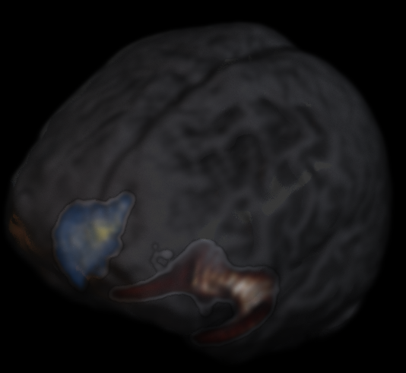
Atlas mapping
XTRACT HCP Probabilistic Tract Atlas
Registered and mapped atlas on sub-009

Slide 6
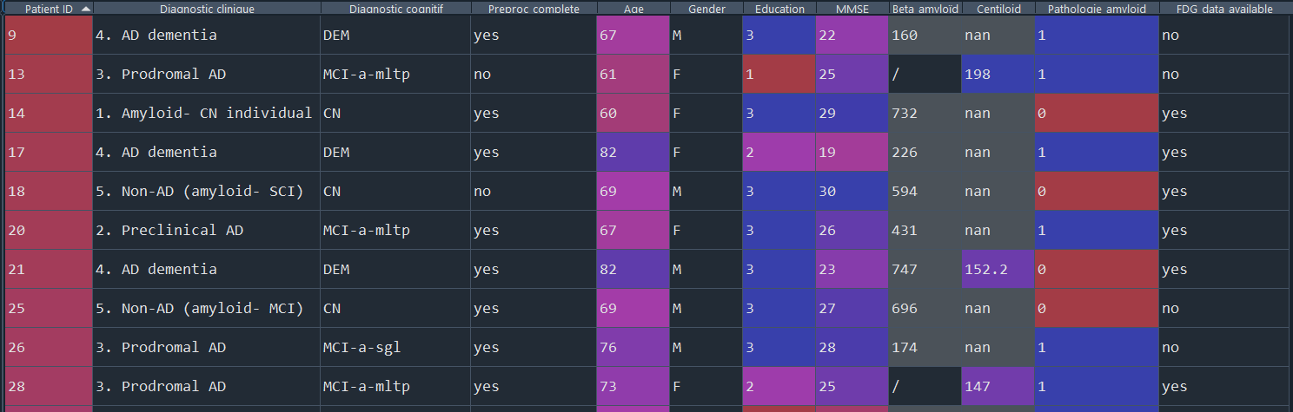
Study

Slide 7
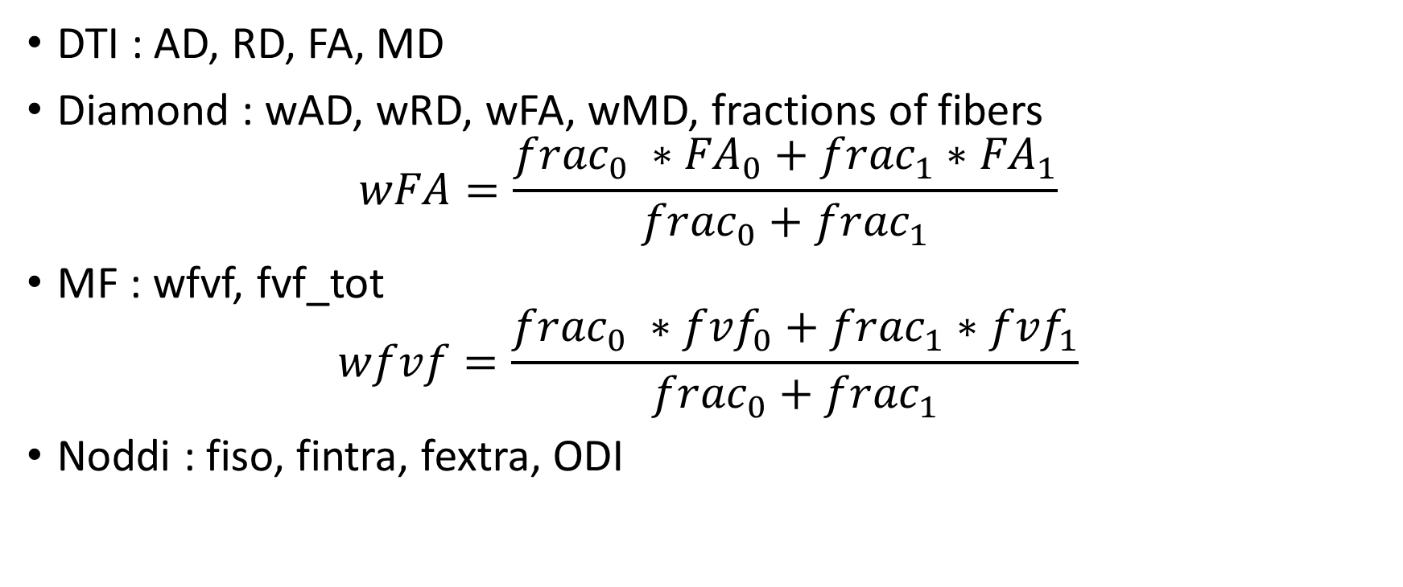
Study
DTI : AD, RD, FA, MD
Diamond : wAD, wRD, wFA, wMD, fractions of fibers
$$wFA=\frac{{frac}_{0} ∗{FA}_{0}+{frac}_{1}∗{FA}_{1}}{{frac}_{0}+{frac}_{1}}$$
MF : wfvf, fvf_tot
$$wfvf=\frac{{frac}_{0} ∗{fvf}_{0}+{frac}_{1}∗{fvf}_{1}}{{frac}_{0}+{frac}_{1}}$$
Noddi : fiso, fintra, fextra, ODI

Slide 8
Timeline
Progress made on the state of the art -> To continue
Start the statistical analysis of microstructure
Dec 13 - Feb 28
Preprocessing
Feb 13 - Mar 20
State of the art writing
Feb 13 - Mar 20
Study of the microstructure of the CB
Mar 20 - Mar 31
Comparison with the literature
Apr 1 - Apr 30
Comparison with PET tau
Mar 20 - Jun 2
Writing of the master thesis
State of the art
Analysis
Master thesis complete
Mar 20
Apr 30
Jun 2
2022
2023
Dec
Jan
Feb
Mar
Apr
May
Jun
2023
Today

