Slide 1


Quantifying anomalies in patients with neuropathologies via diffusion Magnetic Resonance Imaging. (Application to Alzheimer diagnosis)
Nicolas Indriets

Slide 2
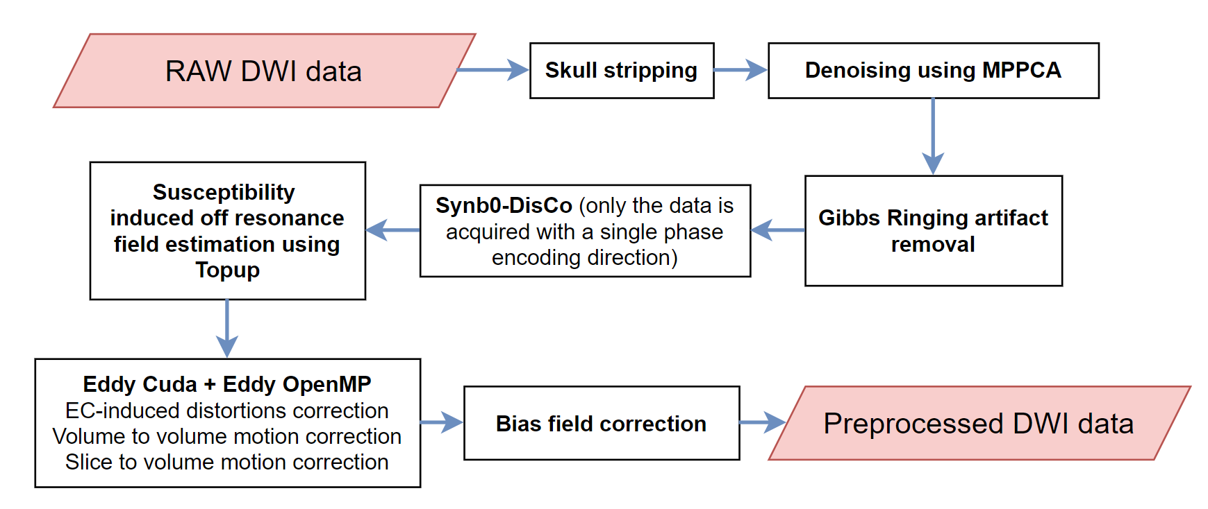
Preprocessing
Reslicing
Brain extraction
MPPCA Denoising
Gibbs ringing correction
Susceptibility field estimation
Eddy and motion correction
Bias field correction

Slide 3
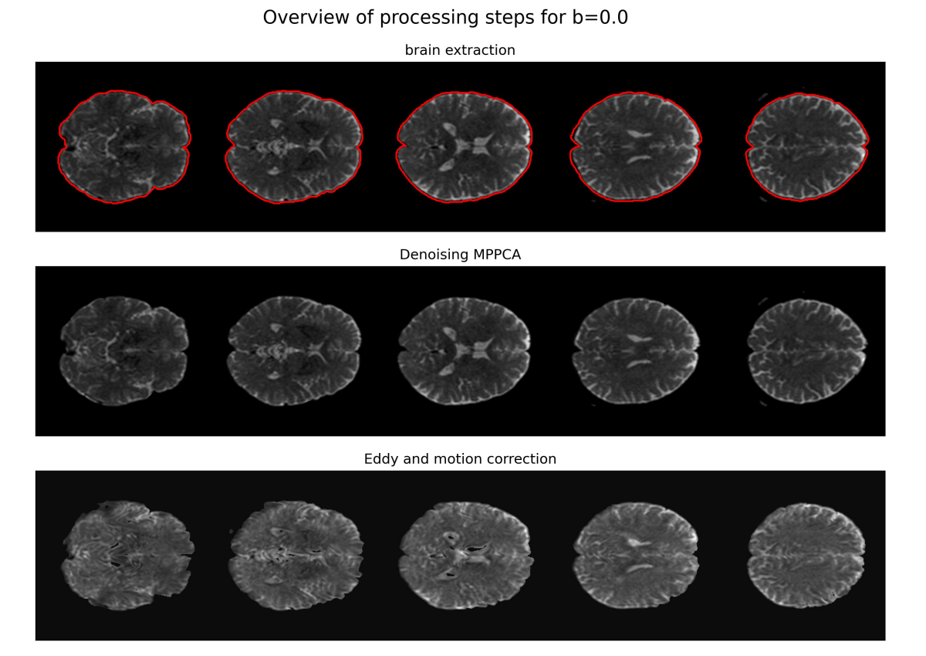
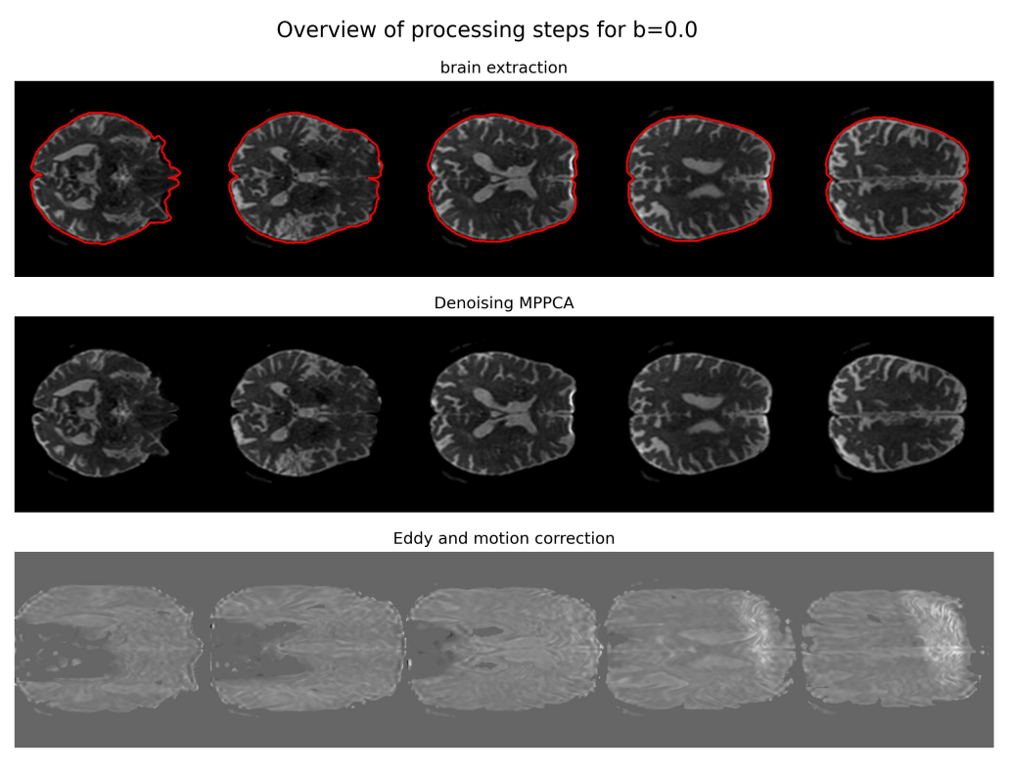
Preprocessing
Sub-103 preprocessing
Sub-106 preprocessing

Slide 4
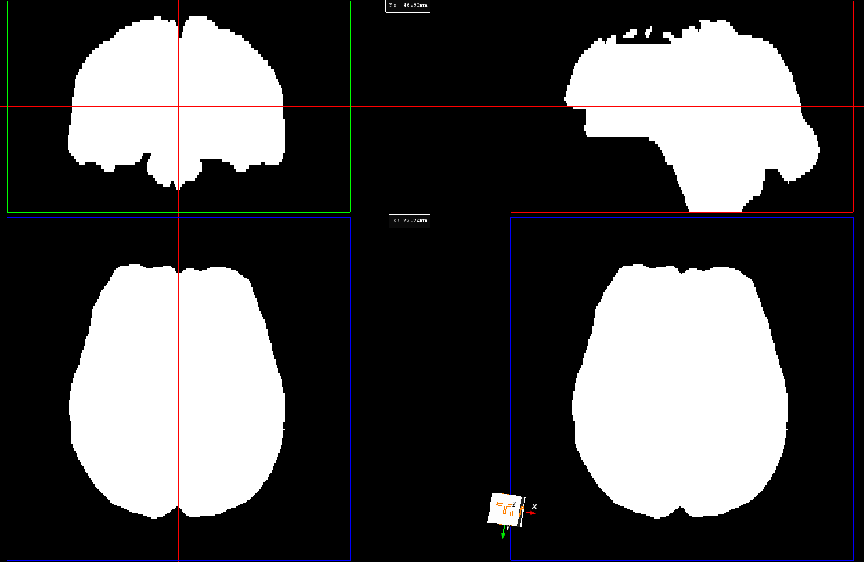
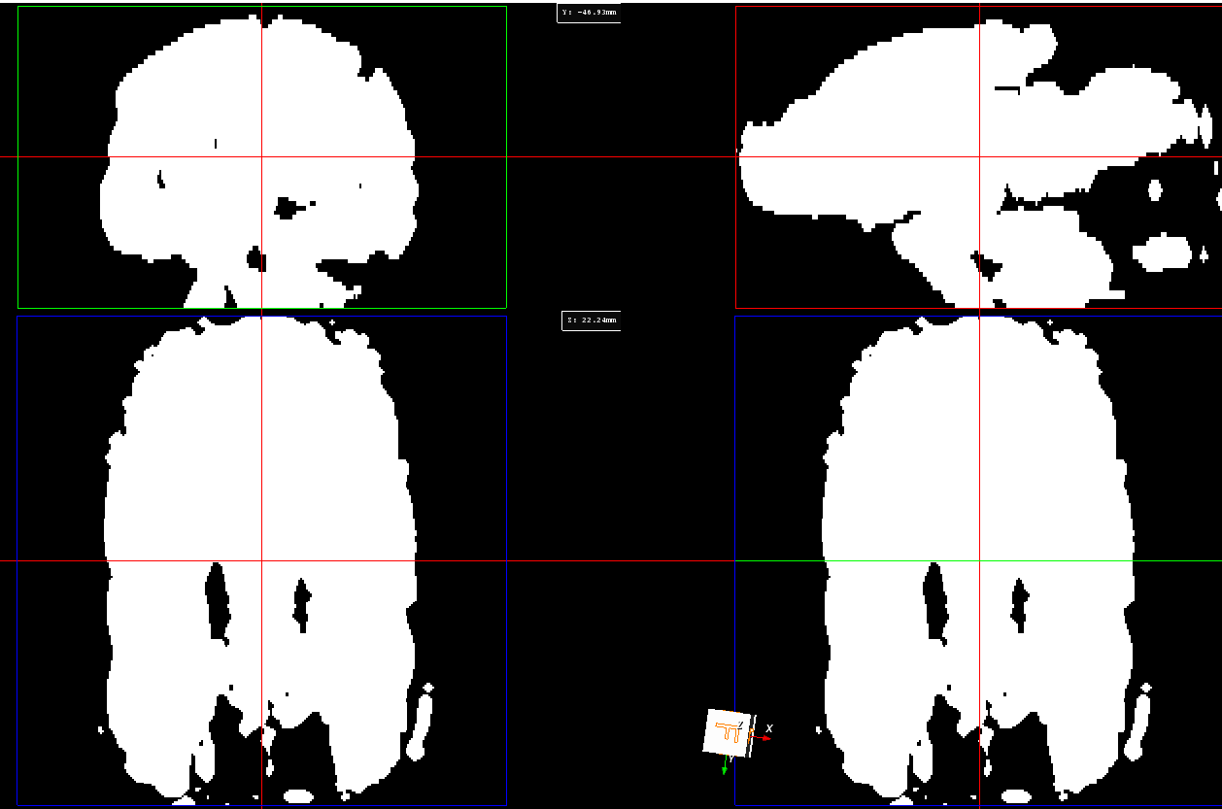
Preprocessing
Brain mask sub-106
Brain mask dilated sub-106
Solutions ?
- Retry preprocessing
- Use the reslice and see if it changes something
- Try to use only the brain mask and not the dilated one

Slide 5
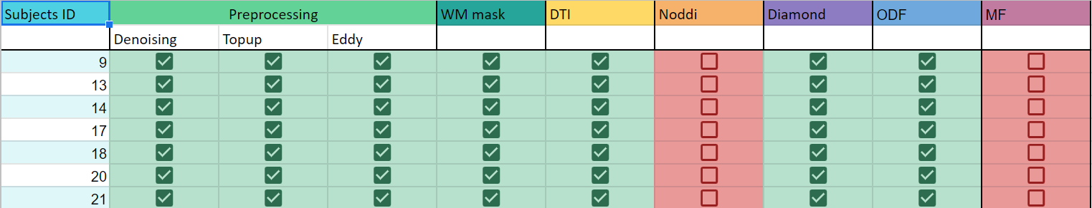
Following steps
White matter mask -> Done
DTI, Diamond and ODF models -> Done
Noddi and MF -> in progress

Slide 6
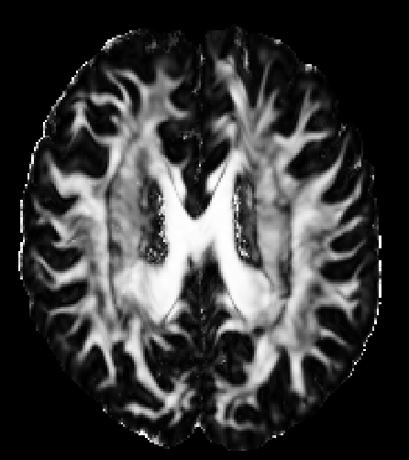
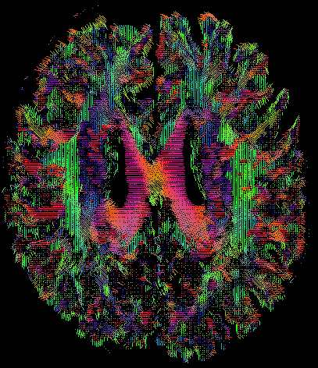
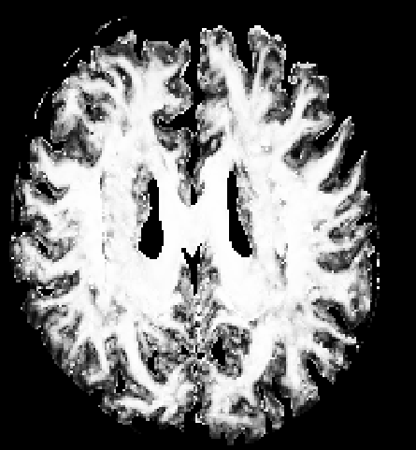
DTI and Diamond
Reminder about metrics :
- Mean diffusivity : indicator of white matter damage
Axial diffusivity : may reflect axonal degeneration or deletion
Radial diffusivity : may reflect myelin disruption
Fractional anisotropy : indirect indicator of axonal integrity and indicator of packing of fibers in a voxel
FA from DTI sub-103
Tensor field t0 sub-103
t0_FA from DIAMOND sub-103

Slide 7
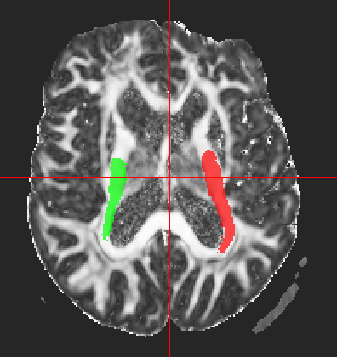
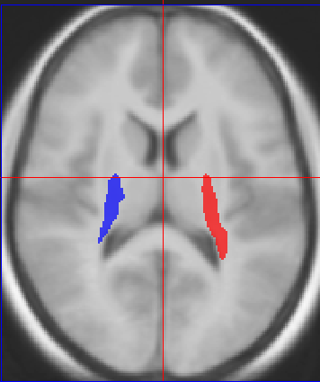
Atlas mapping in progress
Sub-009 FA with ponto-cortico-cerebellum
Average brain with ponto-cortico-cerebellum

Slide 8
Timeline
Dec 13 - Feb 28
Preprocessing
Feb 13 - Mar 20
State of the art writing
Feb 13 - Mar 20
Study of the microstructure of the CB
Mar 20 - Mar 31
Comparison with the literature
Apr 1 - Apr 30
Comparison with PET tau
Mar 20 - Jun 2
Writing of the master thesis
State of the art
Analysis
Master thesis complete
Mar 20
Apr 30
Jun 2
2022
2023
Dec
Jan
Feb
Mar
Apr
May
Jun
2023
Today

