Slide 1


Quantifying anomalies in patients with neuropathologies via diffusion Magnetic Resonance Imaging. (Application to Alzheimer diagnosis)
Nicolas Indriets

Slide 2
Clinical diagnosis of Alzheimer’s disease: recommendations of the International Working Group – Dubois et al.
Risk of confusion between the presence of Alzheimer’s brain lesions and Alzheimer’s disease
Low predictive accuracy
Presence of other pathologies
Uncertainty about the pathogenesis model of Alzheimer’s disease
Difficulty in classifying cognitively unimpaired biomarker-positive individuals
Biomarker thresholds
Generalisability and accessibility in clinical practice
Ethical concerns

Slide 3
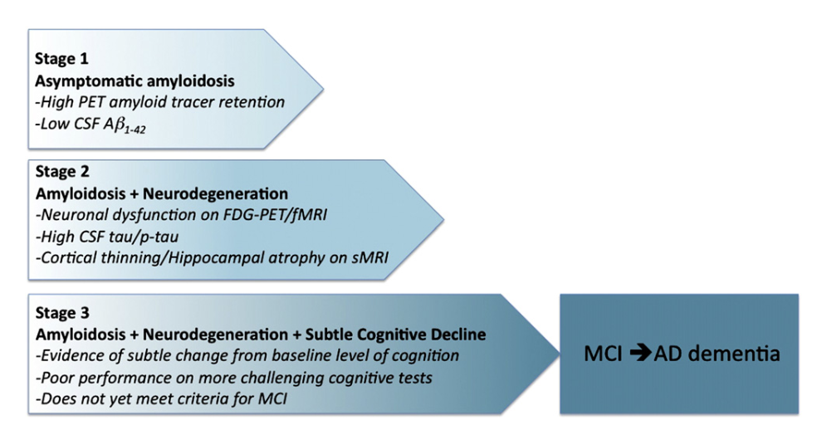
Toward defining the preclinical stages of Alzheimer’s disease: Recommendations from the National Institute on Aging and the Alzheimer’s Association workgroup – Sperling et al.

Slide 4
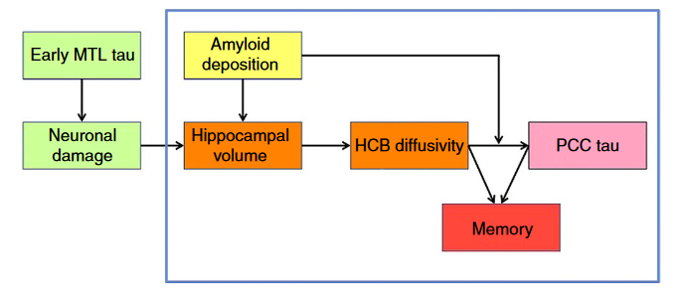
Structural tract alterations predict downstream tau accumulation in amyloid-positive older individuals – Jacobs et al.

Slide 5
Results :
Amyloid deposition is associated with increased hippocampal volume loss
Lower hippocampal volume is associated with white matter abnormalities of HCB and UF at baseline
Hippocampal volume predicts change in diffusion over time of HCB, but not in UF
Hippocampal cingulum diffusivity selectively predicts accumulation of tau pathology in the connected PCC in amyloid-positive individuals
Memory-tract diffusivity associations are driven by tau pathology

Slide 6
