Slide 1


Web Application Attacks Detection Using Deep Learning
Nicolas Montes

Slide 2
Nicolas Montes
Speaker’s affiliations
Speaker’s BIO
Data Scientist with a bachelor degree in Statistics. Currently finishing a MSc in Machine Learning and Data Science from the Engineering School of Universidad de la Republica, UDELAR.

Slide 3
AUTHORS & AFFILIATIONS

Slide 4
Outline
Problem definition: attacks on web applications and web application firewalls (WAFs).
The process for applying machine learning models to improve WAFS.
Advanced NLP approaches to text encoding. A learning framework is proposed that uses a RoBERTa language model as a feature extractor.
View of the RoBERTa architecture.
The evaluation for the learning framework is presented.
Finally, the results and conclusions.

Slide 5
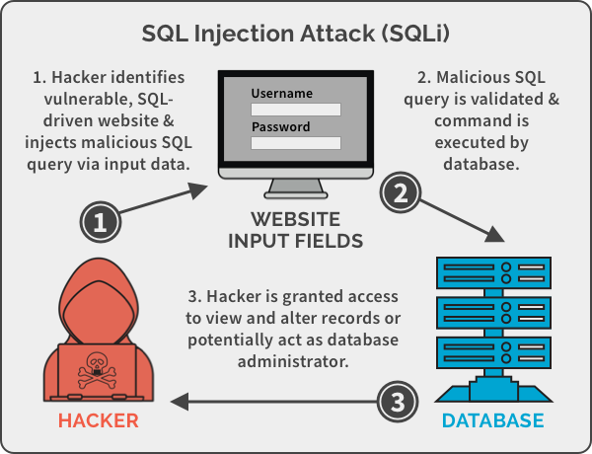
Web Application attacks
SQL injection
Cross Site Scripting (XSS)
Buffer Overflow

Slide 6
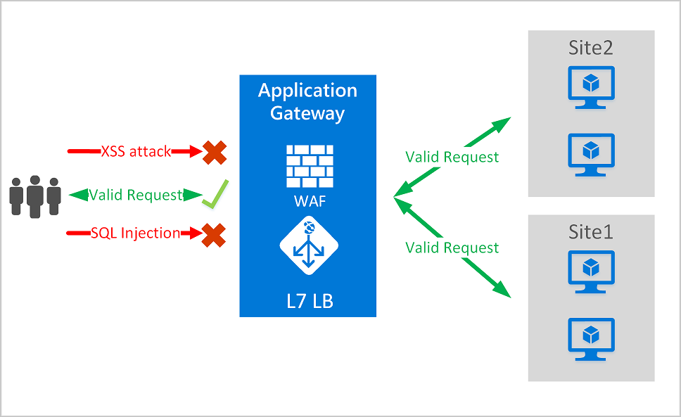
Web Application Firewall (WAF)
Rule-based approach (static and rigid) False Positive Rate close to 40%.
Would potentially lead to a denial of service of the application.
Machine Learning and pattern recognition models to improve the performance of the WAFs.

Slide 7
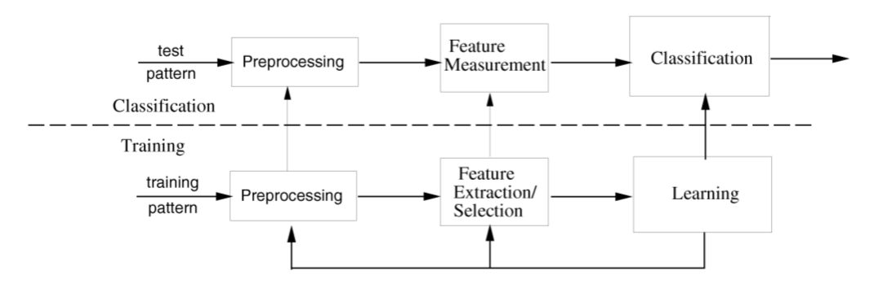
ML pipeline
Multi-class
One-class (anomaly detection). More realistic scenario
We use the anomaly detection approach.
One of the most challenging problems when applying machine learning to anomaly detection to web security is how to extract features from the raw network data.
We treat the HTTP as raw text and investigate advanced approaches in NLP for text encoding.
Text encoding: Transforming the HTTP into a vector of numbers (feature extraction). Then we use it as input for a one-class classifier.

Slide 8
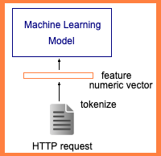
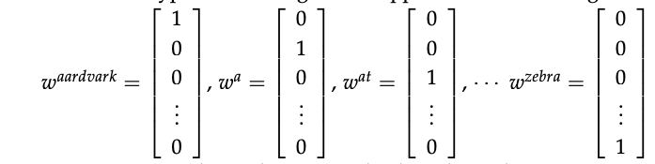
Classic text encoding
Represent words as atomic units (one-hot)
Classic Bag of Words encoding (BoW): sum of the one-hot encoding vector of each token present into the input text.
BoW (or TF-IDF variant) drawbacks: big (size |V| large of vocabulary ) and sparse. The semantic similarity of these feature vectors is pretty rigid and heavily relies on the literal lexicographical match between shared words.

Slide 9
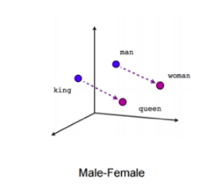
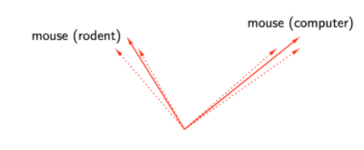
Representation Learning (self-supervised)
Static Word Embeddings (w2v, skip-gram, etc.)
Contextual Word Embeddings (ELMO, BERT, RoBERTa, etc)

Slide 10
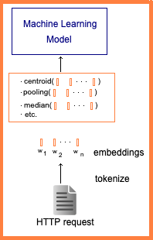
Text encoding with embeddings
The embedding of each token is a dense representation.
Each embedded token has dimension d, much less than |V|.
The learned embeddings explicitly encode many linguistic regularities and patterns.
We can represent the whole raw text using each token representation, with strategies like pooling, centroid, fine-tuning, etc. (or other variants depending on the downstream task).

Slide 11
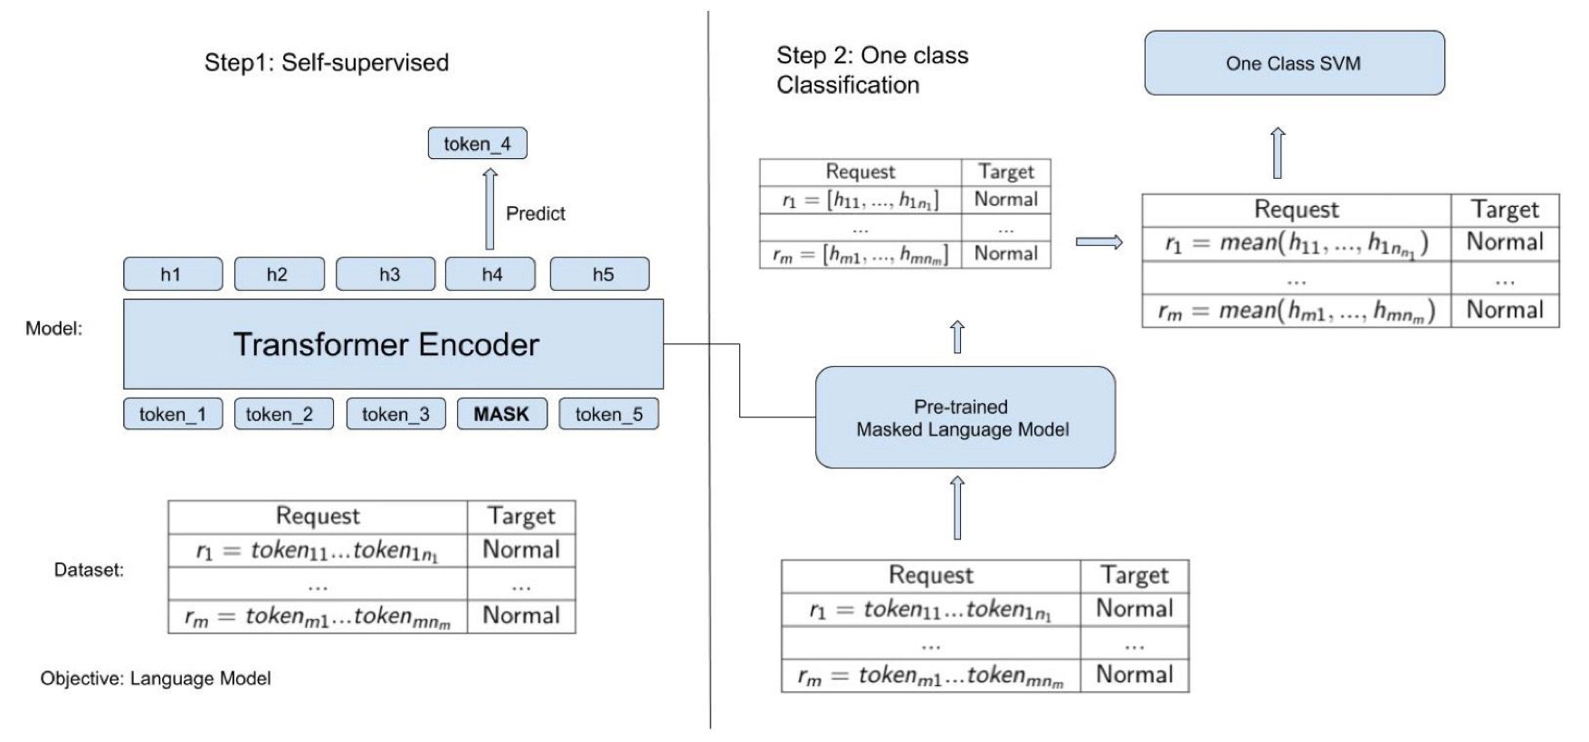
Two-step learning framework
Treat HTTP request as raw text.
First step: train a RoBERTa Language model.
Second step: extract features from RoBERTa and perform One-class SVM classification.

Slide 12
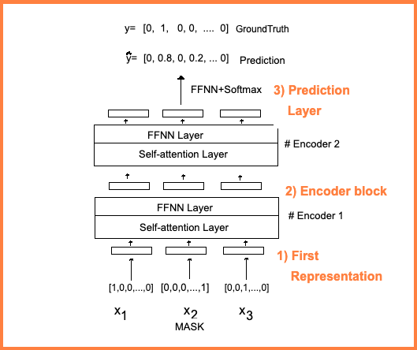
RoBERTa high level
Self-supervised
Masked Language Model
Stack of L identical encoder layers
Input Representation

Slide 13
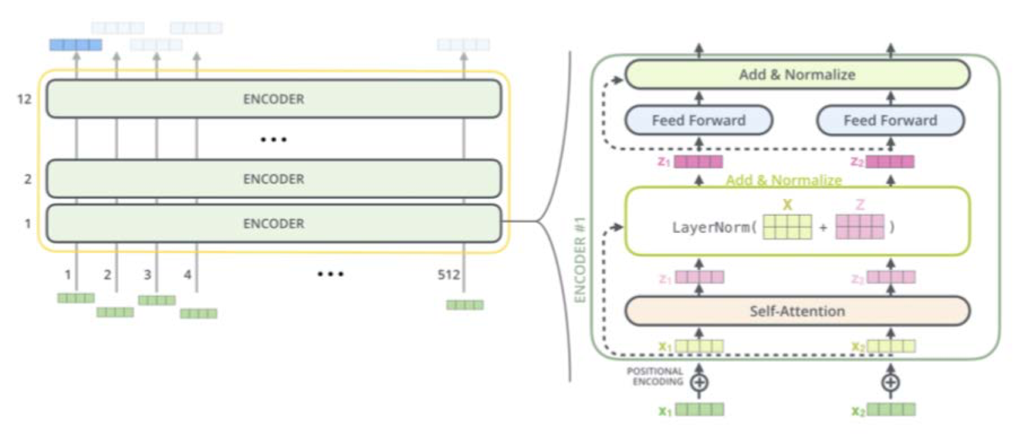
RoBERTa architecture
Each encoder layer contain two sub-layers.
Multi-head self-attention layer, which helps looking at other tokens in the sequence while encoding a specific token
Feed Forward layer applied to each position separately and identically.

Slide 14
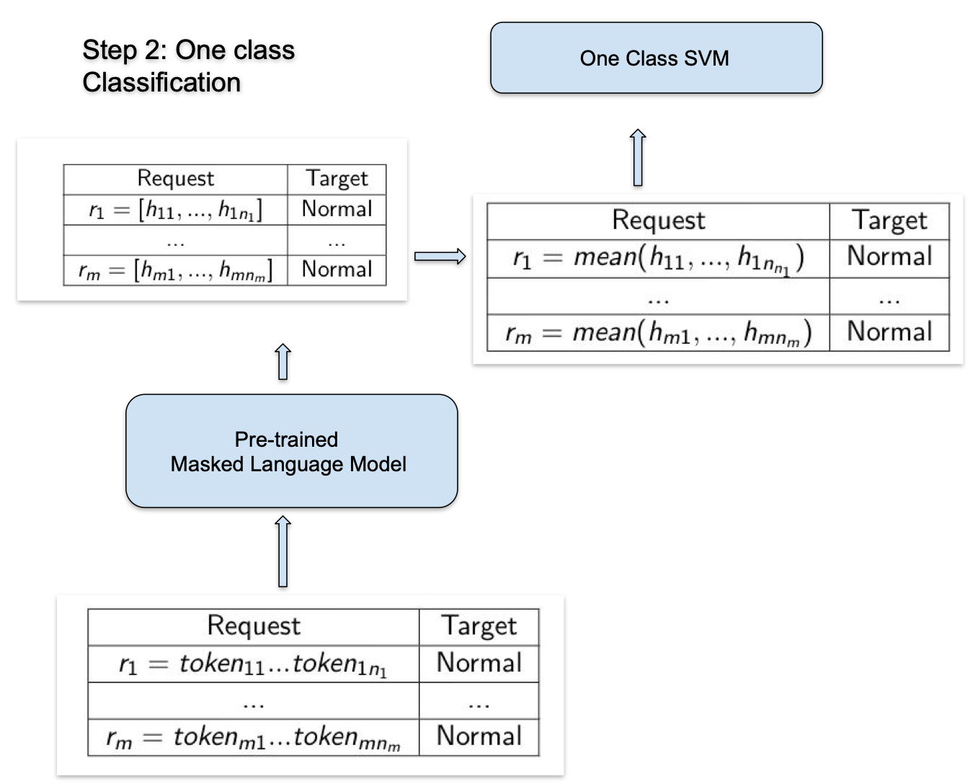
One class classification
Convert each request into a numeric form whit the RoBERTa model.
Perform a One-Class classification model with a One-class SVM (OCSVM).
Performance metric derived from normal and unlabeled examples (proposed by [X]), to estimate the operational point for the OCSVM.

Slide 15
Model evaluation
Evaluation with two datasets from two applications (CSIC and DRUPAL). Each application has its own model (both the pre-trained and the one-class classifier)
Performance comparison with MODSECURITY configured with the OWASP Core Rule Set version 3 out of the box with two paranoia levels.
Performance comparison with a classic information retrieval approach presented in []. In these model a security expert defines the features to be extracted and used to train a once class- classifier based on a Gaussian Mixture Model.

Slide 16
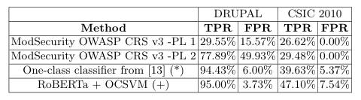
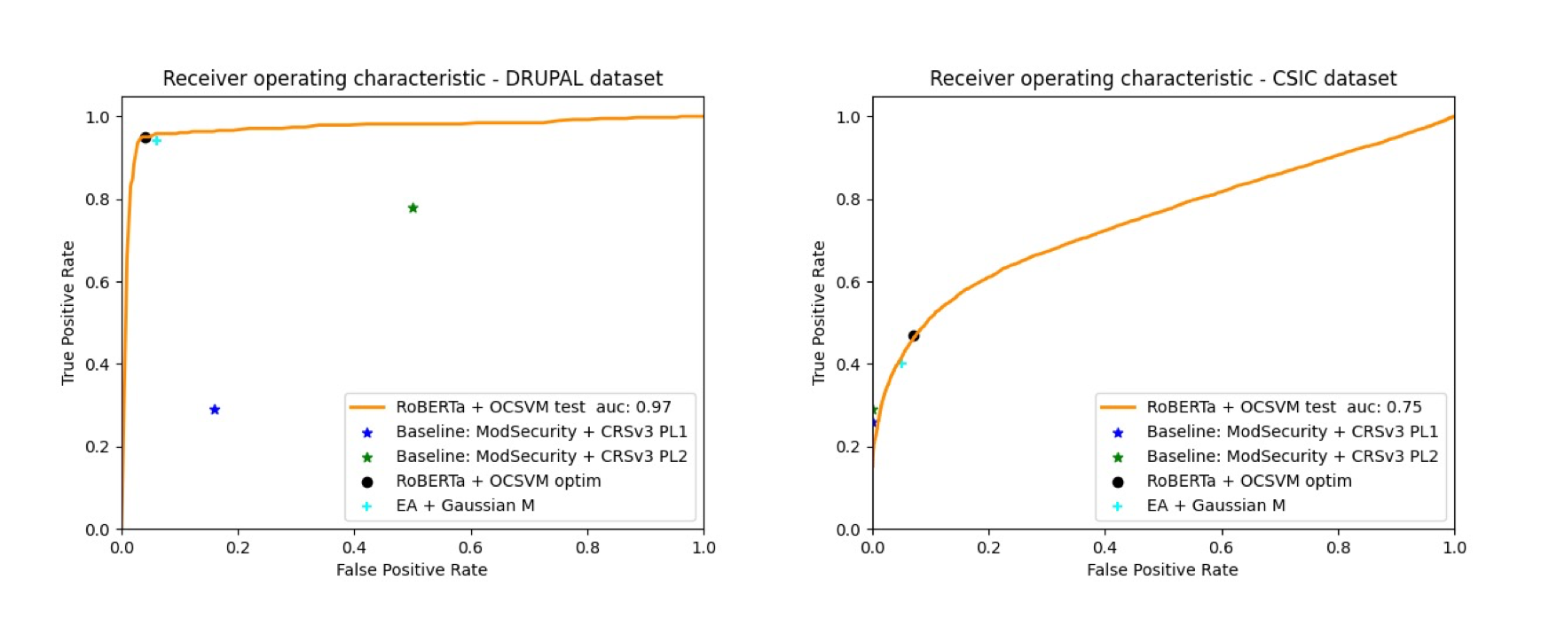
Results

Slide 17
Conclusion
The experimental results show that the proposed approach outperforms the ones of the classic rule-based MODSECURITY configured with a vanilla CRS and does not require the participation of a security expert to define the features.
Future work we intend to re-train the pre-trained Language Model with more HTTP request for the DRUPAL dataset. We also plan to use a set of attacks and explore the fine-tuning approach for RoBERTa.

Slide 18
Thank you!
KEEP IN TOUCH
Email: info@codan-consulting.com
Website: www.ciarp25.org
Twitter: @CiarpCongress
Facebook: @CIARPcongress

