Slide 1
Visual-system-for-interaction-human-with-robot
Nicolas Orság

Slide 2
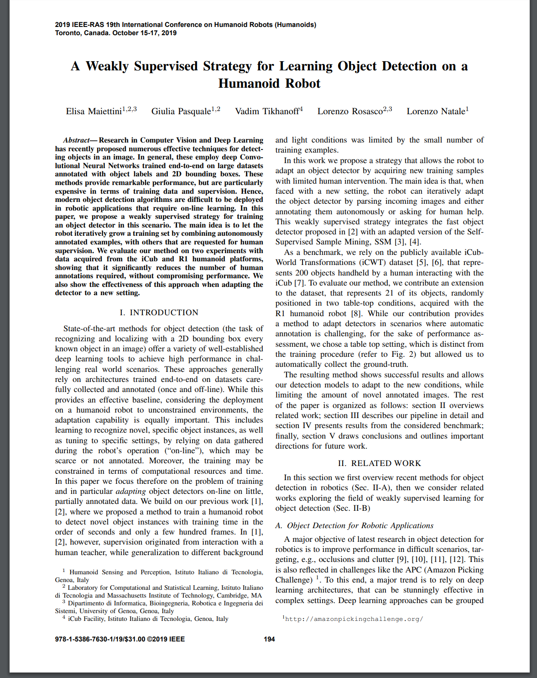
A Weakly Supervised Strategy for Learning Object Detection on a Humanoid Robot

Slide 3
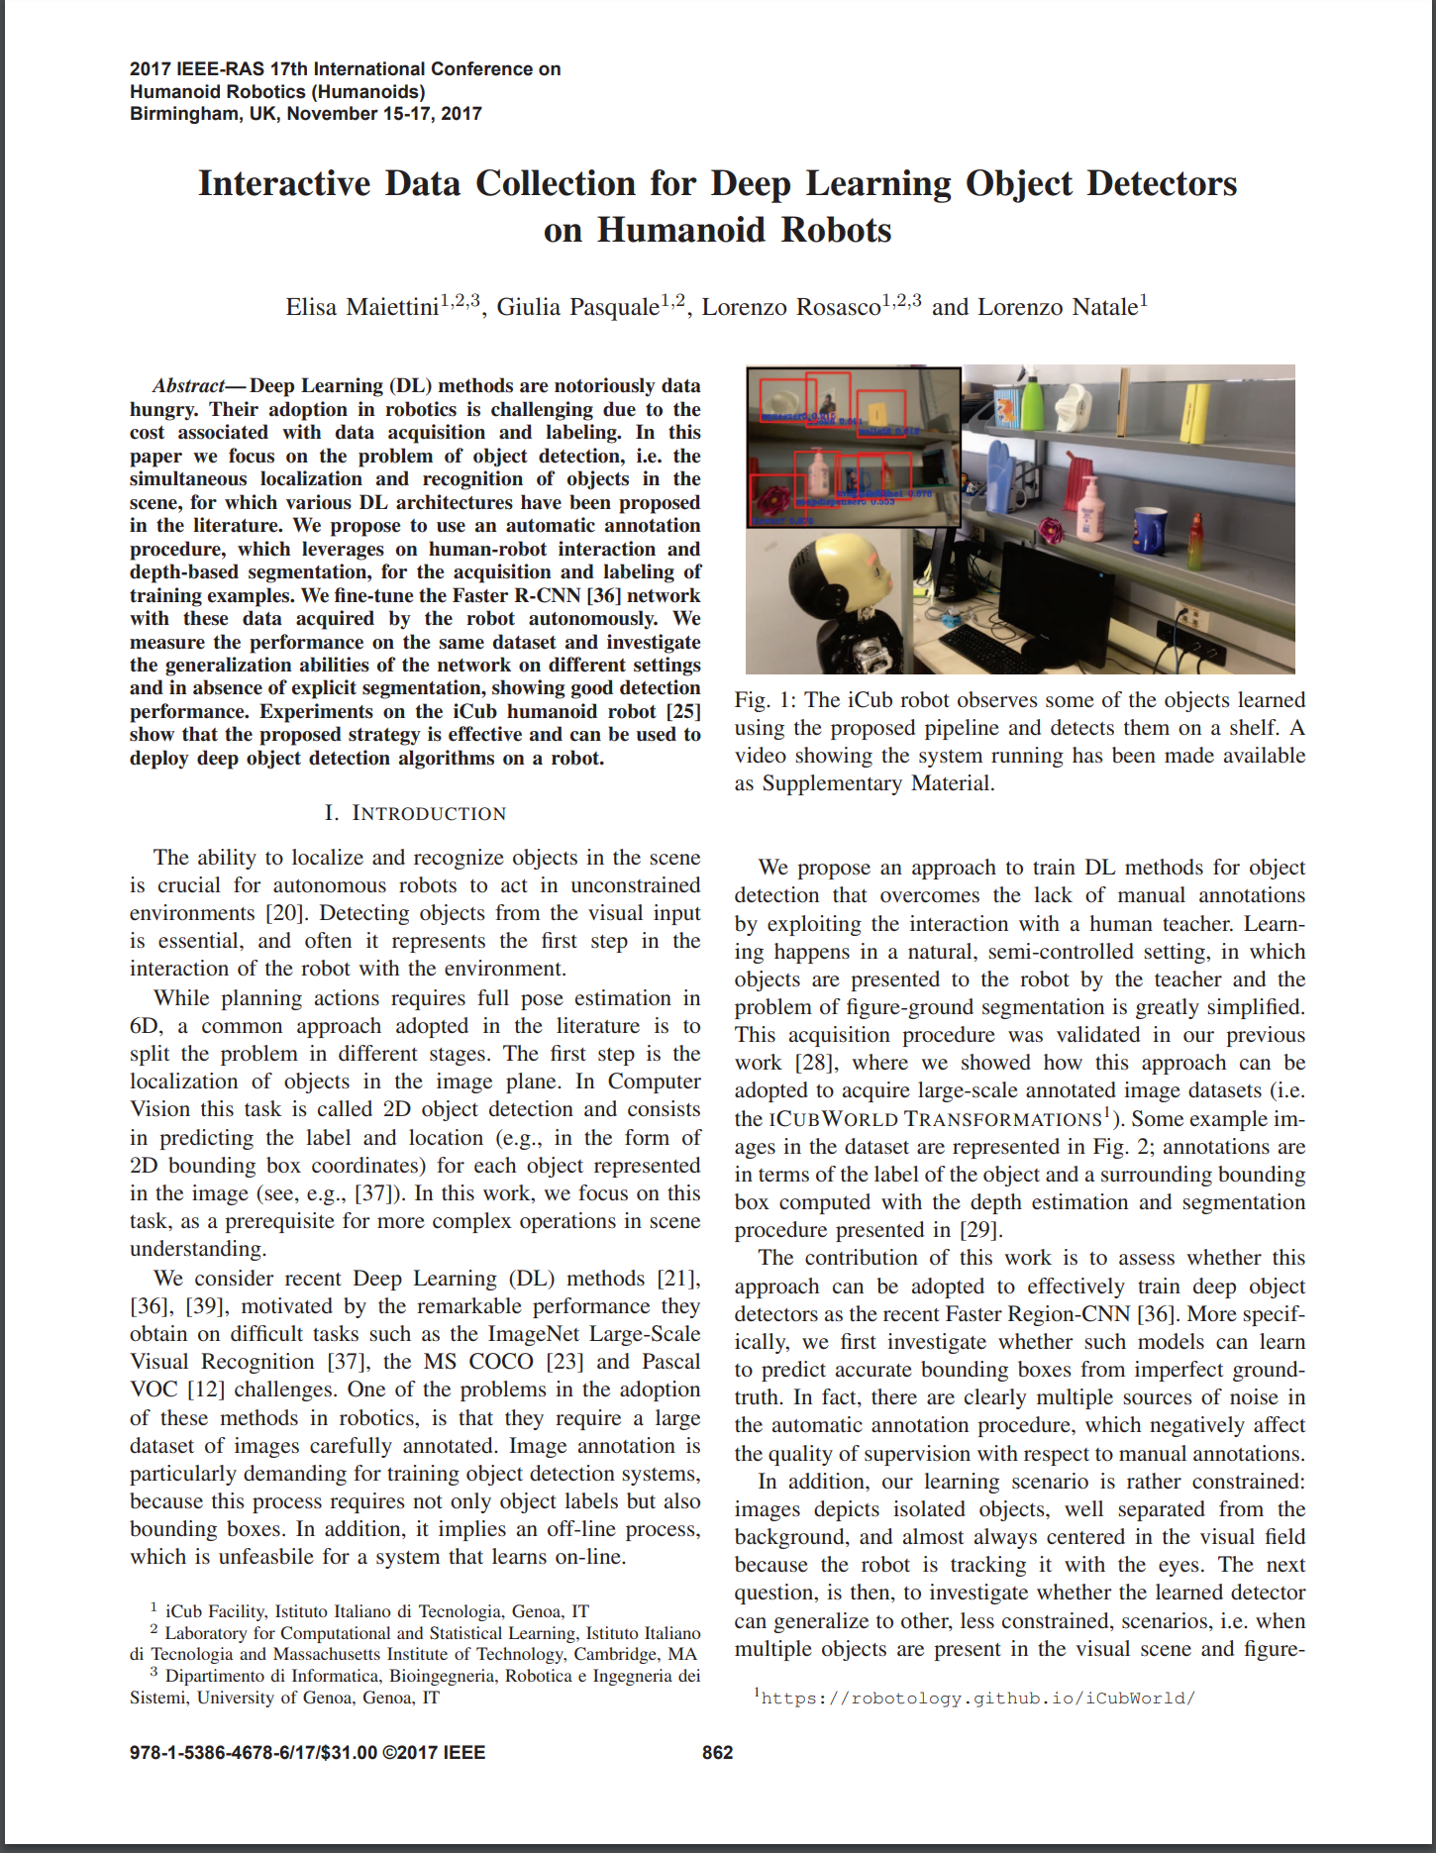
Interactive Data Collection for Deep Learning Object Detectors on Humanoid Robots

Slide 4
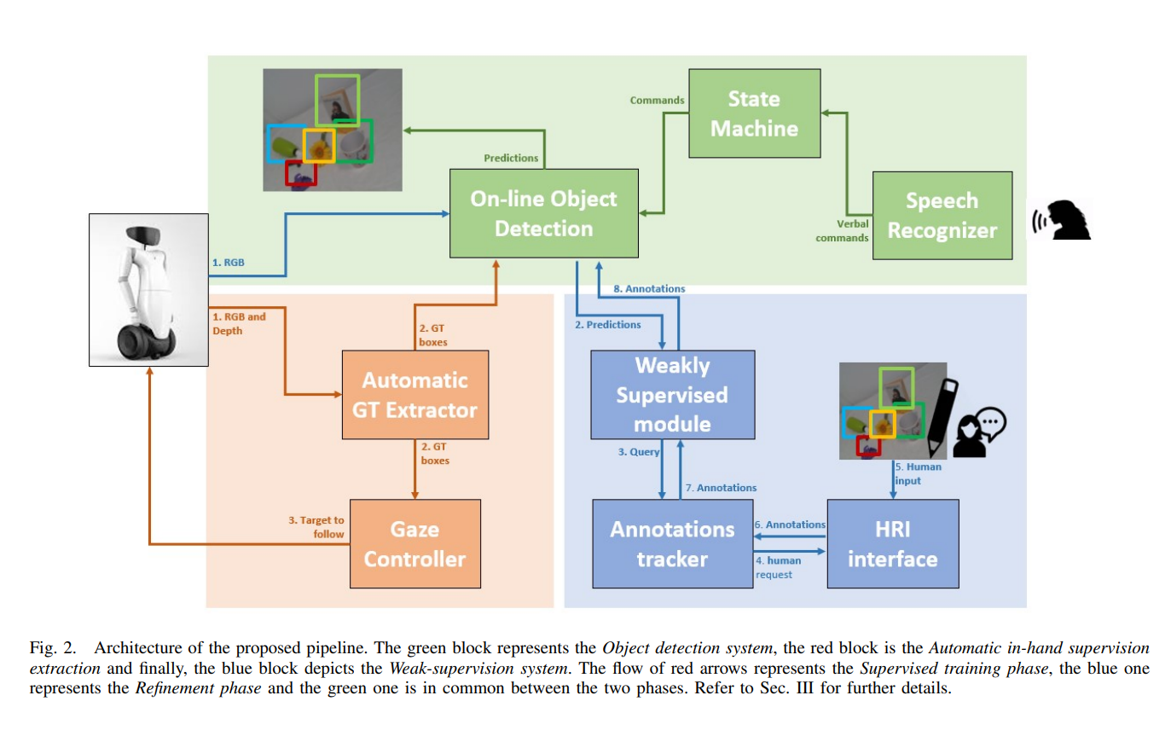
On-line Detection Application

Slide 5
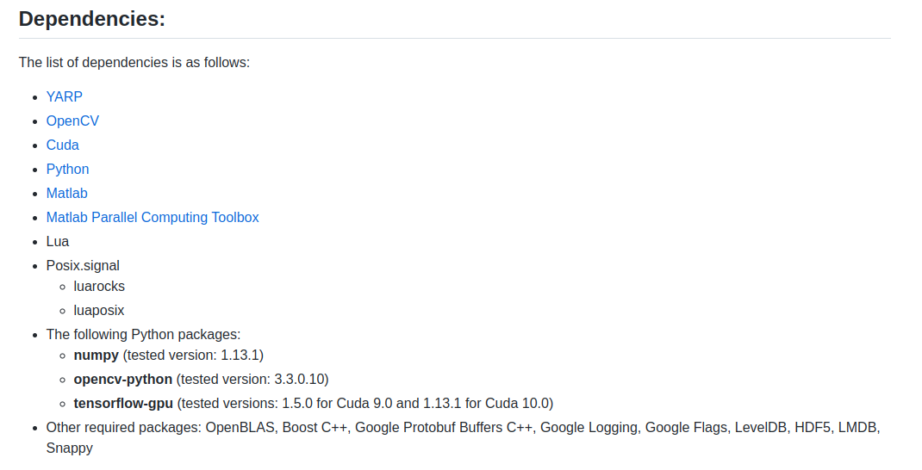
Installed dependencies

Slide 6
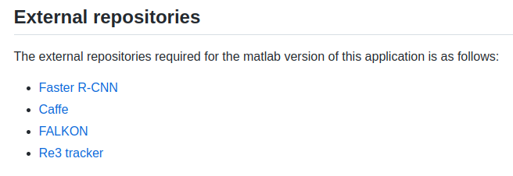

Slide 7
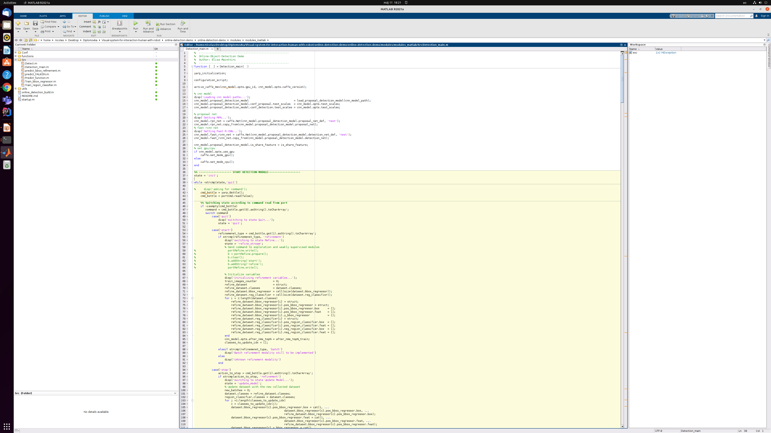
Ukážka detection_main.m

