Slide 1
Visual-system-for-interaction-human-with-robot
Nicolas Orság

Slide 2
Progress mojej prace
Prečítanie a porozumenie 2 dôležitých článkov
https://sci-hub.se/10.1109/humanoids43949.2019.9035067
Spoznamkovanie : https://github.com/NicolasOrsag/Visual-system-for-interaction-human-with-robot/blob/main/Documentation/Sources/notes_from_sources.pdf
https://sci-hub.se/10.1109/humanoids.2017.8246973
Vytvorenie a manažovanie github repozitára:
https://github.com/NicolasOrsag/Visual-system-for-interaction-human-with-robot
Písanie a udržovanie denníka:
https://github.com/NicolasOrsag/Visual-system-for-interaction-human-with-robot/blob/main/Documentation/Diary.txt

Slide 3
Progress prace
Vytvorenie templatu diplomovej práce a pridania zdrojov:
https://github.com/NicolasOrsag/Visual-system-for-interaction-human-with-robot/tree/main/LaTex%20Text%20of%20thesis
Poznámky z konzultácii:
https://github.com/NicolasOrsag/Visual-system-for-interaction-human-with-robot/tree/main/Documentation/Notes-from-consultations
Inštalácia všetkých potrebných dependencies pre spojazdnenie online detection dema podľa:
https://github.com/robotology/online-detection-demo

Slide 4
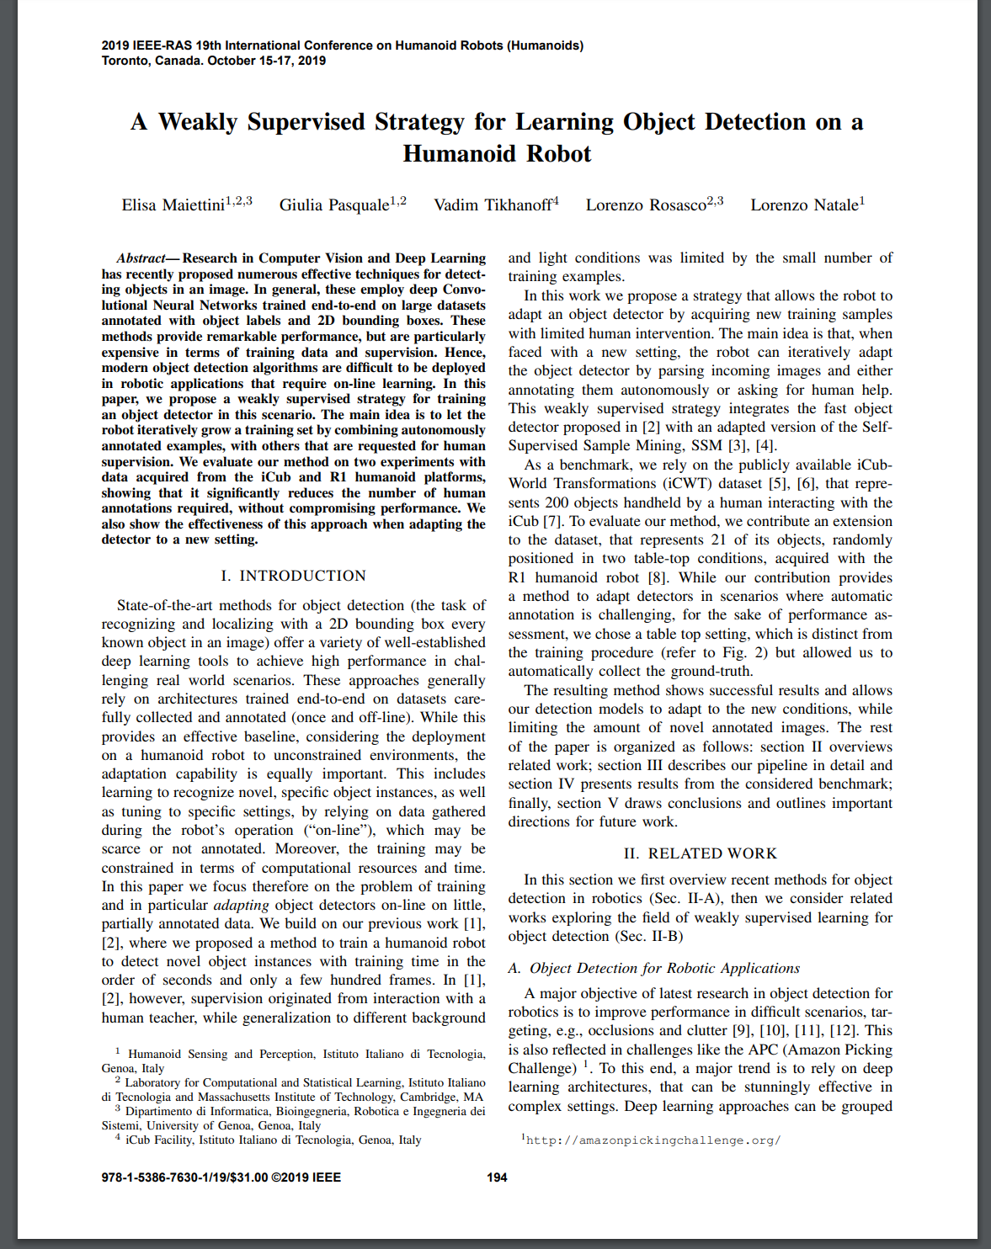
A Weakly Supervised Strategy for Learning Object Detection on a Humanoid Robot

Slide 5
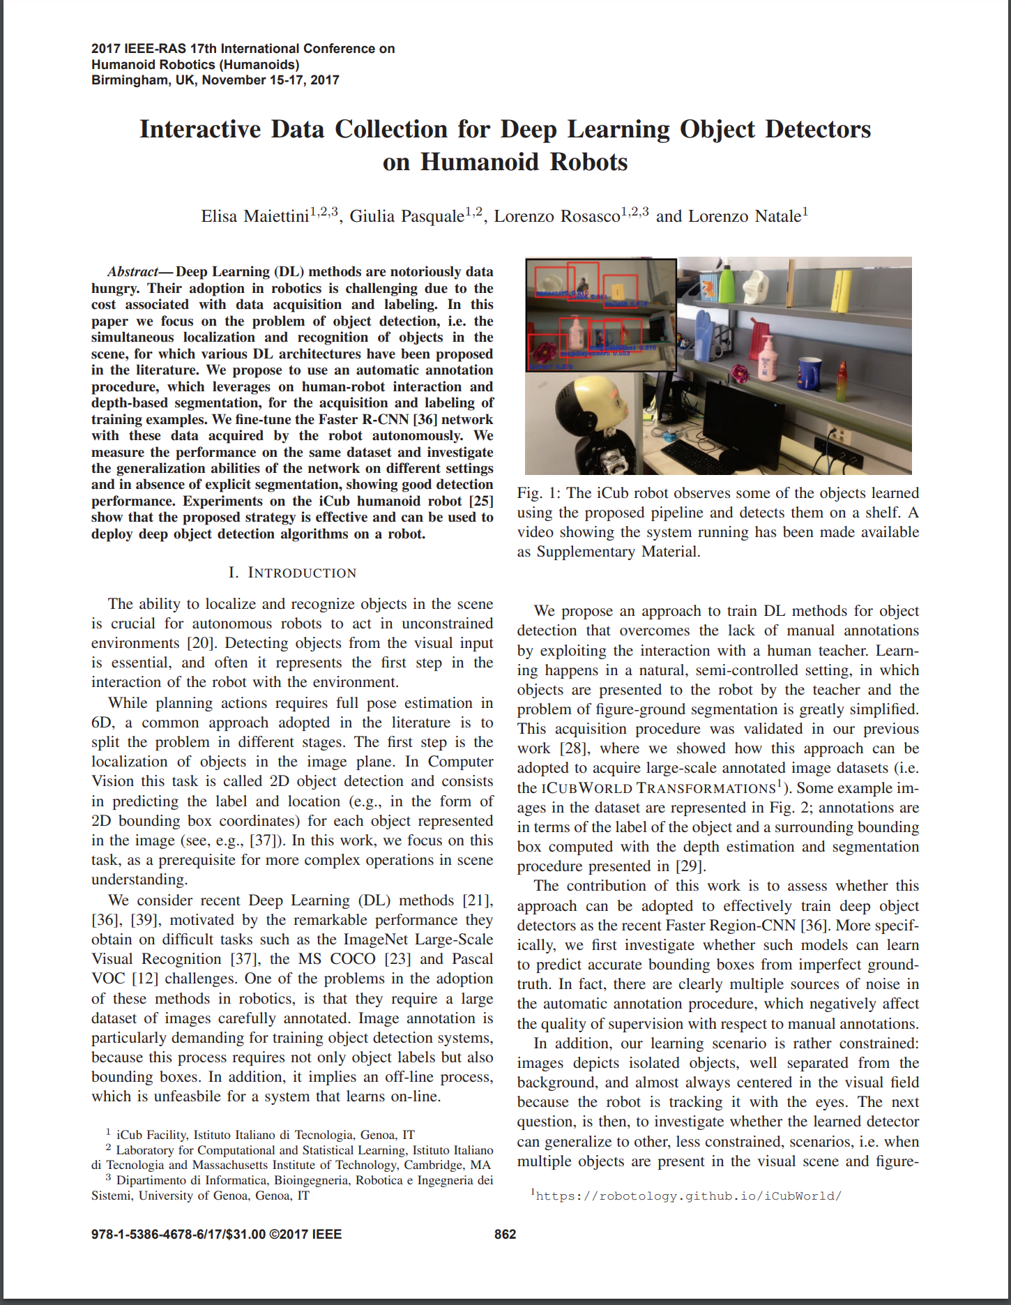
Interactive Data Collection for Deep Learning Object Detectors on Humanoid Robots

Slide 6
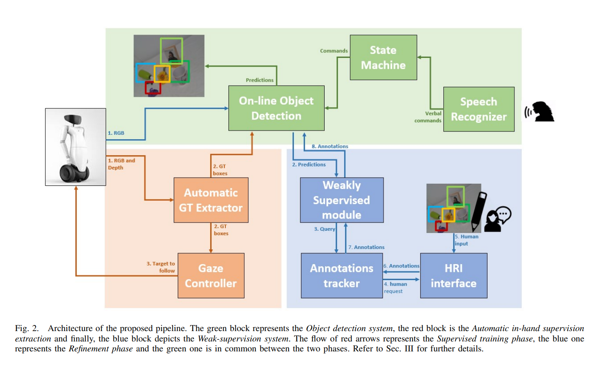
On-line Detection Application

Slide 7
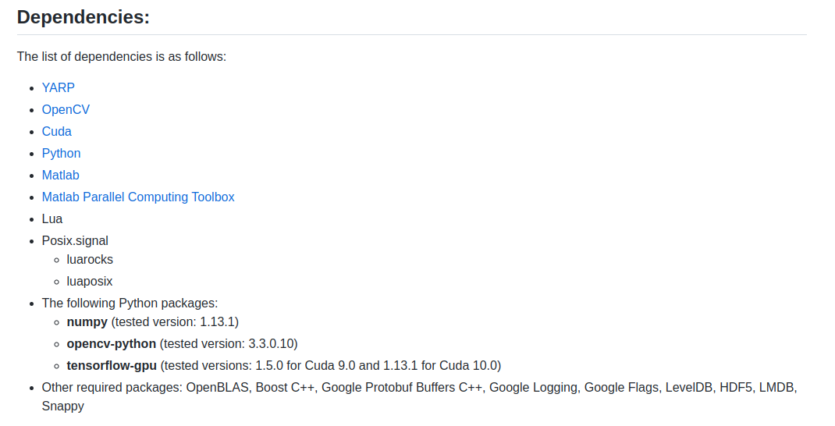
Installed dependencies

Slide 8
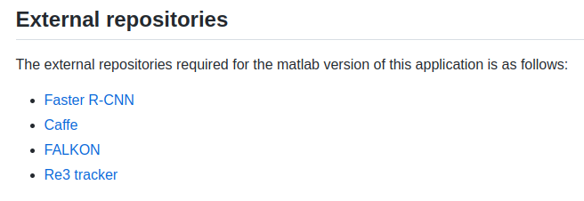

Slide 9
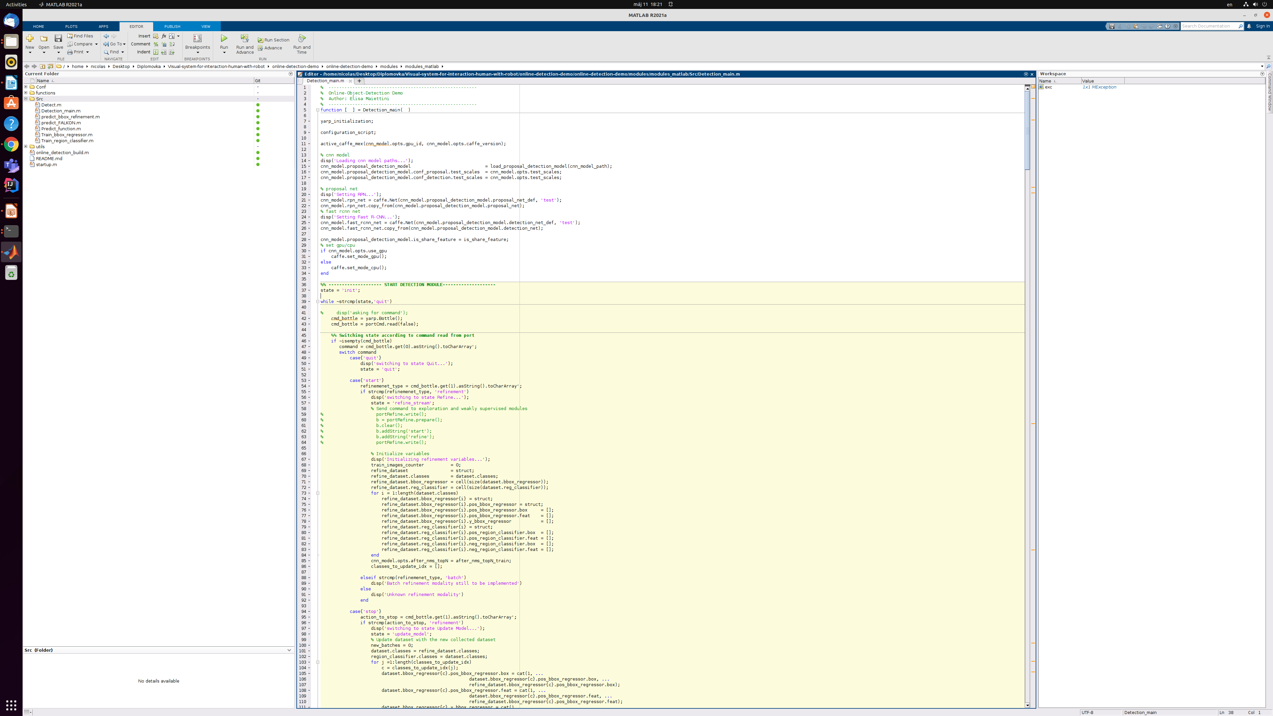
Ukážka detection_main.m

