Slide 1
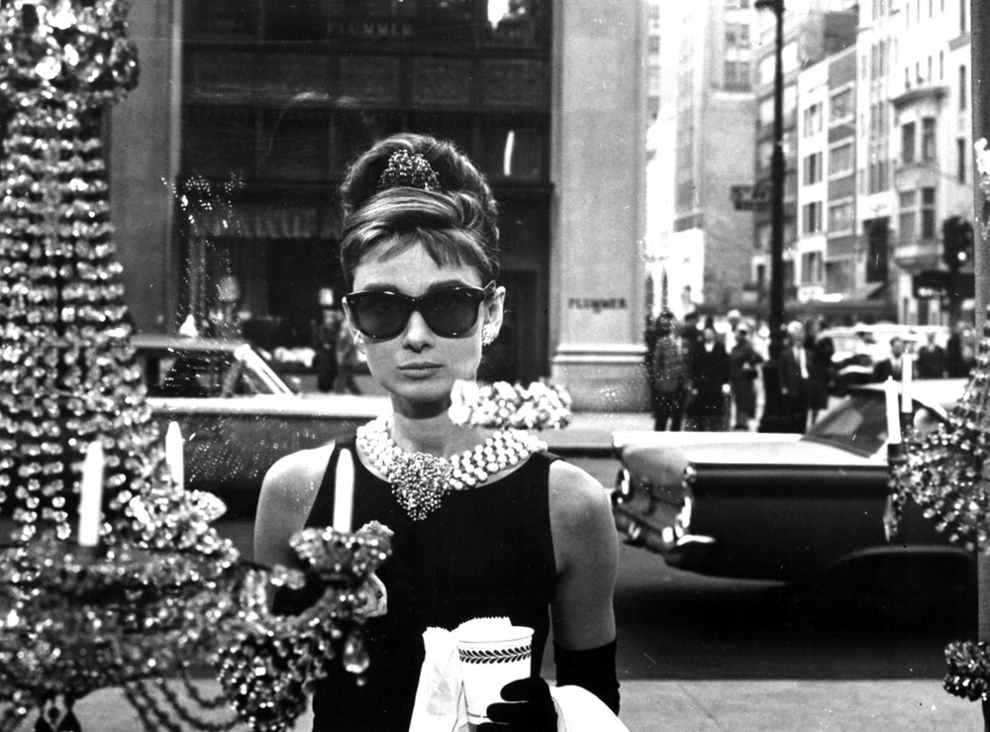

Diamonds Competition
Methods used
Results
Linear Regression
Decision Tree Classifier
Decision Tree Regressor
Random Forest
RMSE: 565

