Slide 1
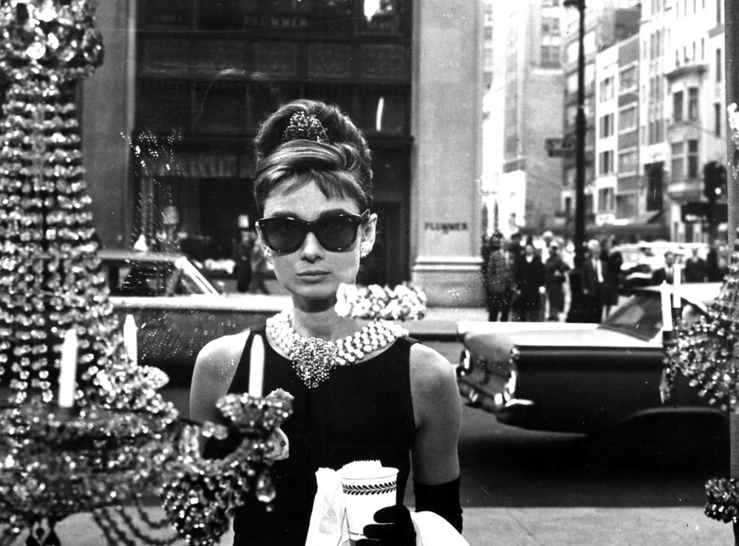

Diamonds Competition
Methods used
Results
Linear Regression
Decision Tree Regressor
Gradient boosting
Random Forest
RMSE: 560

