Slide 1
LaMEM short course
19-23 02 2024 Heidelberg
Nicolas Riel- nriel@uni-mainz.de

Slide 2



Needed softwares
VS Code
https://code.visualstudio.com/download
Julia
https://julialang.org/downloads/
Paraview
https://www.paraview.org/download/

Slide 3
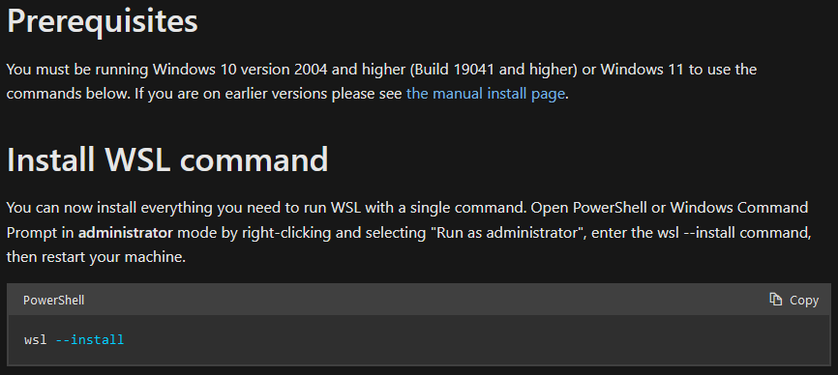
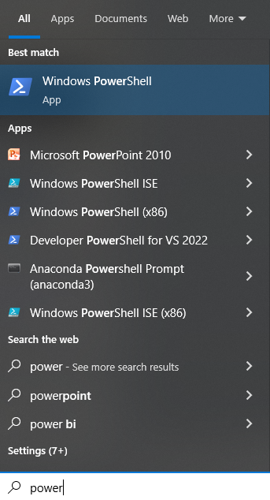
Windows install
(linux/mac users can skip to slide 8)
We won’t use windows…
First install WSL (Windows Subsystem for Linux)
https://learn.microsoft.com/en-us/windows/wsl/install

Slide 4
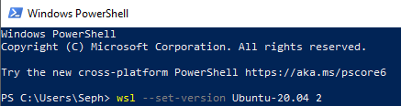
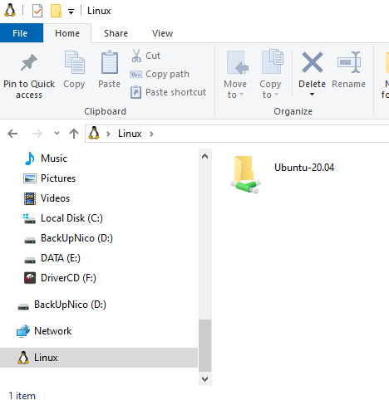
Windows install
Install a Linux distribution in Windows
wsl --set-version Ubuntu-20.04 2
Once installed, the Linux folder can be easily accessed in the bottom left of the explorer

Slide 5
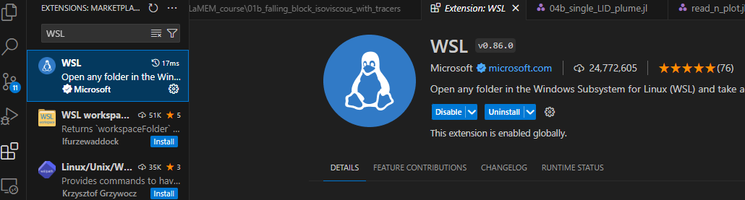
Setup VS-Code for WSL (Windows users)
Add WSL plugin
This operation allow to have linux working directly through vscode as a terminal

Slide 6
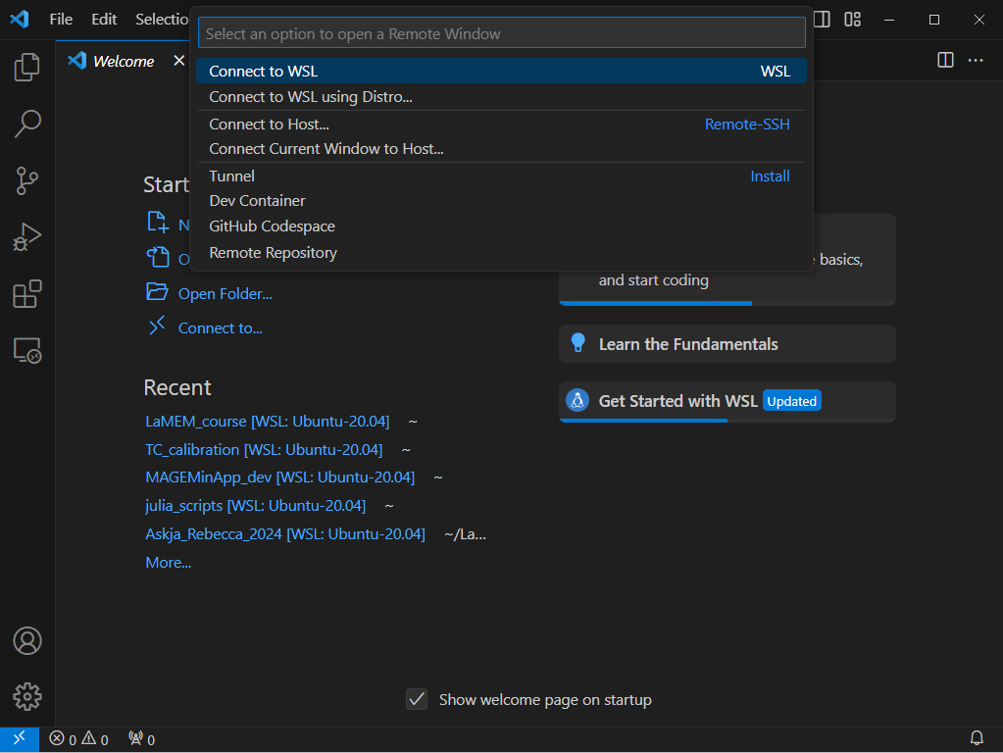
Connect VS-Code to WSL (Windows users)
2
1

Slide 7
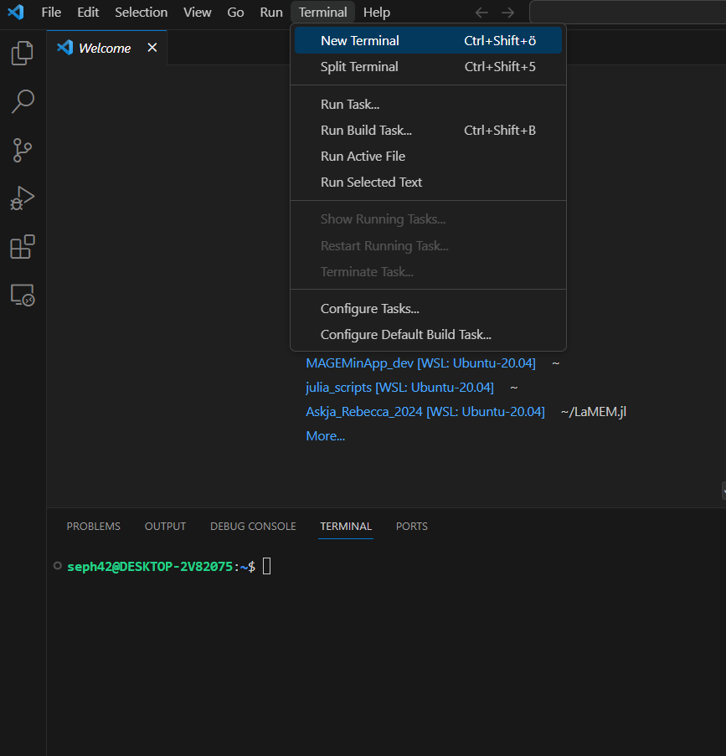
Connect VS-Code to WSL (Windows users)
1
2 wget https://julia_link

Slide 8
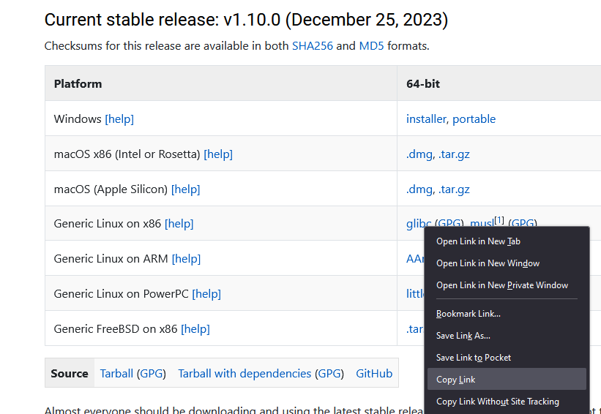
Linux / Mac
Julia
https://julialang.org/downloads/
Download Julia 1.10 (64 bits)
wget http://full_link_(...)

Slide 9


Linux / Mac
Extract archive the /home/username/
Create symbolic link to Julia binary
Open Terminal (in VS-code)
sudo ln -s /path/to/<Julia directory>/bin/julia /usr/local/bin/julia
export PATH="$PATH:/path/to/<Julia directory>/bin"
julia

Slide 10
Setting up Julia working
environment

Slide 11
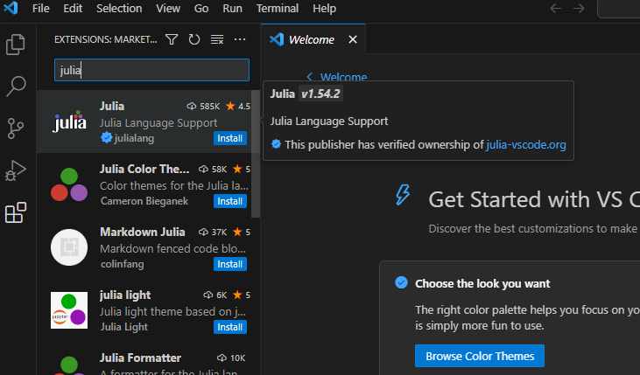
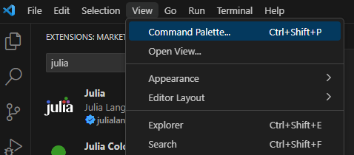
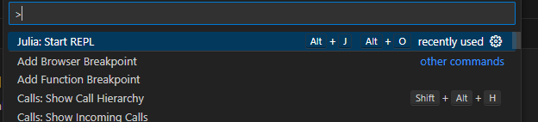
Setup VS-Code for Julia
Add Julia plugin
Start Julia REPL (terminal)

Slide 12
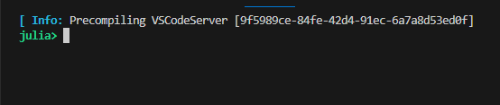


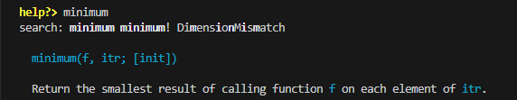
Julia REPL (read-eval-print loop)
  → Terminal or prompt pasting
  Julia terminal
    computation space, execute scripts…
  ] package manager
    add/update packages
  ; shell
    Changing directories
  ? help
  provide help with functions
  Backspace
  back to julia terminal
Note that on Windows the shell is bugged,
navigate through directory using terminal → cd(“path”), pwd()

Slide 13

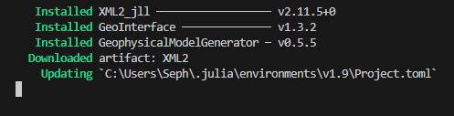
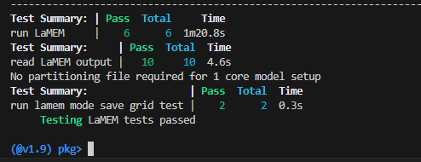

Add LaMEM.jl (Julia wrapper)
] add LaMEM
Test LaMEM
…
  (takes several minutes)
  All tests should pass!

Slide 14
Add other packages
] add GeophysicalModelGenerator
] add GeoParams
] add GMT
] add PlotlyJS
] add MAGEMinApp
Creates 3D input for LaMEM
Set of tools
Import topography
Plotting routine
Create phase diagrams

