Slide 1
LaMEM short course
17-21 02 2025 Heidelberg
Nicolas Riel- nriel@uni-mainz.de

Slide 2
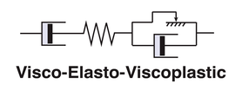
How to link rheology to rock type?
The most complex rheologies in LaMEM are visco-elasto-viscoplastic
Iso-viscous
Arrhenius (T dep.)
Diffusion creep (PT dep.)
Dislocation creep (PT dep.)
“Brittle” behavior
using Drucker-Prager
(cohesion + frictional angle)
How to set?
Elastic bulk modulus
(of the order 1e10 Pa)

Slide 3
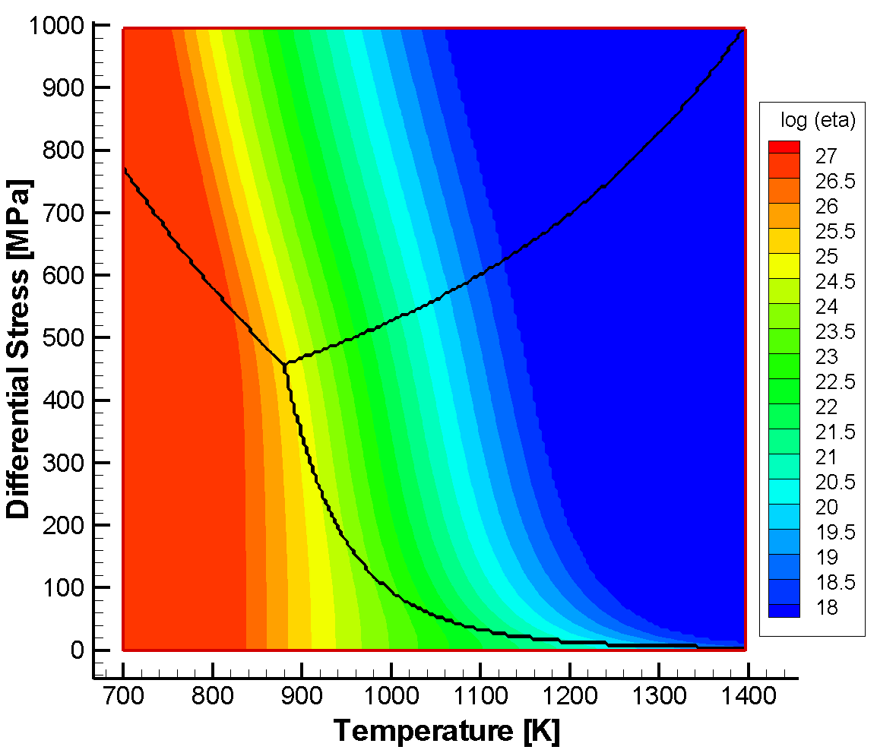
Relationships between creep laws
Peierls
Diffusion
Dislocation

Slide 4
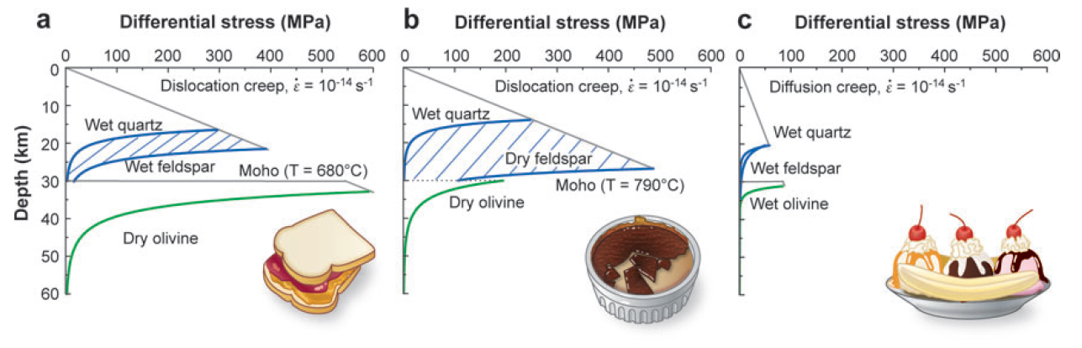
Flow laws
Burgmann & Dresen, 2008

Slide 5
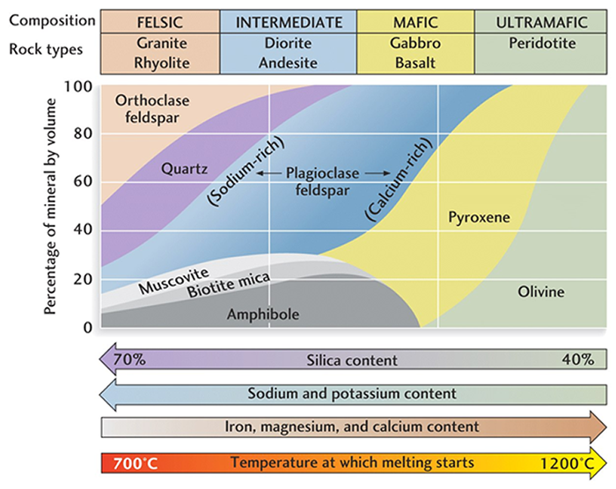
How to link rheology to rock type?
Find the dominant mineral of your rock
Choose flow law of this mineral

Slide 6
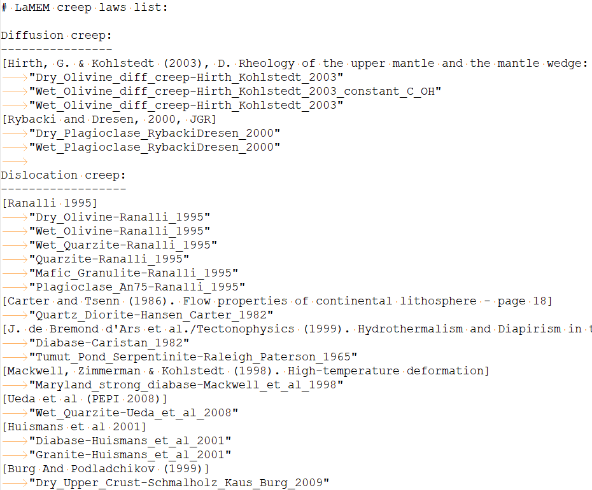
Available creep laws of LaMEM
List given in “tools_and_tips.txt” and on the Github repository
(…)
https://github.com/UniMainzGeo/LaMEM/blob/master/src/phase.cpp

