Slide 1
Julia introduction
17-21 02 2025 Heidelberg
Nicolas Riel - nriel@uni-mainz.de

Slide 2
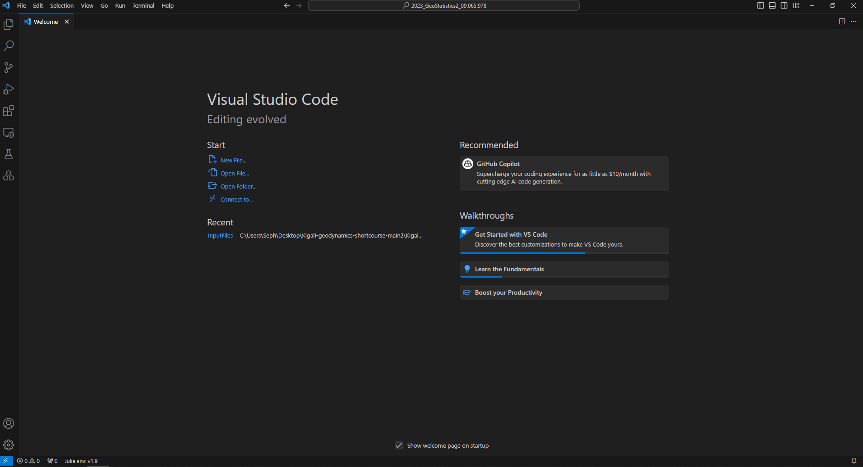
VS Code
1. File → open folder → your working folder
2. Click on explorer

Slide 3
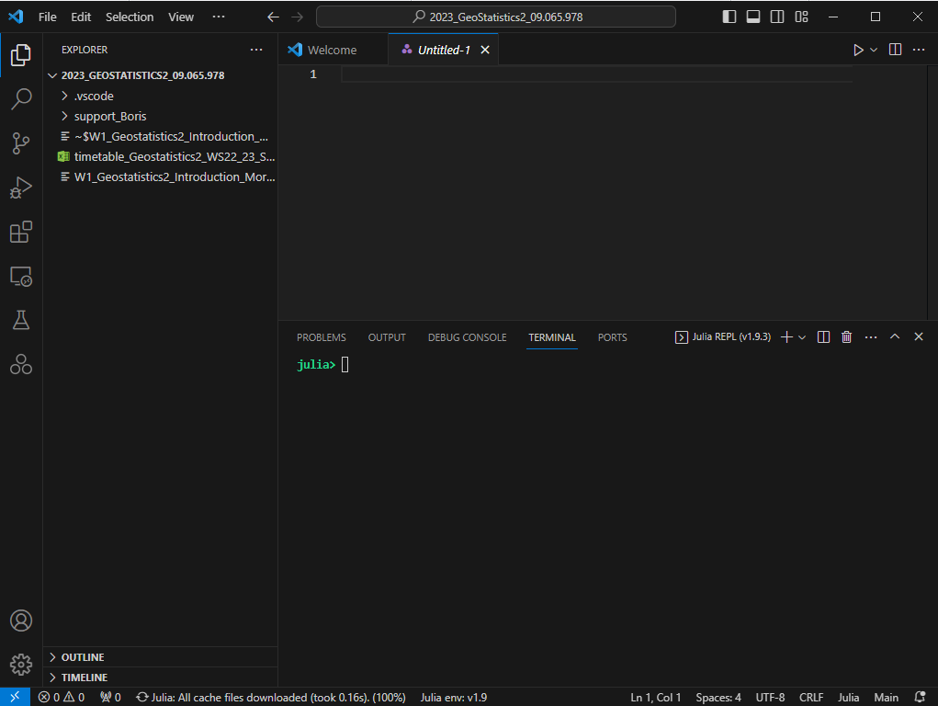
Julia REPL (demonstration)

Slide 4
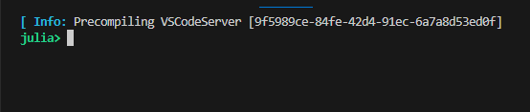


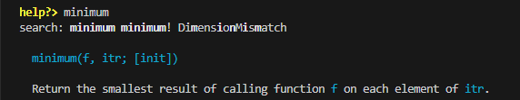
Julia REPL (read-eval-print loop)
Terminal or prompt pasting
Julia terminal
computation space, execute scripts…
] package manager
add/update packages
; shell
Changing directories
? help provide help with functions
Backspace
back to julia terminal

Slide 5
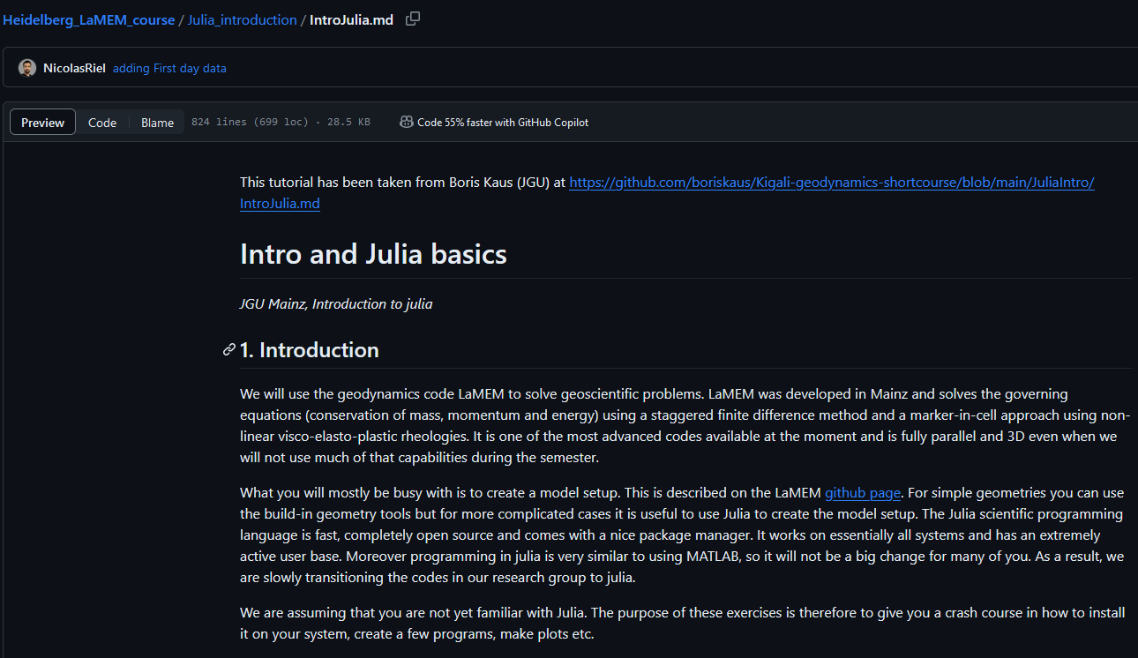
Julia introduction
Access the following link and complete the Julia introduction
https://github.com/NicolasRiel/Heidelberg_LaMEM_course/blob/main/Julia_introduction/IntroJulia.md

Slide 6
Extra tutorial (optional)
For those who are fast, who want to go beyond what is needed within the scope of the course

Slide 7
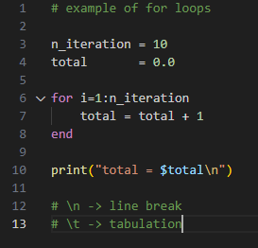
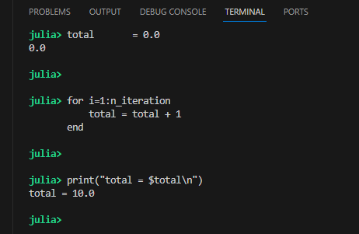
“for” loops
Open new Julia file and
reproduce the following lines
of codes
Paste it in the terminal

Slide 8
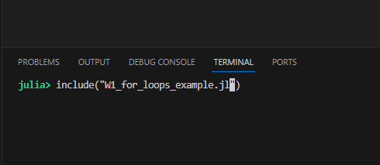
“for” loops
CTRL + L to clear the terminal
Save the file as “meaningful_name.jl”
Execute the scripts using “include”

Slide 9
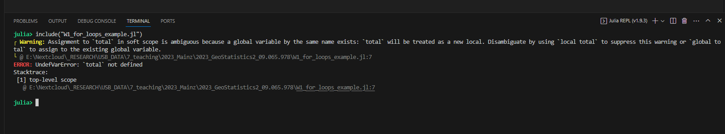
First bug?
Here Julia does not know the “scope” of the variable total.
Scope can be seen as the region of a code where the variable is visible/exists
The main file here can been thought as an “open space”
→ The right way to solve the issue is to work in a “closed space” i.e. using functions!

Slide 10
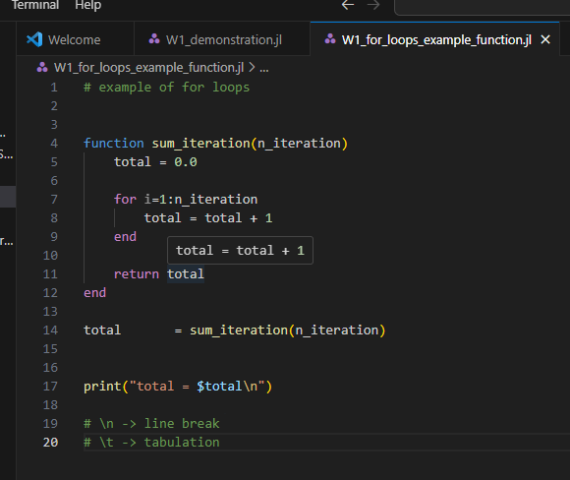
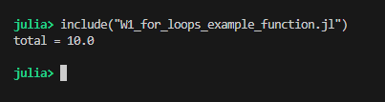
Functions
Take one or multiple entries as arguments
Return one of multiple variables
Solve the “scope” problem

Slide 11
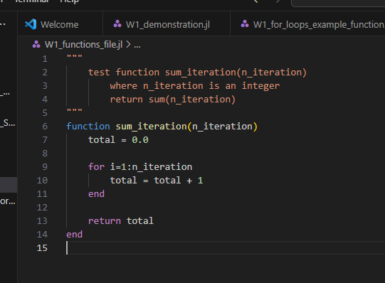

Function file
When developing a code is it useful to put the functions in other files to keep the main file readable
Create a “functions_file.jl” and copy/paste the For loop example in it
Add comment before the function definition as
The “”” mark the start and ending of the comment
The first lines should be the function first lines copied and pasted
Subsequent lines describe the input/output and role of the function

Slide 12
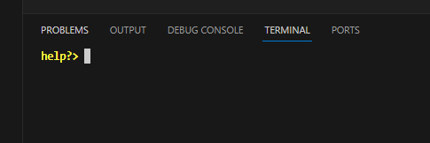
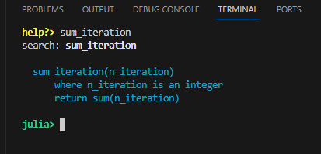
Forgot what the function(s) does?
Open the help in the REPL (terminal) with ?
Type sum_iteration and enter (or sum_i +DOUBLE TAB)
This displays the comment of your function. Very useful:
When your code becomes big (many files)
When you did not use your code for a while
When you share your code!

Slide 13
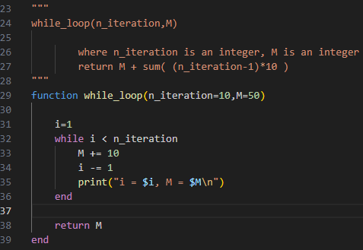
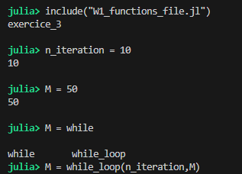
“while” loops
Generalization of the for loop: loops until the looping condition is broken
Reproduce the following code in the functions_file.jl (after sum_iteration function)
In the REPL include “W1_functions_file.jl” and define M and n_iteration then call the function
Note that default values can be defined as such:
Or using default values
Will this program stop or run forever?

Slide 14
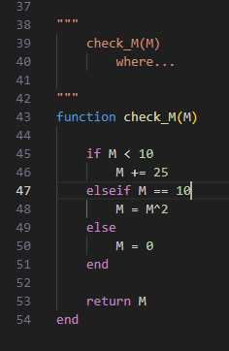

“if elseif else” statement
Check the state of a condition (true or false) and perform different computation depending on the case
Reproduce code in “functions_file.jl”
And test it
(re-include “W1_functions_file.jl” )

Slide 15
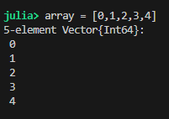
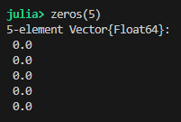
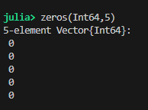
Arrays (Vector)
There is several different ways to declare a Vector in Julia for instance:
This creates and fill the Vector with given values
This creates a Vector of length 5 and fill it with zeros
Note: you can also use: ones()
The type can be specified

Slide 16
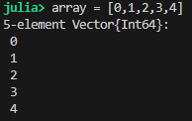

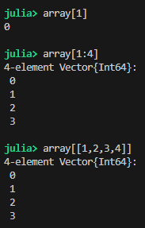
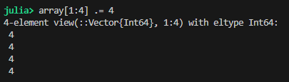
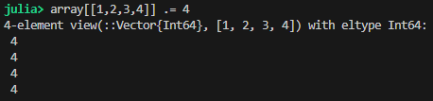
Access/Modify Arrays (Vector)
Access
Modify
By position
Don’t forget the dot
(pointwise)
Using range
Using vector of positions

Slide 17



Arrays (Matrix)
There is several different ways to declare an array in Julia for instance:
This creates and fill the matrix with given values
This creates a Matrix of 2 lines and 5 columns filled with 0.0
As before the type can be specified

Slide 18


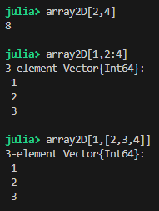


Access/Modify Arrays (Matrix)
Access
Modify
2D arrays are row major
By position
Don’t forget the dot
(pointwise)
Using range
Using vector of positions

Slide 19
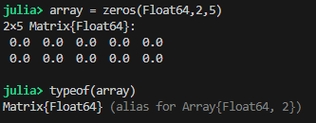
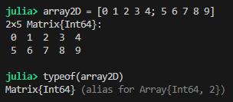
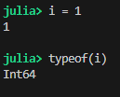
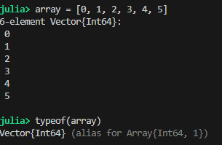
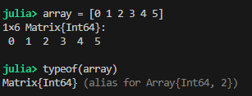
Why does type matters?
There is three main types in Julia: Int64, Float64 and String
To find the type of any variable use “typeof”
Using some of the previous array definition, this gives:

Slide 20
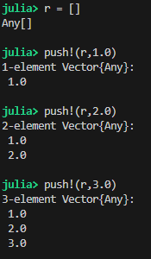
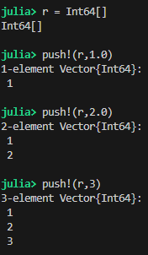
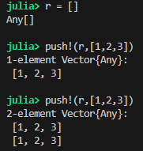

Arrays with push!
Another way to create array is to declare it empty and push elements to it
The type can be enforced too:
This can also be done for
Vectors (and Matrix)
And converted to matrix using mapreduce function
Type Any
(can contain anything)
Note that even if a Float is pushed, an integer is stored

Slide 21
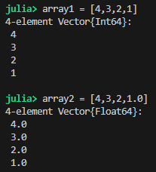
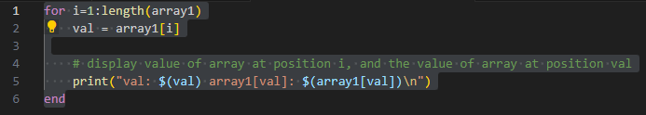
Working with arrays
Creates 2 arrays as follow:
Here no comma is used and the Vector is created using Integers
Here a single comma is used and the Vector is created using Float
Go through the values of the array using a “for” loop
What happens if we use array2 instead?

Slide 22
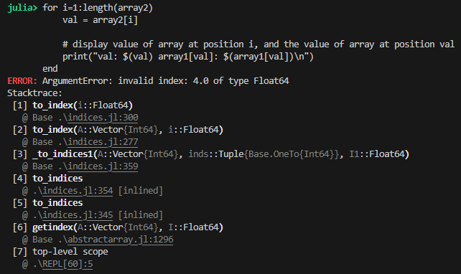
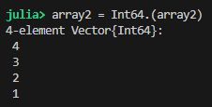
Working with arrays
Position in an array has to be access with integers (positional index)
Luckily Floats (including Vector{Float64}) can be converted to integer as:

Slide 23

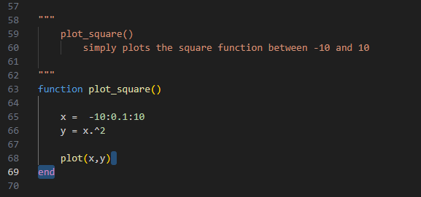
First Julia plot
First add a plotting package “Plots”
] add Plots
“]” opens the package manager
It can take a few minutes as other default packages are updated
Create a plot_square function (still in functions_file.jl)

Slide 24
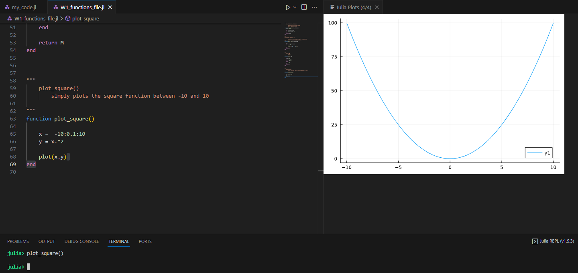
First Julia plot
Execute “my_code.jl”
In the REPL (terminal) type: plot_square()
→ The figures are displayed within VS code in a dedicated window

Slide 25
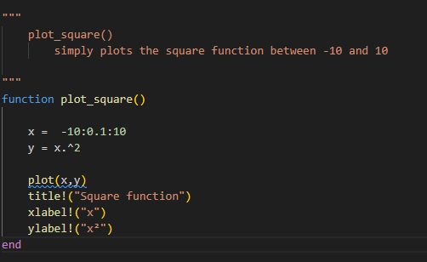
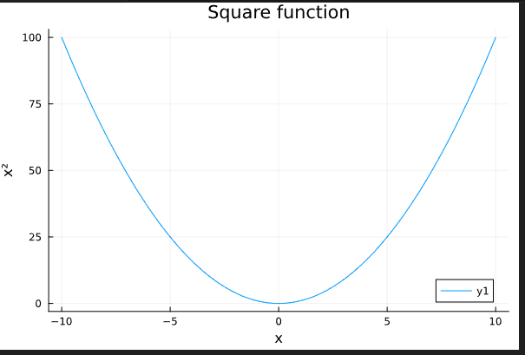
Add title and label
Modify the function as
Here the “!” means that the title, x- and y-labels will be added to previously declared plot.

Slide 26
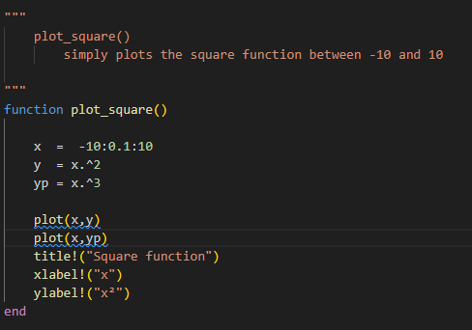
Adding another curve to existing plot
Modify the function as
What happens here?

Slide 27
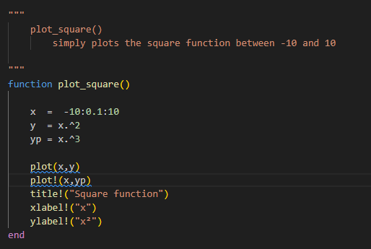
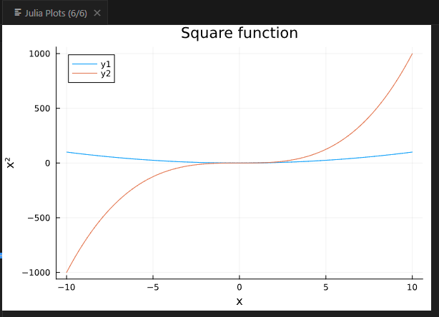
Adding another curve to existing plot
The “!” is also used to add curves to an existing plot

Slide 28
Exercise 1a
Assume we have an initial amount of money on the bank (M=1000) and each year we save some money (dM=100)
What will the amount of money be after 25 years? Create Julia function for this.
Plot the total amount of money (M) versus time in years.

Slide 29
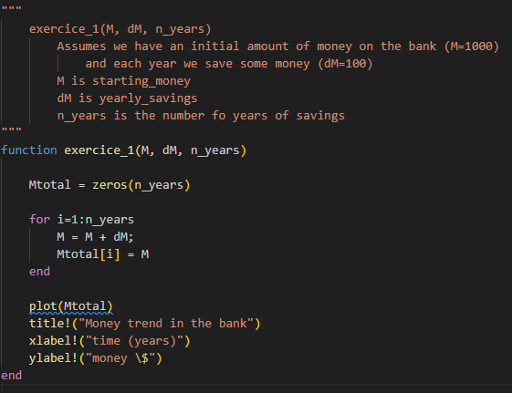
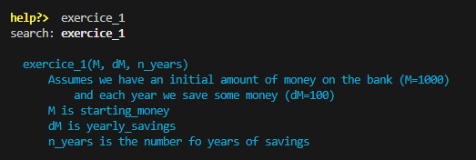
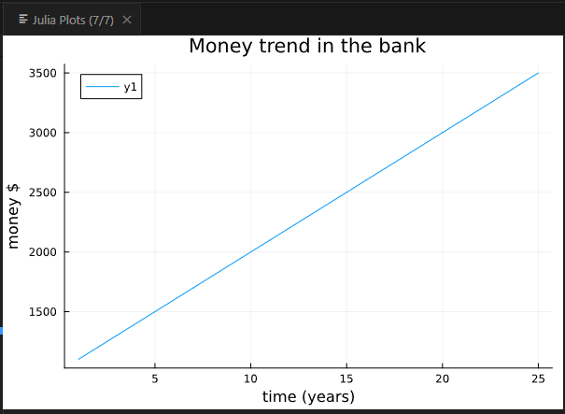

Example of solution

Slide 30
Exercise 1b
Most banks give an interest on the money you have and pay that at the end of the year. Let’s assume that the interest rate is 10%.
Duplicate the previous function and call it exercice_1b.
Modify the function to account for interest rate

Slide 31
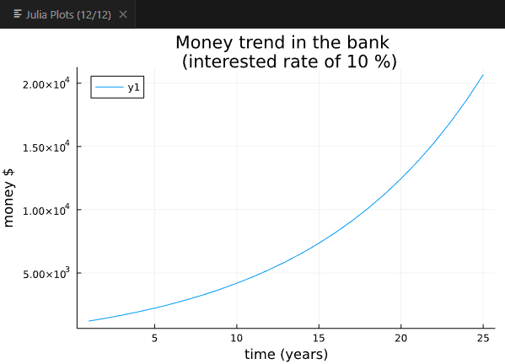
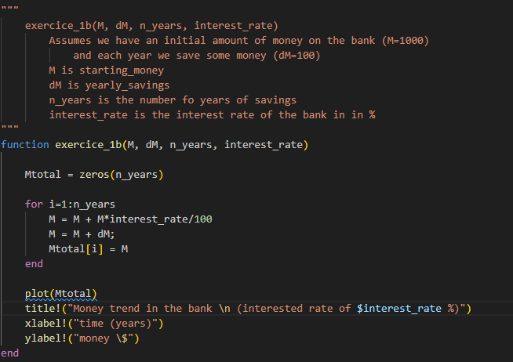

Example of solution

Slide 32
Exercise 1c
Explore plotting options (Plots.jl) use online doc: https://docs.juliaplots.org/latest/tutorial/
Improve “exercise_1b()” -> “exercise_1c()”
Change colors of the curve
Display points on top of the curve function (scatter)
Notes:
32

Slide 33
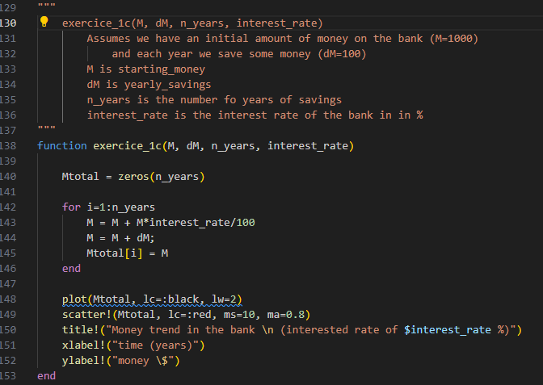

Example of solution
Save the plot to a file as:
(The file is saved in the working directory)
Notes:
33

Slide 34

To go further
Exercise 1d: fit an equation through the datapoints
Copy function “exercise_1c()” to “exercice_1d()”
Use CurvFit.jl to fit the points
(julia> ] add CurveFit)
Use online doc and provided examples
https://juliapackages.com/p/curvefit
Try different polynomial exponent and plot the results using Plots.jl
Notes:
34

