Slide 1
LaMEM short course
17-21 02 2025 Heidelberg
Nicolas Riel- nriel@uni-mainz.de

Slide 2
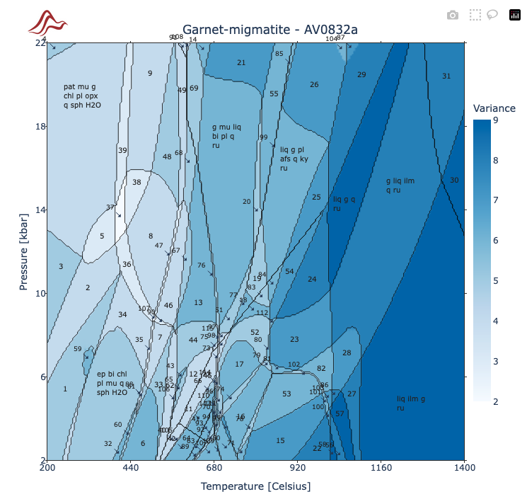
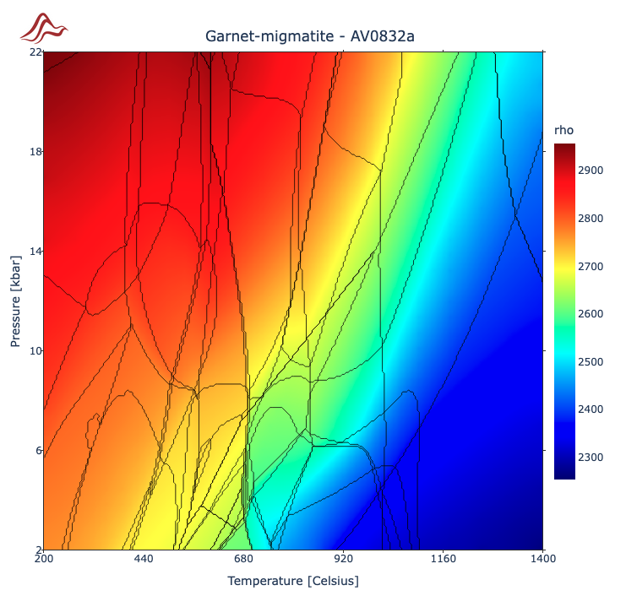
How to compute density diagram for LaMEM using MAGEMin?

Slide 3
MAGEMinApp installation
Create a MAGEMinApp directory
mkdir MAGEMinApp
cd MAGEMinApp
Step 2:
julia
julia> ]
pkg> activate . # “.” is important!!!
add MAGEMinApp
Note:
- Every time you want to use MAGEMinApp (if you closed the Julia terminal) you need to open a terminal, change path to MAGEMinApp then execute Step 2.

Slide 4
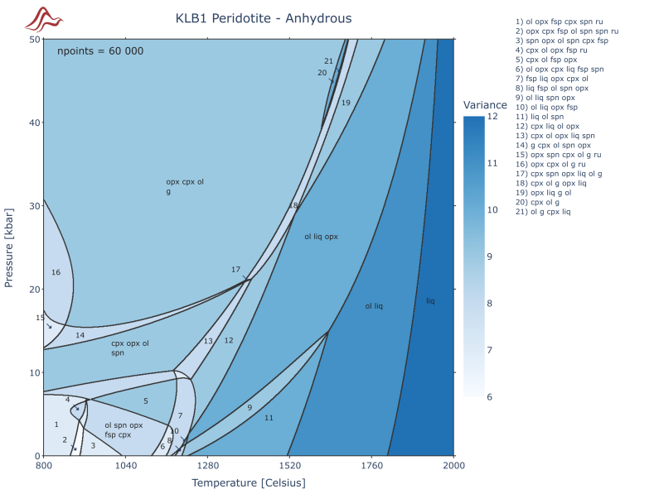

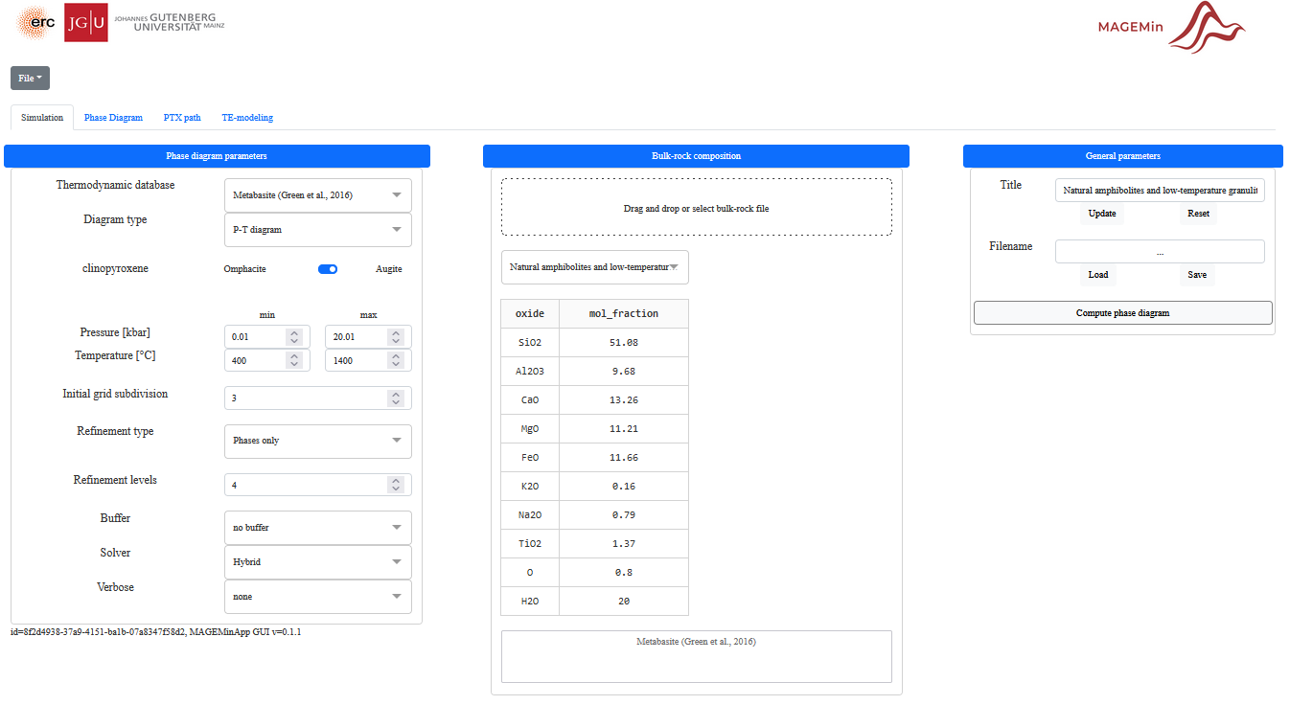
MAGEMinApp.jl
using MAGEMinApp (https://github.com/ComputationalThermodynamics)
Julia –t 5 #threaded
Julia> ] add MAGEMinApp
Julia> using MAGEMinApp
Julia> App()
http://127.0.0.1:8050/ web browser

Slide 5
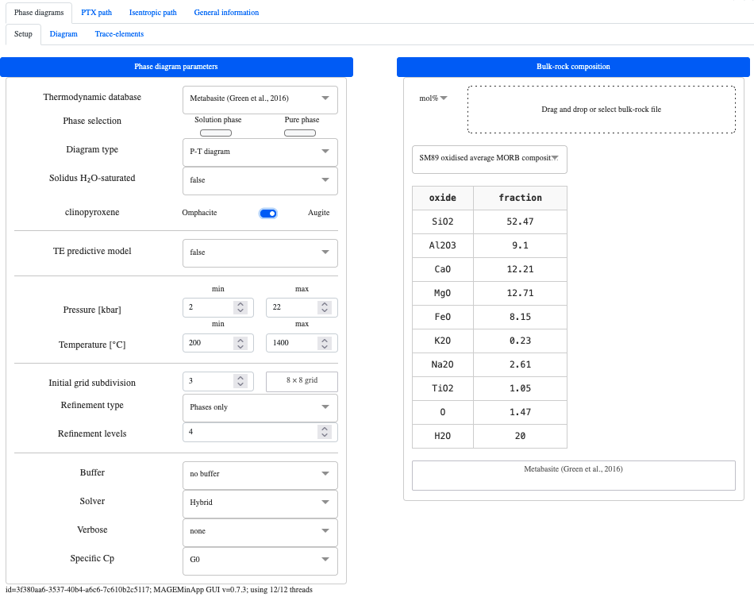
MAGEMin – phase diagrams
1
4
2
3
Select database,
select P-T range → 200 to 1200°C 2 to 24 kbar,
select levels of refinement = 4,
choose MORB composition

Slide 6
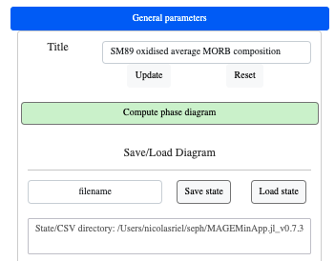
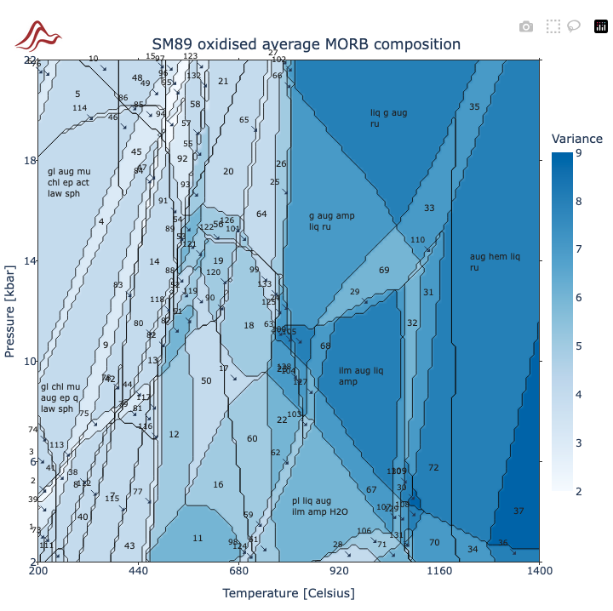
MAGEMin – phase diagrams
1
Compute diagram (wait a few minutes)
Gives a low-resolution diagram (enough for density)

Slide 7
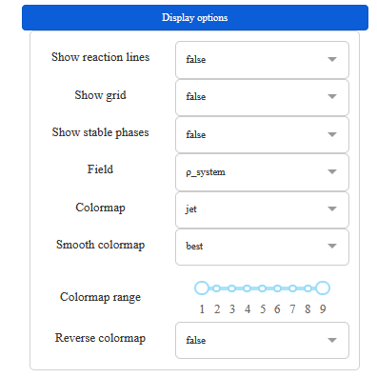
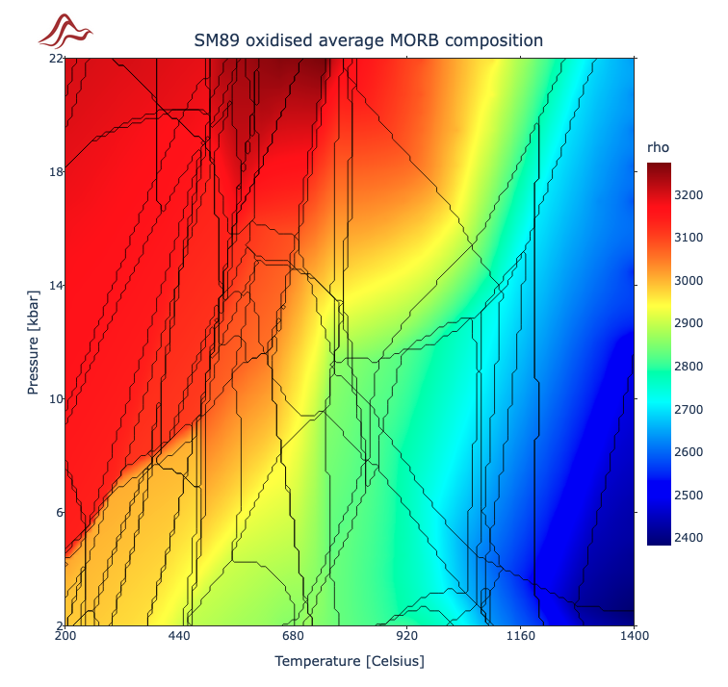
MAGEMin – phase diagrams
2
2. Change field to rho and colormap to jet
Gives a low-resolution diagram (enough for density)

Slide 8
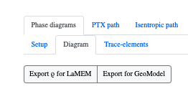
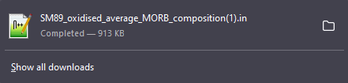
MAGEMin – phase diagrams
Export to LaMEM
In the top-left
→ “export for LaMEM”
Now it can be added to your LaMEM julia script as rho_ph = “SM89_oxidised…”
3-4 refinements are enough for a LaMEM density diagram
Can be done for any custom rock composition and PT conditions
Make sure you use the right database
Set minimum pressure > 0.0, e.g. 0.01!
If your LaMEM simulation goes outside the computed diagram range, it will extrapolate the density from the used phase diagram

Slide 9
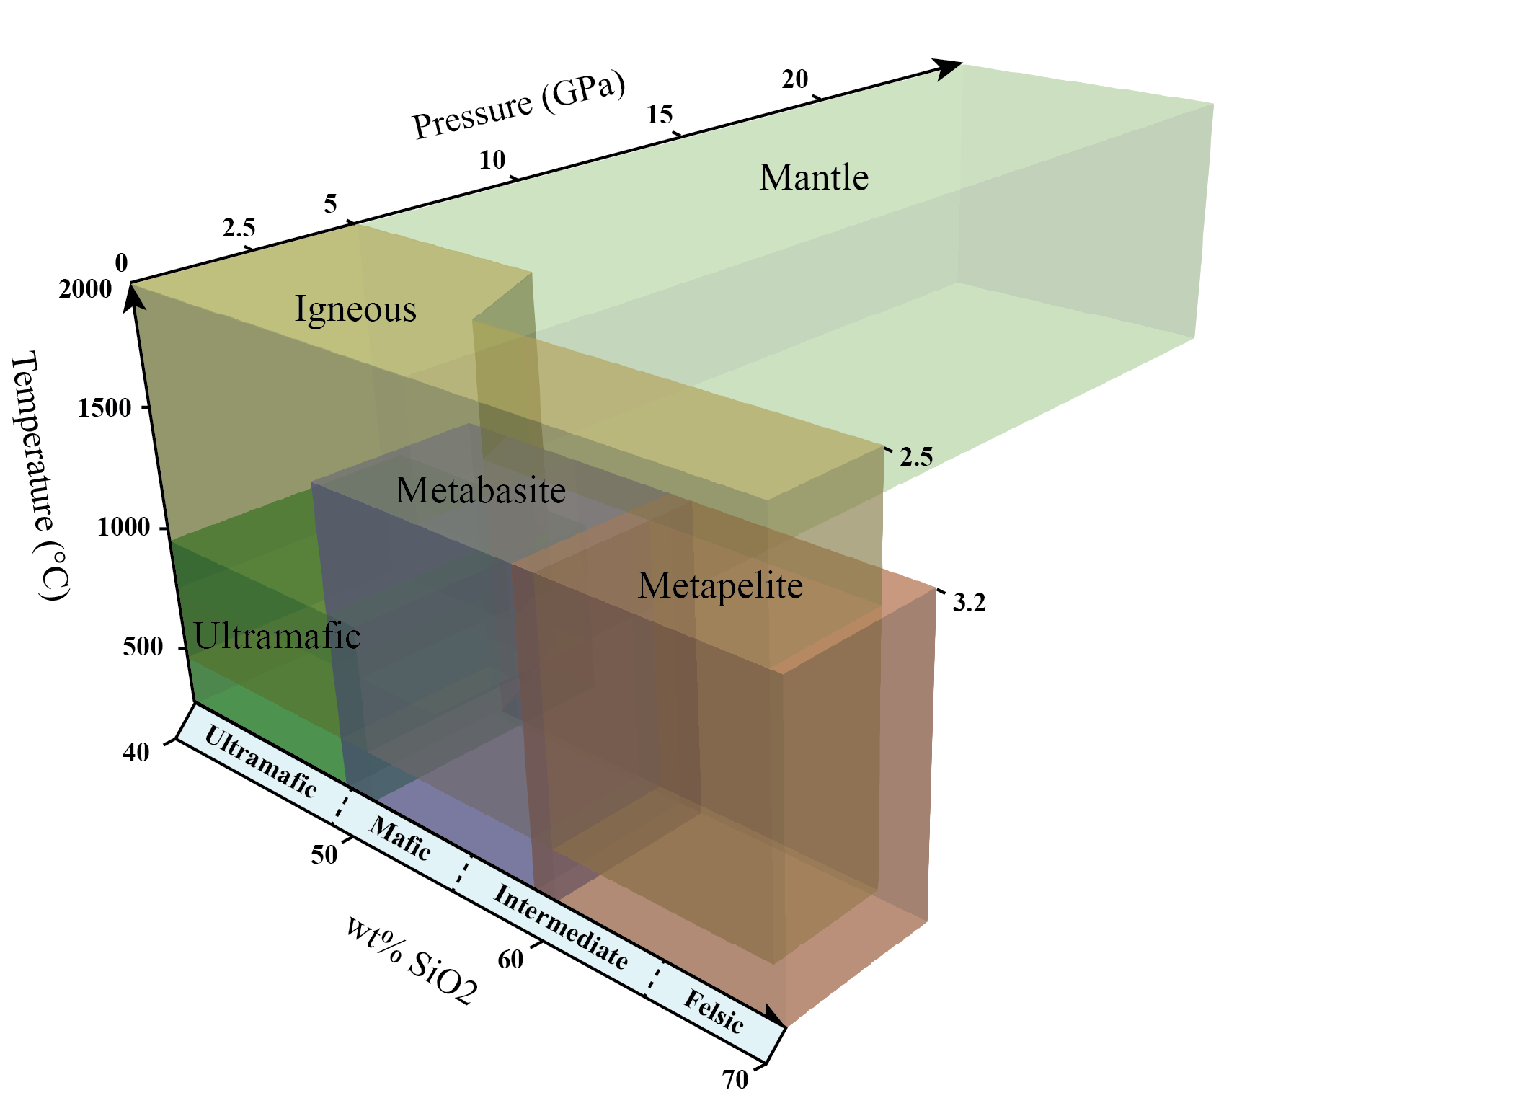
MAGEMin – how to choose database

Slide 10
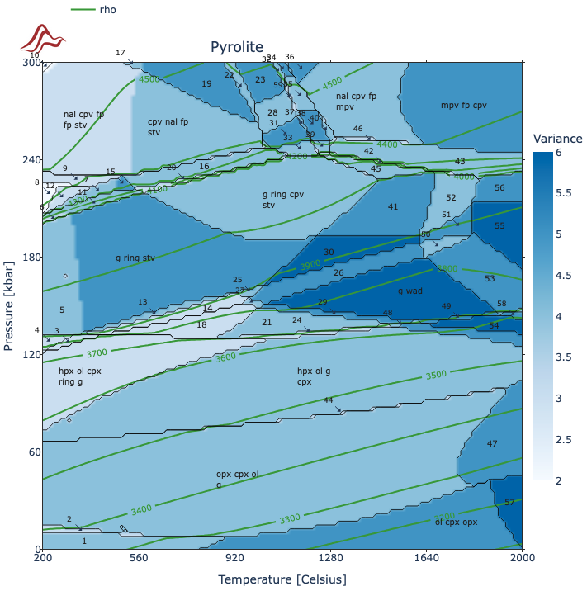
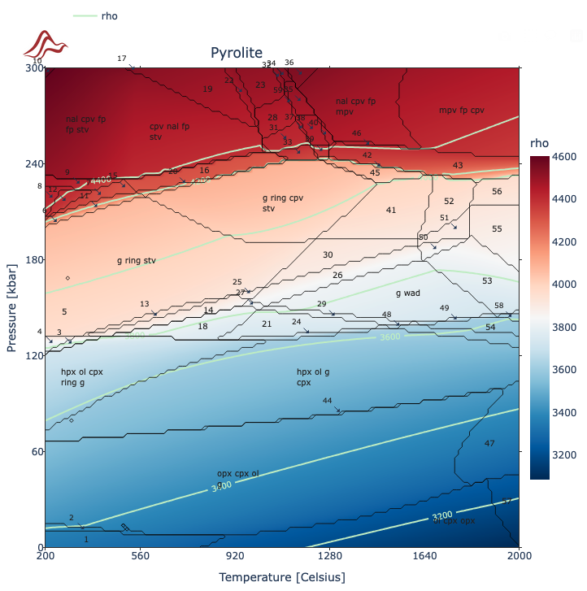
Upper mantle density diagram (Peridotite.in)

