Slide 1



Compose Multiplatform
KMM
KMP

Slide 2
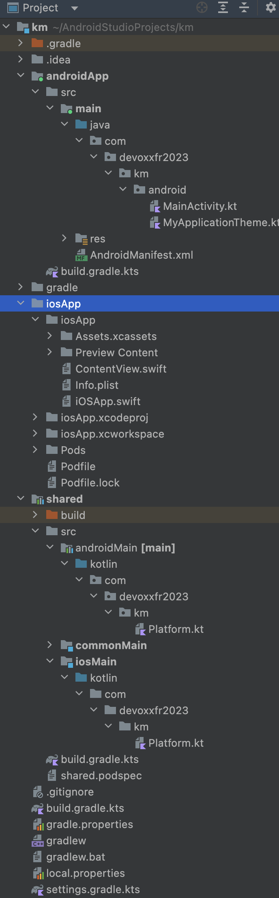
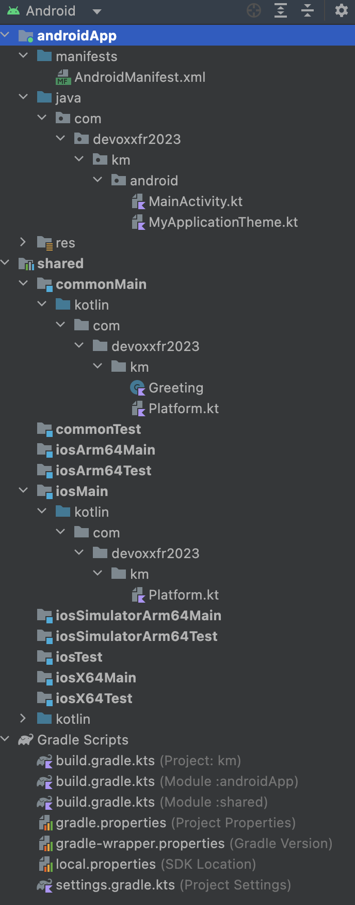
3
3
3.1
3.1
2
4
1
1 - Kotlin shared library module
3
1.1 - Shared kotlin source file
2 - Kotlin library module (android / ios)
3.1
1.1
2.1 - Per platform specific library kotlin source file
2
3 - Per platform app modules (android / ios)
2
3.1 - Target application source file (kotlin/swift)
2.1
4 - Gradle configuration file
1
2.1
2
2
4
2.1
4
4

