Slide 1
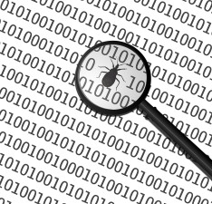
JF2-5 Testing

Slide 2
What is Testing?
Testing involves checking out each line of code of a program to identify bugs or errors during the software development process. Specific test cases are checked on the program to see if it performs the functions required

Slide 3
Why do we test code?
Developers write unit tests for their code to make sure that the code works correctly. This helps to detect and protect against bugs in the future. Sometimes developers write unit tests first, then write the code. This approach is also known as test-driven development (TDD)

Slide 4
Why is it so important?
Every developer who has worked on long-term projects has come across common problems at some point while fixing broken code and asked:
“How and where in the codebase do I fix this?”
“What do these lines of code do?”
“Is this code still needed or used at all?”
And most importantly:
“How can I make sure that if I change this, nothing else breaks?”

Slide 5
Why is it so important?
Simply put, code that is automatically unit-tested will effectively translate in practical terms into:
more reusability
refactoring made easy/clean code
agile code
robust code
readable code
Simplified debugging
Avoid regression

Slide 6
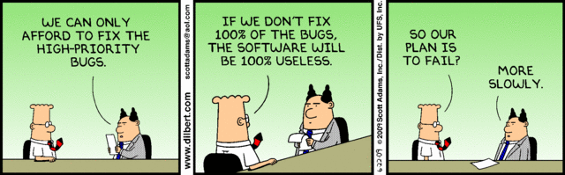
It saves time, really
Number one excuse not to write tests is that you do not have time for it or your client does not want to pay for it. Writing tests can indeed cost you some time

Slide 7
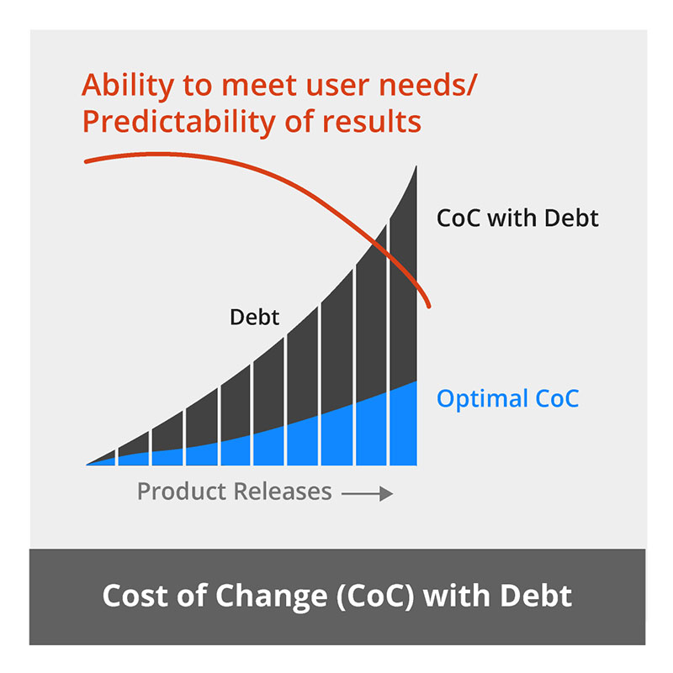
Technical debt

Slide 8
What are unit tests, anyway?
Unit tests are automated tests written (in code) by developers, each testing a particular standalone unit of code, separately from the rest of the application. One unit test is given control data for executing a particular scenario (the input of whatever code it tests) and expects a given output. If that output is met, the test passes.
A test scenario usually (but not necessarily) tests a single function/method (the unit).

Slide 9
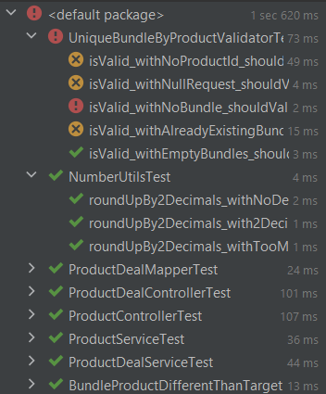
Automated tests

Slide 10

JUnit
JUnit is a popular unit-testing framework in the Java ecosystem. JUnit 5 added many new features based on the Java 8 version of the language

Slide 11
Junit – maven dependency
<dependency>
<groupId>org.junit.jupiter</groupId>
<artifactId>junit-jupiter</artifactId>
<version>5.9.0</version>
<scope>test</scope>
</dependency>

Slide 12
Maven test job - scan test classes – maven plugin
<plugin>
<artifactId>maven-surefire-plugin</artifactId>
<version>2.22.2</version>
<dependencies>
<dependency>
<groupId>org.junit.platform</groupId>
<artifactId>junit-platform-surefire-provider</artifactId>
<version>1.3.2</version>
</dependency>
</dependencies>
</plugin>

Slide 13
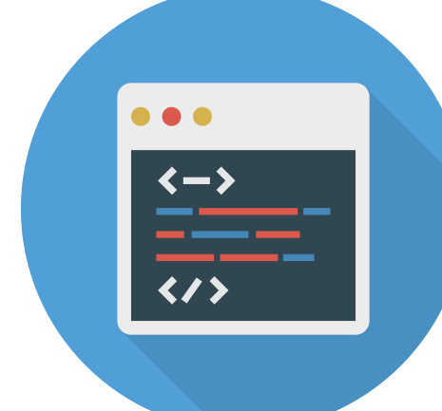
Demo
Successful test
Failing test (bad assert), failing

Slide 14
Assignment
Write our first unitary test

Slide 15
Assertions
Assert statement | Example
assertEquals | assertEquals(4, calculator.multiply(2, 2)); assertEquals(4, calculator.multiply(2, 2),"optional failure message");
assertTrue | assertTrue(a < b); assertTrue('a' < 'b', () → "optional failure message");
assertFalse | assertTrue(a > b); assertFalse('a' > 'b', () → "optional failure message");
assertNotNull | assertNotNull(yourObject); assertNotNull(yourObject, "optional failure message");
assertNull | assertNull(yourObject); assertNull(yourObject, "optional failure message");
assertThrows | Throwable exception = assertThrows(IllegalArgumentException.class, () -> user.setAge("23")); assertEquals("Age must be an Integer.", exception.getMessage());

Slide 16
Assignment
Assertions

Slide 17
Parameterized Tests
This feature enables us to execute a single test method multiple times with different parameters

Slide 18
Assignment
Rewrite same tests with Parametrized tests

Slide 19
Test coverage
Code coverage is a software metric used to measure how many lines of our code are executed during automated tests

Slide 20

JaCoCo
It’s an open-source toolkit for measuring code coverage in a code base and reporting it via visual reports. It is quite popular among a variety of code coverage frameworks
It runs as a Java Agent. It is responsible for instrumenting the byte code while running the test. JaCoCo exercises in each instruction, and shows which lines are used during each test. It is also possible to run the JaCoCo agent in server mode

Slide 21
Assignment
Test coverage

Slide 22
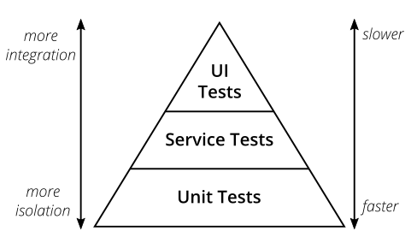
Testing pyramid

Slide 23
Mocks
What is mock testing?
Mocking means creating a fake version of an external or internal service that can stand in for the real one, helping your tests run more quickly and more reliably. When your implementation interacts with an object’s properties, rather than its function or behavior, a mock can be used

Slide 24

Mockito
Mockito is a mocking framework, JAVA-based library that is used for effective unit testing of JAVA applications. Mockito is used to mock interfaces so that a dummy functionality can be added to a mock interface that can be used in unit testing

Slide 25
Assignment
Mocks: demo + exercise (static/not static mocks)

Slide 26
Demo + practice
Spy, Captor

Slide 27
Test-driven development - TDD
Test Driven Development (TDD) is software development approach in which test cases are developed to specify and validate what the code will do. In simple terms, test cases for each functionality are created and tested first and if the test fails then the new code is written in order to pass the test and making code simple and bug-free

Slide 28
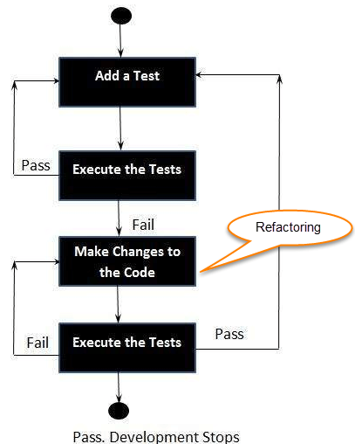
How to perform TDD Test
Following steps define how to perform TDD test,
Add a test.
Run all tests and see if any new test fails.
Write some code.
Run tests and Refactor code.
Repeat.

Slide 29
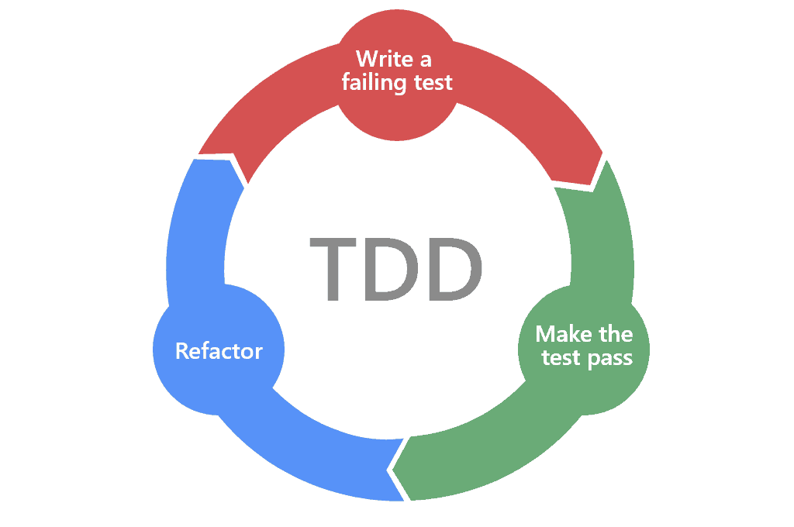
TDD

Slide 30
TDD Vs. Traditional Testing
The foundations are in place before you build the house
TDD helps you to develop the logic in your code
Very high test-coverage
Prevents bugs early on in the development process
Your code can be understood easily

Slide 31
Assignment
TDD - calculator

