Slide 1


SBM-1 Spring Boot Microservices

Slide 2
Inversion of control (IoC)
With Inversion of Control we want to decouple some dependencies
Goal is to improve simplicity
Goal is to improve testability

Slide 3
Dependency injection (DI)
“Dependency Injection (DI) is a form of inversion of control, where implementation are passed into an object by an IoC container”
Diﬀerent types of Injection types:
Field-based Injection
Method-based Injection
Constructor-based Injection

Slide 4
Dependency injection - field
public class InjectionClass { private Object field; }

Slide 5
Dependency injection – method/setter
public class InjectionClass { private Object field; void setField (Object field) { this.field = field; } }

Slide 6
Dependency injection - constructor
public class InjectionClass { private final Object field; public InjectionClass(Object field) { this.field = field; } }

Slide 7
Springboot
Generating a new project

Slide 8
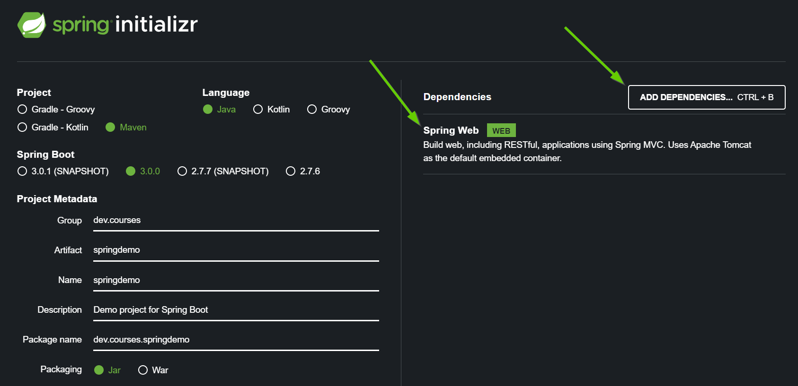
Spring initializr - https://start.spring.io/

Slide 9

Github repo
https://github.com/spring-guides/gs-spring-boot

Slide 10

Assignment
Dependency injection

Slide 11
Dependency injection - field/annotation
@Component public class MyClass { private final Dependency1 dependency1; private final Dependency2 dependency2; public MyClass(Dependency1 dependency1, Dependency2 dependency2) { this.dependency1 = dependency1; this.dependency2 = dependency2; } }
@Component public class MyClass { @Autowired private Dependency1 dependency1; @Autowired private Dependency2 dependency2; }

Slide 12
Why Should I Use Constructor Injection?
All required dependencies are available at initialization time: The IoC container makes sure that all the arguments provided in the constructor are available before passing them into the constructor. This helps in preventing the infamous NullPointerException.
Identifying code smells: Constructor injection helps us to identify if our bean is dependent on too many other objects. If our constructor has a large number of arguments this may be a sign that our class has too many responsibilities. We may want to think about refactoring our code to better address proper separation of concerns.

Slide 13
Why Should I Use Constructor Injection?
Preventing Errors in Tests: constructor injection simplifies writing unit tests. The constructor forces us to provide valid objects for all dependencies. Constructor injection ensures that our test cases are executed only when all the dependencies are available. It’s not possible to have half created objects in unit tests

Slide 14
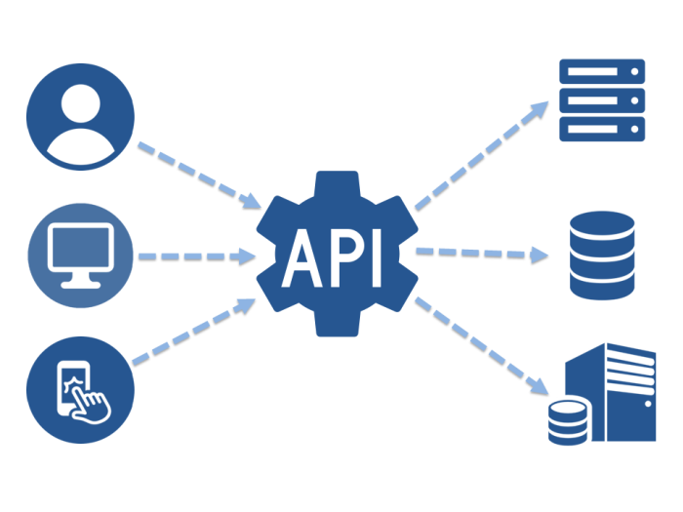
REST API

Slide 15
What is an API?
API stands for application programming interface, which is a set of definitions and protocols for building and integrating application software

Slide 16
What is a REST API? (Representational State transfer)
A REST API (also known as RESTful API) is an application programming interface (API or web API) that conforms to the constraints of REST architectural style and allows for interaction with RESTful web services
RESTful: it has to conform to these criteria:
A client-server architecture made up of clients, servers, and resources, with requests managed through HTTP
Stateless client-server communication, meaning no client information is stored between get requests and each request is separate and unconnected
Cacheable data that streamlines client-server interactions
A uniform interface between components

Slide 17
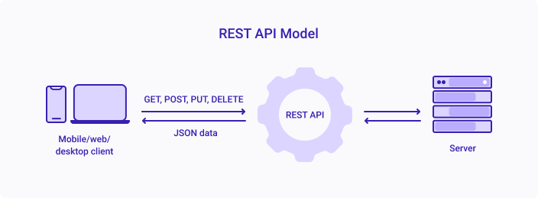
REST API

Slide 18
HTTP verbs
HTTP Verb | CRUD
POST | Create
GET | Read
PUT | Update/Replace
PATCH | Update/Modify
DELETE | Delete

Slide 19
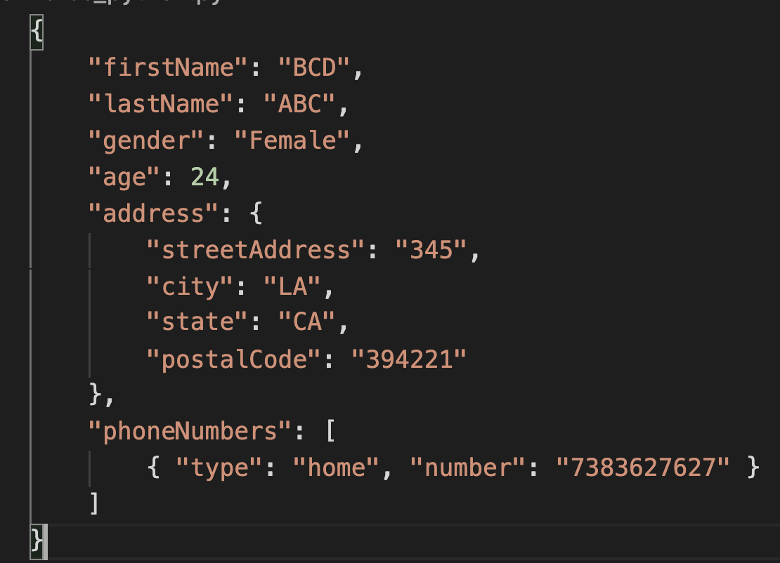
JSON

Slide 20
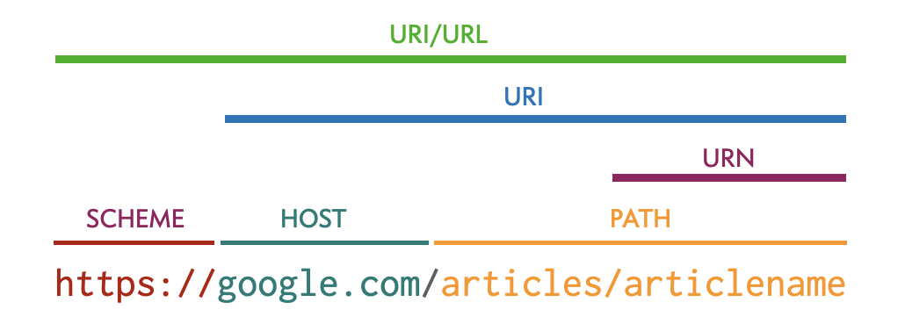
HTTP request

Slide 21
REST endpoint - CRUD examples
REST endpoint HTTP verb + server host URL + entity
Get all users GET http://my-server/users
Get user by ID = 15 GET http://my-server/users/15
Get user by name = John GET http://my-server/users/john
Create a user POST http://my-server/users
Body: {name=“John”, age=25}
Update user by ID = 12 PUT http://my-server/users/12
Body: {name=“Leo”, age=32}
Delete user by ID = 2 DELETE http://my-server/users/2

Slide 22
REST endpoint - CRUD examples
Get address of user ID = 3
GET /users/3/addresses
Get book ID = 5 from the library name = Amsterdam
GET /libraries/Amsterdam/books/5
Use plurals for entities
GET /user/12 -> GET /users/12
Don’t use verbs in URLs. Use HTTP verbs instead
POST /users/createNewUser -> POST /users
GET /articles/{article id}/generateBanner -> GET /articles/{article id}/banners

Slide 23
REST endpoint – parameters and body
Request parameters: /users?field1=value1&field2=value2
GET /users?name=John&age=15
GET /users?pageSize=20&pageNumber=3
Path variables: /users/{user id}
GET /users/15
GET /users/10/addresses/5
Body:
JSON data mainly for POST and PUT
GET can’t have a body

Slide 24
REST endpoints - exercices
“Give me users with the name Paul”
Solution: GET /users?name=Paul
“Add a book in the library with title = Memories and pages = 123”
POST /libraries/books
Body = {“title”: “Memories”, “pages”: 123}
“Make a payment with amount = 1000, currency = USD”
-> Fix this junior endpoint: GET /payment/1000/USD
POST /payments
Body = {“amount”: “1000”, “currency”: USD}

Slide 25
HTTP response codes - ranges
HTTP code range | Type
100 - 199 | Informational response
200 - 299 | Successful responses
300 - 399 | Redirection messages
400 - 499 | Client error responses
500 - 599 | Server error responses

Slide 26
HTTP codes - success
HTTP code | Description
200 | OK
201 | Created
202 | Accepted
204 | No Content

Slide 27
HTTP response codes - client errors
HTTP code | Description
400 | Bad Request
401 | Unauthorized
403 | Forbidden
404 | Not Found

Slide 28
HTTP response codes - server errors
HTTP code | Description
500 | Internal Server Error
502 | Bad Gateway
503 | Service Unavailable
504 | Gateway Timeout

Slide 29
Error handling - risks
Hide information (security)
Balance between inform the client and protecting data structures
Agreements in a company about them and how to react on them

Slide 30

Postman
Postman is an API platform for developers to design, build, test and iterate their APIs

Slide 31
Free public APIs without authentication
https://mixedanalytics.com/blog/list-actually-free-open-no-auth-needed-apis/
https://apipheny.io/free-api/

Slide 32
Assignment
Install Postman
Call a public API

Slide 33

Spring

Slide 34
How can Spring help us?
Start up the application
Initialize all the beans
Run the automated tests

Slide 35
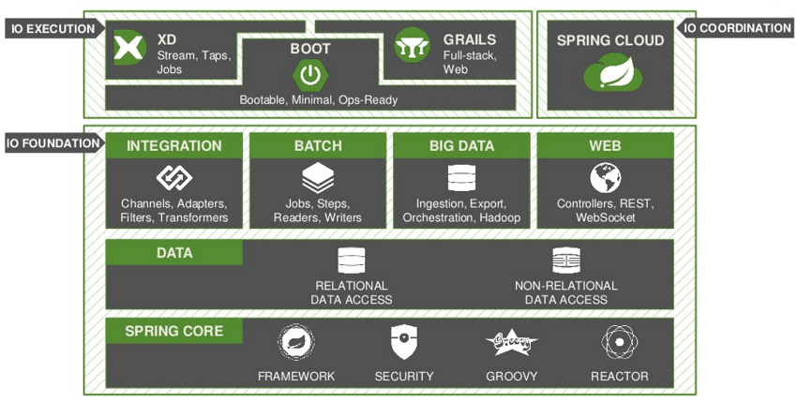
Spring ecosystem - what will we use today

Slide 36
Assignment
Make our first Controller - Hello World

Slide 37

Model–View–Controller (MVC)
Spring
MVC is a software architectural pattern commonly used for developing user interfaces that divide the related program logic into three interconnected elements

