Slide 1




Class of Web Technologies
Presentation Interface / Front-End
Student : Nicolas Solaz Teacher : Sarra Boucetta Semester 7

Slide 2

RESUME
1 EXPLICATION OF THE FUNCTIONING OF THE SITE
2 WELCOME PAGE AND INTERACTION WITH THE OTHER
3 PAGE 2 : RESEARCH
4 PAGE 3 : RECIPE
2 PAGE 4 : SHOPPING BASKET
3 PAGE 5 : PDF RESUME

Slide 3
EXPLICATION OF THE FUNCTIONING OF THE SITE

Slide 4
EXPLICATION OF THE FUNCTIONING OF THE SITE
The main purpose of this web page it’s to make your shop on supermarket easier. In the same time it allows you to cooks various meal according to different criteria of your choice. To
At the end you obtain 2 things :
A list of product with the price and the quantity
The recipe related
Your shopping already done in the market, ready to get back
To access to the service of the web site you will have to create an account.
In order to not cook the same things a monthly personal calendar will be available.

Slide 5

WELCOME PAGE AND INTERACTION WITH THE OTHER

Slide 6
WELCOME PAGE AND INTERACTION WITH THE OTHER
Illustration
Shop/Menu bar/Language setting
Logo e-shop
Login :
- Create an account
- Connection : ID / Password
Quote
Information about :
Author / Web page / Context / Version/Policy/Social network…

Slide 7
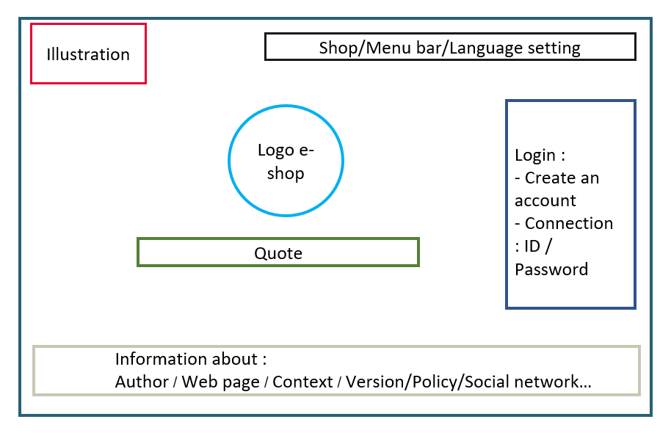
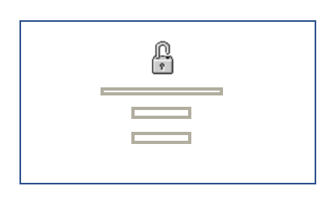

WELCOME PAGE AND INTERACTION WITH THE OTHER
PAGE 3 : RECIPE
PAGE 2 : RESEARCH
PAGE : MONTHLY CALENDAR
Disconnection
PAGE 4 : SHOPPING BASKET
PAGE 5 : PDF RESUME

Slide 8

PAGE 2 : RESEARCH

Slide 9

PAGE 2 : RESEARCH
This page will be manage like a probability tree. To find the recipe that fit to you, the site will propose to a succession of choice like the picture below.
When you finish to chose you will have to validate and you will be able to find the matching recipe.
Furthermore any choice is required. If you only choose step 1, for example “Desert”, then all recipe related to “Desert” will be show. After selected all the recipe you can find your shopping basket on the top of the page with this symbol “ ” who will get you on page 4.
1 2 3 4
P
T
I
D
P
I
D
Price (P)
Localization (L)
Time of preparation (T)
P
L
I
D
Desert
Ingredient (I)
Diet (D)
P
L
T
I
D
Starter
Dish

Slide 10

PAGE 3 : RECIPE

Slide 11
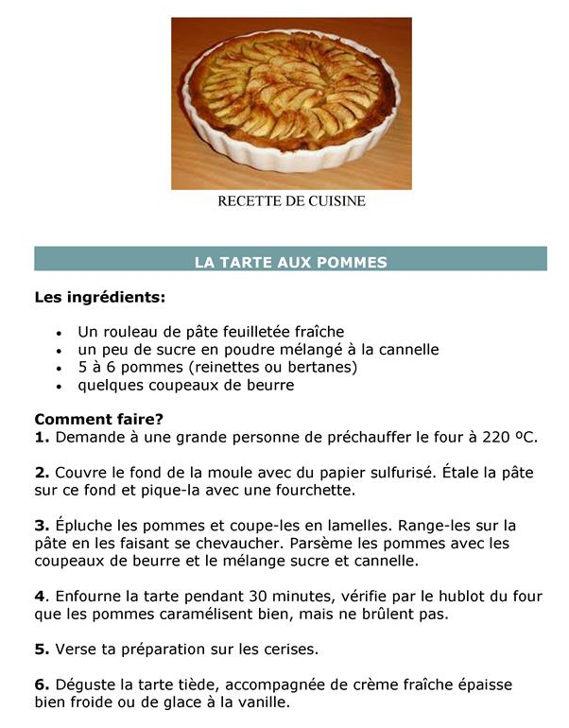

PAGE 3 : Recipe
Once you validate your choice on page 3 you can see all name of the recipe related to your choice.
By clicking on one recipe you open the recipe entirely.
If want to cook that, you validate and all ingredient are added to your shopping basket.
You can do that as many time as you want.

Slide 12

PAGE 4 : SHOPPING BASKET

Slide 13

PAGE 4 : SHOPPING BASKET
Once you finish you can see on your shopping basket all the ingredient with the quantities and the average price of each one. You can validate to get the result and order in your market.
Ingredients | Quantity | Price
Apple Butter … | 1 kg 500 g … | 2,6 € 3 € … TOTAL : … €

Slide 14

PAGE 5 : PDF RESUME

Slide 15
PAGE 5 : PDF RESUME
The next step before making shopping is to validate the shopping basket. Once is done, you obtain two things :
A PDF of each recipe
A PDF of you shopping list
In the same time the name of the recipe you choose will be added to the week of the actual month in your personal calendar
After using the site web, you just have to buy all the ingredient, to cook and … bon appétit !

Slide 16
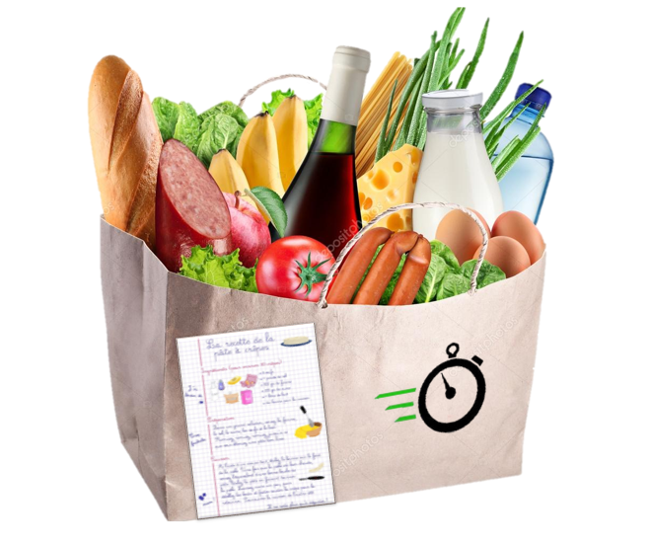
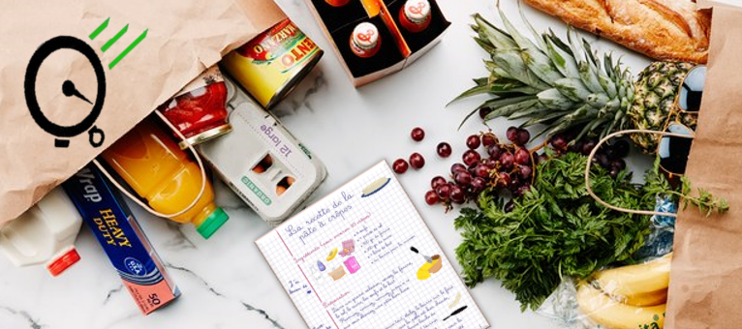
Student : Nicolas Solaz Teacher : Sarra Boucetta Semester 7

