Slide 1

Project 2: Natural Language Processing(NLP)
Group 1: John-Baptist, Lovely & Nicolas

Slide 2

Project Overview
Objective: Classify news articles as real or fake
Text preprocessing & Regex
Model training & performance
Validation prediction results
Conclusion

Slide 3
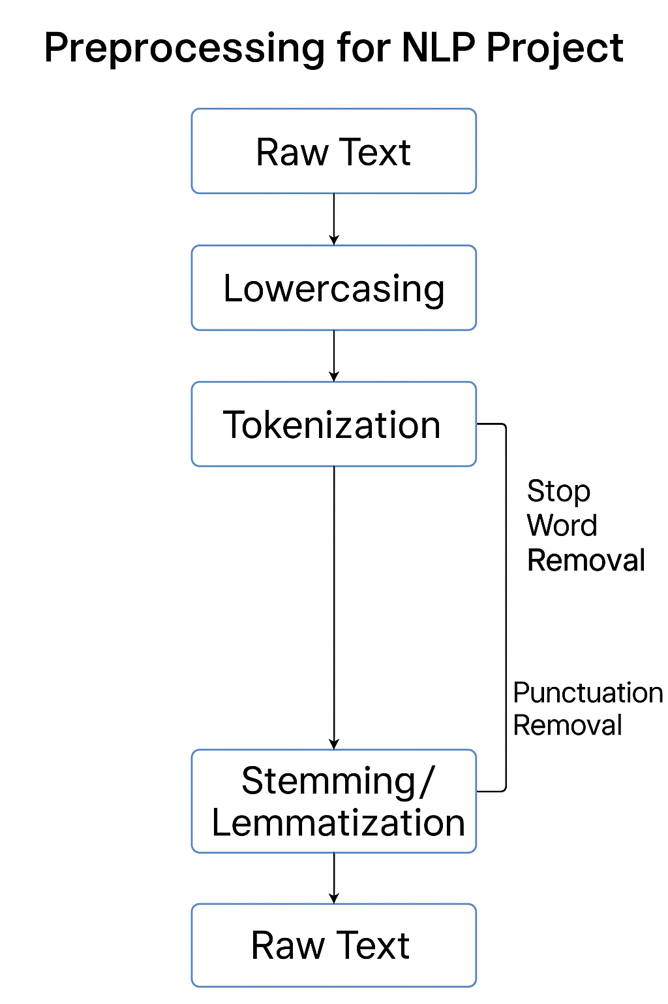
Preprocessing & Regex

Slide 4
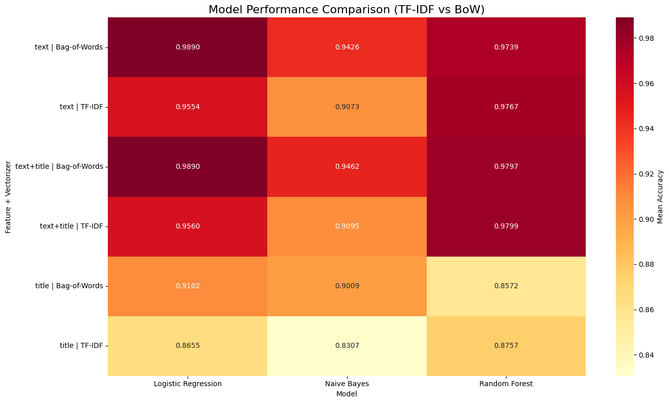
Model Training & Evaluation

Slide 5
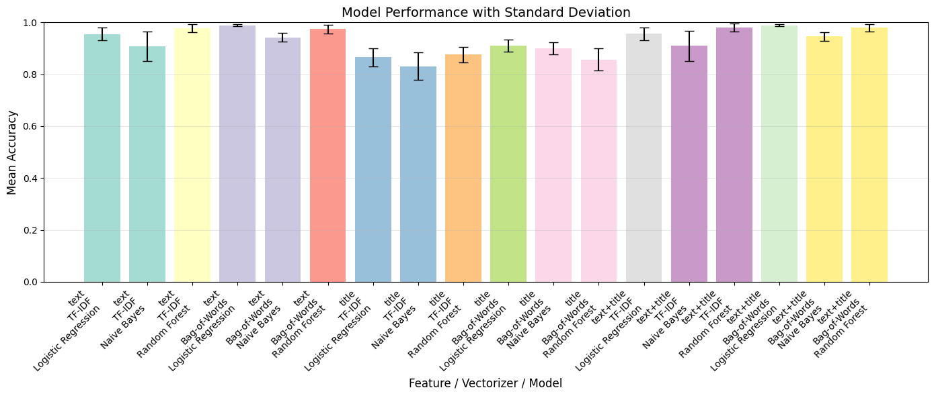
Model Training & Evaluation

Slide 6
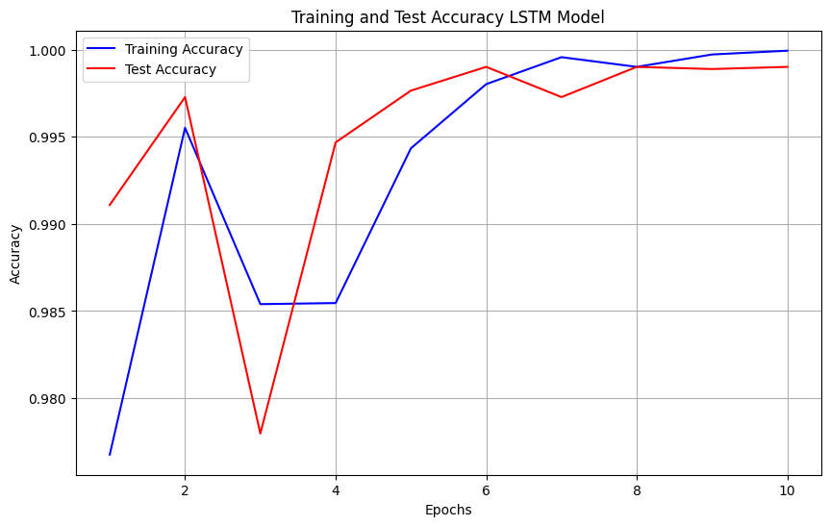
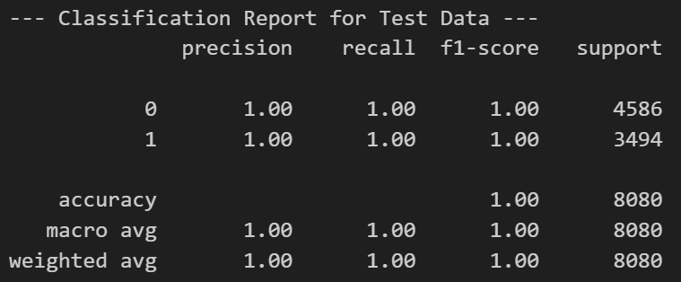
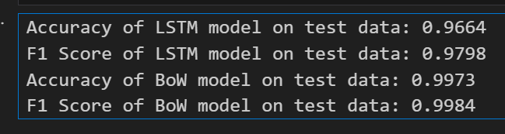
Model Training & Evaluation
Transformer-based model: LSTM model

Slide 7
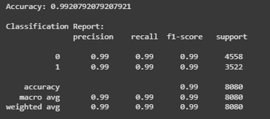
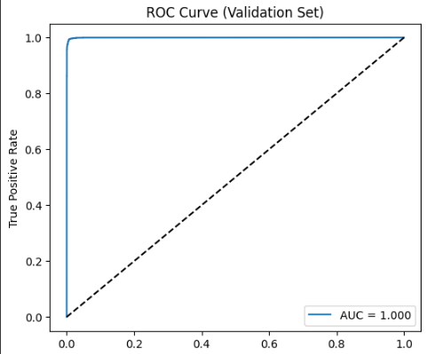
Validation Prediction Results
Transformer-based model: RF & BERT model

Slide 8
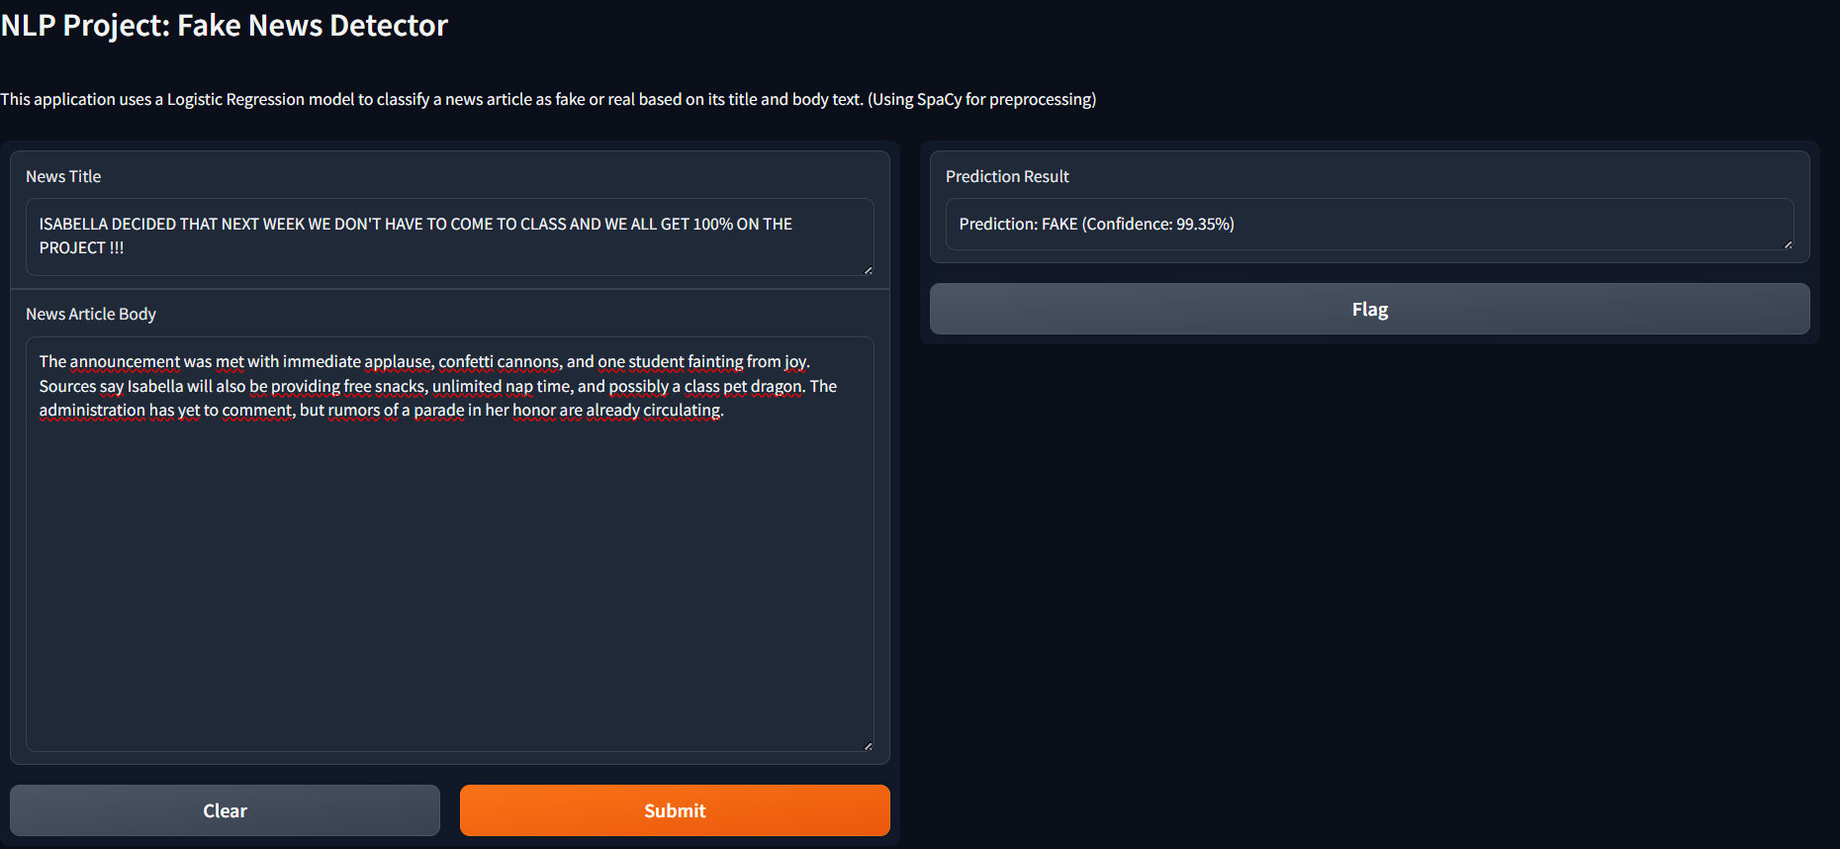
Conclusion
Model deployment

Slide 9
Conclusion
Takeaways/key learnings:
Ensuring clean preprocessing pipeline as it is critical in NLP tasks
Deep learning can provide improvements but at higher cost.
Challenge: Handling class imbalance

Slide 10
Thank You
Questions and Discussion

