Slide 1


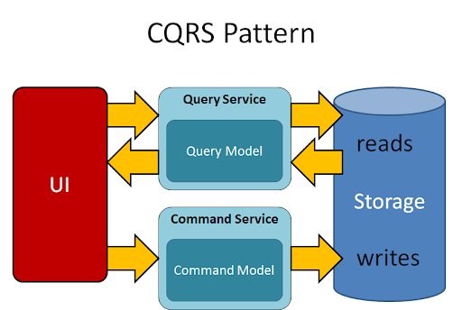


Presentation
Cross
Application
Mediatr , CQRS Pattern
Domain
Domain Driven
Infrastructure
Persistence
External Interfaces
Database
SAP

