Slide 1
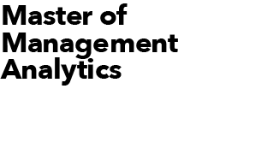
Who Are The Best Ice Hockey Players?
2023 MMA Summer Datathon
June 14, 2023 Prepared by Yejun Tu, Yuxuan Yang, Ashmal Sameeh

Slide 2
Objective
A team of five top players from all over the world
Who are the top five hockey players?
Given women’s hockey data from the NWHL, we wonder that, among over a hundred of players participating in the game, who are the top five players excelling in all areas of the game.
Thus, our goal is to form a team of five top players for the next competition. The group of five players come from different teams, among which we have at least 3 excellent goal scorers and at least 2 excellent passers. Among the 5 players, there will also be two faceoff specialists and one takeaway specialist.
How to find the best hockey players?
To evaluate each player’s performance, we introduced the NWHL Game Score and NWHL Play Score. The Game Score evaluates each player’s performance on scoring goals, and the Play Score evaluates each player’s performance on passing the puck. Both Scores are created based on various factors, such as the player’s ability to successfully earn a goal, the ability to pass puck, takeaway and faceoff win performance, puck recovery ability, penalty taken times and the ability to conduct penalty draw.
Based on the Game Score and the Play Score, together with the amount of faceoff win and takeaway conducted by each player, we will be able to form a comprehensive assessment of each player and thus select our desired five.

Slide 3
Method
Game Score and Play Score
We use Game Score to evaluate individual player’s overall performance in different events regarding earning a goal.
The idea is to compare all of a player’s valuable events to the frequency in which goals are scored.
Game_Score= goals +0.0071*play + 0.0383*shot + 0.0898*faceoff win + 0.0629*takeaway - 0.0139*penalty taken + 0.0139*penalty draw +0.0093*puck_recovery
Factors are obtained by taking the frequency of each stat to successful goals.
For example, there were 1985 shot attempts (including both successful and unsuccessful attempts), and 76 goals. Take the 76 goals and divide them by the 1985 shot attempts, we get the factor of 0.0383.
We add value to players who conduct favorable events such as a penalty draw and a puck recovery
We minus value to players for bad event such as a penalty taken.
We use Play Score to evaluate individual player’s overall performance in different events regarding passing a puck.
Play_Score= plays + 0.6788*goal + 3.6519*incomplete_play + 8.5686*faceoff win + 6.0058*takeaway - 0.3889*penalty taken + 0.3889*penalty y draw +0.8825*puck_recovery
Similarly, factors are obtained by taking the frequency of each stat to successful pass attempts.
We divide the individual Game Score and Play Score by the total number of games played by individual player to find the average score for individual player. The average Game Score and average Play Score will then be the performance evaluation standards.
Below is a link to the article where we get insights on the Game Score and Play Score formulas:
https://hockey-graphs.com/2019/08/21/revisiting-nwhl-game-score/#more-23764

Slide 4
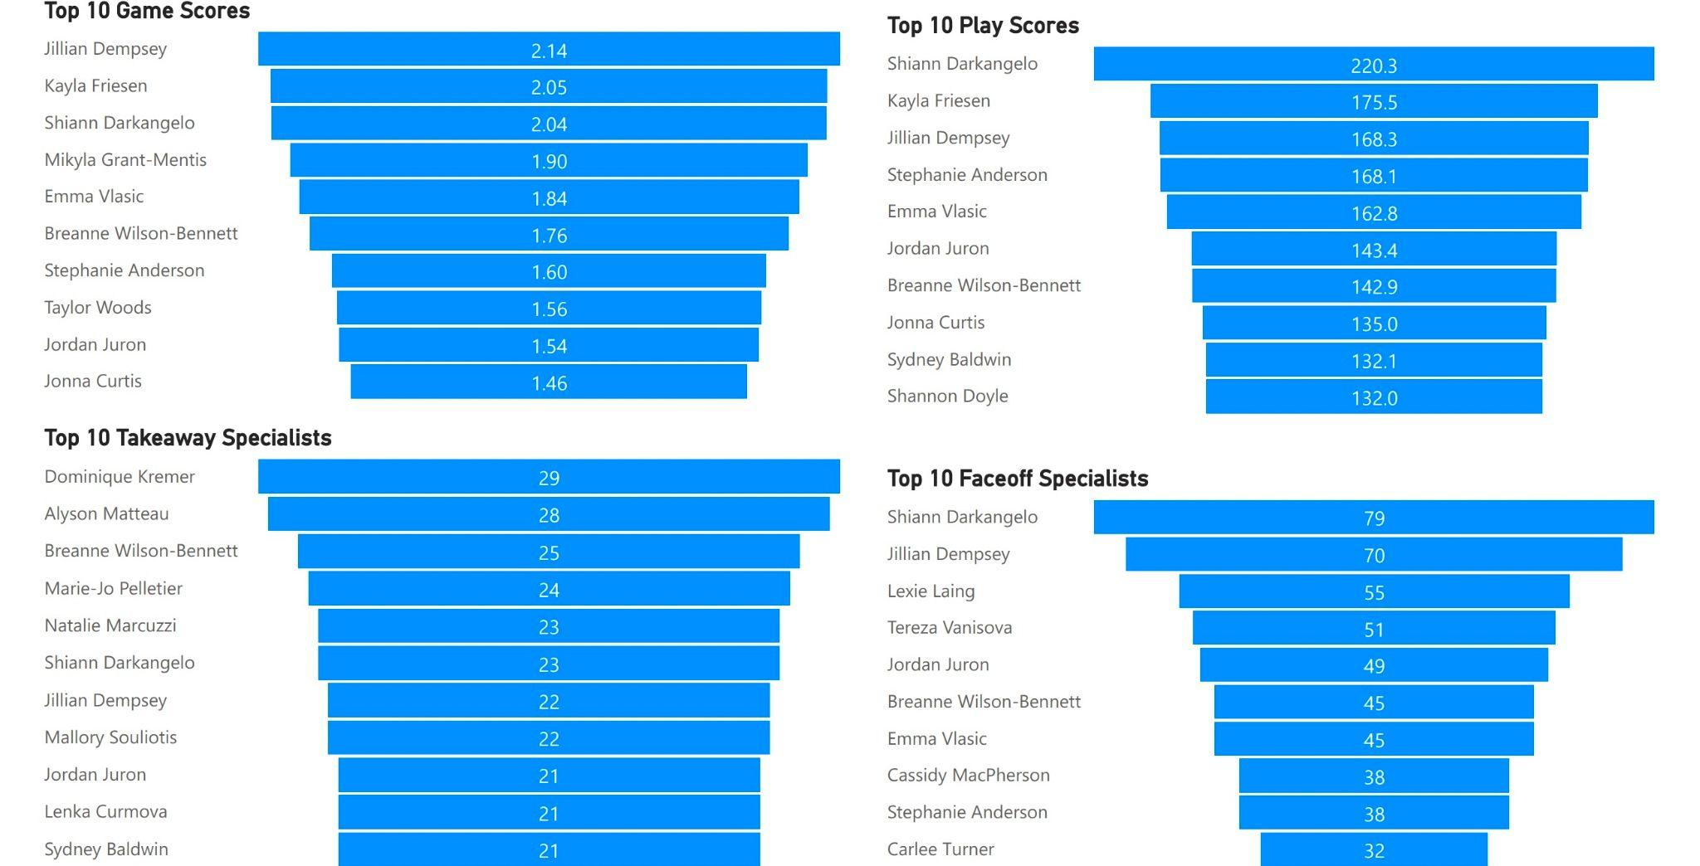
Important Event Summaries
Statistics on Game Score, Play Score, number of takeaway & faceoff win

Slide 5
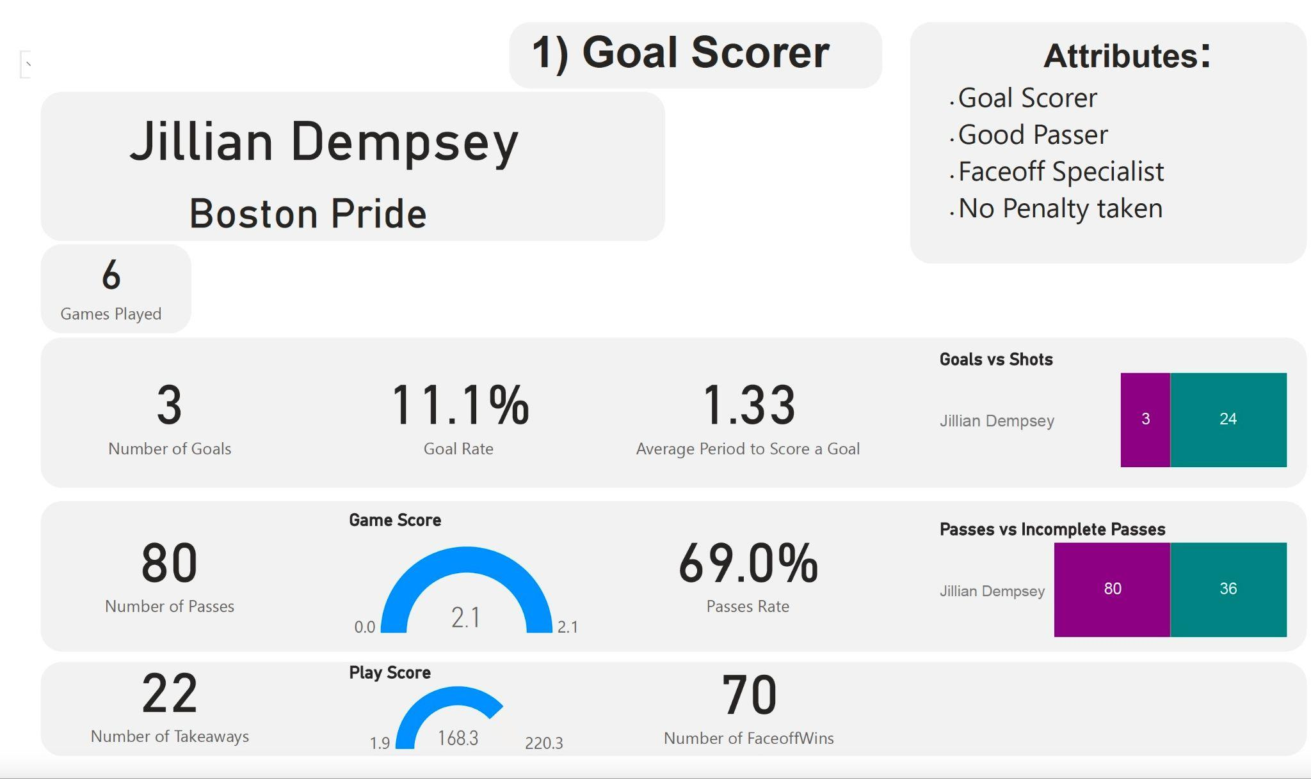
Results
Top 5 players across all teams — Jillian Dempsey

Slide 6
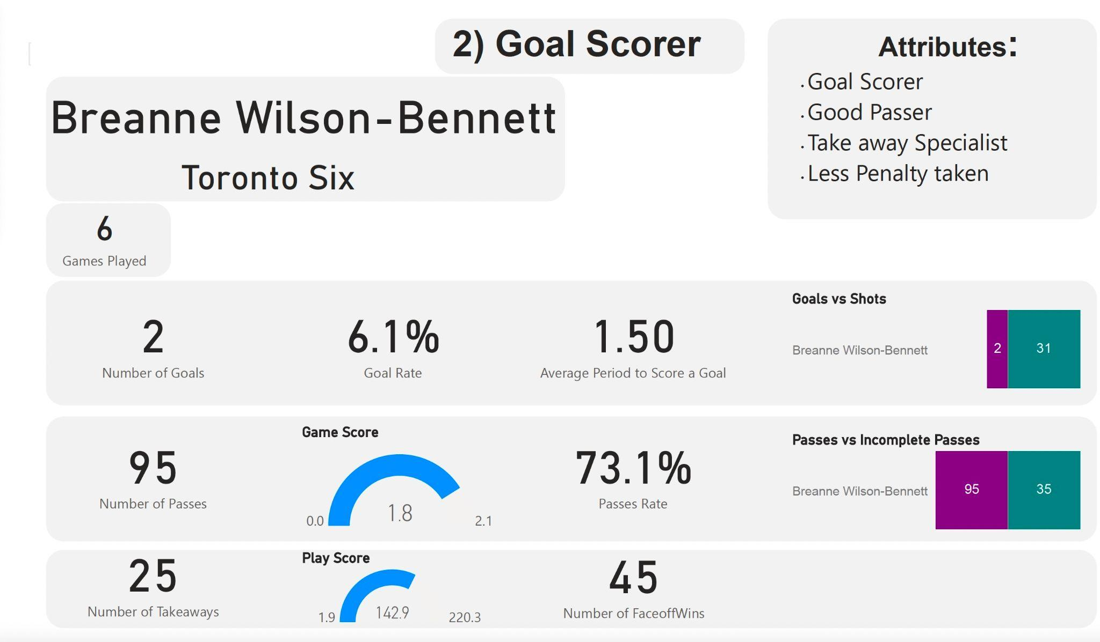
Results
Top 5 players across all teams — Breanne Wilson - Bennett

Slide 7
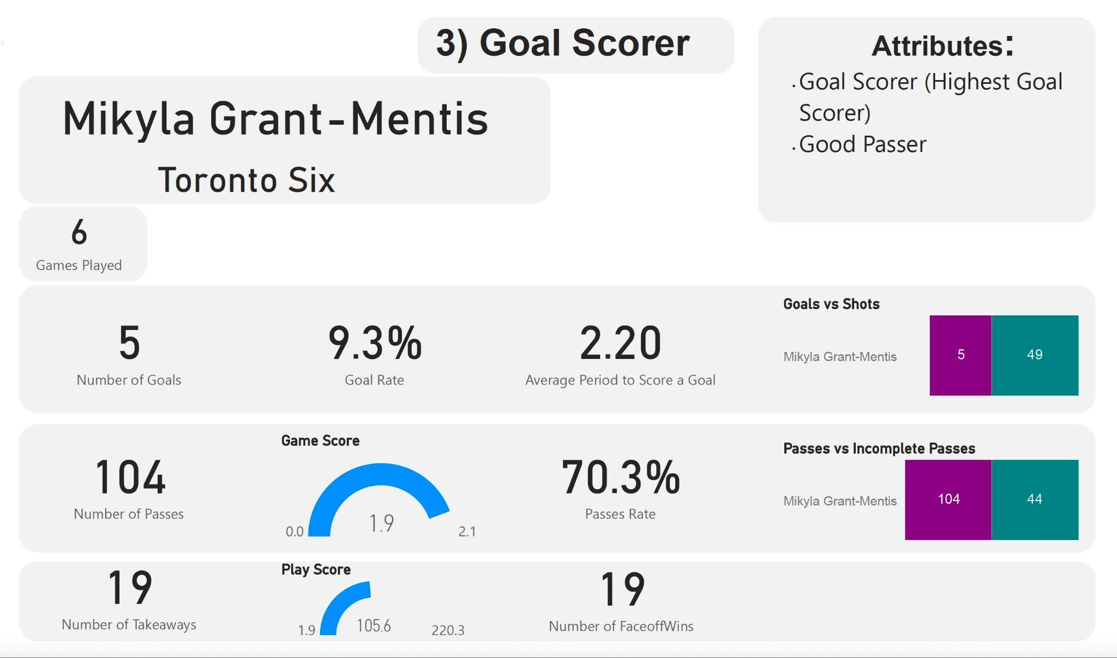
Results
Top 5 players across all teams — Mikyla Grant - Mentis

Slide 8
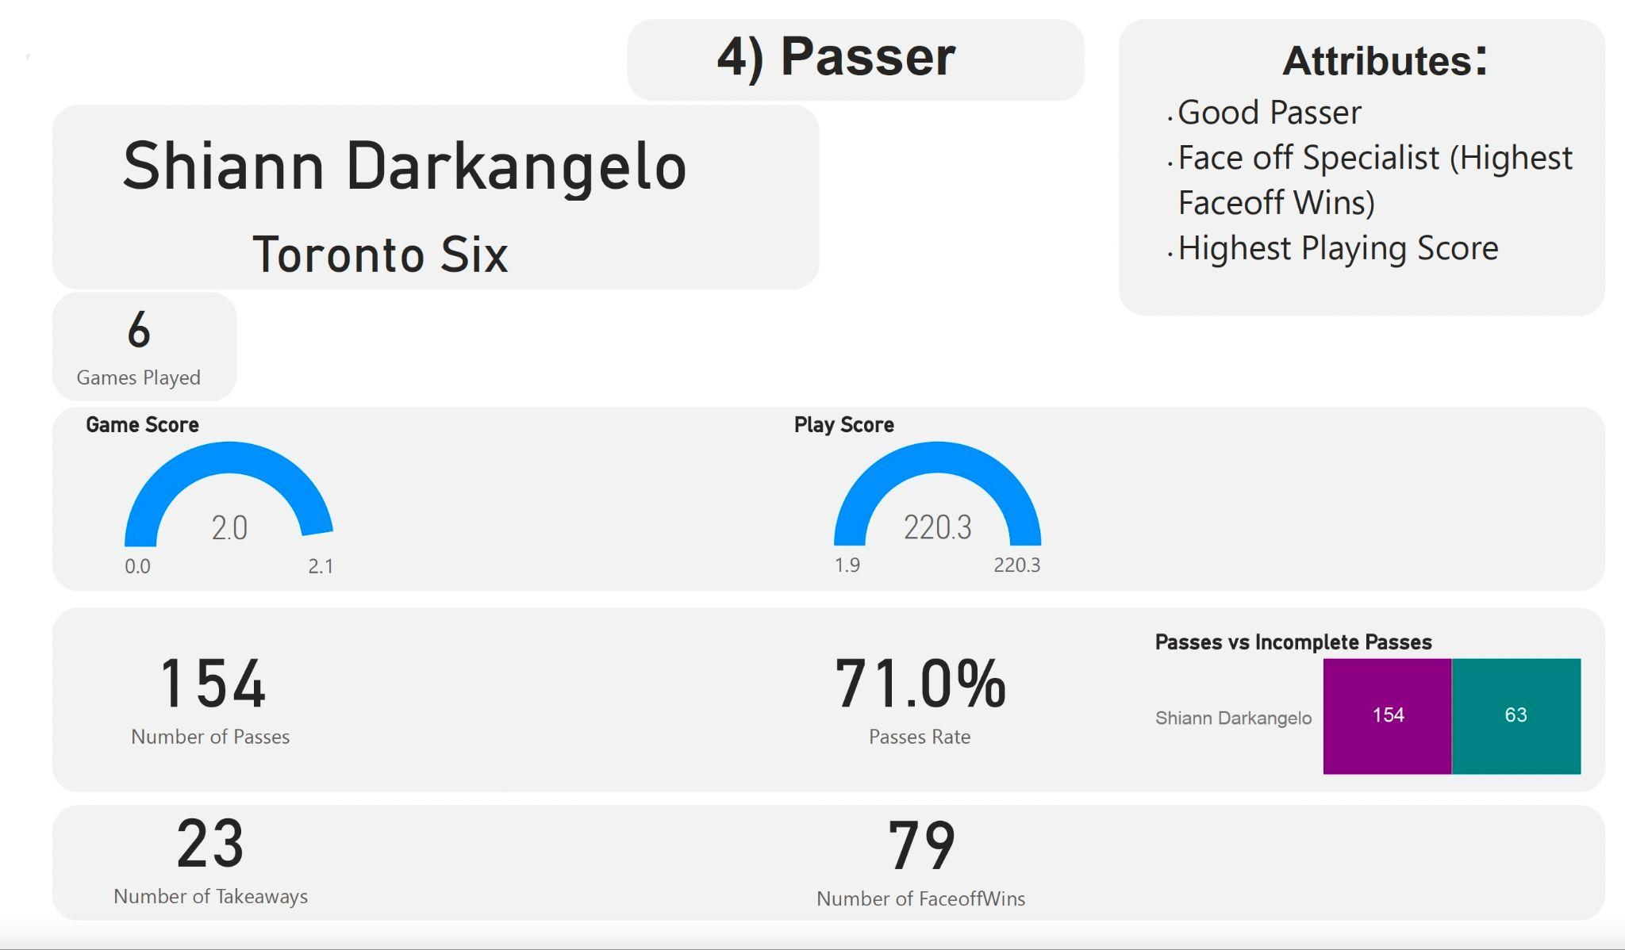
Results
Top 5 players across all teams — Shiann Darkangelo

Slide 9
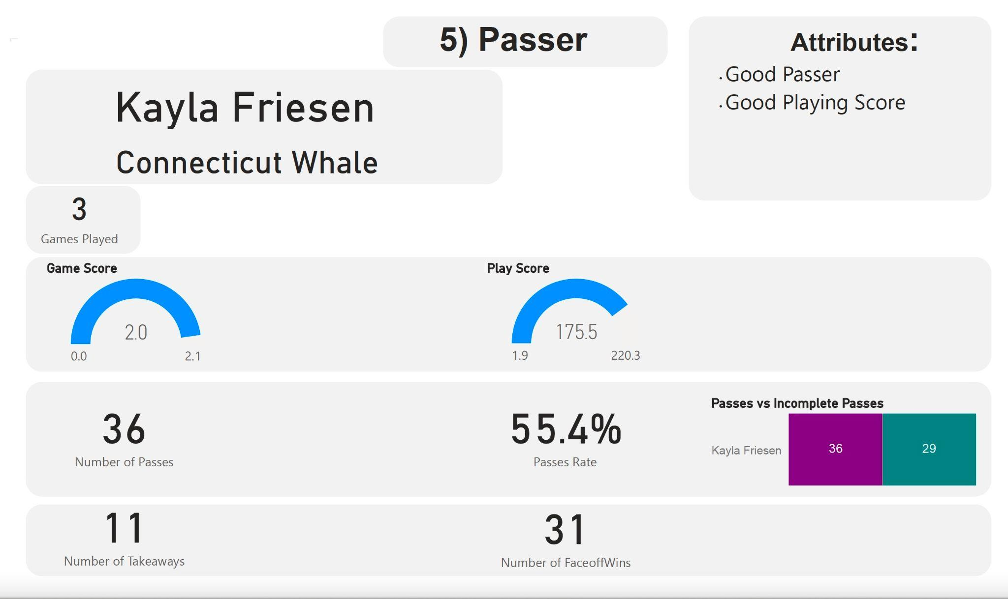
Results
Top 5 players across all teams — Kayla Friesen

Slide 10
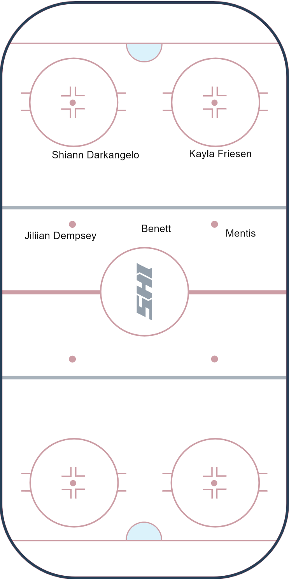
Conclusions & Limitations
Conclusions:
We have chosen 5 top players across all teams in the NWHL Dataset (See image on the right for their names and positions).
Limitations:
The sample size of our NWHL Dataset is too small.
Recommendation: we can conduct more research to extract more comprehensive sample data in the future.
We lack information on other types of events (e.g. faceoff lose, primary and secondary assists).
As a result, our Game Score and Play Score formulas might not be perfectly comprehensive, and there is room for improvement.

Slide 11
Appendix
Who are the best ice hockey players? — A special case for team Toronto Six
Previously, we selected top 5 players across all teams in the NWHL Dataset.
We made sure there are at least 3 excellent goal scorers, 2 excellent passers, 2 faceoff specialists, and 1 takeaway specialist.
Due to the nature that these 5 players are from different teams, they lack track records on completing successful passes between each other (i.e., Players won’t tend to pass the puck to other players from different teams).
As a result, we didn’t investigate whether the top 5 players we chose were familiar with each other.
To compensate for this, we did the same procedure to select top 5 players from only team Toronto Six.
We calculated Game Score & Play Score for each player.
We looked at Game Score, Play Score, number of takeaways and faceoff wins of each player.
We chose: Shiann Darkangelo, Mikyla Grant-Mentis, Breanne Wilson-Bennett, Taylor Woods, & Lindsay Eastwood.
We made sure there are at least 3 excellent goal scorers, 2 excellent passers, 2 faceoff specialists, and 1 takeaway specialist.
We also calculated play success rate (i.e., proportion of successful passes) between each pair of top players.

Slide 12
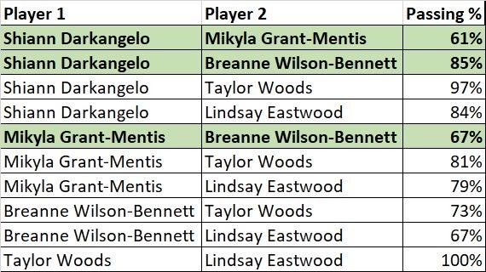
Appendix
Who are the best ice hockey players? — A special case for team Toronto Six
We chose 5 top players from team Toronto Six.
Shiann Darkangelo
Mikyla Grant-Mentis
Breanne Wilson-Bennett
Taylor Woods
Lindsay Eastwood
We also calculated play success rate (i.e., proportion of successful passes) between each pair of players (See image on the right for details).
Play success rate indicates how familiar players are with each other.
Note: the players highlighted in green are also present in our top 5 players from across all the teams.

